Slide 1


Individual Research Project (ESR-2)
Benyou Wang
University of Padova
University of Padova, DD/MM/YYYY

Slide 2
Contents
Self-Introduction
Research Framework
Current Progress and future work

Slide 3




Research Background
Master
Associate
Researcher
Research
Consulate
PHD in Padova
MC ITN project
2014.9-2017.2 | 2017.6-2017.7 | 2017.7-2018.6 | 2018.6-…. | ….

Slide 4




Research
Publish 15 peer-review papers, including
Conferences:
1 ACM SIGIR long paper
2 CIKM long papers, short paper
1 AAAI long paper
2 IJCAI oral papers
Journals:
3 Entropy [JCR Q2]
1 Information Science [JCR Q1]
1 Theoretical Computer Science [JCR Q1]
Google Scholar Citation: 91
New Chinese Boob (deep learning and recommendation system) will be published recently.
SIGIR Best Paper Award Honourable Mentions
[Scimago Journal & Country Rank https://www.scimagojr.com/journalrank.php

Slide 5
Research Proposal- ESR2
Dynamic content monitoring and exploration using vector spaces
…
evolved
evolved
Vector Space, e.g. word embedding, Hilbert Space

Slide 6
Research Plan
Vector Space Representation for static text/document
Quantum-inspired representation for static text [1,2,3,7,8,9]
Some benchmarks and open-source project [6]
Overview of Vector Space approaches
Extend it to dynamic content
Exploring the dynamics of information e.g. recommendation [4] and language model
Implement it in dynamic corpora, e.g. newspaper, blogs, paper collections
July 2018 – July 2019
July 2019 …
[1] Peng Zhang, Zhan Su, Lipeng Zhang, Benyou Wang , Dawei Song. 2018. A Quantum Many-body Wave Function Inspired Language Modeling Approach. CIKM 2018
[2] Li Qiuchi, Uprety Sagar, Wang Benyou , Song Dawei Quantum-inspired Complex Word Embedding, ACL 2018 3rd Workshop on Representation Learning for NLP , ACL 2018 RepL4NLP
[3] Yazhou Zhang, Dawei Song, Peng Zhang, Panpan Wang, Jingfei Li, Xiang Li, Benyou Wang A Quantum-Inspired Multimodal Sentiment Analysis Framework. Theoretical Computer Science 2018.
[4] Wei Zhao, Wang Benyou , Jianbo Ye, Yongqiang Gao, Min Yang, Xiaojun Chen, PLASTIC: Prioritize Long and Short-term Information in Top-n Recommendation using Adversarial Training, IJCAI 2018
[5] Wei Zhao, Wang Benyou , Jianbo Ye, Min Yang, Zhou Zhao, Ruotian Luo, Yu Qiao A Multi-task Learning Approach for Image Captioning, IJCAI 2018
[6] Wang Benyou, Wang Li. et al. TextZoo, a New Benchmark for Reconsidering Text Classification , in Arxiv. 2018.
[7] Zhang Peng, Niu Jiabing, Su Zhan, Wang Benyou et al. End-to-End Quantum-like Language Models with Application to Question Answering. AAAI 2018
[8] Wang Benyou, Li Q*, Prayag T, Massimo M, Sagar U, Dawei S. Quantum Probability Driven Framework for Sentence Modeling, WSDM 2018 submission.
[9] Li Q*, Wang B*, CNM: An Interpretable Complex-valued Network for Matching, AAAI 2018 submission.

Slide 7
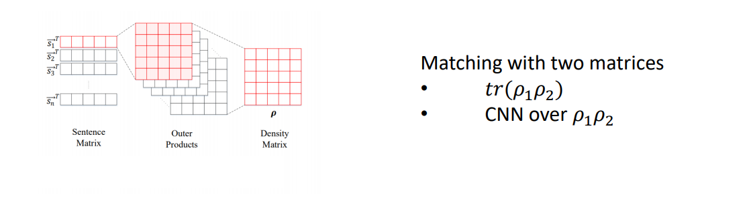
Progress1: End-2-end Language model
Zhang Peng, Niu Jiabing, Su Zhan, Wang Benyou et al. End-to-End Quantum-like Language Models with Application to Question Answering. AAAI 2018

Slide 8
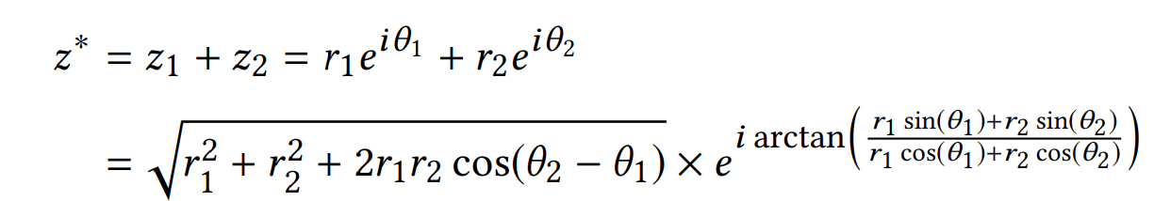
Progress 2: Complex Word Embedding
Interference term for semantic composition
Li Qiuchi, Uprety Sagar, Wang Benyou , Song Dawei Quantum-inspired Complex Word Embedding, ACL 2018 3rd Workshop on Representation Learning for NLP , ACL 2018 RepL4NLP

Slide 9
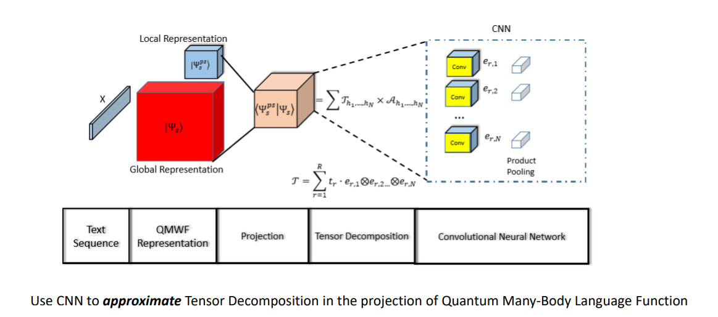
Progress 3: Quantum Many-body function for text
Peng Zhang, Zhan Su, Lipeng Zhang, Benyou Wang , Dawei Song. 2018. A Quantum Many-body Wave Function Inspired Language Modeling Approach. CIKM 2018

Slide 10
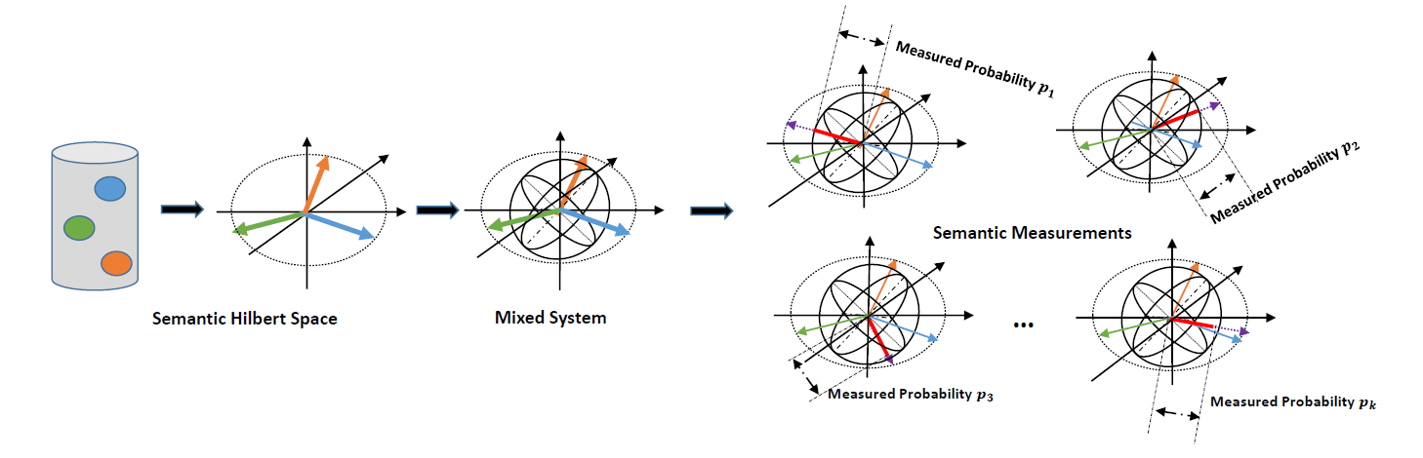
Progress 4: Hilbert Semantic Space
Wang Benyou, Li Q*, Prayag T, Massimo M, Sagar U, Dawei S. Quantum Probability Driven Framework for Sentence Modeling, WSDM 2018 submission.
Li Q*, Wang B*, CNM: An Interpretable Complex-valued Network for Matching, AAAI 2018 submission.

Slide 11
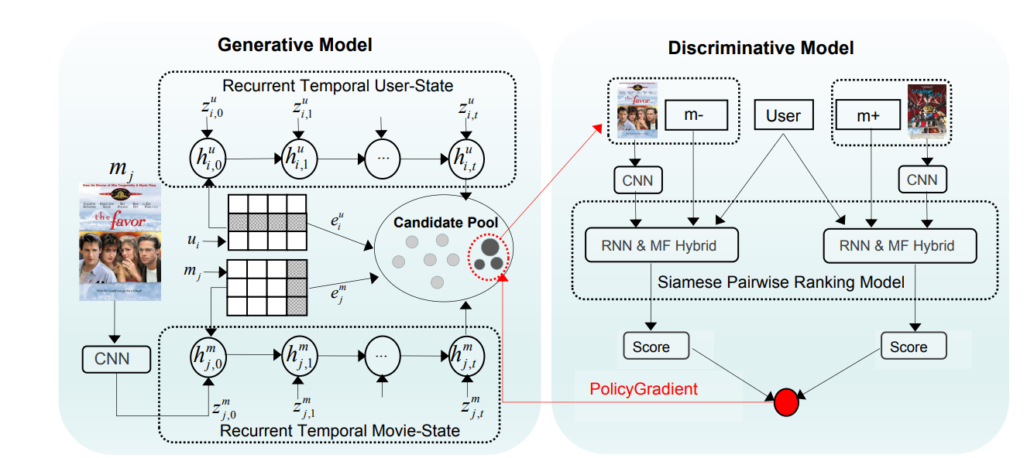
Progress 5: Dynamics in Recommendation System
Wei Zhao, Wang Benyou , Jianbo Ye, Yongqiang Gao, Min Yang, Xiaojun Chen, PLASTIC: Prioritize Long and Short-term Information in Top-n Recommendation using Adversarial Training, IJCAI 2018

Slide 12
Future Work
Deep Investigation of Quantum-inspired textual representation
Quantum-inspired evolved language model for dynamic
Thematic issues in dynamic corpora

Slide 13
Publications
Peng Zhang, Zhan Su, Lipeng Zhang, Benyou Wang , Dawei Song. 2018. A Quantum Many-body Wave Function Inspired Language Modeling Approach. CIKM 2018
Li Qiuchi, Uprety Sagar, Wang Benyou , Song Dawei Quantum-inspired Complex Word Embedding, ACL 2018 3rd Workshop on Representation Learning for NLP , ACL 2018 RepL4NLP
Yazhou Zhang, Dawei Song, Peng Zhang, Panpan Wang, Jingfei Li, Xiang Li, Benyou Wang A Quantum-Inspired Multimodal Sentiment Analysis Framework. Theoretical Computer Science 2018.
Wei Zhao, Wang Benyou , Jianbo Ye, Yongqiang Gao, Min Yang, Xiaojun Chen, PLASTIC: Prioritize Long and Short-term Information in Top-n Recommendation using Adversarial Training, IJCAI 2018
Wei Zhao, Wang Benyou , Jianbo Ye, Min Yang, Zhou Zhao, Ruotian Luo, Yu Qiao A Multi-task Learning Approach for Image Captioning, IJCAI 2018
Wang Benyou, Wang Li. et al. TextZoo, a New Benchmark for Reconsidering Text Classification , in Arxiv. 2018.
Zhang Peng, Niu Jiabing, Su Zhan, Wang Benyou et al. End-to-End Quantum-like Language Models with Application to Question Answering. AAAI 2018
Zhao Wei, Wang Benyou et al. Leveraging Long and Short-term Information in Content-aware Movie Recommendation , in Arxiv. 2018. Zhihu link (in Chinses)
Su Zhan, Wang Benyou, Niu Jiabin, Tao Shuchang, Zhang Peng, Song Dawei. Enhanced Embedding based Attentive Pooling Network for Answer Selection. NLPCC 2017
Wang Jun, Yu Lantao, Zhang Weinan, Gong Yu, Xu Yinghui, Wang Benyou , Zhang Peng, Zhang Dell. IRGAN: A Minimax Game for Unifying Generative and Discriminative Information Retrieval Models. SIGIR 2017. Best Paper Award Honourable Mentions.
Wang Benyou A Chinese Question Answering Approach Integrating Count-based and Embedding-based Features ,in Chinese, master thesis in Tianjin University
Li Jinfei. Wu Yue, Zhang Peng, Song Dawei, Wang Benyou. Learning to diversify web search results with a Document Repulsion Model. Information Sciences, 411, 136-150. 2017. (factor : 4.832)
Zhang Shengnan, Hou Yuexian, Wang Benyou, Song Dawei. Regularizing Neural Networks via Retaining Confident Connections. Entropy , 19(7), 313. 2017. (factor : 1.821)
Shang Zhenguo, Li Jinfei, Zhang Peng, Song Dawei, Wang Benyou. How Users Select Query Suggestions Under Different Satisfaction States? CCIR 2017 (pp. 93-105), Springer, Cham. July,2017.
Wang Benyou, Niu Jiabing, Ma Liqun, Zhang Yuhua, Zhang Lipeng, Li Jinfei, Zhang Peng Song, D. . A Chinese Question Answering Approach Integrating Count-Based and Embedding-Based Features. ICCPOL-NLPCC . December, 2016
Wang Benyou, Zhang Peng, Li Jinfei, Song Dawei, Hou Yuexian, Shang Zhenguo. Exploration of quantum interference in document relevance judgement discrepancy. Entropy , 18(4), 144. 2016.
Zhang Peng, Li Jinfei, Wang Benyou, Zhao Xiaochao, Song Dawei, Hou Yuexian, Melucci, M. A Quantum Query Expansion Approach for Session Search. Entropy , 18(4), 146.2016. 2015
Chen Yongqiang, Zhang Peng, Song Dawei, Wang Benyou. A Real-Time Eye Tracking Based Query Expansion Approach via Latent Topic Modeling. CIKM 2015 (pp. 1719-1722). ACM. October, 2015
Huang Xin, Wei zhao, Wang Benyou, Rui Zhao. Recommendation System and Deep Learning, Tsinghua University Press. chapters related "Learn to rank" and "Generative Adversarial Nets(GAN) for Recommendation"

