Slide 1


Individual Research Project (ESR-2)
Benyou Wang
University of Padova
University of Padova, DD/MM/YYYY

Slide 2




Background/1
Master
Computer Science
Associate
Researcher
Research
Consultant
Ph.D in Padova
MSCA ESR
Sougou
Tencent
2014.9-2017.2 | 2017.6-2017.7 | 2017.7-2018.6 | 2018.6-…. | ….

Slide 3




Background/2
Publish 15 peer-review papers, including
Conferences:
1 SIGIR long paper
2 CIKM long papers, short paper
1 AAAI long paper
2 IJCAI long papers
Journals:
3 Entropy [JCR Q2] ^{[1]}
1 Information Sciences [JCR Q1]
1 Theoretical Computer Science [JCR Q1]
Google Scholar Citation: 96 ^{[2]}
New Chinese Boob (deep learning and recommendation system) will be published recently.
SIGIR Best Paper Award Honourable Mentions
[1] https://scholar.google.com/citations?user=Jk4vJU8AAAAJ&hl=zh-CN
[2] Scimago Journal & Country Rank https://www.scimagojr.com/journalrank.php

Slide 4
Training experiences
Training organized by Quartz
Winter school [1] in Padova, Italy
Autumn School in Cuttbus, Germany
Presentation Training in Padova
Conferences founded by Quartz
ICML 2018 in July, Sweden
IJCAI 2018 in July, Sweden
ICTIR 2018 in Sep., China
CIKM 2018 in Oct., Italy
Coming Ph.D courses in the University of Padova
[1] I was recruited in that moment although not yet hired, I signed the contract since June, 2018

Slide 5

Research Proposal- ESR2
Dynamic content monitoring and exploration using vector spaces
Clean
Energy
Death
Weapon
…
evolved
evolved
Nuclear Technology
1950s
1975s
2000s
Vector Space, e.g. word embedding, Hilbert Space

Slide 6
Research Plan
Vector Space Representation for static text/document
Quantum-inspired representation for static text [1,2,3,7,8,9]
Some benchmarks and open-source project [6]
Overview of Vector Space approaches
Extend it to dynamic content
Explore the dynamics of thematic issues e.g. recommendation [4] and language model
Implement it in dynamic corpora, e.g. newspaper, blogs, paper collections
[1] Peng Zhang, Zhan Su, Lipeng Zhang, Benyou Wang , Dawei Song. 2018. A Quantum Many-body Wave Function Inspired Language Modeling Approach. CIKM 2018
[2] Li Qiuchi, Uprety Sagar, Wang Benyou , Song Dawei Quantum-inspired Complex Word Embedding, ACL 2018 3rd Workshop on Representation Learning for NLP , ACL 2018 RepL4NLP
[3] Yazhou Zhang, Dawei Song, Peng Zhang, Panpan Wang, Jingfei Li, Xiang Li, Benyou Wang A Quantum-Inspired Multimodal Sentiment Analysis Framework. Theoretical Computer Science 2018.
[4] Wei Zhao, Wang Benyou , Jianbo Ye, Yongqiang Gao, Min Yang, Xiaojun Chen, PLASTIC: Prioritize Long and Short-term Information in Top-n Recommendation using Adversarial Training, IJCAI 2018
[5] Wei Zhao, Wang Benyou , Jianbo Ye, Min Yang, Zhou Zhao, Ruotian Luo, Yu Qiao A Multi-task Learning Approach for Image Captioning, IJCAI 2018
[6] Wang Benyou, Wang Li. et al. TextZoo, a New Benchmark for Reconsidering Text Classification , in Arxiv. 2018.
[7] Zhang Peng, Niu Jiabing, Su Zhan, Wang Benyou et al. End-to-End Quantum-like Language Models with Application to Question Answering. AAAI 2018
[8] Wang Benyou *, Li Q*, Prayag T, Massimo M, Sagar U, Dawei S. Quantum Probability Driven Framework for Sentence Modeling, WSDM 2018 submission.
[9] Li Q*, Wang B*, CNM: An Interpretable Complex-valued Network for Matching, AAAI 2018 submission.

Slide 7
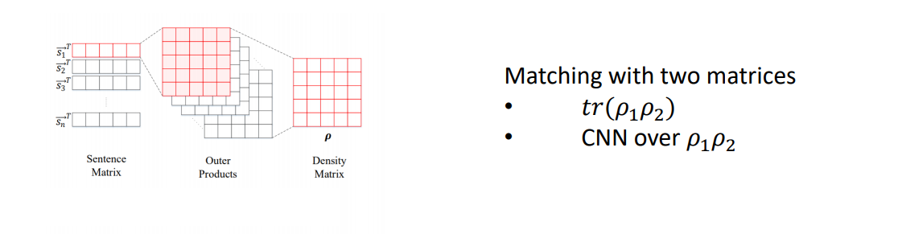
Progress 1: End-2-end Language model
Zhang Peng, Niu Jiabing, Su Zhan, Wang Benyou et al. End-to-End Quantum-like Language Models with Application to Question Answering. AAAI 2018

Slide 8
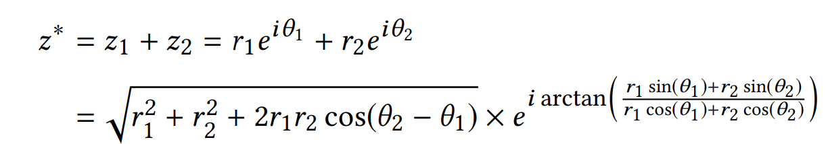
Progress 2: Complex Word Embedding
Interference term for semantic composition
Li Qiuchi, Uprety Sagar, Wang Benyou , Song Dawei Quantum-inspired Complex Word Embedding, ACL 2018 3rd Workshop on Representation Learning for NLP , ACL 2018 RepL4NLP

Slide 9
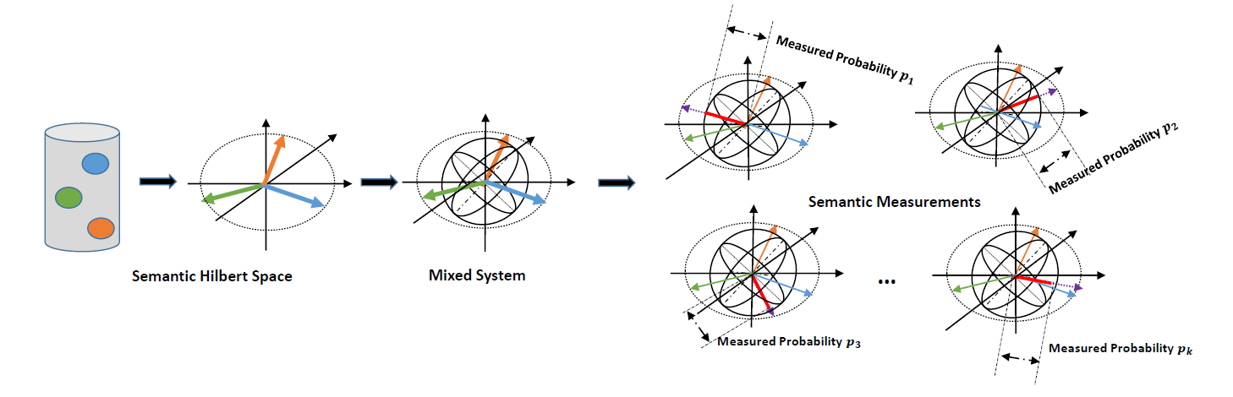
Progress 3: Hilbert Semantic Vector Space
Wang Benyou, Li Q*, Prayag T, Massimo M, Sagar U, Dawei S. Quantum Probability Driven Framework for Sentence Modeling, WSDM 2018 submission.
Li Q*, Wang B*, CNM: An Interpretable Complex-valued Network for Matching, AAAI 2018 submission.

Slide 10
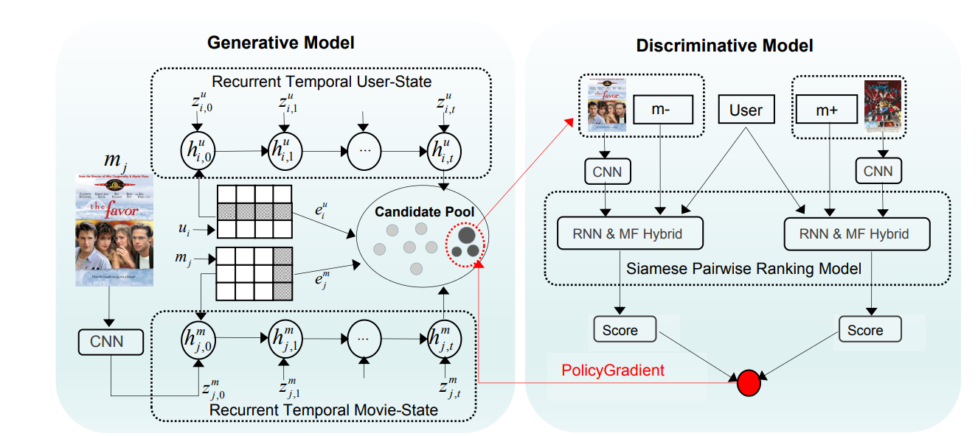
Progress 4: Dynamics in case of RecSys.
Wei Zhao, Wang Benyou , Jianbo Ye, Yongqiang Gao, Min Yang, Xiaojun Chen, PLASTIC: Prioritize Long and Short-term Information in Top-n Recommendation using Adversarial Training, IJCAI 2018

Slide 11
Future Work
Deep Investigation of Quantum-inspired textual representation
Quantum-inspired evolved language model for dynamic
Thematic issues in dynamic corpora

