Slide 1


Dynamic content monitoring and exploration using vector spaces (ESR-2)
Benyou Wang
University of Padova
University of Padova, 06/12/2018

Slide 2




Background
Master
Computer Science
Associate
Researcher
Research
Consultant
Ph.D in Padova
MSCA ESR
Sougou
Tencent
2014.9-2017.2 | 2017.6-2017.7 | 2017.7-2018.6 | 2018.6-…. | ….
Oldest university
in China
Input method with 0.45 billion DAU(Daily Active User)
Its market value once exceeds FACEBOOK
One of the oldest universities in the world China

Slide 3






Industry
The main coder and designer for First-generation customer server in the Tencent cloud
First DL practice for Q-zone video
Industry
Academics
Deep learning- based language model
Tencent’s market value once exceeded FACEBOOK, ranked fifth in the world, only less than Apple, Google, Microsoft, and Amazon. The biggest IT company in the world
Sougou has the word-leading NLP technologies, with 0.45 billion DAU for input method and second biggest search engine in Chinese

Slide 4




Academics
Publish 15 papers
Conferences:
1 SIGIR oral
2 CIKM oral & poster
1 AAAI oral
2 IJCAI oral
Journals:
3 Entropy [JCR Q2] ^{[1]}
1 Information Sciences [JCR Q1]
1 Theoretical Computer Science [JCR Q1]
Google Scholar Citation: 109 ^{[2]}
New Chinese Boob “RecSys & DL”
SIGIR Best Paper Award Honorable Mentions
Industry
Academics
[1] https://scholar.google.com/citations?user=Jk4vJU8AAAAJ&hl=zh-CN
[2] Scimago Journal & Country Rank https://www.scimagojr.com/journalrank.php

Slide 5
Training experiences
Training organized by Quartz
Winter school [1] in Padova, Italy
Autumn School in Cuttbus, Germany
English Training in Padova
Conferences founded by Quartz
ICML 2018 in July, Sweden
IJCAI 2018 in July, Sweden, involving with two oral papers
ICTIR 2018 in Sep., China
CIKM 2018 in Oct., Italy, involving with one oral papers
Upcoming Ph.D courses in the University of Padova
[1] I was recruited in that moment although not yet hired, I signed the contract since June, 2018

Slide 6

Vision
Quantum Mechanism
Natural Language
Neural network
Particles
Words
Word embedding vector space
Complex-valued Hilbert space
Sequence/time-aware quantum representation

Slide 7
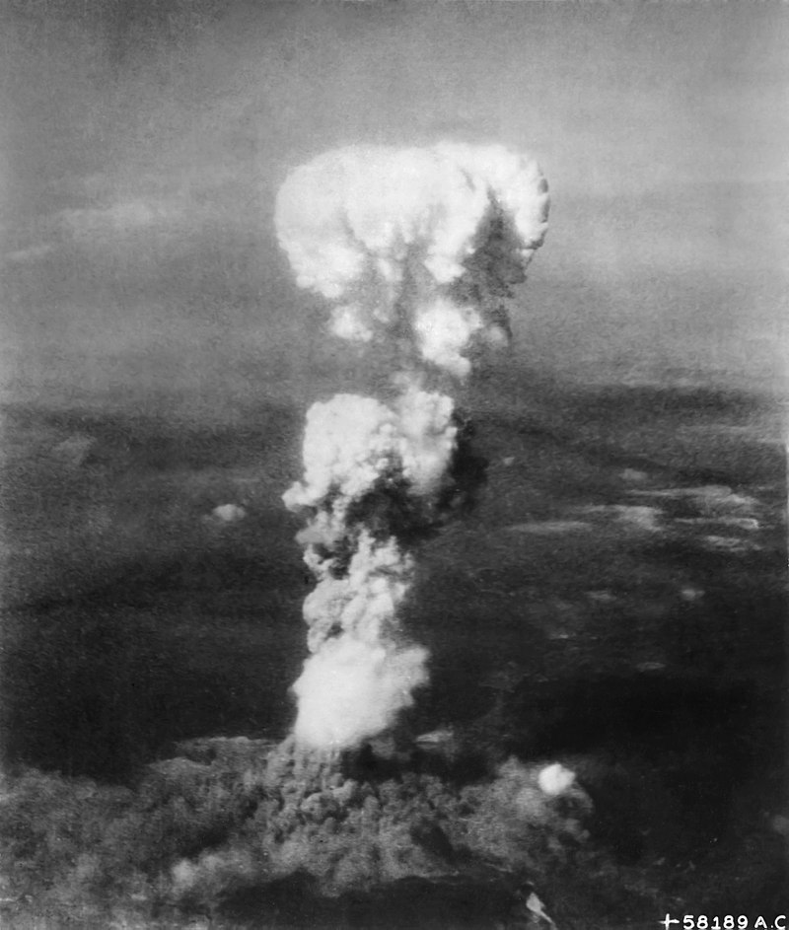
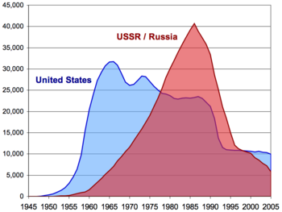

Research Proposal- ESR2
Dynamic content monitoring and exploration using vector spaces
Clean
Energy
Death
Weapon
Nuclear Technology
e.g. in newspaper, blogs
evolved
evolved
…
1950s
1975s
2000s
Vector Space, e.g. word embedding, Hilbert Space
Examples Credited by Dr. Emanuele

Slide 8
Research Plan
Vector Space Representation for static text/document
Quantum-inspired complex-valued framework for static text
Some benchmarks and open-source project
Overview of Vector Space approaches
Extend it to dynamic content
Extend the above static framework to language scenarios with dynamics, e.g. language model, multi-turn dialogue,
Address the thematic issues in dynamic corpora, e.g. newspaper, blogs, paper collections (Google books, ArXiv)

Slide 9
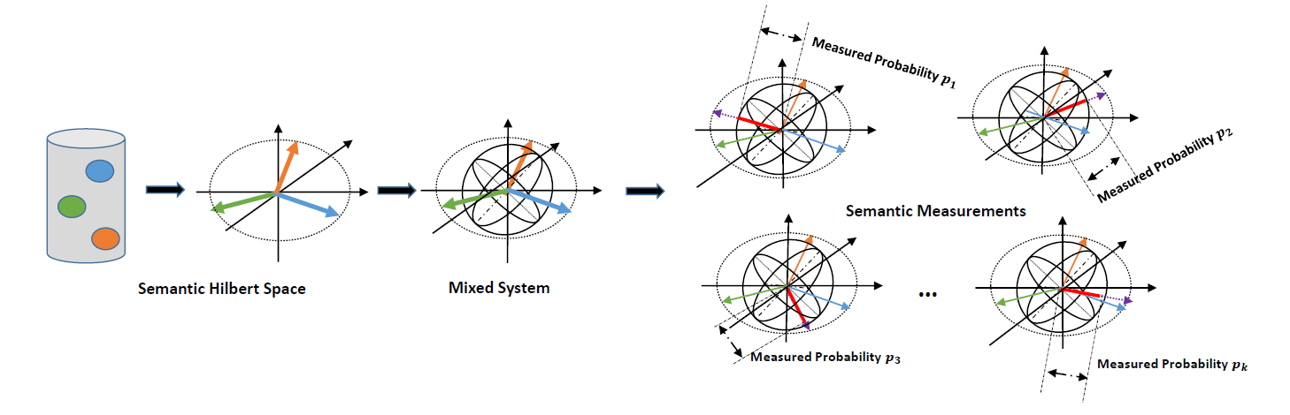
Progress: Hilbert Semantic Vector Space (HSVS)
Benyou Wang, Li Q*, Massimo M, Dawei S. Semantic Hilbert Space for Text Representation Learning, in progress.

Slide 10
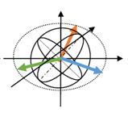
Future work : HSVS for dynamics
Evolution over time/sequence
…
Benyou Wang, Li Q*, Massimo M, Dawei S. Semantic Hilbert Space for Text Representation Learning, in progress.

Slide 11
Publications
2018
[1] Peng Zhang, Zhan Su, Lipeng Zhang, Benyou Wang , Dawei Song. 2018. A Quantum Many-body Wave Function Inspired Language Modeling Approach. CIKM 2018
[2] Li Qiuchi, Uprety Sagar, Wang Benyou , Song Dawei Quantum-inspired Complex Word Embedding, ACL 2018 3rd Workshop on Representation Learning for NLP , ACL 2018 RepL4NLP
[3] Yazhou Zhang, Dawei Song, Peng Zhang, Panpan Wang, Jingfei Li, Xiang Li, Benyou Wang A Quantum-Inspired Multimodal Sentiment Analysis Framework. Theoretical Computer Science 2018.
[4] Wei Zhao, Wang Benyou , Jianbo Ye, Yongqiang Gao, Min Yang, Xiaojun Chen, PLASTIC: Prioritize Long and Short-term Information in Top-n Recommendation using Adversarial Training, IJCAI 2018
[5] Wei Zhao, Wang Benyou , Jianbo Ye, Min Yang, Zhou Zhao, Ruotian Luo, Yu Qiao A Multi-task Learning Approach for Image Captioning, IJCAI 2018
[6] Wang Benyou, Wang Li. et al. TextZoo, a New Benchmark for Reconsidering Text Classification , in Arxiv. 2018.
[7] Zhang Peng, Niu Jiabing, Su Zhan, Wang Benyou et al. End-to-End Quantum-like Language Models with Application to Question Answering. AAAI 2018
[8] Huang Xin, Wei zhao, Wang Benyou, Rui Zhao. Recommendation System and Deep Learning, Tsinghua University Press, in Chinese, to be appeared.
2017
[9] Zhao Wei, Benyou Wang et al. Leveraging Long and Short-term Information in Content-aware Movie Recommendation , in Arxiv. 2018.
[10] Su Zhan, Benyou Wang, Niu Jiabin, Tao Shuchang, Zhang Peng, Song Dawei. Enhanced Embedding based Attentive Pooling Network for Answer Selection. NLPCC 2017
[11] Wang Jun, Yu Lantao, Zhang Weinan, Gong Yu, Xu Yinghui, Benyou Wang, Zhang Peng, Zhang Dell. IRGAN: A Minimax Game for Unifying Generative and Discriminative Information Retrieval Models. SIGIR 2017. Best Paper Award Honorable Mentions
[12] Li Jinfei. Wu Yue, Zhang Peng, Song Dawei, Benyou Wang. Learning to diversify web search results with a Document Repulsion Model. Information Sciences, 411, 136-150. 2017. (factor : 4.832)
[13] Zhang Shengnan, Hou Yuexian, Benyou Wang, Song Dawei. Regularizing Neural Networks via Retaining Confident Connections. Entropy , 19(7), 313. 2017.
[14] Shang Zhenguo, Li Jinfei, Zhang Peng, Song Dawei, Benyou Wang. How Users Select Query Suggestions Under Different Satisfaction States? CCIR 2017 (pp. 93-105), Springer, Cham. July,2017.
2016 & 2015
[15] Benyou Wang, et. al. A Chinese Question Answering Approach Integrating Count-Based and Embedding-Based Features. ICCPOL-NLPCC . December, 2016
[16] Benyou Wang, Zhang Peng, Li Jinfei, Song Dawei, Hou Yuexian, Shang Zhenguo. Exploration of quantum interference in document relevance judgement discrepancy. Entropy , 18(4), 144. 2016.
[17] Zhang Peng, Li Jinfei, Benyou Wang, et. al. A Quantum Query Expansion Approach for Session Search. Entropy , 18(4), 146.2016.
[18] Chen Yongqiang, Zhang Peng, Song Dawei, Benyou Wang. A Real-Time Eye Tracking Based Query Expansion Approach via Latent Topic Modeling. CIKM 2015 (pp. 1719-1722). ACM. October, 2015

