Slide 1
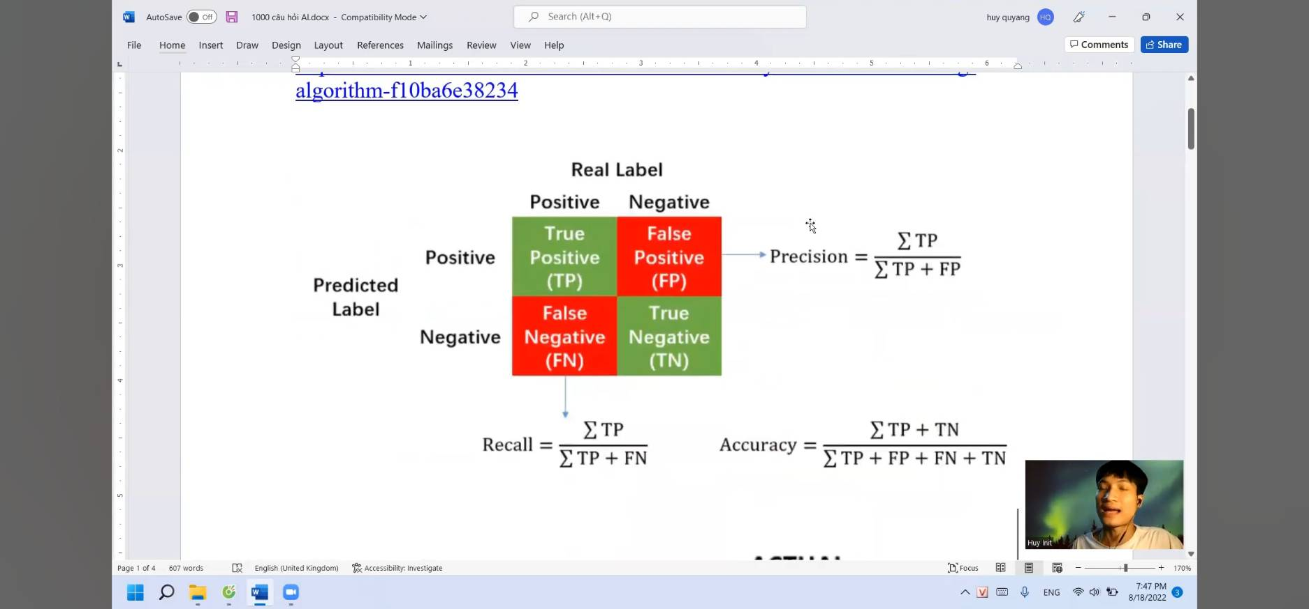
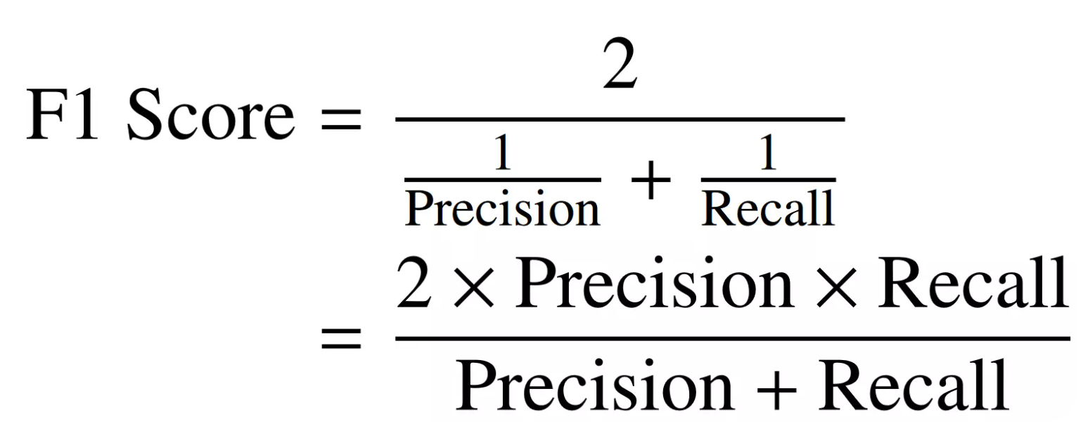
Tradeoff depends on your problem
Video safe for kids
High precision => FP as low as possible (保留安全)
Low recall => allows a higher FN value (拒絕好)
Detect shoplifters (偷竊商店；具潛變材料)
High recall => FN as low as possible (根據錄影)
Low precision => allows a higher FP value (漏網之魚 => 免於責難)

Slide 2
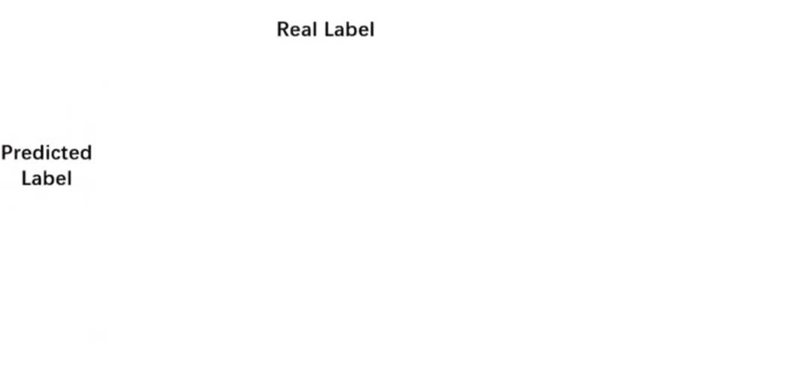
Video safe for kids
High precision => FP as low as possible (保留安全)
Low recall => allows a higher FN value (拒絕好)
Detect shoplifters (偷竊商店；具潛變材料)
High recall => FN as low as possible (盡可能撈出確實是小偷的人=>根據錄影)
Low precision => allows a higher FP value (漏網之魚 => 但可免於責難)
暴力
非暴力
好人
壞人
BCC
FCC
暴力
好人
BCC
非暴力
FCC
壞人
壞人
好人
FCC
BCC
壞人
FCC
好人
BCC

Slide 3
https://medium.com/ai%E5%8F%8D%E6%96%97%E5%9F%8E/learning-model-%E4%BB%80%E9%BA%BC%E6%98%AFroc%E5%92%8Cauc-%E8%BD%89%E9%8C%84-33aafe644cf

