Slide 1

Información Básica sobre Granos Enteros

Slide 2
El evento de hoy incluye:
Información básica sobre los granos enteros
… información detallada sobre los beneficios de los granos enteros
… ¿qué son los granos enteros?
… cómo encontrar productos que realmente contienen granos enteros
… ideas sencillas para añadir más granos enteros en su dieta
Recorrido por la tienda sobre granos enteros
… exploraremos el supermercado, pasillo por pasillo, para buscar productos con granos enteros
Fiesta de degustación de granos enteros
… una probadita le ayudará a encontrar granos enteros que le encantarán a su familia
Notes:
Start by giving your group an overview of what you’re going to be doing today. Explain that there will be a short presentation covered information about whole grains, followed by the actual Whole Grains Store Tour, and concluding with a tasting party where the group will be able to sample some of the foods they found on the tour – or some special dishes you’ve prepared for them.

Slide 3
Los Granos Enteros y la Salud
Notes:
More interaction is always better. You may want to pause at this screen, and ask your group what they think the health benefits of whole grains are.
If you have an idea of what they know already, you can tailor the following slides to add the information that’s most lacking.

Slide 4
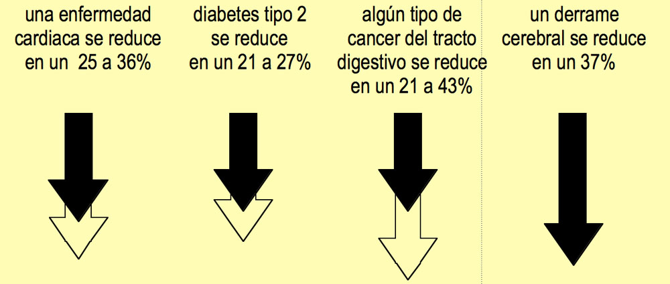
Las personas que consumen granos enteros reducen riesgos graves para su salud. El riesgo de padecer…
Notes:
Scores of studies have been done showing the health benefits of whole grains. This slide shows some of the best-documented health benefits.
Because different studies show slightly different results, this slide shows a range of numbers for most diseases.
Make sure to mention that whole grains benefit everyone with blood vessels (all of us!) not just people who know they have heart disease. We don’t want people to tune out and think “this doesn’t apply to me.”

Slide 5
¡Pero, espere! ¡Aun hay más!
Controlan el peso. De acuerdo a varios estudios de Harvard, los hombres y las mujeres que consumieron más granos enteros consistentemente aumentaron menos de peso en un periodo de 8 a12 años.
Reduce la grasa abdominal que es peligrosa. En un estudio realizado por la universidad Penn State en 2008, se observó que las personas que consumieron granos enteros en lugar de granos refinados perdieron más grasa abdominal. La grasa abdominal es un factor de alto riesgo de padecer problemas cardiacos y otras enfermedades
Baja la presión sanguínea. Los investigadores de la Universidad de Minnesota informaron que comer un cereal de granos enteros como la avena, diariamente, durante tres meses le permitió a un 73% de las personas con presión alta, reducir o eliminar la necesidad de tomar medicina para esta afección.
Notes:
Controlling weight always gets people’s attention. Whole grains are increasingly associated with better weight management.
The majority of people over the age of 60 have high blood pressure. In many cases, eating whole grains regularly can allow people suffering from hypertension to cut back on their medication, or in some cases even eliminate it. Of course, it’s important to advise working with one’s doctor.
There are many more health study thumbnails on our website at
http://wholegrainscouncil.org/whole-grains-101/health-studies-on-whole-grains
If you know what conditions your group might especially be interested in, you can use the additional studies on our website to customize your presentation.

Slide 6
Los niños que consumen granos enteros…
Tienen un menor riesgo de padecer
obesidad y diabetes
Tienen niveles más bajos de colesterol
Reducen su riesgo de padecer asma
Se sienten más llenos y satisfechos
Pueden reducir el acné considerablemente
Notes:
We expect that many of the people who sign up for your WG Store Tour will be parents, concerned about their kids’ health, so we’ve created a special section showing the big impact whole grains can have on kids’ health.
Including this section also helps reinforce the fact that eating well can show very quick results in everyone’s health. Too often nutrition messages seem to say, “Eat this way for years and years and you may have a 2% reduced risk for some obscure disease you’ve never heard of anyway.”
A better message: Every bit of good food you add to your diet helps, and helps quickly, to bring you to better health.

Slide 7
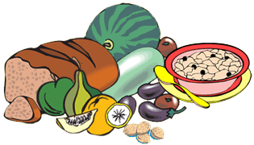
Con una buena dieta, los niños se benefician rápidamente
• Niños con sobrepeso de entre
9 y 15 años
• Una dieta en la que se consume todo lo que se pueda comer
• Granos enteros, frutas, verduras y proteína magra
• Ejercicio diario
En 2 semanas…
• El nivel de colesterol bajó en un 21%
• Los niveles de insulina bajaron un 30%
• El nivel de leptina (hormona del apetito) bajó un 57%
Source: Atherosclerosis. 2007 Mar; 191(1):98-106. RJ Barnard, AK Chen, and CK Roberts.
Notes:
The key messages here are that
• major change can happen quickly, in just a few weeks
• there’s no need to deprive yourself if you’re eating healthy foods. Eating well does not have to mean subsisting on a leaf of lettuce and 3 carrot sticks each day.
FYI, the kids in this study exercised 2.5 hours a day, in a summer-camp type atmosphere of fun activities -- not endless mind-numbing calisthenics. This is the level of exercise that growing kids have traditionally enjoyed.

Slide 8
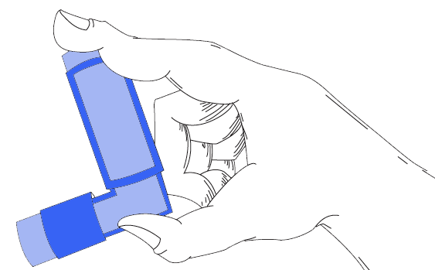
Los granos enteros reducen el riesgo de padecer asma en un 50%
Los niños que consumieron granos enteros tuvieron
• Un 54% menos de probabilidad de padecer asma
• Un 45% menos de probabilidad de tener sibilancias
que los niños que no consumieron granos enteros
Source: Thorax. December 2006; 61(12):1048-53. Dutch National Institute of Public Health & the Environment.
Notes:
Asthma is the third leading cause of hospitalization among children under 15, and leads to 14 million days of missed school each year. Its incidence doubled from 1981 to 2004, and inhalers are now common in elementary schools.
Eating a good diet can help kids reduce the risk of asthma -- and reduce its impact if they already have this disease.

Slide 9
Siéntase más satisfecho
Cereal procesado
Pan blanco tostado
Avena, All-Bran
Pan integral tostado
Los niños que consumieron desayunos con granos refinados tuvieron más hambre e ingirieron150 calorías más cuando se les ofreció un buffet de almuerzo, con la opción de poder comer todo lo que quisieran, que los niños que consumieron un desayuno con granos enteros.
Source: Oxford Brookes University, www.brookes.ac.uk/news/2003/november/nr_113_03
Notes:
Send your kids to school with a hearty breakfast that will stick with them all morning.

Slide 10

Reducen el acné considerablemente
Los jóvenes de entre 15 y 25 años con acné de ligero a moderado “mejoraron drásticamente, más del 50%," en un periodo de 12 semanas, después de consumir carne magra, pollo, pescado, fruta, verduras y sustituir los alimentos refinados por panes, cereales y arroz integrales.
Source: Journal of Dermatological Science, Apr 2008;50(1):41-52. Epub Jan 4, 2008..
Notes:
It’s not easy to get your teenagers to pay attention to any advice you offer. But this research, from scientists in Australia, may be more powerful than any other in motivating your kids to eat healthier foods, including whole grains.
Note that many of these studies document that the subjects ate whole grains AND other healthy foods. Whole grains are not a magic bullet. Eating a range of healthy foods provides synergistic benefits we are only beginning to understand.

Slide 11
Razones por las que los granos enteros benefician la salud
Nutrientes
Los granos enteros tienen de 3 a 5 veces más vitaminas y minerales que los granos refinados.
Antioxidantes
El maíz tiene casi el doble de capacidad antioxidante que las manzanas. El trigo y la avena tienen casi la misma capacidad antioxidante que el brócoli y la espinaca.
Fibra
Los productos con granos enteros contienen de 1 a 4 gramos de fibra por porción. El contenido de fibra varía de un 3.5% en el arroz integral a aproximadamente un 17% en la cebada.
Energía a largo plazo
Si usted se siente lleno durante más tiempo, es menos probable que vaya corriendo a la maquina expendedora de comida chatarra.
Notes:
This summary screen ends our section on whole grains and health.

Slide 12
En los Guías Alimentarias para los
Norteamericanos 2010 se recomienda…
Consumir lo equivalente a 3 o más onzas de productos con granos enteros al día, y que el resto de los granos recomendados provengan de productos enriquecidos o granos enteros.
En general, al menos la mitad de los granos que se consuman deben ser granos enteros.
Notes:
Everyone age 9 and older needs about 6 servings of grains per day, at least half of which should be whole grains There’s no problem with making all of your grains whole grains. Younger kids need slightly less, but it’s easy just to remember that everyone can aim for 3 servings or more of whole grains daily.
An easy way to think of this is “Whole Grains at Every Meal”
An “ounce equivalent” is our government’s way of saying that you should consume about 3 ounces of actual whole grain foods daily to get the amount of whole grain ingredients your body needs.

Slide 13
¿Qué son los Granos Enteros?
Notes:
You may want to pause at this screen, and ask your group to tell YOU what a whole grain is. If you have an idea of what they know already, you can tailor the following slides to add the information that’s most important.

Slide 14
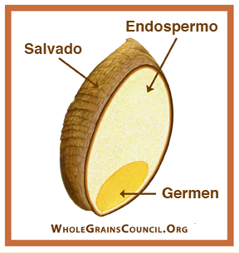
Un grano entero incluye todo
Los granos enteros o los alimentos que contienen estos, tienen los tres componentes esenciales y todos los nutrientes naturales del grano entero.
Si el grano ha sido procesado (por ejemplo, si es quebrado, molido, cortado, extrudido, perlado ligeramente o cocido), el producto alimenticio debe ofrecer aproximadamente el mismo equilibrio rico en nutrientes que se encuentra en el grano original.
Notes:
Emails we’ve received at the Whole Grains Council show that many people think that grains have to be intact (physically whole) to count as whole grains. No! You don’t have to sit in the middle of the field, eating them right off the stalk -- as long as all the bran, germ, and endosperm are still present.
This diagram shows the three EDIBLE parts of the grain kernel. Many grains also have an inedible outer hull or husk that must be removed in order for the grain to be digested.

Slide 15
Lista de Granos Enteros
Los siguientes ejemplos son todos de granos enteros, si se consumen con toda la fibra, el germen y el endospermo:
• Amaranto • Cebada (no incluye la cebada perlada)
• Alforfón • Maíz, incluye harina de maíz integral, palomitas
Mijo • Avena, incluye harina de avena integral
Quínoa • Arroz (integral y de color)
Centeno • Sorgo (también conocido como milo)
Teff • Triticale (un híbrido de centeno y trigo)
• Arroz silvestre
Trigo, incluye las variedades como la espelta, emmer, farro, einkorn, Kamut®, durum y tipos como el trigo bulgur, trigo quebrado y el grano de trigo tosco
* Los granos en rojo no contienen gluten. La avena también puede no contener gluten, si en el producto se certifica que no contiene gluten.
Notes:
Make sure they understand that the grains listed here are not AUTOMATICALLY whole grains -- unless you’re sure that all the bran, germ, and endosperm are still there.
That said, the grains in red are virtually always whole in our food supply:
Amaranth, buckwheat, millet, oats, quinoa, brown rice, teff, and wild rice. And popcorn, bulgur, cracked wheat, and wheatberries are whole grain forms of corn and wheat, respectively.
Check carefully on the ones in black, to be sure they’re whole.
Pearled barley is NOT a whole grain. Look for “hulled barley” or “hull-less barley.”
Degerminated cornmeal is not a whole grain, as the germ is missing.

Slide 16
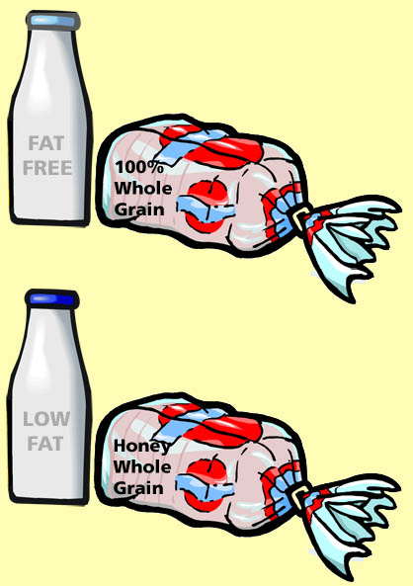
Productos compuestos de granos enteros en un 100% o parcialmente
Así como la leche viene en diferentes presentaciones para los diferentes gustos, también hay diferentes contenidos de granos enteros.
Algunas personas prefieren empezar a consumir alimentos con un contenido parcial de granos enteros hasta que se acostumbran al sabor más fuerte, como de nuez, que tienen los productos que contienen granos enteros en un 100%.
¡Sano en serio!
Parcialmente más sano
Notes:
The Dietary Guidelines recommend everyone eat 3 or more servings of 100% whole grain foods. But you could just as easily eat all six of of your daily grain servings as foods made half and half with whole grain and refined grain -- and also end up eating 3 servings of whole grain.
Just as it’s hard to jump right from whole milk to skim milk, many people may not find it easy to jump from a lifelong habit of refined grains to eating 100% whole grains. Partial whole grains can help them through the transition, just as reduced fat milk can.
Soon you’ll find your tastes adjusting, and you’ll begin to enjoy the fuller, nuttier taste of whole grains. At this point, some of your old favorites may seem rather bland!

Slide 17
¿Qué cuenta como una porción?
Granos enteros
en un 100%
Esta cantidad de alimentos cuenta como una porción de granos enteros
• 1/2 taza de pasta
• 1/2 taza de arroz u otros granos
• 1 rebanada de pan
• 1 taza de cereal frío
• 1/2 taza de cereal caliente
• 1 bagel o muffin pequeño
Contenido parcial de granos enteros
16 gramos de granos enteros
La cantidad varía dependiendo del contenido de granos enteros. 16 gramos o más de ingredientes con granos enteros cuenta como una porción.
Notes:
The common kitchen-measurement serving sizes described in the Dietary Guidelines apply only to whole grain foods.
When partial whole grains are consumed, we need to know how many grams of whole grain are in each serving, so we can aim for 48g or more (16g x 3 servings) each day.
It’s actually very easy, thanks to a new tool -- the Whole Grain Stamp -- that we’ll explain in a minute.

Slide 18
Cómo encontrar granos enteros:
Cómo leer las etiquetas y cómo usar el sello de granos enteros
Notes:
You may want to pause at this screen, and ask your group to tell YOU how they currently identify whole grains. The more discussion you can generate, the more your participants will learn.

Slide 19

Estas palabras significan que el producto contiene granos enteros
Whole (integral) [Nombre del grano]
Whole [nombre del grano] flour (harina integral)
Whole grain [nombre del grano] (grano entero o integral)
[nombre del grano] berries o groats
(grano entero / intacto)
Notes:
The next four screens use traffic signal imagery to reinforce words that ALWAYS, SOMETIMES, and NEVER indicate whole grains.
The first three are self-explanatory. Berries and groats both mean the whole kernel. You will see terms like “wheatberries” and “rye berries” or “oat groats” and “buckwheat groats.” These all describe whole forms of these grains.

Slide 20
Estas palabras significan que el producto contiene granos enteros
Brown rice (Arroz integral)
Wild rice (Arroz silvestre)
Oats, oatmeal (Avena)
Cracked wheat (Trigo quebrado)
Hulled or hull-less barley (Cebada descascarada)
Graham flour (Harina de trigo sin cernir)
Whole white wheat (Trigo blanco integral)
Notes:
You’ll rarely see the words “whole grain rice” -- more often, just brown rice. Whole grain rice comes in other colors too, such as black, purple and red. Wild rice is not technically a form of rice, but it IS a whole grain.
Even instant oatmeal contains all the bran, germ and endosperm.
Bulgur is made by cooking wheat kernels, then drying them and breaking them into small pieces. Cracked wheat is raw broken wheat kernels, while bulgur is cooked broken wheat kernels.
Two kinds of barley grow in the fields. Most is what’s called “covered” barley which has an inedible hull firmly attached to the kernel. If part of the bran is lost in scraping off the hull, the result is pearled barley, which is not considered a whole grain. Less common “naked” barley does not have this tough hull. Look for hulled barley (covered barley with the hull carefully removed to minimized bran loss) or hull-less barley (naked barley that never had the close-fitting hull) to be sure you’re getting whole grain.
Graham flour is a kind of coarse whole wheat flour. But be careful! Most graham crackers are NOT made with graham flour.
Whole white wheat is a special variety of whole wheat that grows naturally with a lighter color and milder flavor. It has all the same good nutrition as regular (red) whole wheat. You can trust the words “whole white wheat.”

Slide 21

Quizás sí, quizás no
Flour (Harina)
Wheat flour (Harina de trigo)
Organic (Orgánica)
Unbleached (sin blanquear)
Semolina (Sémola)
Multigrain (Multigrano)
Stoneground (Molido en molino de piedra)
Notes:
Flour: FDA defines as meaning “refined wheat flour.”
Wheat flour: An honest term for refined wheat flour. Watch out for products that say 100% wheat flour as this is most likely not whole grain!
Organic, natural, unbleached -- all healthy sounding words that do not guarantee whole grains -- although whole grains can be all these things.
Semolina is a kind of finely ground durum wheat used in pasta. It can be whole or refined.
Multigrain just means there are several different grains. If you refine wheat, corn, oats and rye and mix them together you can make a “multigrain” bread without any whole grains. This word OFTEN fools shoppers.
Stoneground just means the grain was milled on stones rather than metal rollers. The bran and/or germ may still have been removed.

Slide 22

NO contiene granos enteros
Enriched flour (Harina enriquecida)
Bran (Fibra o salvado)
Germ (Germen, germen de trigo)
Degerminated cormeal (Harina de maíz desgerminado)
Pearled barley (Cebada perlada)
Grits, Hominy, Farina (Sémola de maíz, maíz para pozole, farina)
Notes:
Enriched flour -- refined flour with 5 nutrients added back in, not nearly replacing the dozens of nutrients removed or diminished by refining.
Bran, Germ -- these are two of the PARTS of a whole grain. Alone they are never a whole grain. Remember, we need bran, germ and endosperm (all three parts) all present to consider something a whole grain.
Degerminated -- You’ll often see this on cornmeal. The germ’s missing so it’s not whole grain.
Pearled barley -- missing some of the bran. See earlier slides.
Grits, hominy, farina -- all terms for foods that are almost invariably refined.

Slide 23
Práctica para leer la etiqueta
• ¿Qué ingredientes son granos enteros?
• ¿Este producto está compuesto de granos enteros en un 100%?
Ingredients: Whole White Wheat Flour, Millet, Oats, Brown rice flour, Degerminated cornmeal, Water, Sugar, Soybean Oil, Salt, Wheat germ, Oat bran, Baker's yeast.
Notes:
Ask participants to tell you which of these ingredients are whole grain.
Definitely whole grain: whole white wheat flour, oats, brown rice flour.
Probably: Millet
Definitely NOT whole grain: Degerminated cornmeal, wheat germ, oat bran
Not even grains: water, sugar, soybean oil, salt, baker’s yeast.
Whole white wheat is a special variety of whole wheat that grows naturally with a lighter color and milder flavor. It has all the same good nutrition as regular (red) whole wheat. You can trust the words “whole white wheat.”

Slide 24
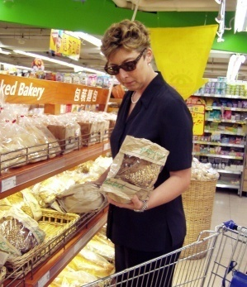

En la tienda: confíe en el sello
Este es un símbolo que se ve a simple vista y que le garantiza que el producto contiene media porción (8g) o más de granos enteros
Notes:
We’re all busy. It’s not easy to stop in the grocery aisles and read all the ingredients carefully, and often there’s no way to tell from the package
• how much whole grain is in a food
• whether certain ingredients are whole grain or not
Look for the Whole Grain Stamp. It’s on more than 2,000 products and is used in five countries, to help shoppers quickly and easily spot whole grains. Here’s how it works (see following slides).

Slide 25

El sello de grano entero
Ícono de gavilla de granos
Vea el sitio
Web para más
información sobre
granos enteros
Gramos de granos enteros
por porción etiquetada
El sello “básico”
Notes:
(Point out the different parts of the Whole Grain Stamp)
The Stamp always has
The number of grams of whole grain ingredients per serving. Remember that 16g equals one serving. You will never see a number lower than 8g, or half a serving, the minimum requirement of the program.
The grain sheaf icon.
The address of the Whole Grains Council’s website, to remind you to visit them for all kinds of great information about whole grains.

Slide 26

El sello de grano entero
La marca del 100%
aparece si todos los granos* que contiene el producto son granos enteros;
Es decir, que NO contiene granos refinados
El sello del “100%”
* En Canada, todos los ingredientes deben ser de granos enteros.
Notes:
If all the grain in a food is whole grain, the “100% banner” will be added to the Stamp.
Remember we said earlier there are 100% whole grain foods and partial whole grain foods? The Stamp helps you see which foods are made totally with whole grain, and which are made with a mix of whole and refined grain.

Slide 27
El sello de granos enteros
Compare el número de gramos con la cantidad mínima que necesita
cada día.
CONSUMA 48g O MÁS DE
GRANOS ENTEROS AL DíA
En todos los sellos
EAT 48g OR MORE OF
WHOLE GRAINS DAILY
Notes:
You’re aiming for three or more servings, with each serving consisting of 16g or more of whole grains. That means you need to eat 48g or more of whole grain daily.
It’s unlikely that most people will carefully count up the grams on every food they eat. Most people simply look for the Stamp. They know they’re guaranteed at least half a serving (8g) every time they choose a food with the Stamp. If they eat all six of their daily grain servings as “Stamped” foods, they’re sure to get the three servings or more recommended by experts.

Slide 28
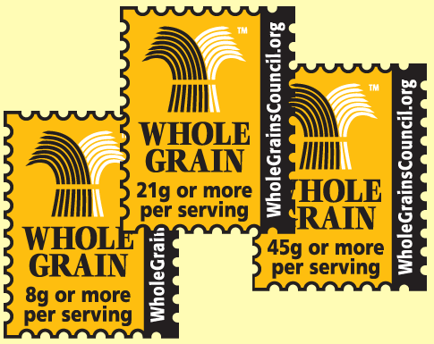
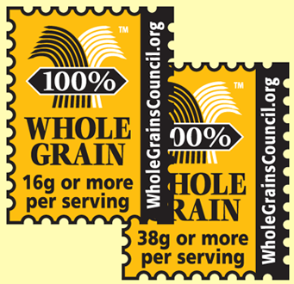
El sello de granos enteros
Hay diferentes cantidades en cada producto
EAT 48g OR MORE OF
WHOLE GRAINS DAILY
EAT 48g OR MORE OF
WHOLE GRAINS DAILY
Sello básico
Contiene al menos
8g (1/2 porción)
de granos enteros
Sello del 100%
NO contiene granos refinados Y
contiene al menos 16g (1 porción)
de granos enteros
Notes:
Foods like pasta – with a fairly large standard serving size and virtually no ingredients other than grain – may show a number as high as 56 grams on their Stamp. You’ll see a wide range of numbers on the Stamp.
About 3/4 of the products currently certified to use the Whole Grain Stamp offer a serving or more of whole grain.

Slide 29
Evalúe su conocimiento
Notes:
This section is totally optional, but your group may find it fun to test its knowledge at the end of the session.
You can have them figure out their responses individually then put up the answer for each question -- or you can invite the class to shout out the answers.
If you skip this self-quiz, we recommend you move the two summary slides up, so that your group will be reminded about all the great information on the Whole Grains Council website.

Slide 30
#1. ¿Qué son los granos enteros?
Granos que tienen un color más oscuro.
Granos que tienen un bajo contenido de carbohidratos.
Granos que contienen la fibra, el germen y el endospermo.
Granos que son orgánicos.
Granos que han sido fortificados.

Slide 31
#1. ¿Qué son los granos enteros?
Granos que tienen un color más oscuro.
Granos que tienen un bajo contenido de carbohidratos.
Granos que contienen la fibra, el germen y el endospermo.
Granos que son orgánicos.
Granos que han sido fortificados.

Slide 32
#2. ¿Cuál es siempre un grano entero?
Cebada
Avena
Harina de trigo enriquecida
Pan de trigo con un 100% de trigo
Todos los anteriores
Ninguno de los anteriores

Slide 33
#2. ¿Cuál es siempre un grano entero?
Cebada
Avena
Harina de trigo enriquecida
Pan de trigo con un 100% de trigo
Todos los anteriores
Ninguno de los anteriores

Slide 34





#3. ¿Cuál garantiza que el producto contiene media porción o más de granos enteros?
a.
d.
b.
EAT 48g OR MORE OF
WHOLE GRAINS DAILY
c.
e.

Slide 35
#3. ¿Cuál garantiza que el producto contiene media porción o más de granos enteros?
a.
d.
b.
EAT 48g OR MORE OF
WHOLE GRAINS DAILY
c.
e.

Slide 36
#4. ¿Verdadero o falso?
Los productos con granos enteros
siempre tienen un contenido alto de fibra.
Verdadero
Falso

Slide 37
#4. ¿Verdadero o falso?
Los productos con granos enteros
siempre tienen un contenido alto de fibra.
Verdadero
Falso
Una porción completa de granos enteros puede contener de
1 a 5 gramos de fibra. La fibra es solo UNO de los beneficios de
los granos enteros.

Slide 38
#5. ¿Cuál indica que el producto contiene granos enteros?
Molido en molino de piedra
Sin blanquear
Multigrano
Trigo
Todas las anteriores
Ninguna de las anteriores

Slide 39
#5. ¿Cuál indica que el producto contiene granos enteros?
Molido en molino de piedra
Sin blanquear
Multigrano
Trigo
Todas las anteriores
Ninguna de las anteriores

Slide 40
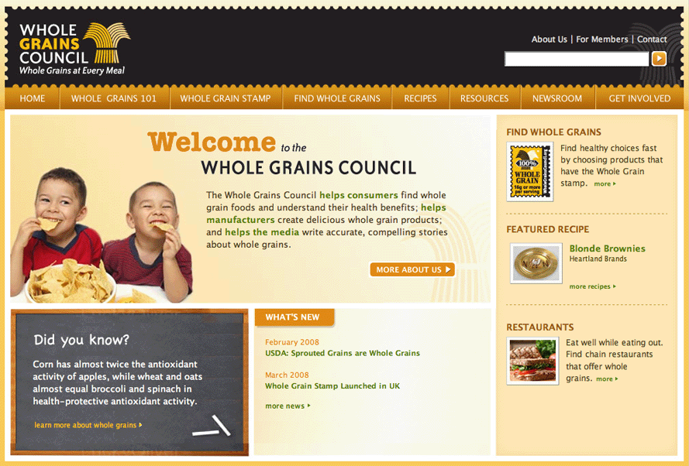
¡Visite nuestro sitio web!
Notes:
(Before you give your Whole Grains Store Tour, visit our website yourself and note three or four sections you think are especially interested. When you get to this screen, mention some of the website’s features, such as:
Health studies under Whole Grains 101
Lists of products using the Stamp under Find Whole Grains
Recipes under Recipes
Information on gluten free whole grains, under Whole Grains 101
and so on….)

Slide 41

El Consejo de Granos Enteros
Ayuda a la gente de todo el mundo a disfrutar más de los granos enteros
www.WholeGrainsCouncil.org

