Slide 1

An Accurate Passive RFID Indoor Localization System Based on Sense-a-Tag and Zoning Algorithm
Majed Rostamian, Jing Wang, Miodrag Bolic
Presenter: Jing Wang
Date: Sept. 27th, 2016
Faculty of Engineering

Slide 2
Outline
Motivation
Augmented UHF RFID system and Sense-a-Tag
Zoning Algorithm
Simulation results
Real experiment
Conclusion

Slide 3
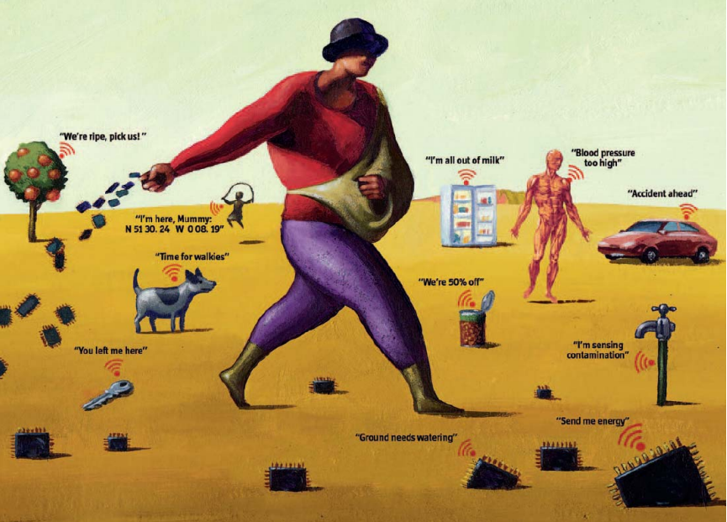

Who
Where
How
(Courtesy to The Economist, London)
Notes:
It is widely recognized that Internet of things will be the third innovation wave of ICT world, after computer and internet. Conceptually, IoT means who, where and how of physical objects. Since the satellite based positioning system are restricted to outdoor environment, indoor localization has become the focus of research during the past decades.

Slide 4
Indoor environment:
UHF RFID:
Trillions of small and inexpensive items
Severe multipath from signal reflection
Non-line-of-sight (NLoS) conditions
High attenuation, signal scattering
Fast temporal change
Low cost
Ease deployment
Miniature-size tag
Free maintenance
Backscattering
Proximity detection-based method
Notes:
For IoT localization service, indoor environment has the following characteristic: it contains trillions of small and inexpensive items, which inspires the adoption of UHF RFID technology due to its advantages such as low cost, ease deployment, miniature size tag, and free maintenance. The most important feature of UHF RFID is the backscattering communication scheme. All these characteristics make the majority of UHF RFID indoor localization solution, which utilize the propagation characteristics of wireless signal unreliable. One direction to solve this problem is to apply proximity detection based method, which relies on using binary measurements related to whether target is within small range of the reference landmarks.

Slide 5
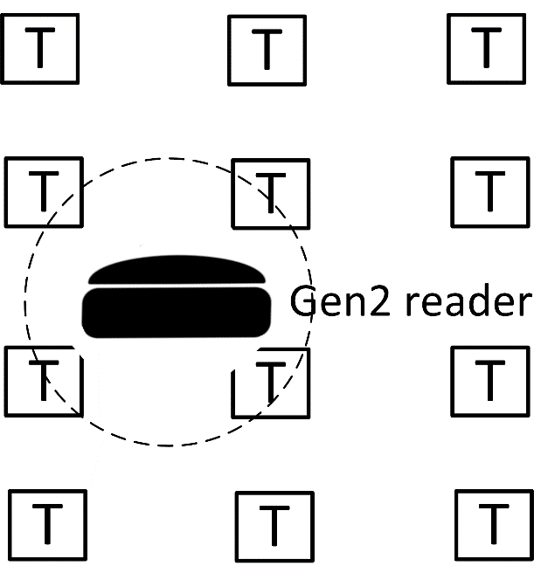
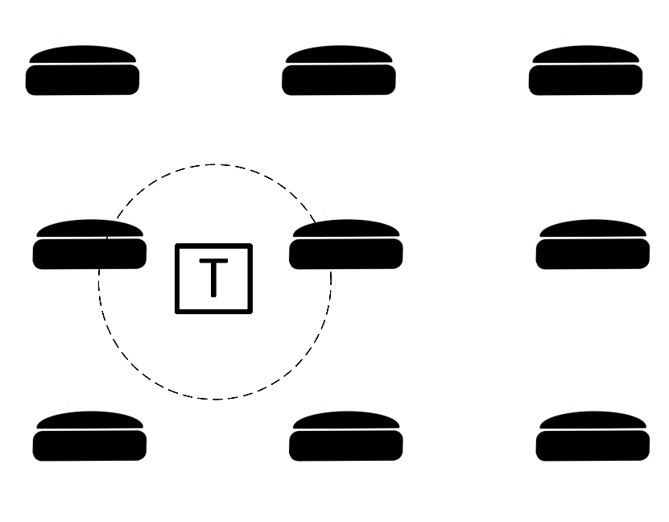
The problems: energy, size and cost
State-of-the-art solutions:
Reader-based
Tag-based
Limited to relatively large and expensive objects that justifying carrying the RFID reader, such as autonomous household robot.
Not cost-efficient to densely deploy reader with tuned read range.
Notes:
The proximity-based methods fall into two categories, reader based and tag based. In reader based method, passive tags are deployed at fixed locations as landmarks and rfid reader is attached to the mobile target. The tag based is vice versa.

Slide 6
Outline
Motivation
Augmented UHF RFID system and
Sense-a-Tag
Zoning Algorithm
Simulation results
Real experiment
Conclusion
Notes:
In response to this research challenge, we develop augmented uhf rfid system with Sense-a-tag

Slide 7
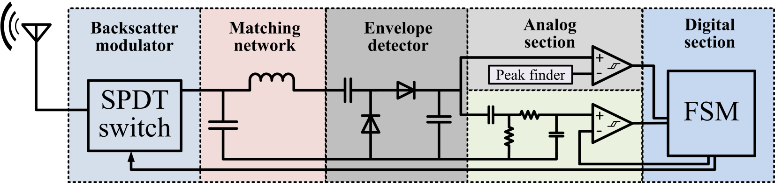
Augmented UHF RFID System:
Key component: Sense-a-Tag (ST)
It can communicate with the off-the-shelf RFID reader following Gen2 protocol;
It can sense the backscattering communication between the neighboring passive tags and Gen2 reader;
Notes:
The key component in augmented uhf rfid system is ST. It has an unique dual functionalities. Here is the block diagram of ST hardware. We can see in analog section, there are two channels for rfid reader’s PIE command signal and passive tag’s backscattering signal respectively. Such unique functionality enables the fine-grained proximity-based localization method, which keeps both mobile and landmark simple and cheap.

Slide 8
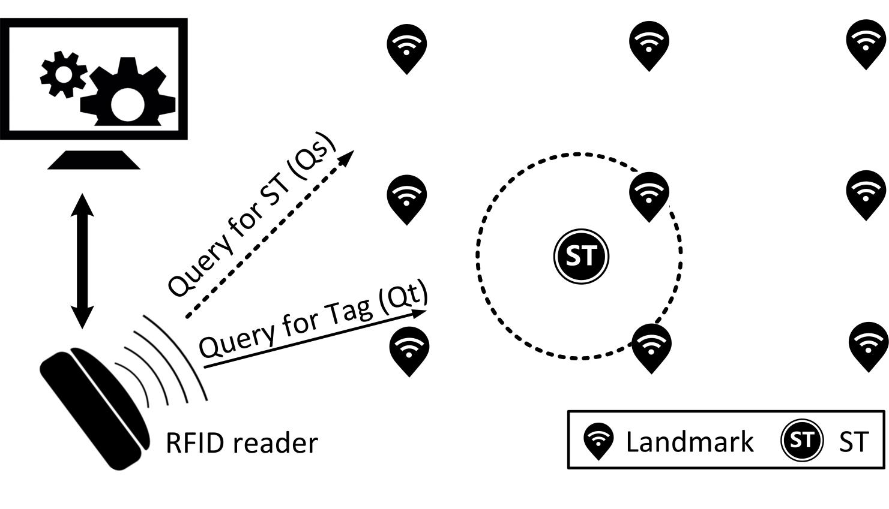
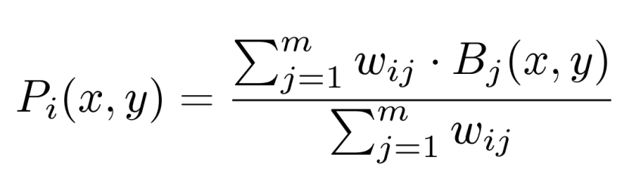
Populated with a large set of reference tags
LISTEN
RESPONSE
Weighted centroid localization
8
Notes:
In Augmented UHF RFID system, Populated with a large set of reference tags in the field, In listen state, ST could capture the backscattering communication signal from reference tags within its proximity
In response state, ST could backscatter the captured IDs information to reader, and then perform the localization algorithm, such as weighted centroid localization.

Slide 9
Outline
Motivation
Augmented UHF RFID system and Sense-a-Tag
Zoning Algorithm
Simulation results
Real experiment
Conclusion

Slide 10
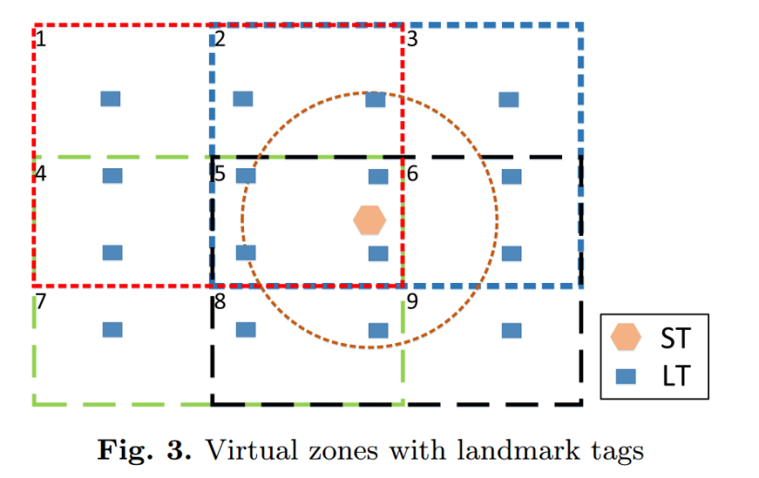
Primary research problem:
the power of the backscattered signal from passive tags varies in time. That might cause ST to detect some landmark tags that are farther than some other landmark tags that are not detected. This will cause significant localization error.
Solution:
Iteratively refine the inventory zone .
In this paper, we divide the whole area into symmetric rectangular zones

Slide 11
Outline
Motivation
Augmented UHF RFID system and Sense-a-Tag
Zoning Algorithm
Simulation results
Real experiment
Conclusion
Notes:
With this simple idea, we conduct the simulation on our newly developed PASS simulation framework/

Slide 12
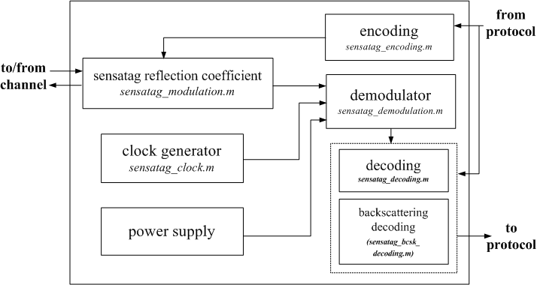
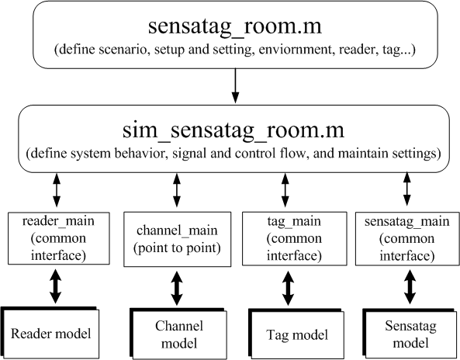
PASS Simulation Framework
PASS(Proximity-detection-based Augmented RFID System Simulator) is a MATLAB-based system-level simulator designed for UHF RFID technology. https://github.com/wacoder/PASS.git
Notes:
PASS is a matlab based time domain system-level simulator for the research in the context of issues related with signal level. The simulator is organized in a hierarachy fashion, The user script describes the simulation setup, which is scenario-dependent. The type of simulation, signal and control flow are defined in behavior description script.
The basic main functions control the behavior of reader channel, tag and ST through underlying model and calculation.

Slide 13
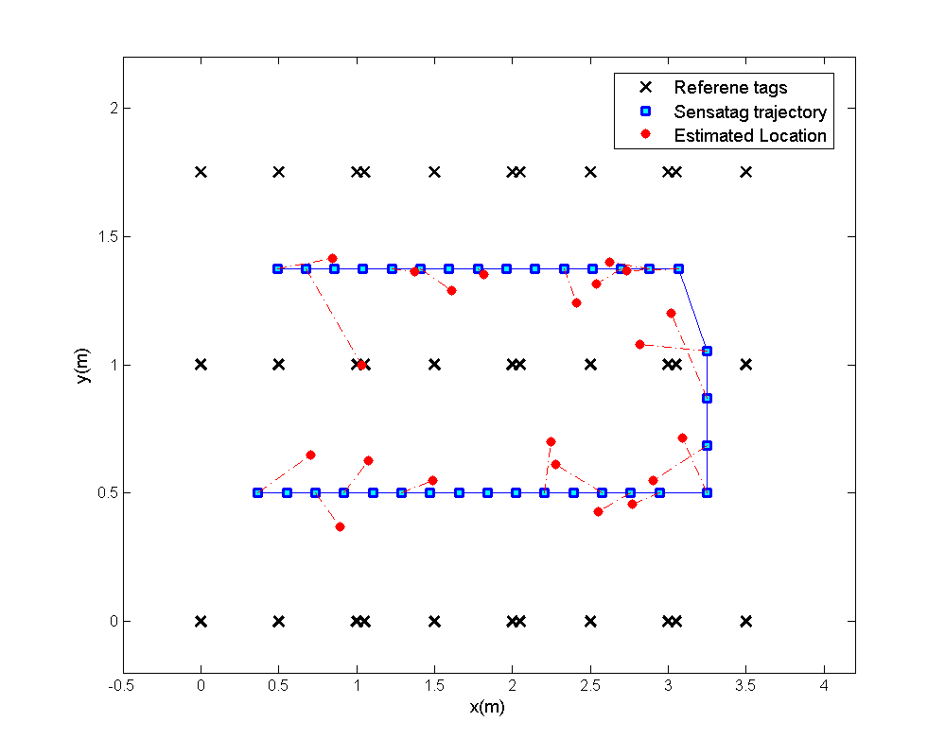
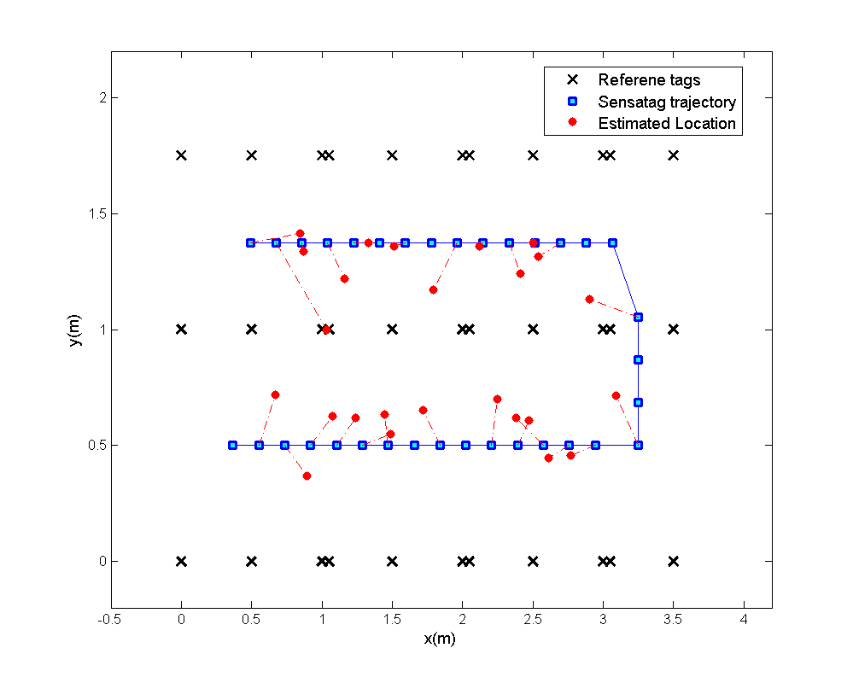
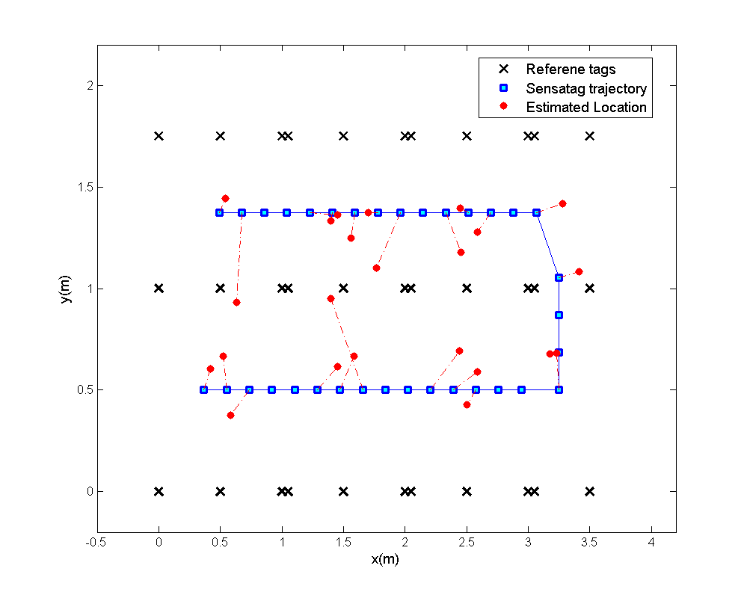
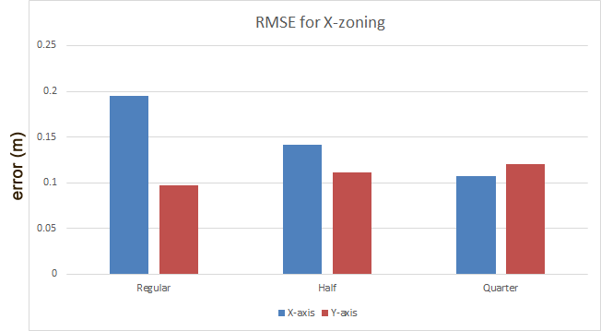
Regular
Half
Quarter
Notes:
The simulation setup is as shown in the graph. We conduct zoning algorithm on horizontal x axis. We have the regular, half which has two inventory zone on x axis and quarter, which has four zones. We can see form the simulation result, the localization error on x axis descreased, but the error on y axis increased because we did not do zoning on y and the included landmarks is less and less.

Slide 14
Outline
Motivation
Augmented UHF RFID system and Sense-a-Tag
Zoning Algorithm
Simulation results
Real experiment
Conclusion

Slide 15
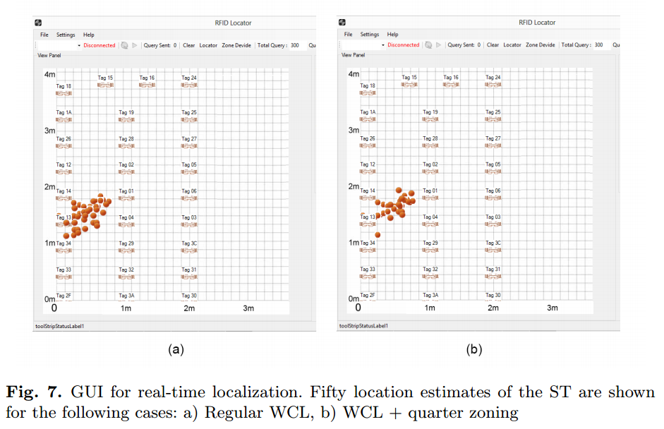
Stationary ST:
Notes:
The experiment setup deploys the passive tag in the field. First we place the ST at the fixed location. With WCL we obtained 50 estimation of ST location. Based on this, we select a quarter zone.

Slide 16
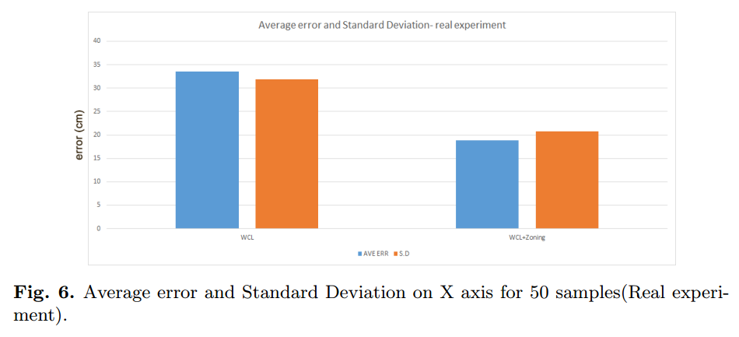

Slide 17
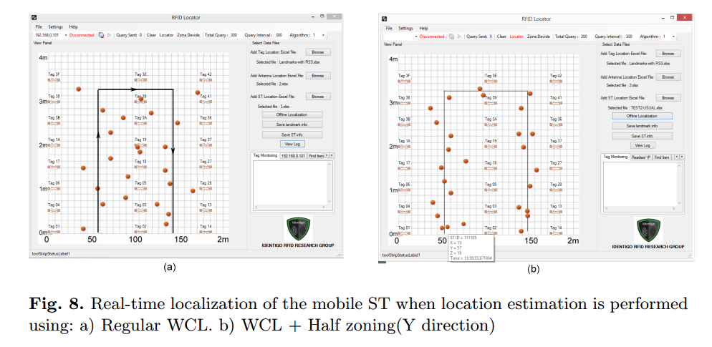
Mobile ST:
Notes:
We build a simple line tracking robot to carry the ST to move along the black line trajectories. Here we get the result for reguarl wcl and half zones on y direction, we could clears see that the location estimation of ST closer to the trajectory.

Slide 18
Outline
Motivation
Augmented UHF RFID system and Sense-a-Tag
Zoning Algorithm
Simulation results
Real experiment
Conclusion

Slide 19
In this paper it is demonstrated that it is possible to improve the localization accuracy of ST-based augmented RFID localization system with the combination of WCL and zoning algorithm.
Two directions for future work:
Applying particle filter to predict which zone to interrogate.
Flexible zoning scheme.

Slide 20


