Slide 1
Predicting Apartment Rental Prices in Switzerland
DSPRO1 Project
Team: Elias Martinelli, Timo Schlumpf
Supervisor: Elena Nazarenko
HSLU Informatik

Slide 2
Problem
Swiss rental prices vary strongly by location.
Prospective tenants often struggle to judge if a rent is fair.
Goal: Predict monthly rent using machine learning.

Slide 3
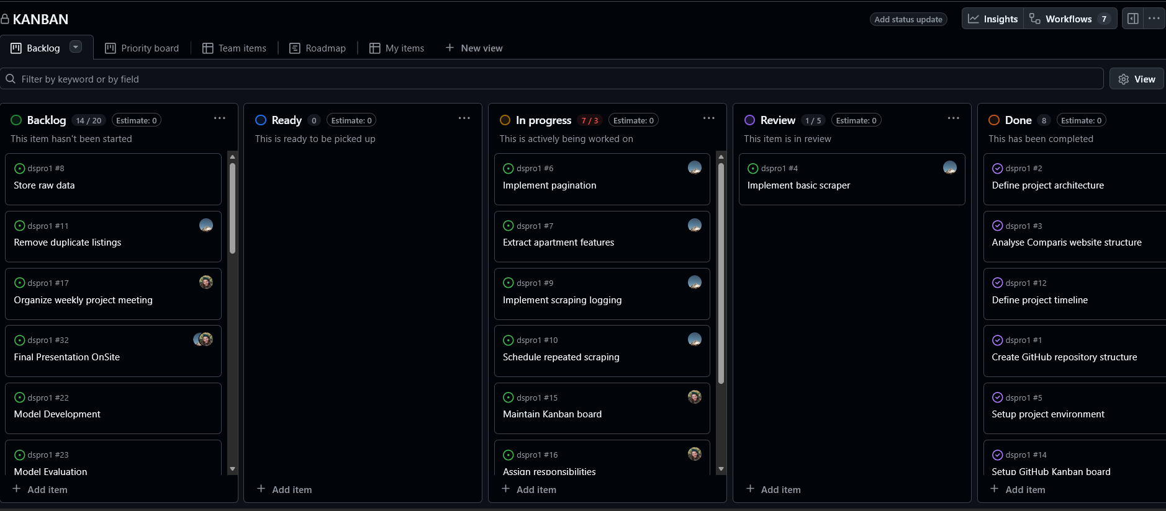
Project Progress
Github Projects => KANBAN Tool
Notes:
Backlog · KANBAN

Slide 4

Milestones

Slide 5

Roadmap

Slide 6
Data Source
Primary dataset: Swiss apartment listings scraped from Comparis.
Several thousand listings expected.
Target variable: Monthly rent in CHF.

Slide 7
Features
Living area (sqm)
Number of rooms
Floor / year built
Canton, city, ZIP code
Apartment characteristics (balcony, parking, furnished)
Monthly rent

Slide 8
Data Processing
Remove duplicates
Handle missing values
Clean categorical labels
Detect outliers
Feature scaling for linear models

Slide 9
Feature Engineering
Location variables
Derived features (rent per sqm)
Tax index by municipality
Distance to public transport

Slide 10
Models
Baseline model (mean rent)
Linear Regression
Random Forest Regressor

Slide 11
Evaluation Metrics
MAE (Mean Absolute Error)
RMSE (Root Mean Squared Error)
R² (Coefficient of Determination)
Cross-validation used for comparison

Slide 12
Results (Planned)
Compare predictive performance of models
Analyze feature importance
Evaluate prediction errors

Slide 13
Conclusion (Planned)
Identify main drivers of rent
Assess usefulness of ML for rent estimation
Discuss limitations and future work

