Slide 1
(Re)creating a videogame soundtrack

Slide 2
Contents
But why?
Idea & Constraints
Pro(o)mpting
Creation Process
Difficulties
Conclusion

Slide 3
But why?
Analyse Risk of “being replaced”
Test AI’s creativity & ability to imitate

Slide 4
Idea & Constraints
Create a song that sounds like it belongs into Minecraft
Cannot mention C418 in prompt
It should invoke nostalgia

Slide 5
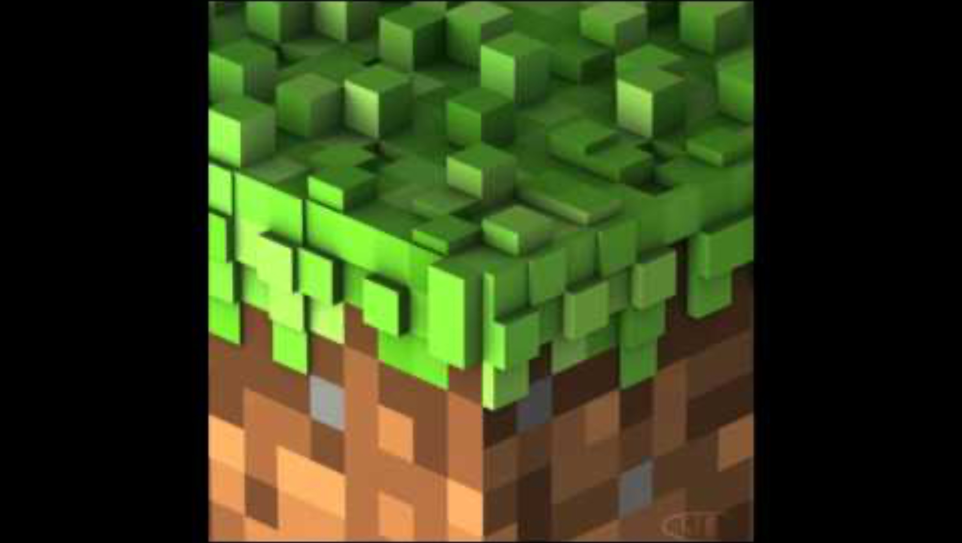
“Inspiration”

Slide 6
Prooooompting
"a soundtrack similar to minecrafts soundtrack - with clear, concise notes and an ambient, relaxing, emotional and slow sound. it should invoke a feeling of nostalgia, while emboding the process of creation."

Slide 7
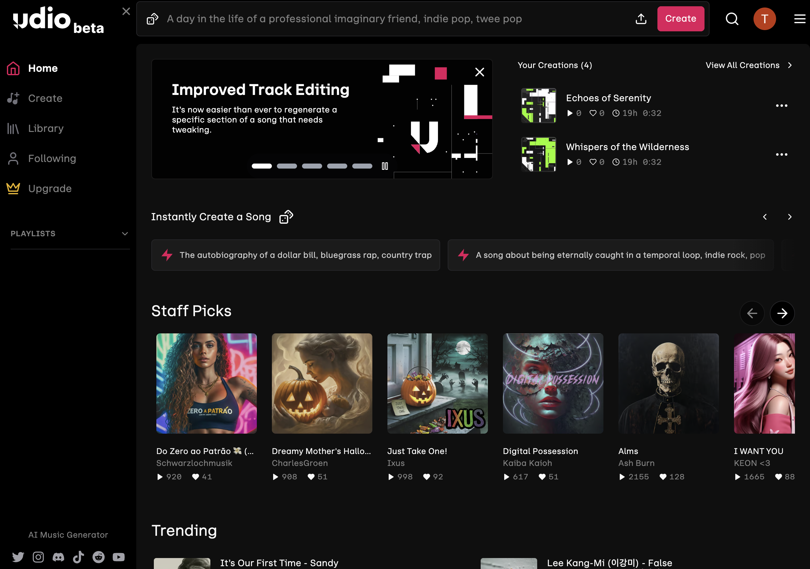
Creation Process
Come up with prompt
Slap it into Udio
Optional: Tweak Settings
profit
Notes:
Has personalization: Remix certain part!

Slide 8
Difficulties
Technical
Free Credits!
(Not so) Huggingface
Suno.ai & co.
Ethical
Copyright?
“Imitation”

Slide 9

Final Product

Slide 10
Output Evaluation
Not as “crisp” as imagined
Lacks that distinct C418 – feeling
Nostalgia is missing

Slide 11
Conclusion
Didn’t sound like intended
Doesn’t quite “hit it home”
Cannot interpret emotions

