Slide 1
Who lives longer with glioblastoma?
Finding the best predictors of survival, and a personal survival-prediction model
CFB-GBM dataset (The Cancer Imaging Archive) · 264 patients · Biostatistics hackathon 2026
t0
t1
t2
Notes:
Welcome. Our task came from a physician who treats glioblastoma, the most aggressive brain cancer. We had two goals: find which patient characteristics go with longer survival, and build a model that predicts survival for an individual patient. We'll go step by step: the data, the assumptions we made, what we found, and finally our best model.

Slide 2
The problem
Two goals: explain who lives longer, and predict it for one patient
What is glioblastoma?
1
Explain
The most common and most aggressive brain cancer in adults
Even with surgery, radiotherapy and chemotherapy, typical survival is about one year
Survival varies a lot: some patients live a few months, others several years
Knowing who is at high risk early helps doctors plan treatment and talk with families
Which patient characteristics are linked to longer survival?
2
Predict
Can we estimate how long one specific patient is likely to live, using information available at diagnosis?
Glioblastoma survival · CFB-GBM
2
Notes:
Glioblastoma is the most common aggressive brain tumour in adults. Even with surgery, radiotherapy and chemotherapy, typical survival is about a year, but it varies a lot from patient to patient. The physician wants to know which characteristics go with longer survival, so high-risk patients can be identified early, and whether we can give a personal estimate of survival for a new patient.

Slide 3
264 patients, all followed until death
Half of the patients died within about one year
264
50 wk
patients
median survival (≈ 11.5 months)
48%
12.5%
alive after 1 year
alive after 2 years
How to read the curve: each step down is a death; where it crosses 50% is the median survival.
Glioblastoma survival · CFB-GBM
3
Notes:
Here is the whole cohort. Every patient's death date is known, so nobody is 'censored', meaning nobody dropped out before the end. The curve on the right is a Kaplan–Meier curve: it shows the share of patients still alive over time. Each step down is a death. Where it crosses 50% is the median survival, about 50 weeks or eleven and a half months.

Slide 4
The patient timeline
We predict from t0, so a prediction may only use what is known at t0
Baseline MRI
Radiotherapy
1st check-up MRI
2nd check-up MRI
Death
t0
RT
t1
t2
end
diagnosis · time zero
3 or 6 weeks
after treatment
later follow-up
end of survival time
Known at t0
Treatment
At t1
At t2
Age, sex, height, weight
Performance status (fitness)
WHO classification edition
Tumour volume
Radiomic features (MRI numbers)
Dose (Gy)
Number of sessions
Delay from t0 to start
Tumour size change t0 → t1
RANO response category
Tumour size change t0 → t2
RANO response category
261–264 patients
194 patients
160 patients
112 patients
Survival time = weeks from the t0 MRI to death (what we want to predict)
Glioblastoma survival · CFB-GBM
4
Notes:
This is the patient journey. t0 is the baseline MRI at diagnosis: it is time zero, and survival is counted in weeks from this scan until death. About one to two weeks later radiotherapy starts and lasts three or six weeks. t1 is the first check-up MRI after treatment and t2 the second. Under each step is the data collected there. Because our model predicts at t0, it can only use the t0 information; the t1 and t2 data come later.

Slide 5
Four data tables
Clinical facts, treatment, tumour response and image measurements
1
2
3
4
Clinical
Treatment
Response (RANO)
Radiomics
Survival (weeks)
Age, sex
Height, weight
Performance status
WHO edition
Delay to radiotherapy
Dose (Gy)
Number of sessions
Tumour size at t0, t1, t2
Shrinkage rate
Response category
107 numbers per MRI scan
Shape, brightness, texture
7 MRI types × 3 time points
264 patients
194 patients (70 missing)
165 patients
261 patients · 2,424 scans
Glioblastoma survival · CFB-GBM
5
Notes:
The data came as four tables linked by a patient number. The clinical table has survival and basic patient facts. The treatment table has the radiotherapy details, but 70 patients have no treatment record. The RANO table has tumour sizes at each scan and the official response category. The radiomics table has 107 numbers computed by software from each MRI scan, describing the tumour's shape, brightness and texture.

Slide 6
The variables in plain words
Everything except survival is a candidate predictor
Variable | What it means | In our data | Known at
Survival (outcome) | Weeks from the t0 MRI until death | 3–238 weeks, median 50 | end
Age | Age at the t0 scan | 25–90 years, median 70 | t0
Sex | Female or male | 106 women, 158 men | t0
Height, weight, BMI | Body size; BMI = weight (kg) ÷ height (m)² | BMI median 25 | t0
Performance status (PS) | Fitness score: 0 = fully active … 4 = bedbound | 0 to 3 | t0
WHO edition | Rulebook used for the diagnosis: 2016 or 2021 | 185 vs 79 | t0
Radiotherapy schedule | 60 Gy in 30 sessions, or 40 Gy in 15 sessions | 130 / 64 / 70 unknown | planned at t0
Delay to radiotherapy | Weeks from t0 to the first session | 0–8 weeks | RT start
Tumour volume | Size of the outlined tumour | 1–181 cm³, median 37 | t0
Radiomic features | 107 numbers on shape, brightness, texture | T1-Gd and FLAIR used | t0
RANO response | Did the tumour shrink or grow? | 4 categories | t1, t2
Glioblastoma survival · CFB-GBM
6
Notes:
This table lists every variable we used, what it means, its range in our data and when it is known. Survival is the outcome we try to explain and predict. Everything else is a candidate predictor. Note the last column: response at t1 and t2 is only known after treatment, which matters later.

Slide 7
Fitness: WHO performance status
Less fit patients (PS 2–3) live about half as long
The score (0 = best)
0
Fully active
1
Symptoms, but walking around
2
In bed < 50% of the day
3
In bed > 50% of the day
4
Bedbound (none in our data)
Glioblastoma survival · CFB-GBM
7
Notes:
Performance status is the doctor's score of how well a patient copes with daily life, from 0, fully active, to 4, bedbound. Nobody in our data was 4. On the right, patients with PS 0 or 1 had a median survival of about 56 weeks, versus 29 for PS 2 and 22 for PS 3. The less fit, the shorter the survival.

Slide 8
Age
Survival drops after 70
What it is
Age at the t0 scan: 25 to 90 years, median 70.
What we found
Under 70: median ≈ 61 weeks
75 and over: median ≈ 31 weeks
Little difference below 70; risk climbs after that
Glioblastoma survival · CFB-GBM
8
Notes:
Age is measured at the t0 scan. Patients under 70 had a median survival of about 61 weeks; at 75 and over it was about 31 weeks. Interestingly, there is little difference between under-60 and 60–69: the risk mainly rises after 70.

Slide 9
Diagnosis rulebook: WHO 2016 vs 2021
Patients diagnosed under the 2021 rules do worse
What it is
Which edition of the WHO tumour rulebook was used to diagnose the patient.
Why it matters
Since 2021, tumours with an IDH mutation (slower growing) are no longer called glioblastoma
So the 2016 group likely includes some slower tumours
New patients are all diagnosed under 2021 rules
Glioblastoma survival · CFB-GBM
9
Notes:
Doctors classify brain tumours using a World Health Organization rulebook. In 2021 the definition of glioblastoma changed: tumours with a mutation in the IDH gene, which grow more slowly, are no longer called glioblastoma. So the 2016 group probably includes some of these slower tumours, which explains its better survival. New patients are all diagnosed with the 2021 rules.

Slide 10
Treatment: two radiotherapy schedules
The short course goes with shorter survival, because older, frailer patients get it
Standard (conventional)
60
60 Gy in 30 sessions · 6 weeks
130 patients · median age 65
Short course (hypofractionated)
40
40 Gy in 15 sessions · 3 weeks
64 patients · median age 75
Unknown
?
No treatment record
70 patients · median age 70
Gy (gray): radiation energy per kg of tissue
Glioblastoma survival · CFB-GBM
10
Notes:
Radiotherapy dose is measured in gray, the energy absorbed per kilogram of tissue. The standard schedule is 60 gray in 30 daily sessions over six weeks. Older or frailer patients usually get a shorter course: 40 gray in 15 sessions over three weeks. Short-course patients lived much less long, but they were also about ten years older. This is called confounding by indication: the treatment marks who the patient is, it does not prove the treatment is worse.

Slide 11
Imaging: from MRI to numbers
Radiomics turns each tumour image into 107 numbers
1
MRI scan
2
Outline the tumour
3
Compute 107 numbers
T1-Gd: contrast makes the active tumour edge bright
FLAIR: fluid is dark; swelling and spreading tumour are bright
GTV: the doctor's outline of the visible tumour, also used to aim radiotherapy
Shape: size, diameter, roundness
Brightness: average, spread, extremes
Texture: smooth or patchy
We used T1-Gd and FLAIR at t0 (available for 261 and 255 patients). Other MRI types were missing for many patients.
Glioblastoma survival · CFB-GBM
11
Notes:
An MRI scan can be taken in different 'modes' called sequences. T1-Gd is taken after injecting a contrast agent, gadolinium, which leaks into the active tumour so its edge lights up. FLAIR makes normal brain fluid dark, so swelling and tumour cells spreading into the brain look bright. A doctor outlines the tumour, called the GTV. Software called PyRadiomics then computes 107 numbers inside that outline: its shape, how bright it is, and its texture, meaning whether the brightness is smooth or patchy. We used T1-Gd and FLAIR at t0 because almost every patient had them.

Slide 12
Tumour size at t0
Only the largest tumours clearly do worse
What it is
Volume of the outlined tumour: 1 to 181 cm³ (a golf ball is about 40 cm³).
What we found
The three smaller quarters look alike
Largest quarter (over 65 cm³): median 28 weeks
A threshold effect, not a straight line
Glioblastoma survival · CFB-GBM
12
Notes:
Tumour volume comes from the outline on the t0 MRI. For scale, a golf ball is about 40 cubic centimetres. We split patients into four equal groups by size. The three smaller groups look alike, with median survival around 50 to 56 weeks. Only the largest quarter, above about 65 cubic centimetres, does clearly worse, at 28 weeks. So the effect of size is a threshold, not a straight line.

Slide 13
Response at the first check-up (t1)
Growth at t1 doubles the risk of death, but it is only known after treatment
CR / PR
Gone, or at least 50% smaller
Stable
Between the two thresholds
Progression
At least 25% bigger
Careful
Only patients alive at t1 have it, so it can't be used at diagnosis
Some early 'growth' is radiation swelling (pseudoprogression)
Glioblastoma survival · CFB-GBM
13
Notes:
At the first check-up the tumour is compared with t0 using the RANO rules: gone, at least 50 percent smaller, stable, or at least 25 percent bigger, called progression. Patients whose tumour grew had a median survival of 44 weeks versus 57 for stable and 70 for those who responded. After adjusting for the baseline factors, progression doubles the death rate. Two warnings: only patients who lived long enough have a t1 scan, so this cannot be used at diagnosis, and some early 'growth' is actually swelling from radiation, called pseudoprogression.

Slide 14
Our assumptions and choices
Each choice protects the results from a known trap
1
Time zero = t0 MRI
2
Every death is observed
3
Response is not a baseline predictor
Survival counts from the baseline scan, so predictions use only t0 information.
No patient was lost to follow-up, so no 'censoring' corrections are needed.
Only survivors reach t1; using it at t0 would flatter it (immortal-time bias).
4
Treatment was not randomized
5
Missing data kept, not dropped
6
Model assumption checked
Doctors choose the schedule by age and fitness, so its effects are associations, not causes.
70 patients without treatment records form an 'Unknown' group; 1 missing PS set to 1.
Cox models assume each effect is constant over time; we tested it and found where it isn't.
Glioblastoma survival · CFB-GBM
14
Notes:
These are the decisions we made before modelling, and why. Time zero is the t0 scan, so predictions only use t0 information. Every death is observed, which keeps the statistics simple. Response at t1 is not used as a baseline predictor, because only survivors reach t1. Treatment was chosen by doctors, not randomly, so its effects are associations, not causes. We kept patients with missing data instead of dropping them. And we checked the main assumption of our model, that each factor's effect is constant over time.

Slide 15
Three tools we use
Curves to see differences, hazard ratios to measure them
1
Kaplan–Meier curve
2
Hazard ratio (HR)
3
Cox regression
Share of patients still alive over time.
Each step down is a death.
Compare the curves of different groups.
HR = 2
twice the death rate → shorter survival
HR = 0.5
half the death rate → longer survival
HR = 1
no difference
If the 95% confidence interval includes 1, there is no clear effect.
Estimates the HR of several factors at once.
Each HR is adjusted for the others.
Example: the effect of age among patients with the same fitness.
Glioblastoma survival · CFB-GBM
15
Notes:
Three tools. The Kaplan–Meier curve shows the share still alive over time; we compare curves between groups. The hazard ratio measures how much faster one group dies than another: 2 means twice the death rate, so shorter survival; 0.5 means half, so longer survival; 1 means no difference. The confidence interval gives the plausible range; if it includes 1, we can't rule out no effect. Cox regression estimates hazard ratios for several factors at once, each adjusted for the others, for example the effect of age among patients with the same fitness.

Slide 16
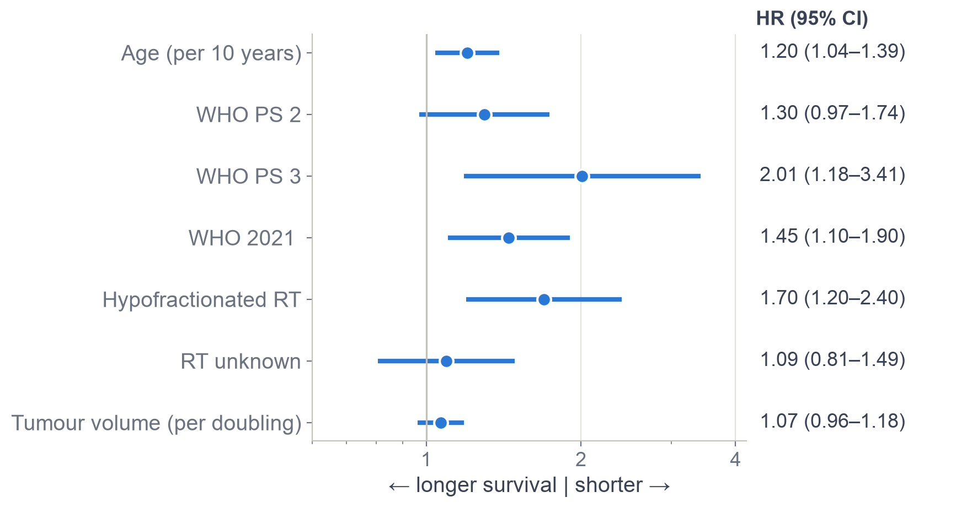
All factors together
Age, fitness, WHO edition and treatment plan still matter after adjusting for each other
How to read it
Dot = hazard ratio; line = 95% confidence interval. Right of 1 = shorter survival.
Key results
Each +10 years: 20% higher death rate
PS 3: 2.0× the death rate
WHO 2021: 45% higher
Short-course RT: 70% higher (a frailty marker)
Sex and BMI: no effect
Glioblastoma survival · CFB-GBM
16
Notes:
This is the Cox model with all factors at once. Each dot is a hazard ratio and the line its 95% confidence interval. Every 10 years of age raises the death rate by about 20%. PS 3 doubles it. The 2021 rulebook raises it by 45%, and the short radiotherapy course by about 70%, again because it marks frailer patients. Tumour volume looks weak here because its effect is a threshold, which the next slides show. Sex and BMI had no effect at all.

Slide 17
Which predictors matter most?
Age, WHO edition and tumour size carry the most information
How we rank them
Remove one predictor at a time
Measure how much worse the model fits
Bigger loss = more important
Result
Age is first
WHO edition and tumour size close behind
Fitness and RT schedule add a bit less
Glioblastoma survival · CFB-GBM
17
Notes:
To rank the predictors, we remove one at a time from the model and measure how much worse it fits. The bigger the loss, the more important the predictor. Age comes first, then the WHO edition and tumour volume, then performance status and the radiotherapy schedule. The differences between them are small.

Slide 18
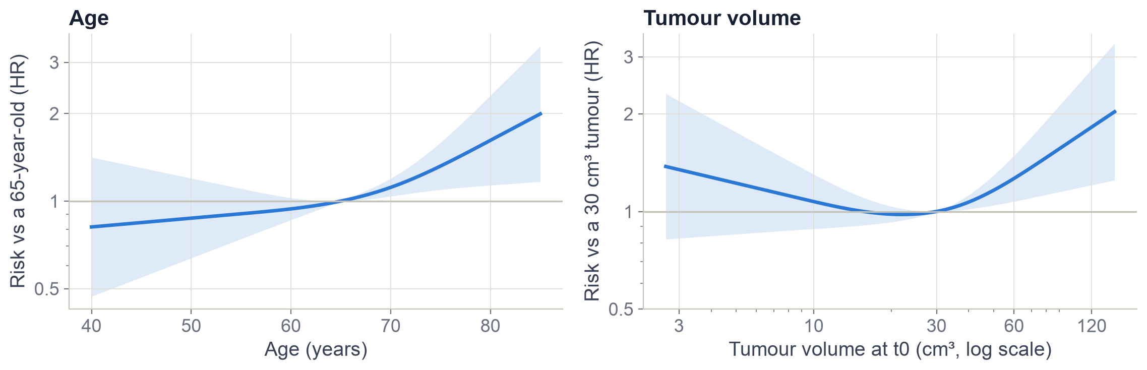
Effects are curves, not straight lines
Risk rises after about 65–70 years and for tumours above ~40 cm³
Shaded band = 95% confidence interval. Letting these effects bend (a 'spline') fitted the data significantly better than straight lines.
Glioblastoma survival · CFB-GBM
18
Notes:
We let age and tumour size act as flexible curves, called splines, instead of straight lines. The shaded band is the uncertainty. Below 65 age barely matters; above 70 the risk climbs steeply. For tumour size the risk is flat up to about 30 to 40 cubic centimetres and then rises. Very small tumours have a wide band, because there are few of them. Allowing curves improved the model significantly.

Slide 19
Some effects fade after six months
Frailty signals predict early deaths; six-month survivors are more alike
What it means
Frailty markers (PS 2, short-course RT) and big tumours predict early deaths
Among six-month survivors these matter much less
Age and WHO edition matter throughout
Glioblastoma survival · CFB-GBM
19
Notes:
Our Cox model assumes each effect stays constant over time. We tested this and found it isn't always true. Here we estimated each hazard ratio separately for the first six months and afterwards. Being PS 2, getting the short radiotherapy course, and a larger tumour mostly predict dying in the first six months. For patients who survive six months, these factors matter much less. Age and the WHO edition keep their effect throughout.

Slide 20
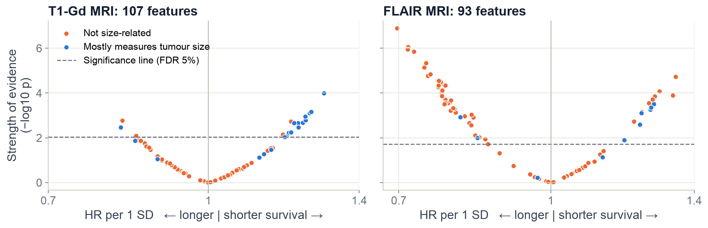
What the MRI numbers add
Most contrast-MRI features just measure size; FLAIR texture adds new information
16 of 20
26
Patchier
significant T1-Gd features are really tumour size
FLAIR features stay significant after adjusting
FLAIR texture goes with longer survival
Glioblastoma survival · CFB-GBM
20
Notes:
We tested each radiomic feature on its own. Each dot is one feature; higher means stronger evidence. Blue features mostly measure tumour size in disguise. On the contrast scan, T1-Gd, most significant features are blue: they add nothing beyond volume. On FLAIR, many orange features are significant and stay significant after adjusting for age, fitness and size. Patchier, more varied FLAIR texture went with longer survival.

Slide 21
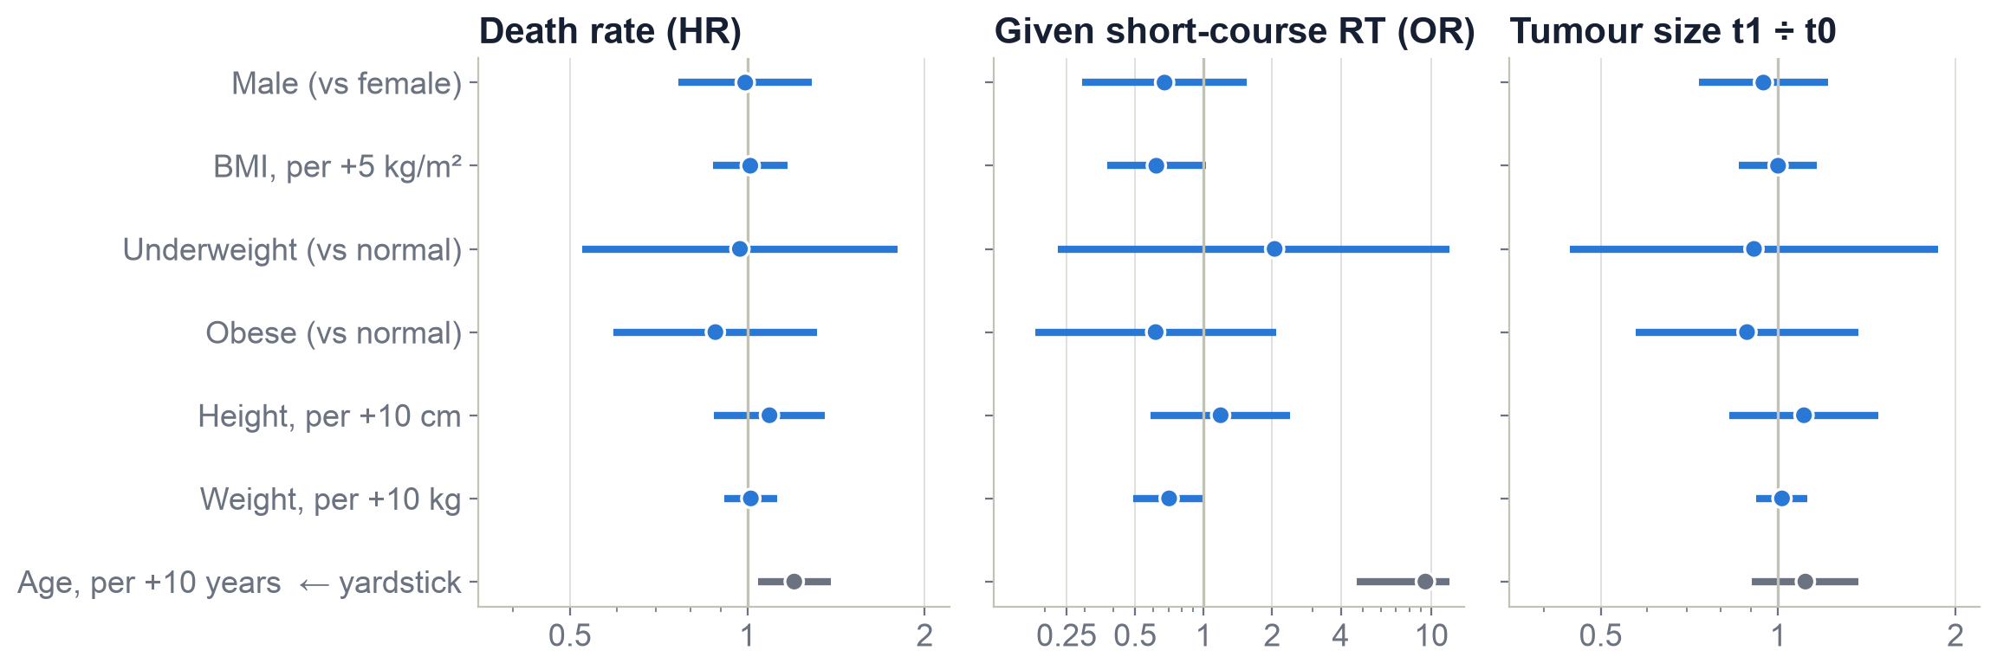
Body size and sex
Neither predicts survival, treatment choice or response; age does
Good to know: radiotherapy dose (Gy) is per kg of irradiated tissue, not of body weight, so heavier patients get the same dose.
Glioblastoma survival · CFB-GBM
21
Notes:
We checked whether body mass, height, weight or sex relate to survival, to which radiotherapy schedule patients got, and to how much the tumour shrank by the first check-up. Every interval crosses 1, so no clear effect. Age, in grey, is shown as a yardstick: it strongly predicts survival and especially the choice of the short course, about nine times the odds per decade. Note that radiotherapy dose is per kilogram of irradiated tissue, not of body weight, so a heavier patient gets the same dose.

Slide 22
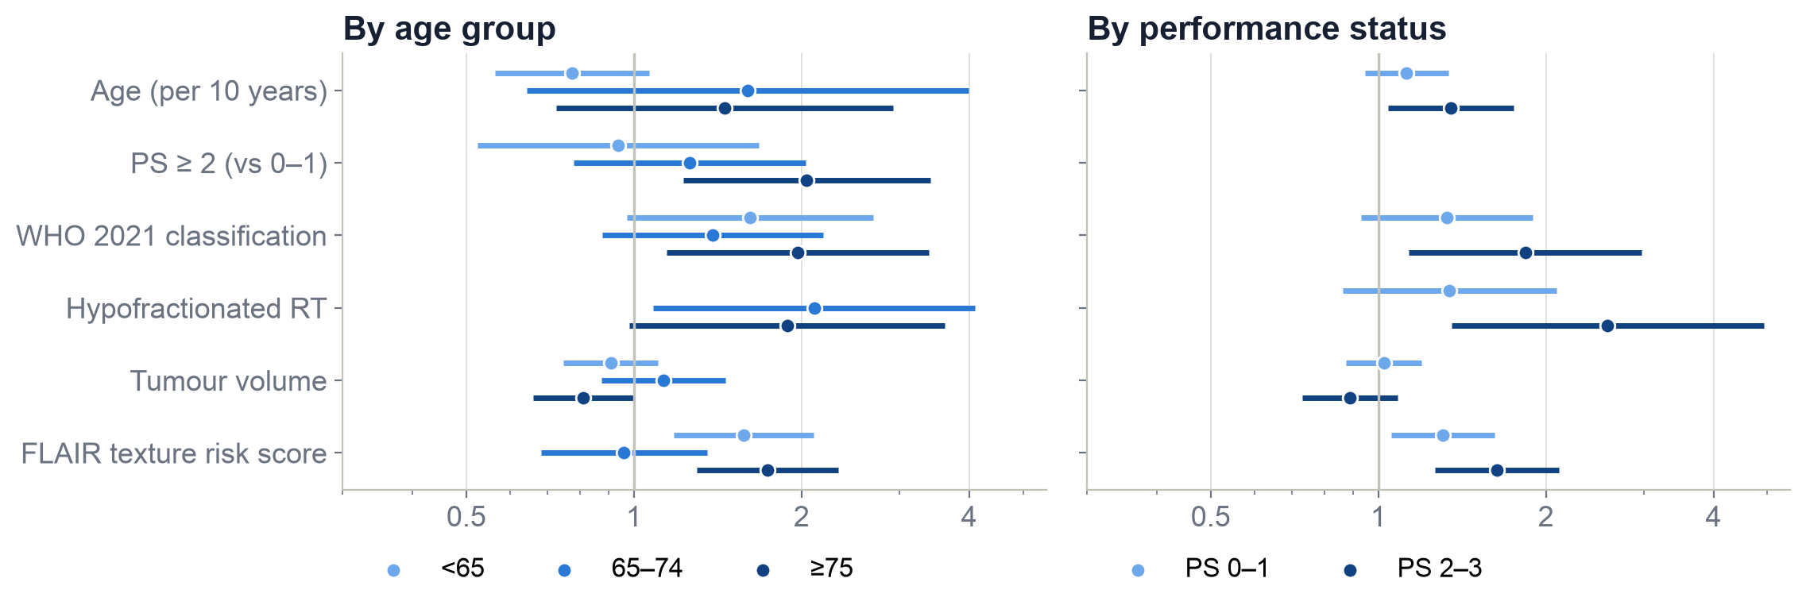
Same predictors in every subgroup?
Mostly yes: the leaders are the same in young and old, fit and frail
Same leaders
FLAIR texture and WHO edition lead in most groups
Possible difference
Fitness (PS) may matter mainly at 75+ (needs confirming)
Can't be judged
Short-course RT under 65: only 4 patients got it
Glioblastoma survival · CFB-GBM
22
Notes:
We repeated the model within age groups and within fitness groups. The leading predictors, FLAIR texture and the WHO edition, look similar everywhere. One possible difference: poor fitness seems to matter mainly in patients over 75. This was one of about eleven tests, so it needs confirming. The short-course effect can't be estimated under 65 because only four young patients received it.

Slide 23
A paradox: wait longer, live longer?
No: the sickest patients are simply treated fastest
Why
Patients started at once were mostly unwell: 75% · 30% · 22% · 23% had PS ≥ 2 (left to right)
Doctors treat the sickest patients fastest
So delay marks who the patient is, not a benefit of waiting
Glioblastoma survival · CFB-GBM
23
Notes:
Here is a trap. Patients who waited longer before radiotherapy lived longer. Does waiting help? No. Look at the labels: three quarters of the patients treated immediately were in poor shape, PS 2 or worse. Doctors start the sickest patients fastest. It is a reminder that in observational data, a treatment variable often tells you who the patient is, not what the treatment does.

Slide 24
Testing prediction models fairly
Every model is scored on patients it has never seen
Train on 4 groups, test on the 5th
C-index
Run 1
Of two patients, how often the model correctly says who lives longer. 0.5 = coin flip, 1 = perfect.
Run 2
AUC at 6, 12, 24 months
Run 3
How well it separates those who died by then from those who didn't.
Run 4
Calibration
Run 5
If the model says '40% alive at 1 year', are about 40% actually alive?
Repeated 10 times with new splits = 50 tests per model
Glioblastoma survival · CFB-GBM
24
Notes:
A model always looks good on the patients it learned from. To be fair, we used cross-validation: split patients into five groups, train on four, test on the fifth, and rotate so every patient is tested once. We repeated this ten times with different splits, giving 50 tests per model. We scored three things: the C-index, how often the model correctly says which of two patients lives longer; the AUC at 6, 12 and 24 months; and calibration, whether a predicted 40% chance really means about 40%.

Slide 25
Eleven models compared
Simple models match machine learning; adding FLAIR texture gives the best score
Takeaways
MRI numbers alone are weaker than clinical data
Machine learning didn't beat the simple model
Best: Model C (orange)
All within 0.61–0.64: the data, not the method, sets the limit
Glioblastoma survival · CFB-GBM
25
Notes:
Here are the eleven models we compared, scored on unseen patients. A model with no information scores 0.5, a coin flip. MRI numbers alone, in light blue, reach about 0.61. Clinical information does better, about 0.62 to 0.63. The machine-learning forest is no better than the simple Cox model. The best is Model C, in orange: the clinical model plus five summary scores of FLAIR texture, at 0.638. The differences are small, which tells us the limit is the information in the data, not the method.

Slide 26
Our best model: Model C
Six ingredients, one personal survival curve
0.64
1
Age
2
Fitness (PS)
as a curve
0–1, 2, 3
C-index: right in 64 of 100 patient pairs (coin flip = 50)
3
WHO edition
4
RT schedule
0.74
0.71
0.67
2016 or 2021
planned at t0
AUC at 6 months
AUC at 1 year
AUC at 2 years
5
Tumour volume
6
FLAIR texture
as a curve
5 summary scores
Clinical-only version (no MRI texture) scores 0.63: almost as good, and easier to use at the bedside.
Glioblastoma survival · CFB-GBM
26
Notes:
Our best model, Model C, combines six ingredients known at diagnosis: age, fitness, the WHO edition, the planned radiotherapy schedule, tumour volume and five summary scores of FLAIR texture. Age and volume enter as curves. On unseen patients its C-index is 0.64: it correctly says which of two patients lives longer 64 times out of 100, where a coin flip gets 50. Its AUC is 0.74 at six months, 0.71 at one year and 0.67 at two years.

Slide 27
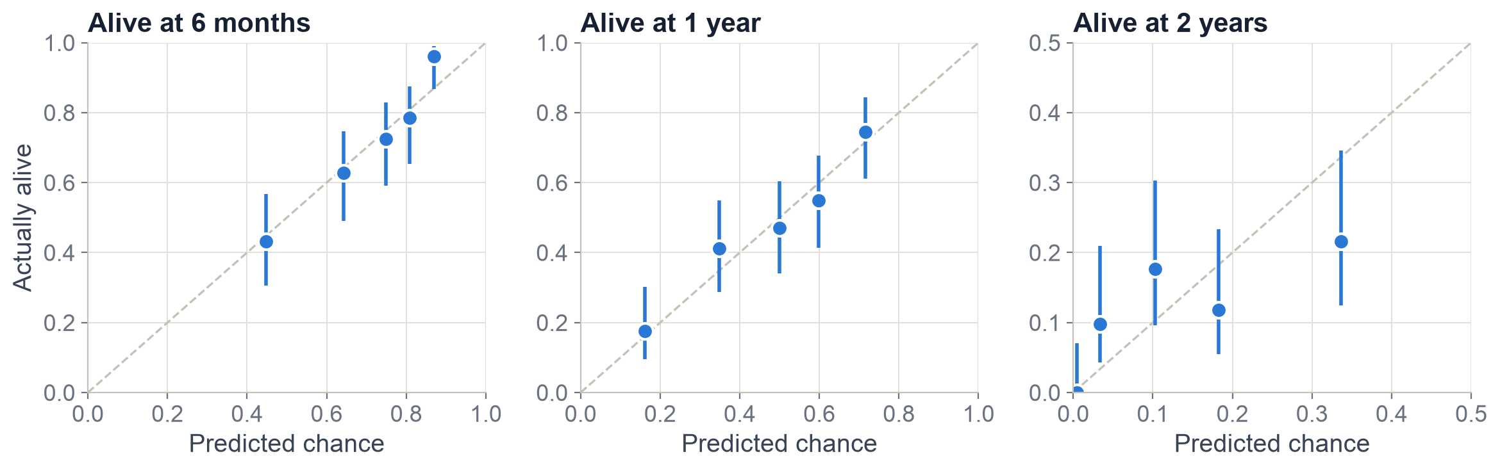
Are the predicted chances right?
Yes at 6 and 12 months; a bit optimistic at 2 years for the best cases
Each dot = one fifth of the patients. On the dashed line = predicted chance matches reality. All predictions come from models that never saw those patients.
Glioblastoma survival · CFB-GBM
27
Notes:
Calibration checks whether predicted chances match reality. We grouped patients into five groups by their predicted chance of being alive, and compared it with how many actually were. Dots on the dashed line mean perfect agreement. At six months and one year the dots sit close to the line. At two years, the best-prognosis group was predicted about one third alive, but only about one fifth were.

Slide 28
Three risk groups
Median survival 28, 50 and 63 weeks
Group | Median | Alive at 1 y
Low | 63 wk | 67%
Intermediate | 50 wk | 47%
High | 28 wk | 27%
Groups made from predictions on unseen patients, so the separation is honest
A tool to flag high-risk patients early
Glioblastoma survival · CFB-GBM
28
Notes:
Using the model's predictions on unseen patients, we split patients into three equal groups. The high-risk group had a median survival of 28 weeks and only about a quarter were alive at one year. The low-risk group had 63 weeks, with about two thirds alive at one year. This is the kind of grouping a doctor could use to spot high-risk patients early.

Slide 29
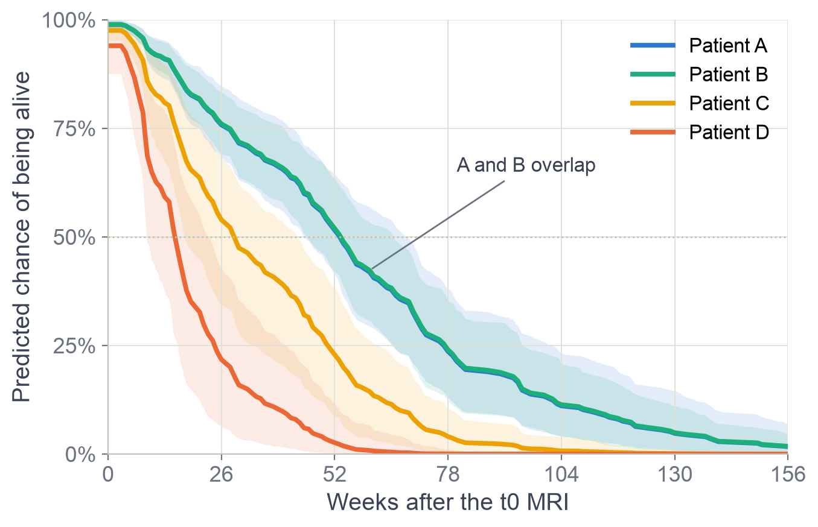
A personal prediction
Each patient gets a survival curve, not just one number
 | Profile | Median | Alive 1 y
A | 52 y, PS 0, standard RT, 20 cm³ | 54 wk | 52%
B | 64 y, PS 1, standard RT, 40 cm³ | 54 wk | 52%
C | 73 y, PS 2, short RT, 60 cm³ | 29 wk | 23%
D | 79 y, PS 3, short RT, 100 cm³ | 16 wk | 3%
Half of patients like B die between 28 and 78 weeks: individual outcomes stay uncertain
Shaded band = uncertainty of the model itself
Glioblastoma survival · CFB-GBM
29
Notes:
Here are four made-up patients run through the model. Each gets a full survival curve with an uncertainty band. Patient D, 79 years old, bedbound half the day, with a large tumour, has a predicted median of about 15 weeks. Patients A and B overlap: in this data, being under 65, PS 0 versus 1, and a 20 versus 40 cubic centimetre tumour make little difference. Even for one profile, outcomes vary widely: half of patients like B die between about 28 and 78 weeks.

Slide 30
The stratified variant
Same weights for everyone, a different starting curve per age group
One model (Model C)
Stratified by age
Separate models
1 starting curve
3 starting curves
3 starting curves
1 set of weights
1 set of weights
3 sets of weights
0.638
0.645
0.603
C-index on unseen patients
C-index on unseen patients
C-index on unseen patients
Verdict: the stratified version was better in 76% of tests, but only slightly. Separate models overfit (≈ 85 patients each). We keep Model C.
Glioblastoma survival · CFB-GBM
30
Notes:
We also tried stratified models. In the usual model everyone shares one starting survival curve and one set of weights. In the stratified model, each age group gets its own starting curve, but the weights stay the same for everyone. In separate models, each group gets its own curve and its own weights. Separate models did worst, because each learns from only about 85 patients. The stratified model was slightly better than Model C, 0.645 versus 0.638, in 76% of tests. It's promising but small, so we keep Model C as our main model.

Slide 31
Limitations
Useful for ranking patients, not yet for clinical decisions
!
One hospital
!
Key markers missing
!
Not randomized
No test yet on patients from other hospitals
MGMT, IDH and extent of surgery are not in the data
Treatment effects are associations, not causes
!
Modest accuracy
!
MRI numbers are fragile
!
Small subgroups
C-index 0.64; one patient's survival stays very uncertain
They depend on scanner and image processing
About 85 patients each; subgroup findings need confirming
Glioblastoma survival · CFB-GBM
31
Notes:
Some honest limits. All patients come from one hospital, and we have not tested the model on other hospitals. The strongest known markers, MGMT, IDH and how much tumour the surgeon removed, are not in the data. Treatment was not randomized. Accuracy is modest, and one patient's survival stays very uncertain. Radiomic numbers depend on the scanner and processing. And subgroup results are based on small groups.

Slide 32
Take-home messages
1
Who lives longer
Younger, fitter patients with smaller tumours; FLAIR texture adds information beyond size
2
What doesn't matter
Body size and sex; treatment differences reflect who gets treated
3
Best model
Model C: a personal survival curve, right in 64 of 100 patient pairs
4
Next steps
Add MGMT/IDH, update at the first check-up, test on other hospitals
Notes:
To sum up. Younger age, better fitness, smaller tumours and the 2021 diagnosis edition are the strongest predictors, and MRI texture on FLAIR adds information beyond tumour size. Body size and sex don't matter. Our best model gives each patient a survival curve and ranks patients correctly about 64% of the time, which is typical for this disease without molecular markers. Next steps: add MGMT and IDH, use the first check-up scan to update predictions, and test on other hospitals. Thank you.

Slide 33
Glossary
Term | Meaning
Hazard ratio (HR) | How much faster one group dies than another. 2 = twice the rate (shorter survival); 0.5 = half
95% confidence interval | Range of plausible values. If it includes 1, there is no clear effect
Kaplan–Meier curve | Share of patients still alive over time; each step down is a death
Cox regression | Model that estimates hazard ratios of several factors at once, each adjusted for the others
Performance status (PS) | Fitness score from 0 (fully active) to 4 (bedbound)
T1-Gd / FLAIR | MRI types: contrast-enhanced (active tumour bright) / fluid-dark (swelling bright)
Radiomics | Numbers computed from MRI images: shape, brightness and texture of the tumour
RANO | Rules for judging tumour response on follow-up MRI
C-index | How often the model correctly says which of two patients lives longer (0.5 = coin flip)
Cross-validation | Train on part of the patients, test on the rest, rotate; gives an honest score
Confounding by indication | A treatment looks harmful because it is given to sicker patients
Glioblastoma survival · CFB-GBM
33
Notes:
Reference slide with the key terms used in the presentation.

