Slide 1
GROUP 1
HI!PARIS DATA CAMP

Slide 2




GROUP 1
French
Army
IPP M2 Data Science
French/Brazilian
HEC
Msc SASI
Indian
HEC MBA
French
Army
IPP M2 Data Science
Dimitri (38)
Pedro (22)
Roshima (33)
Tristan (37)

Slide 3
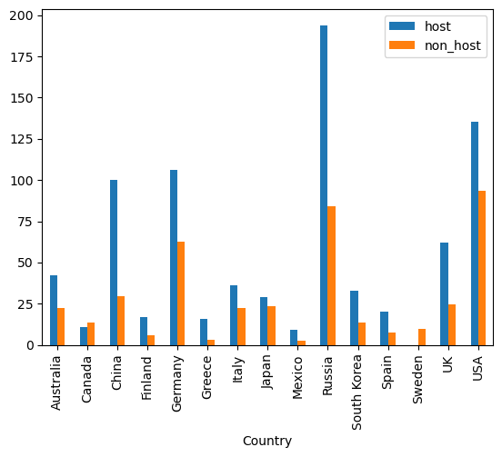
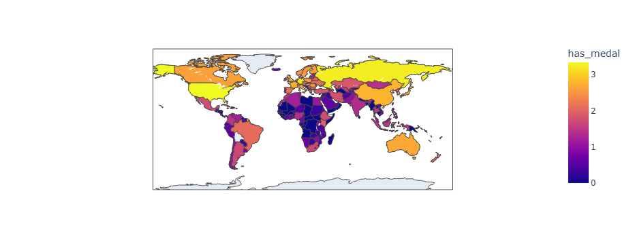

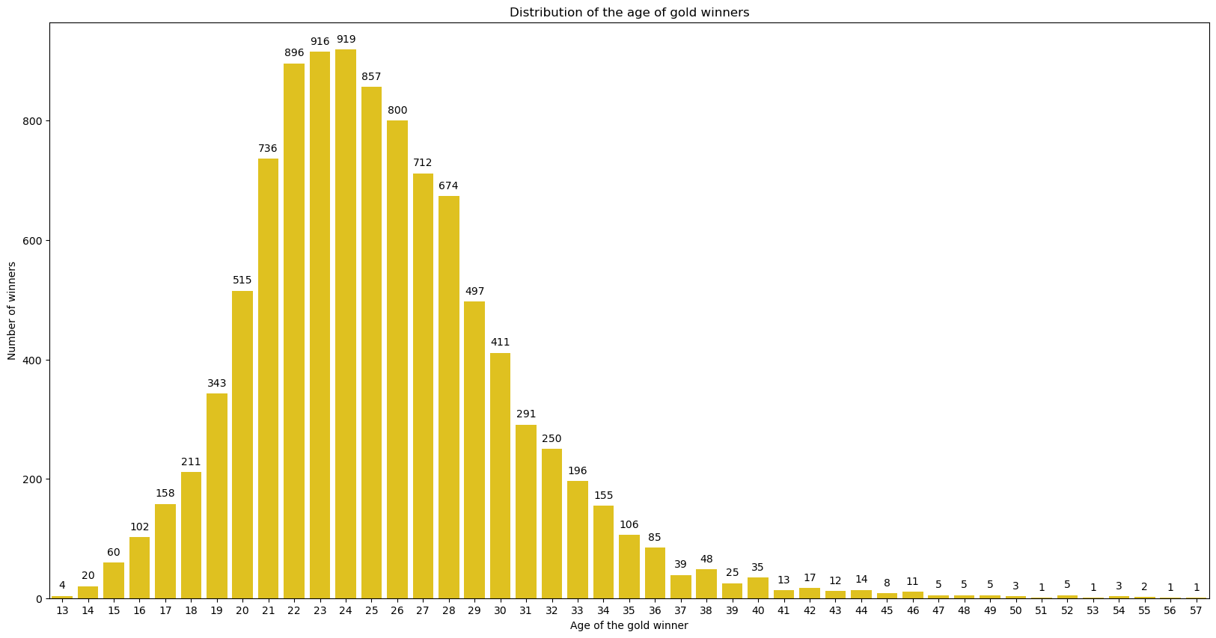
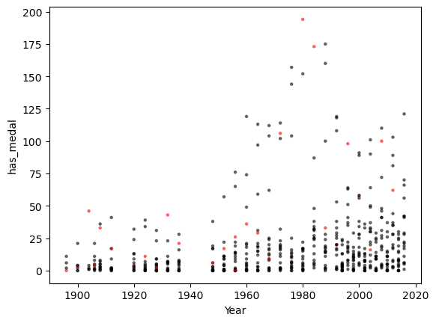
OLYMPICS DATASET
As expected, athletes between 20 and 30 have the highest chances of securing gold.
This can probably be attributed to the ideal combination of experience, training and youthful physical prowess during this stage of their careers.
Notes:
interesting patterns/trends you found regarding the performance of athlete/countries during the Olympics

Slide 4
OLYMPICS DATASET
Hosting the Olympic Games significantly enhances the chances of local athletes winning medals.
However it doesn't necessarily guarantee finishing at the top of the medal table.
This trend could be attributed to two main factors:
athletes competing on home soil benefit from the strong support of local fans;
host countries are likely to invest heavily in its sports programs and present more athletes.
Notes:
interesting patterns/trends you found regarding the performance of athlete/countries during the Olympics

Slide 5
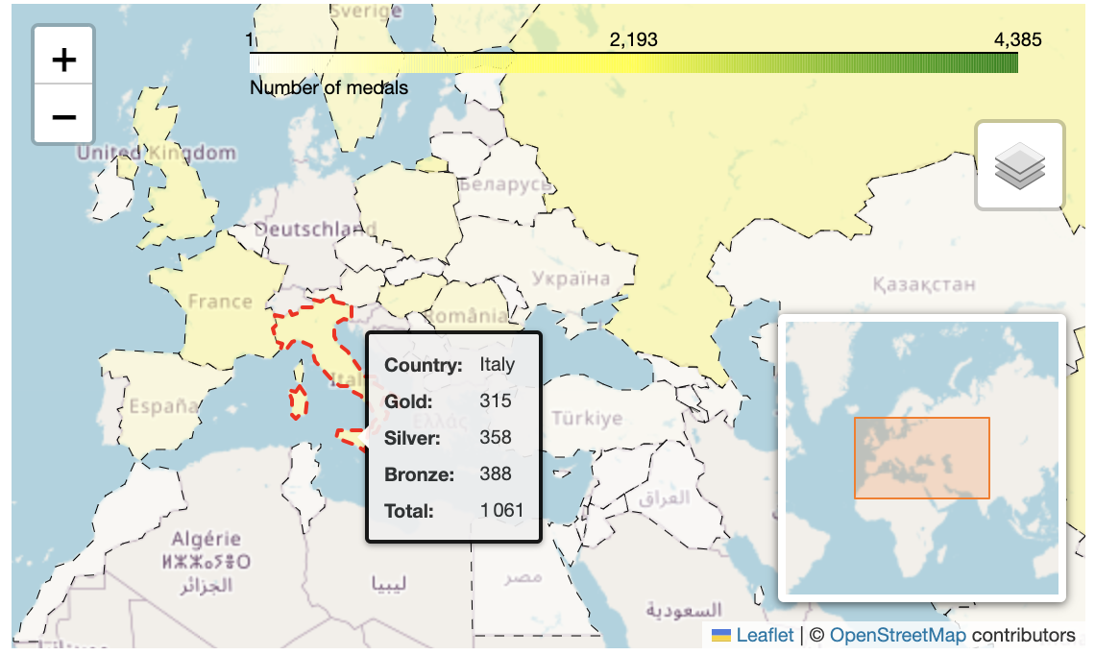
OLYMPICS DATASET
Countries with higher GDP tend to perform better in the Olympics, especially in medal counts, as they can invest more in sports and athlete support.
2,193 medals
0
Notes:
interesting patterns/trends you found regarding the performance of athlete/countries during the Olympics

Slide 6
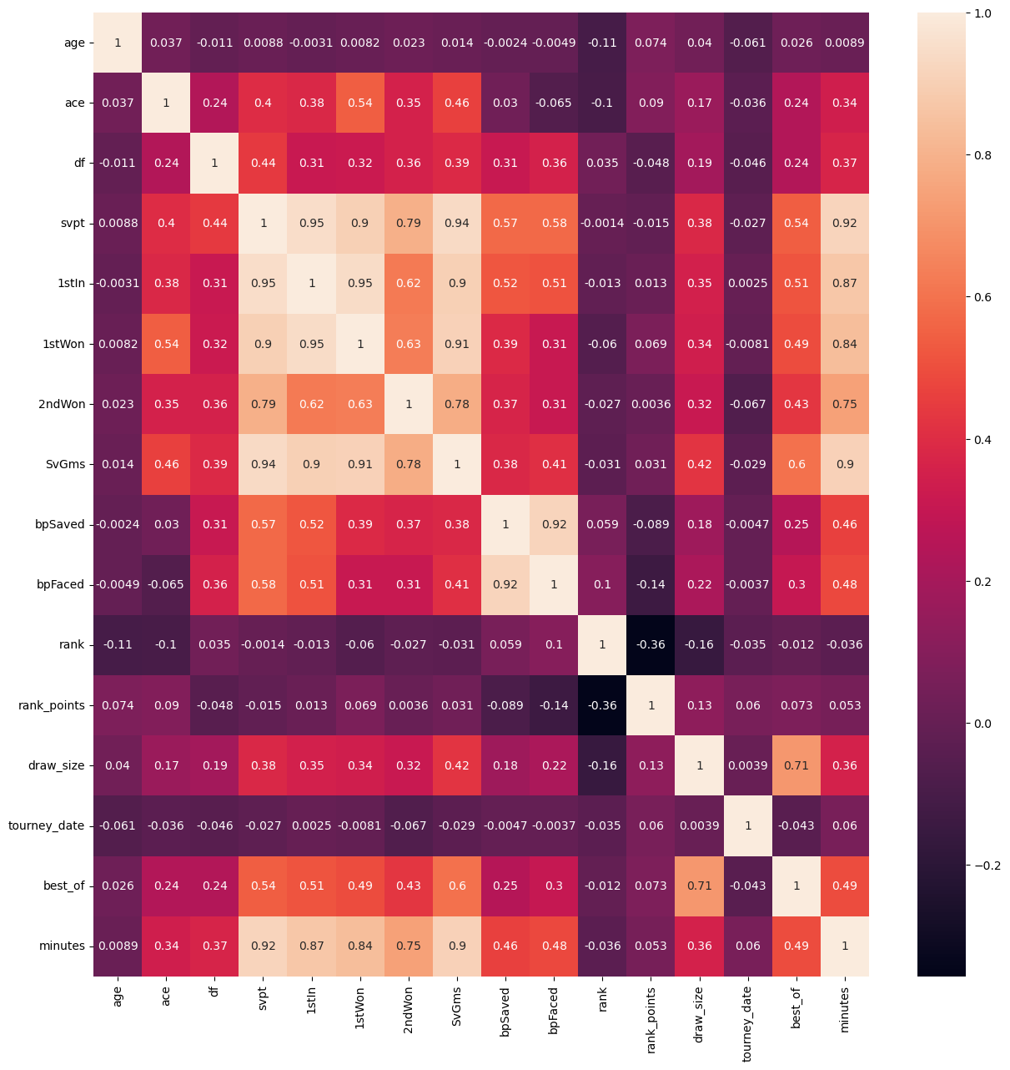
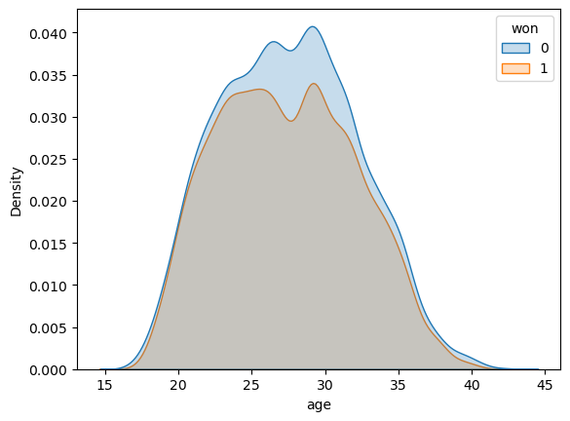
TENNIS DATASET EXPLORATION
Facts:
This dataset contains ~30,000 rows of clean, non-null data divided in 4 categorical variables and 16 continuous variables about matches of tennis players.
The target is the column `won`, which indicates if the player has won the match or not.
We did not find a variable that can explain the target alone. e.g. the age of the player is evenly distributed for both winners and losers. Age distribution →
Conclusions:
The dataset is more and less evenly distributed between won (1300 matches = 47%) and loss (14893 = 53%). We can use it without a bias in a ML process.
The variables `svpt`, `1stIn`, `1stWon`, `SvGms`and `minutes`are highly correlated, more than 90% and may decrease the efficiency of our model.
Correlation matrix of continuous variables: clear cells represent highly correlated variables.
Notes:
describe your approach in predicting the performance of a tennis player: Data exploration & viz >> Data Preprocessing >> Model building and optimization (include Deep Learning if done)

Slide 7
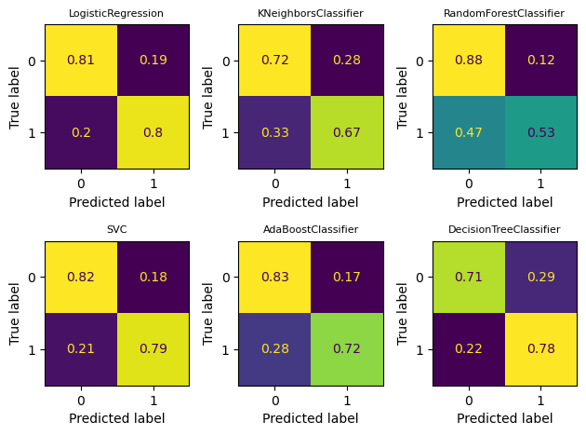
TENNIS PREDICTION
Machine learning process
Split the dataset into a train and test set (‘won’ as the target variable)
A new dataframe was built using the feature names created using OneHotEncoder
A dataframe was built from the scaled continuous variables
Merged OneHotEncoded and scaled variables to create the Preprocessed dataset
6 differents models were fitted on this training set
The test set for each model was predicted, and then the accuracy and F1-score for each model was calculated
The confusion matrix and the results shows that Logistic Regression model had the highest accuracy and F1 score out of the 6 models selected
Even a latter GridSearch on a XGBoost to find and tune the best hyperparameters did not manage to reach the results of Logistic Regression.
Best:
<class 'sklearn.linear_model._logistic.LogisticRegression'>
accuracy: 0.805
f1_score: 0.791
hypertuned XGBoost:
<xgboost.sklearn.XGBClassifier with GRidSearchCV>
Fitting 3 folds for each of 27 candidates, totalling 81 fits
Best parameters: {'max_depth': 3, 'max_leaves': 0, 'n_estimators': 200}
Accuracy Score (Test): 0.8023
F1 Score (Test): 0.7852
Notes:
ustify your content/scientific approach in predicting tennis performance: decision made, model chosen, optimization realized.

Slide 8

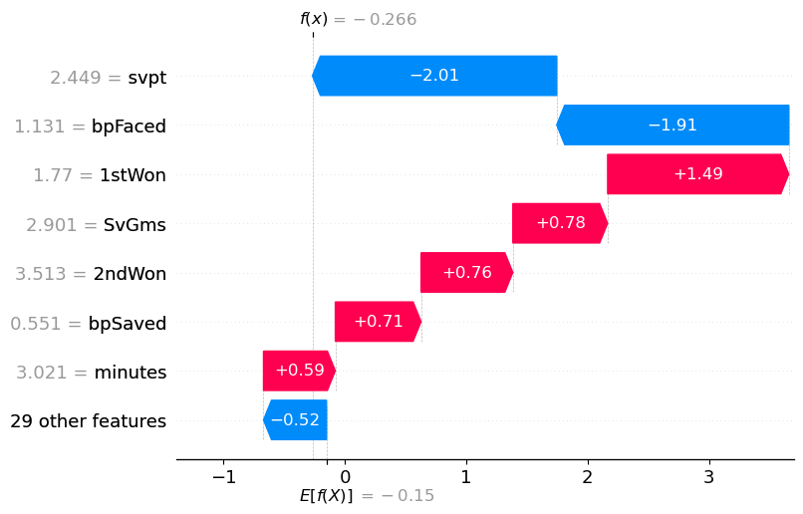

TENNIS MODEL PERFORMANCE
Explainability
Machine Learning
`shap` module, give insight of the importance of variables: `svpt`, `bpFaced` and `1stWon` have the most impact on the prediction. Other features have a very small impact.
Keras.Sequential 3 layer model
model = Sequential([
Dense(32, activation="relu"), # Input
Dense(16, activation="relu"), # Hidden
Dense(1, activation="sigmoid"), # Output])
model.compile(
optimizer=Adam(), loss=tf.keras.losses.BinaryCrossentropy(), metrics=["accuracy"])
Trained on 20 epochs
Epoch 20/20
698/698 ━━━━━━━━━━━━━━━━━━━━ 1s 777us/step - accuracy: 0.8203 - loss: 0.3609
175/175 ━━━━━━━━━━━━━━━━━━━━ 0s 606us/step - accuracy: 0.8025 - loss: 0.3791
Model performances: loss=0.392 accuracy=0.801
Reached accuracy of 0.80 !!!
⇒ A new LogisticRegression model, trained with only the 7 most important features get around the same results that the one using the 36 initial features. This model will be lighter and quicker for real life use.
accuracy= 0.801
f1_score= 0.788
In the real world :
The more first serves in made by a player, the more chances of winning a match. In fact, a first serve in gives the player the chance to dictate the point and win it. High percentage of first serve is key to victory in tennis.
The more break points a player faces, the more likely they are to lose their serve, which in turn increases their chances of losing the match.
On the contrary the variables about the surface or the trourney have a very thin impact on the model. Of course, there are exceptions, such as Rafael Nadal, whose performance is significantly influenced by the playing surface, particularly clay and Roland Garros, where he excels.
Notes:
present your conclusions regarding predicting tennis performance. (You can also include Model Explainability if done)

