Slide 1




World Earthquake Forecaster
Project Final Report
Team 3
Patrick Waddell 001058235
Rajendra kumar Rajkumar 001405755

Slide 2







Overview
Using publicly available data from the U.S. Geological Survey, create a tool to lookup historical data and forecast earthquakes. The tool will include a 10 year historical lookback and provide an interface with Google Maps to provide visualization of the information.

Slide 3

Use Cases
1) Historical Lookup
A user enters latitude/longitude/radius and is provided with a Google Map / pins indicating earthquake events.
2) Earthquake Forecast
A user enters an address and is provided with a percentage chance earthquakes at each magnitude.
3) Top 10 Earthquake Hot Spots
A user enters a date range and is provided with the top ten locations around the globe for earthquake activity.

Slide 4


Methodology
Data Processing
Parsed the data stored in csv files by year
Scaled processing of the data with parallelization through Spark
Multiple Linear Regression
Used multiple linear regression to determine earthquake magnitude at a user provided position
Graphical User Interface
Scala Play Framework
Integrated with Google Maps API for visualization of results

Slide 5
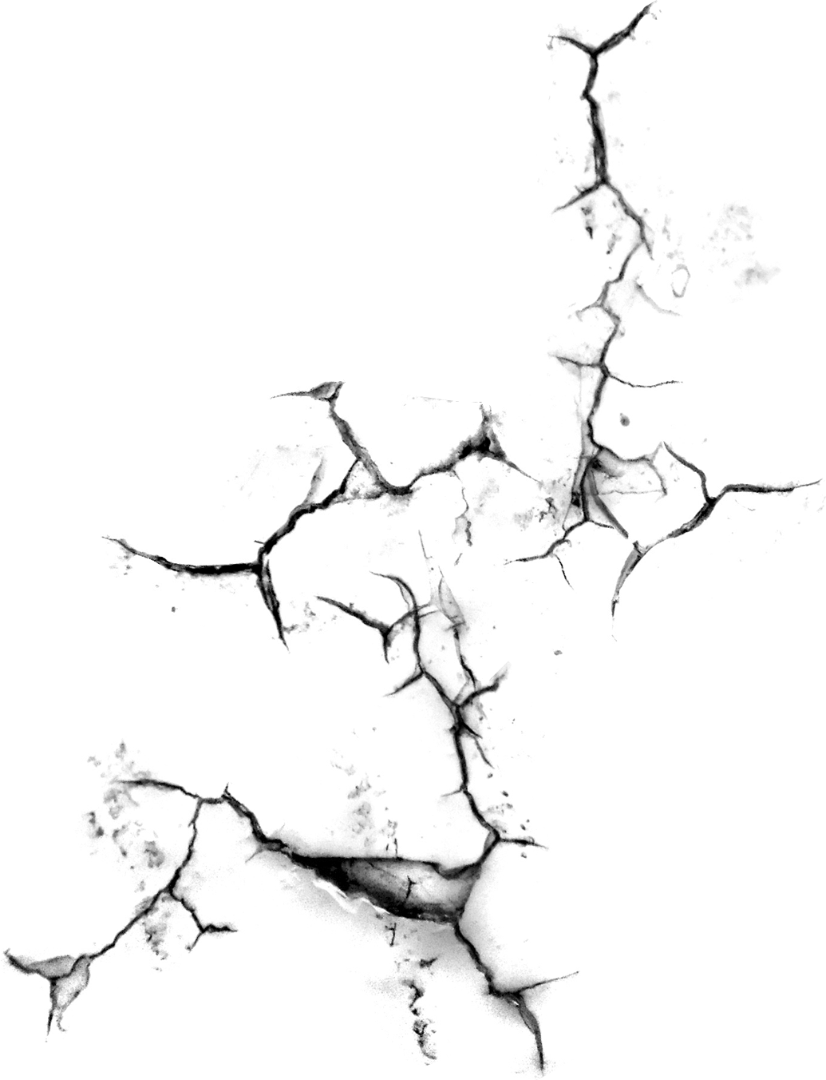

Acceptance Criteria #1
Level 1 Criteria
The System response time for displaying output data should be within 5 seconds
Criteria not met
Response times unknown during planning
Overhead of Spark & Scala Play Framework
Limited by processing power of laptop
Parallelization with Spark could be expanded from a single machine to a distributed cloud

Slide 6
Acceptance Criteria #2
Level 2 Criteria
The R-squared value of the machine learning model should be greater than 0.6
Criteria not met
Achieved an R-squared value of +0.51
Earthquakes aren’t easy to predict!

Slide 7
Acceptance Criteria
Level 3 Criteria
The World Earthquake Forecaster tool will utilize a minimum of 10 years of historical data (approx. 1.2 million rows)
The project uses 11 years of historical data from the USGS site
Approx. 952,000 rows were initially used (1.0+ magnitude)
Scaled back to 292,000 rows (2.5+ magnitude) to improve timing performance

Slide 8

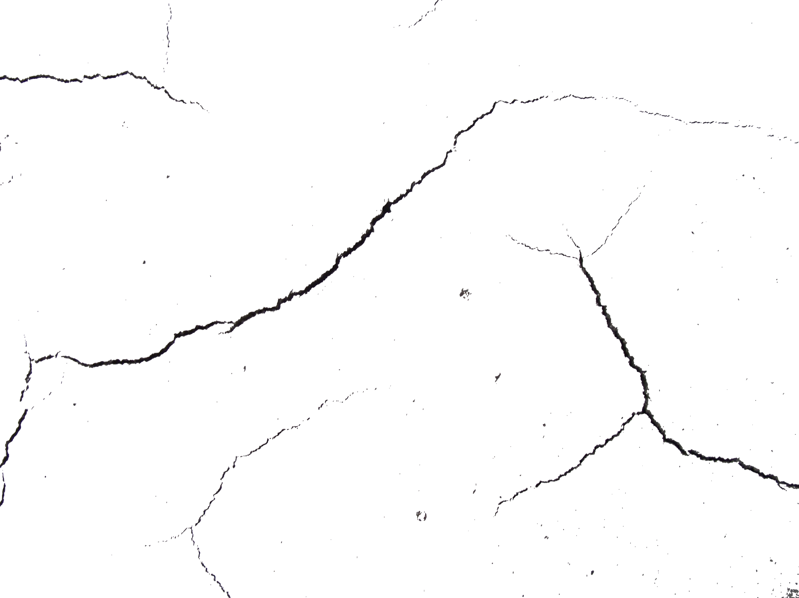
Project Achievements
All objective use cases met
Completed entirely within Scala
UI initially planned with Java
Integrated with Google Maps API
Custom maps
Pins with contextual data
Scala Play UI
All user input forms contain field validation and error feedback
Source code restricted for Scala Play MVC structure
27 Unit Tests

Slide 9

Live Demonstration

