Slide 1




World Earthquake Forecaster
Project Plan
Team 3
Patrick Waddell 001058235
Rajendra kumar Rajkumar 001405755

Slide 2







Overview
Using publicly available data from the U.S. Geological Survey, create a tool to lookup historical data and forecast earthquakes. The tool will include a 10 year historical lookback and provide an interface with Google Maps to provide visualization of the information.

Slide 3

Use Cases
1) Historical Lookup
A user enters latitude/longitude/radius and is provided with a Google Map / pins indicating earthquake events.
2) Earthquake Forecast
A user enters an address and is provided with a percentage chance earthquakes at each magnitude.
3) Top 10 Earthquake Hot Spots
A user enters a date range and is provided with the top ten locations around the globe for earthquake activity.

Slide 4


Methodology
Data Processing
Parse the data sets in monthly increments
Scale up data set processing through Futures and Akka Actors
Multiple Linear Regression
Use multiple linear regression to determine likelihood of earthquake at a given magnitude for a user provided position
Graphical User Interface
Integrate with Google Maps API to provide visualization of the results

Slide 5

Data Resources
USGS – U.S. Geological Survey
Data sets available through multiple formats
xml, json, csv
Data sets include:
Latitude, longitude, magnitude, depth, geographical region, timestamp
~10,000 rows of data (+1..0 magnitude) per month ~120,000 rows of data per year ~1.2 million rows of data per decade
https://earthquake.usgs.gov/earthquakes/search/

Slide 6








Milestones
Week 1
Parse limited data set
Week 3
Expand data set parsing
(Futures/Akka Actors)
Week 4
Google Maps API and UI
Week 2
Functional composition

Slide 7



Program Details
Code language and Framework
Scala
Java
Google Maps API
GitHub Repository
https://github.com/waddellp/CSYE7200_PROJECT

Slide 8
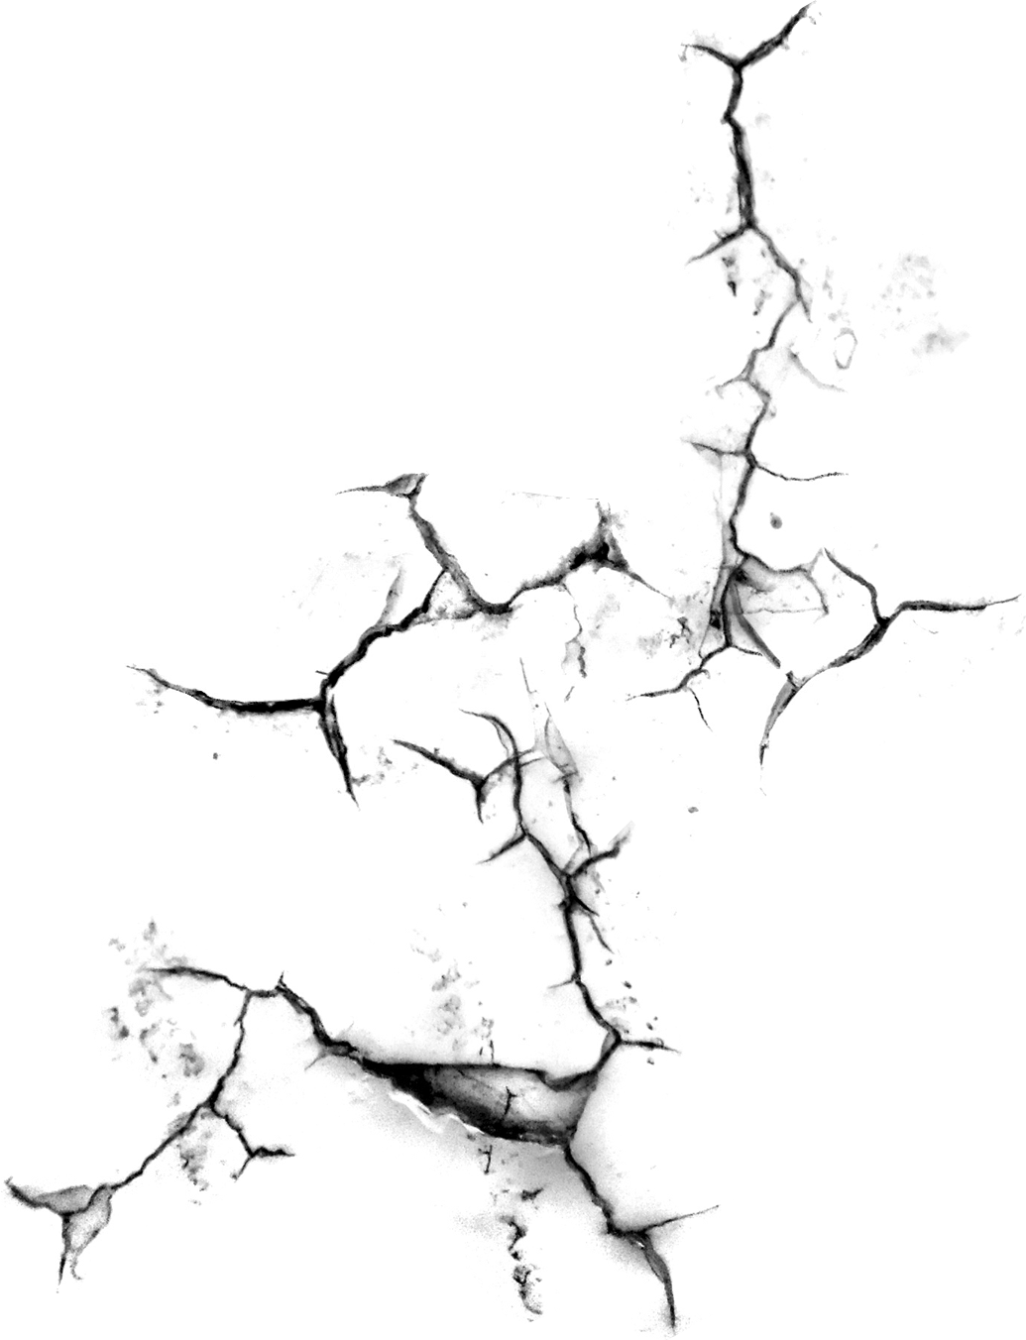

Acceptance Criteria
Acceptance criteria text
A) Level 1 Criteria
The System response time for displaying output data should be within 5 seconds
B) Level 2 Criteria
The R-squared value of the machine learning model should be greater than 0.6
C) Level 3 Criteria
The World Earthquake Forecaster tool will utilize a minimum of 10 years of historical data (approx. 1.2 million rows)

Slide 9

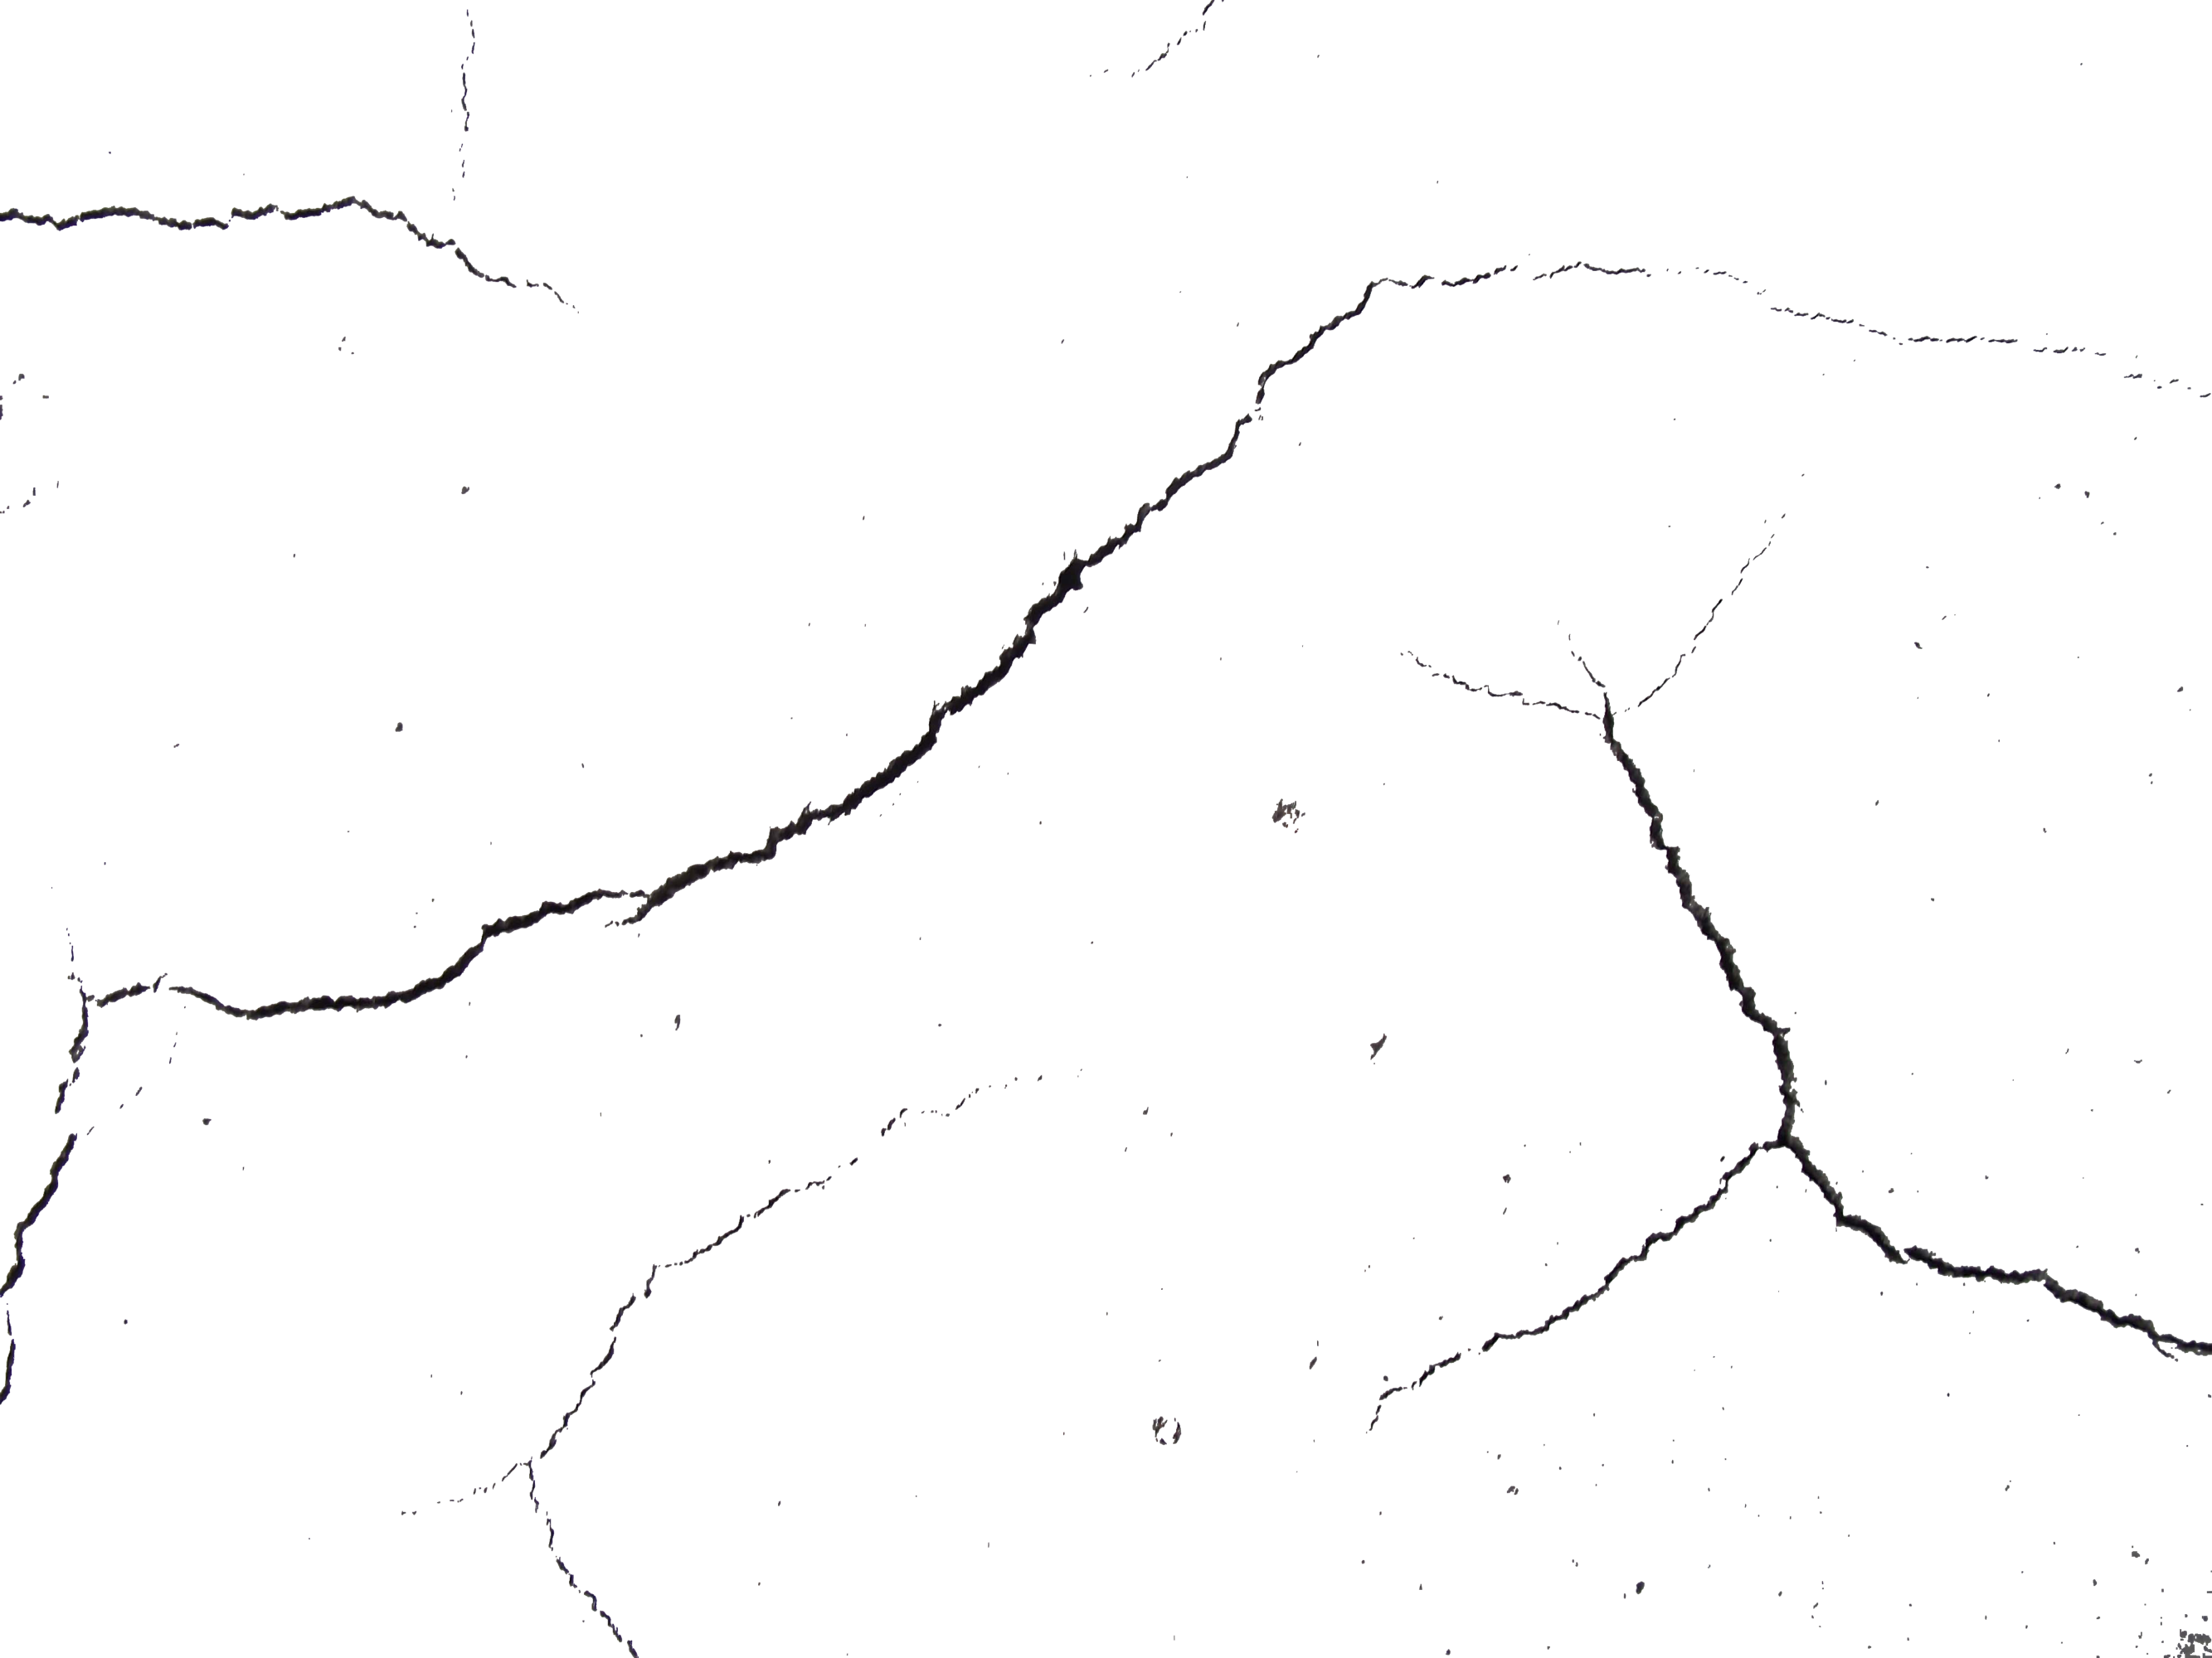
Goals
1) To build an user friendly system, which offers historical information about earthquakes in any location based on user input, thereby acting as ‘Seismic Saviour’ for users during decision making
2) To build a machine learning model which trains on historical earthquake information and accurately predicts the percentage chance of an earthquake occurrence at an user given location
3) To interactively display the places of earthquake occurrence from the system output using Google Maps

Slide 10

Thank You

