Slide 1


Slide 2
NetBeans 7.0
Name
Title

Slide 3
The following is intended to outline our general product direction. It is intended for information purposes only, and may not be incorporated into any contract. It is not a commitment to deliver any material, code, or functionality, and should not be relied upon in making purchasing decisions.
The development, release, and timing of any features or functionality described for Oracle’s products remains at the sole discretion of Oracle.

Slide 4
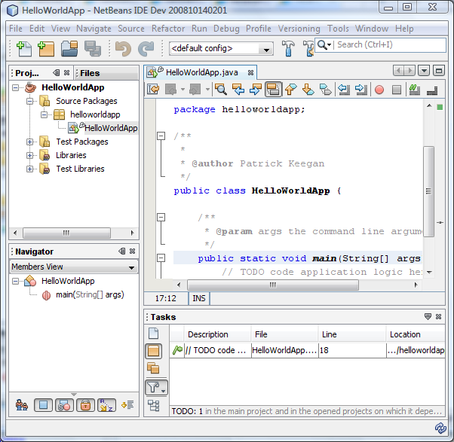
What is NetBeans?
A comprehensive, modular
IDE
  Support for Java
  Other languages too (PHP,
  C/C++, Groovy, etc.)
  Intuitive workflow
  Debugger, Profiler,
  Refactoring, etc.
  Binaries for Solaris, Linux,
  Microsoft Windows,
  and Mac OS X
Simply download and run on
any OS with a JDK!

Slide 5

What is NetBeans?
What applications can I create?
Build
rich applications
Using these
languages
Web
Desktop
Mobile
Enterprise
Java
PHP
Groovy
JavaScript
C/C++
Community support for Python, Scala, Ruby

Slide 6
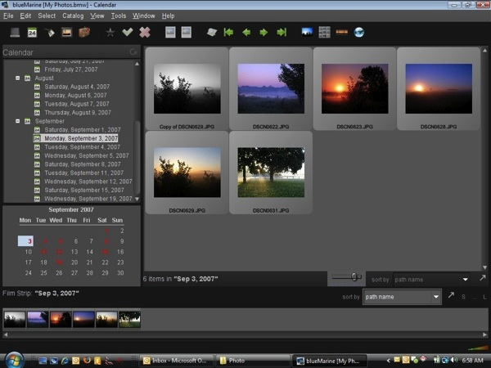
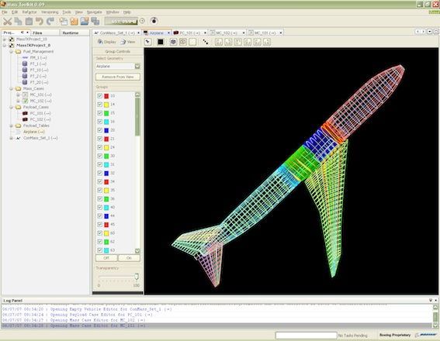
What is NetBeans?
A framework for building desktop applications
  Modular architecture allows easy reuse
  Rich framework of windows, dialogs, menus, tool bars

Slide 7
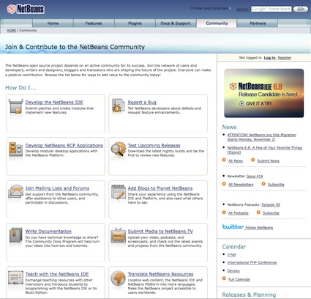
What is NetBeans?
A thriving open source
community
  Growing list of 3rd party
  modules (plug-ins)
  Over 20 Million Downloads
  Active blogging community:
  http://planetnetbeans.org
  Available in many languages

Slide 8
Why use NetBeans?
Increase Development Productivity
Works Out-of-the-Box
Freely Available
Open Source
Support for Java standards and Platforms
Extensible Java Desktop Framework
Powerful & Award Winning GUI Builder
Profiling & Debugging Tools
Ant & Maven Based Projects
Customizable Projects

Slide 9
New in NetBeans IDE 7.0
Support for:
  Proposed JDK 7 Language Enhancements
  GlassFish 3.1
  WebLogic
  HTML 5
PHP Enhancements
Maven 3 supported and bundled
New GridBagLayout Designer
Git version control support (available on Update Center)
And More

Slide 10
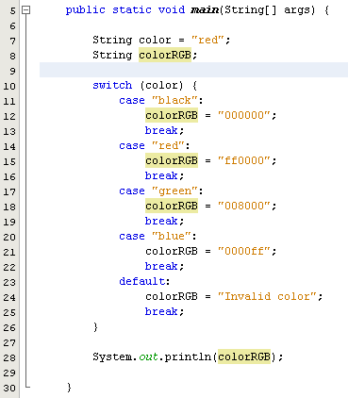
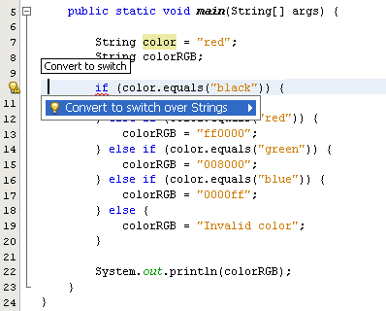
Support for Proposed JDK 7 Language Features
Strings in Switch. The String data type is available in Switch statements.

Slide 11
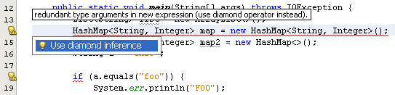
Support for Proposed JDK 7 Language Features
Diamond.
  More compact code
  More readable code
  Saves repeated type arguments.

Slide 12
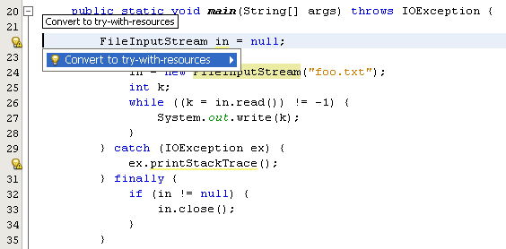
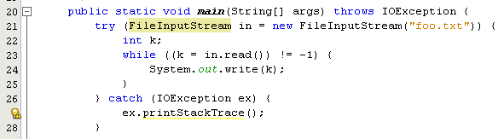
Support for Proposed JDK 7 Language Features
Try-with-resources. Correctly and robustly manage resources that otherwise need to be explicitly closed.

Slide 13
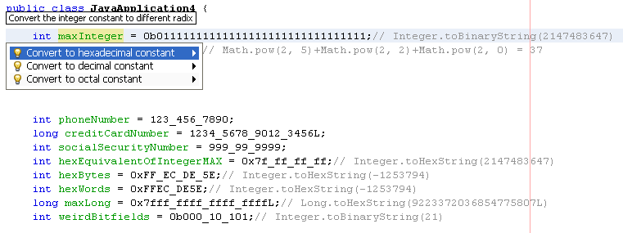
Support for Proposed JDK 7 Language Features
Integer Literals & Underscores. Binary integer literals in addition to octal, decimal, and hexadecimal literals.

Slide 14
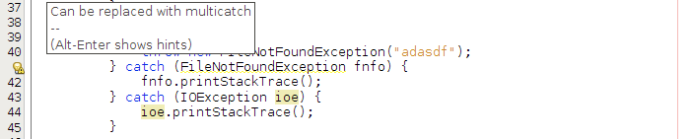

Support for Proposed JDK 7 Language Features
Multicatch Variable Declaration. Join multiple catch statements into a single multicatch.

Slide 15
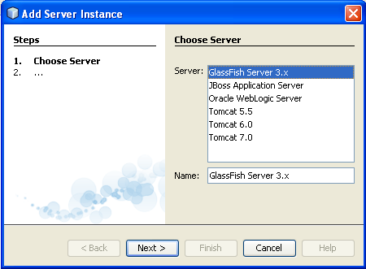
Support for GlassFish v 3.1
Register latest
GlassFish release
Restart & debug
remote instances
View remote instance
log files
Enable/disable deployed applications

Slide 16
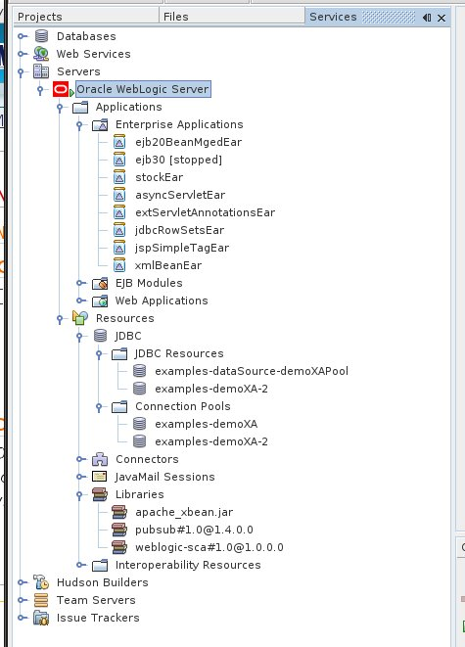
Support for Oracle WebLogic
Directory based
deployment
Deploy on save
Brand new node
displaying deployed apps
JSF integration
Datasource creation
& deployment

Slide 17
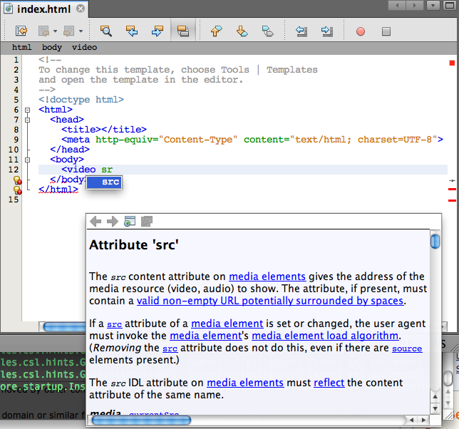
New HTML 5 Editor
Code
completion
Syntax
coloring
Validation
Doc & Help

Slide 18
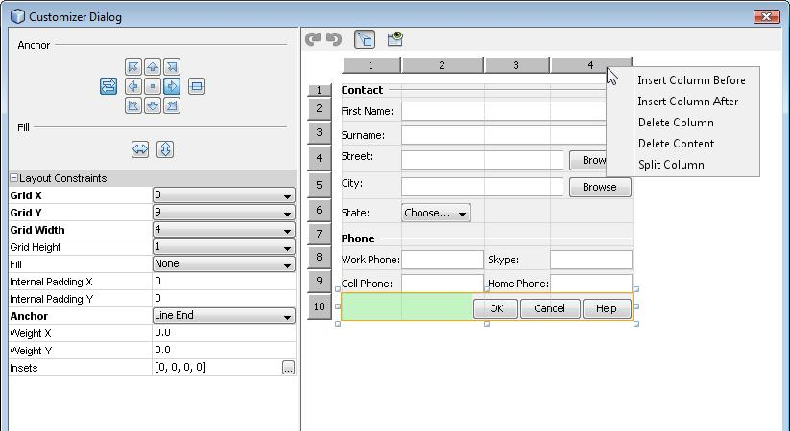
New GridBagLayout Designer
Point-and-click
realignment
Drag-and-drop
repositioning
Smooth, easy,
intuitive
No need to know GridBagLayout anymore

Slide 19
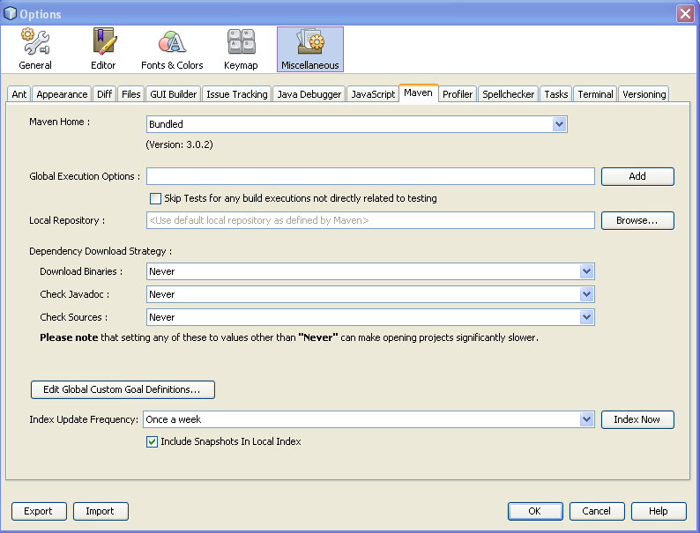
Apache Maven 3
Bundled
support for
latest Maven
Built-in
archetype
support
Export settings
Many fixes,
enhancements, and performance improvements

Slide 20
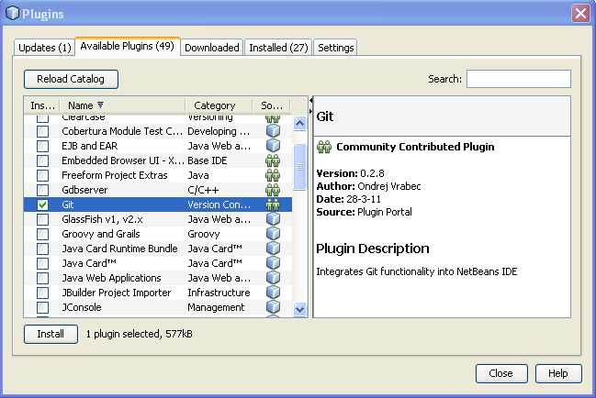
Git in Plugin Manager

Slide 21
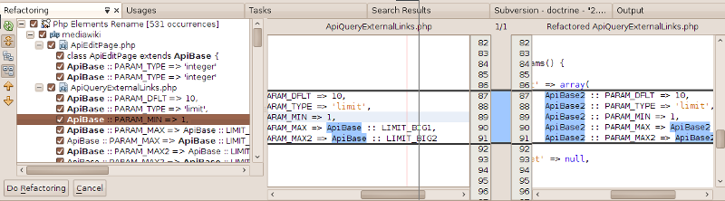
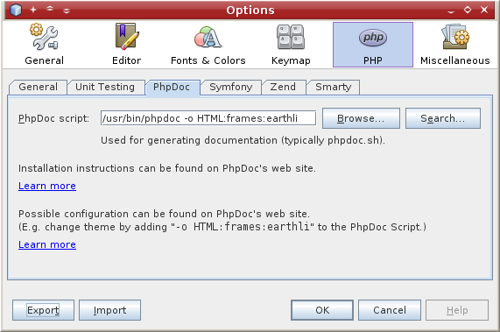
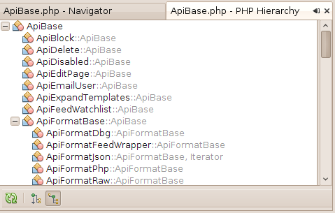
PHP Editor Enhancements

Slide 22
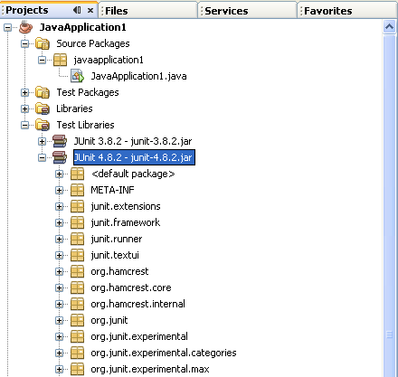
JUnit 4.8.2

Slide 23
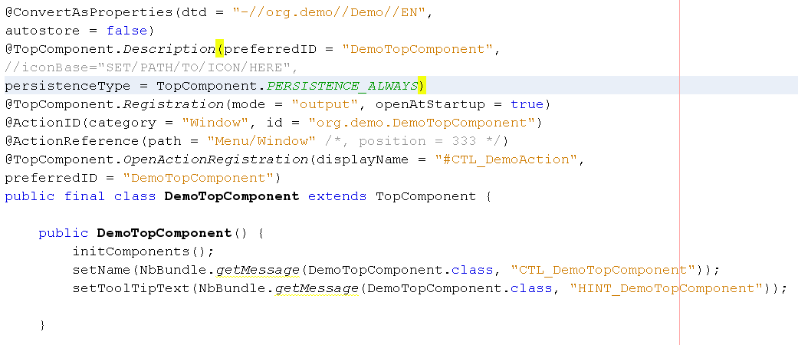
Annotations for Simplified Registration in NetBeans Plugins

Slide 24
Next Steps
Download NetBeans IDE
Create a user account
Participate in the NetBeans community
  Mailing lists
  Forums
Blog about NetBeans (share your experiences)
Resources:
  NetBeans product site: http://netbeans.org
  NetBeans wiki: http://wiki.netbeans.org
  NetBeans blog aggregation: http://planetnetbeans.org

Slide 25

Thank You!

