Slide 1


Slide 2

What's New in NetBeans IDE 7.1
Name
Title

Slide 3
The following is intended to outline our general product direction. It is intended for information purposes only, and may not be incorporated into any contract. It is not a commitment to deliver any material, code, or functionality, and should not be relied upon in making purchasing decisions.
The development, release, and timing of any features or functionality described for Oracle’s products remains at the sole discretion of Oracle.

Slide 4
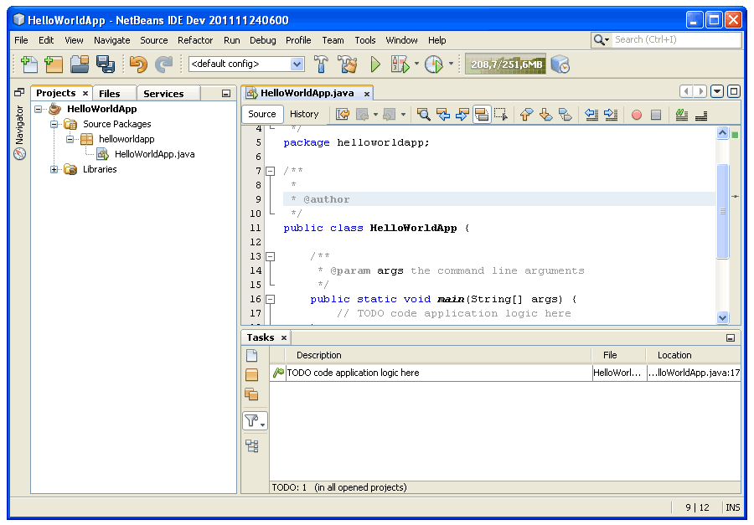
What is NetBeans?
A comprehensive, modular IDE
  Ready to use out of the box
  Support for latest Java
  specifications
  & standards
  Other languages too
  (PHP, C/C++, etc)
  Intuitive workflow
  Debugger, Profiler,
  Refactoring, etc.
  Binaries & ZIPs for
  Solaris, Linux, Windows, Mac
Simply download and run on
any OS with a JDK!

Slide 5

What is NetBeans?

Slide 6

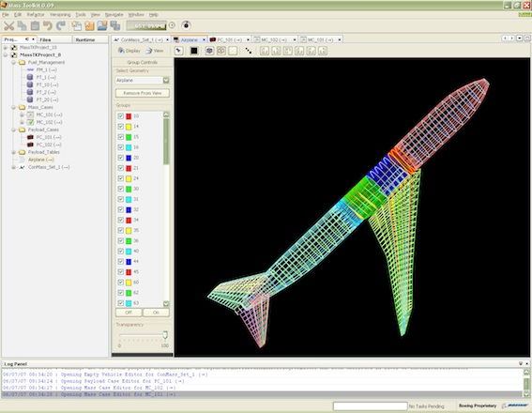
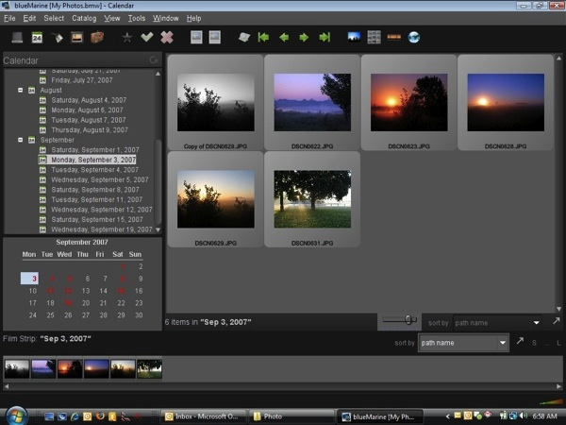
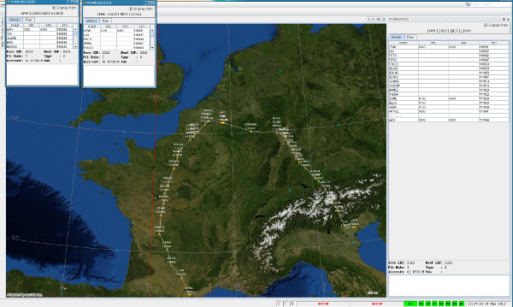
What is NetBeans?
A framework for building desktop applications
  Modular, pluggable, architecture allows easy reuse
  Rich framework of windows, dialogs, menus, toolbars

Slide 7
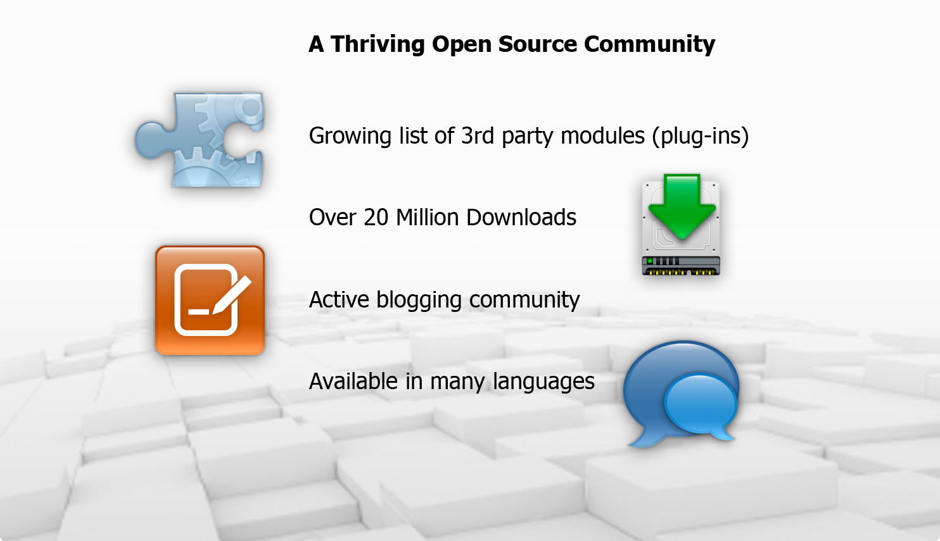
What is NetBeans?

Slide 8
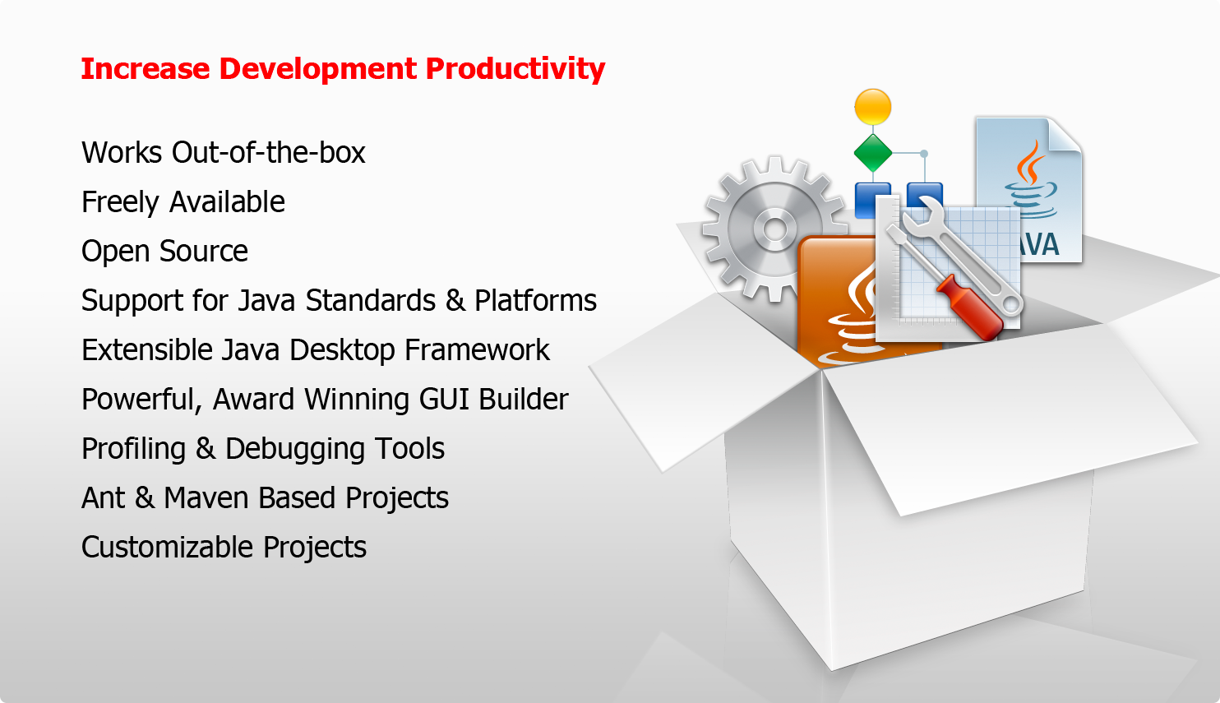
Why use NetBeans?

Slide 9
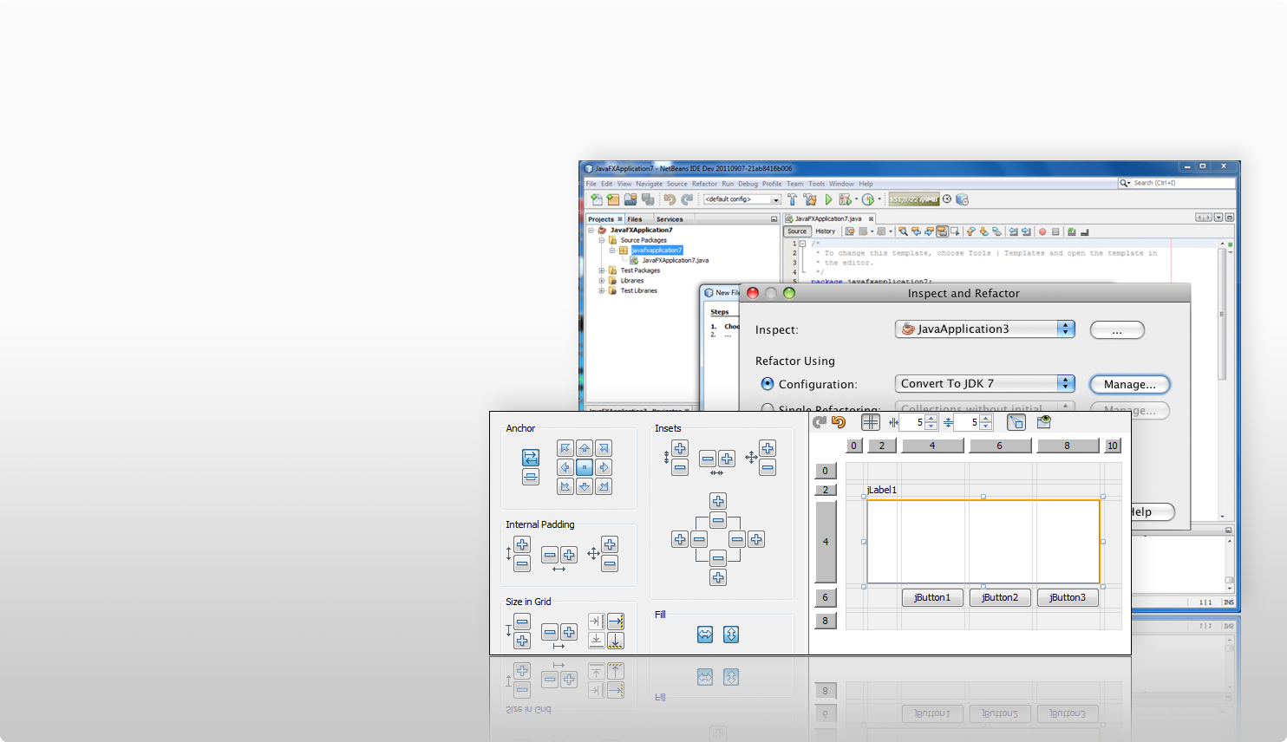
About NetBeans IDE 7.1
Support for JavaFX 2
  full compile/debug/profile
  development cycle
Many Enhancements
  Java Editor
  Swing & JavaFX GUI
  Debugger
  Java EE
  Versioning &
  Bug Tracking
  Maven, PHP, CSS
  And More

Slide 10
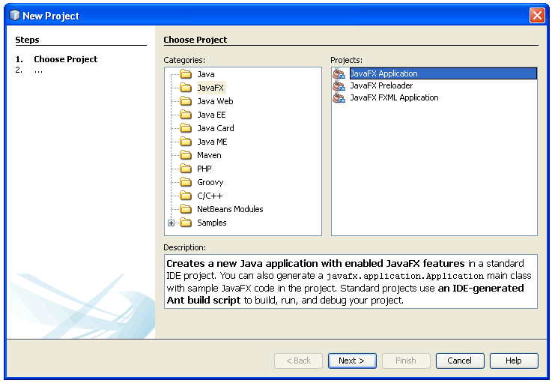
Support for JavaFX 2
Create, edit,
debug, profile,
deploy
Project template
for new JavaFX
projects
Quickly get
started
Many samples

Slide 11
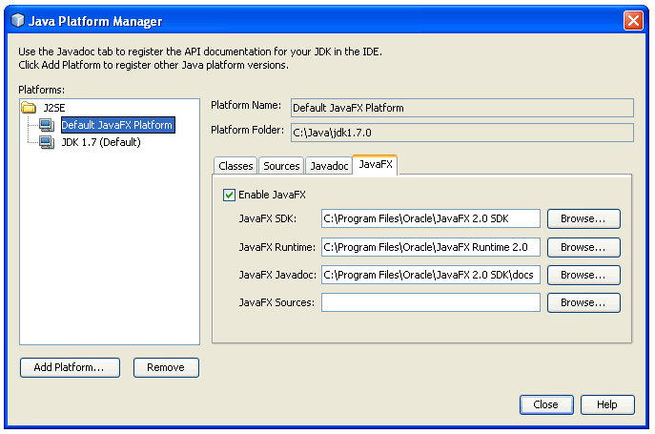
Support for JavaFX 2
Automatic
JavaFX
registration
when new
project is
created
Registration tool
for JavaFX
platform and
supporting
artifacts

Slide 12
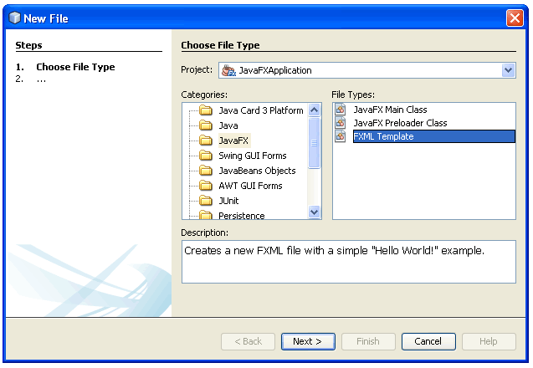
Support for JavaFX 2
Templates for
creating new
Java and
FXML files
Samples
illustrating
JavaFX
features

Slide 13
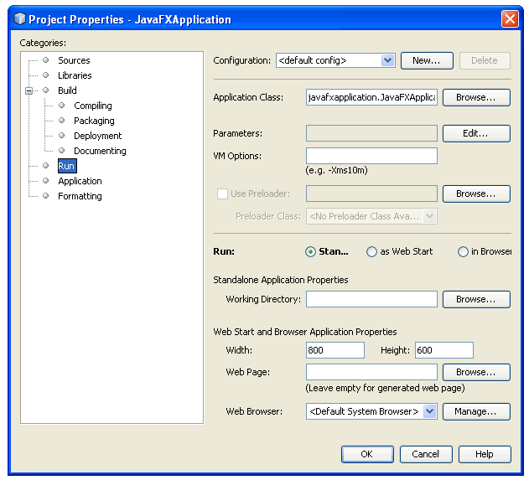
Support for JavaFX 2
Deployment
tools
  Standalone
  Java
  Web Start
  Applet

Slide 14
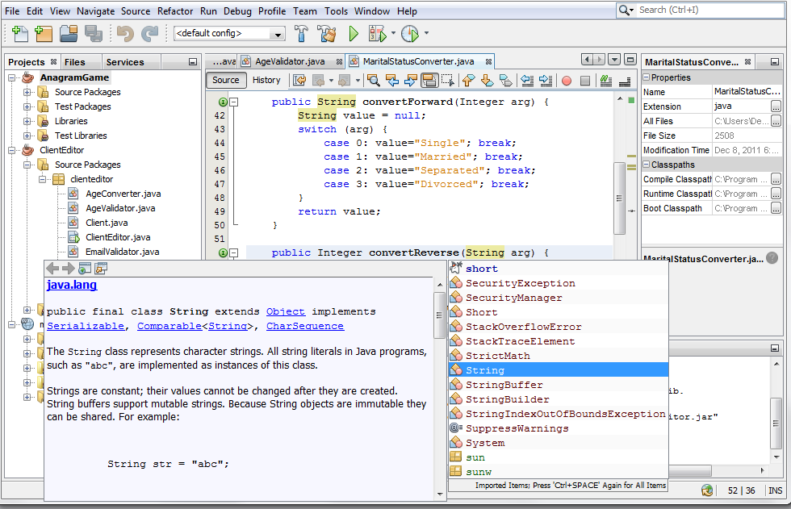
About the NetBeans Java Editor
The main feature of NetBeans IDE
Developed in close co-operation
with Java SE Team
in Sun and in Oracle
First editor to support
Java 7 & JavaFX 2.0
“javac” is our parser
all language features
always in sync
with the Java language

Slide 15
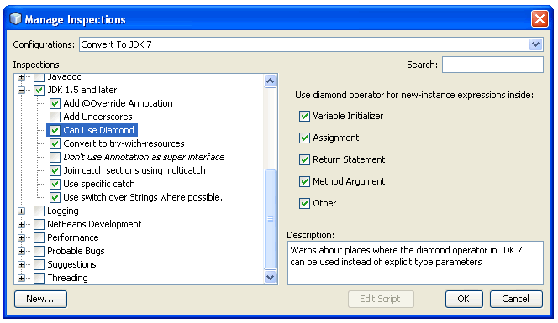
New in the NetBeans Java Editor
Batch Refactoring
  Fix problems across packages and projects
  Upgrade projects
  completely to JDK 7
  Customized scopes
  for refactoring
  Expression language
  for defining rules

Slide 16
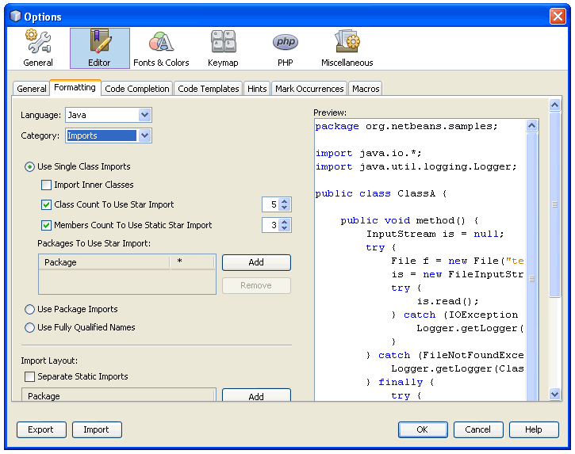
New in the NetBeans Java Editor
Import Statement
Organizer
  Centralized tool for
  managing import
  statements
  Neatened section of
  import statements
  at top of Java class
  Hints & tips within
  Java Editor

Slide 17
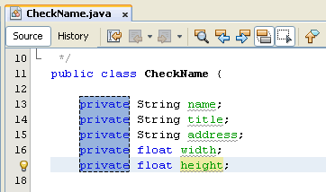
New in the NetBeans Java Editor
Rectangular Block Selection
  One-click toggle button
  for selecting code blocks
  across multiple lines
  Scenarios:
    Delete rectangular block
    In-place editing
    Cut/Copy/Paste
    Move up/down

Slide 18
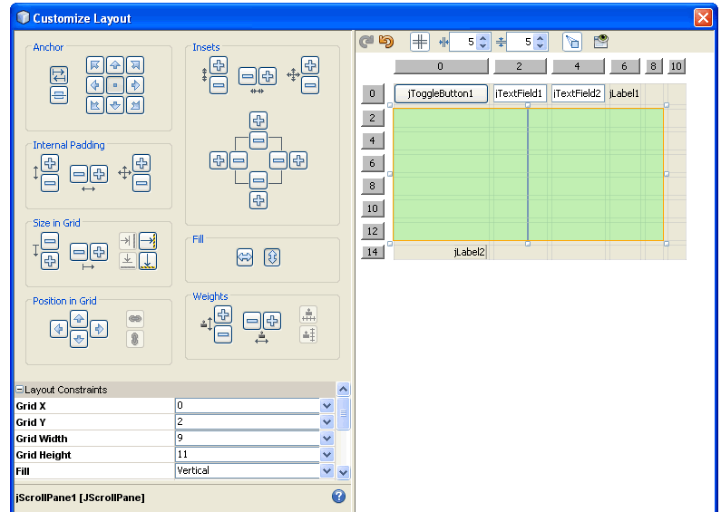
New in the NetBeans Java Editor
Improved
GridBagLayout
editing capabilities
  Visually maintain
  gaps between
  components
  Visual marking
  for components,
  gaps, and insets

Slide 19
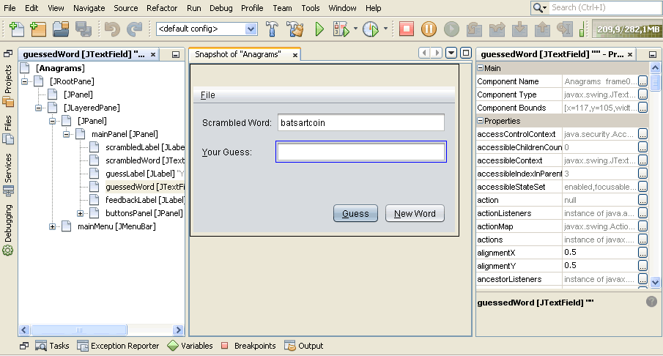
New in the NetBeans Java Editor
Visual debugger for Java FX & Swing
  New tool takes
  screenshots
  of GUI
  Select &
  analyze
  components
  Examine:
    component hierarchy
    currently attached listeners
    newly attached logging listeners

Slide 20
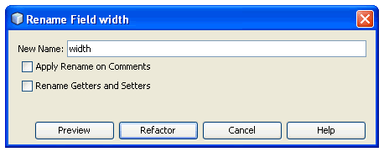
New in the NetBeans Java Editor
Other Java Editor Enhancements
  Getters & Setters included
  in field refactoring
  Finely tuned search feature
  New Find & Replace bar
  integrated in Java Editor
  Javadoc highlighter &
  formatter added
  New hints & tips in editor

Slide 21
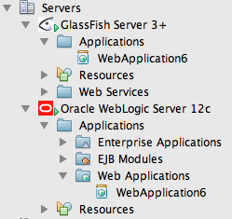
About NetBeans Java EE Support
Developed in co-operation
with GlassFish Team
and WebLogic Team
Best-in-breed GlassFish
integration, strong
support for WebLogic
and other servers
Support for standards,
e.g., Java EE 6
Ready to use out of the box

Slide 22
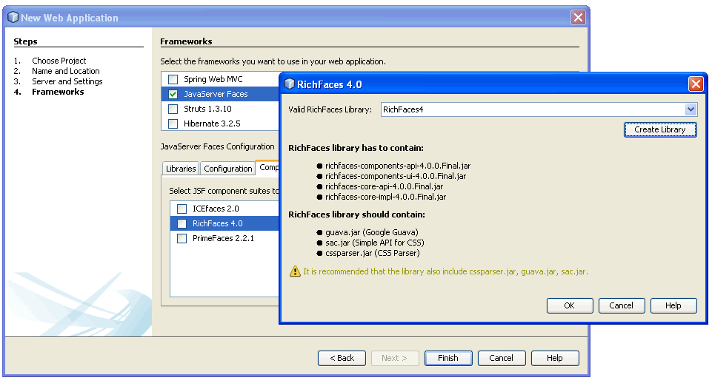
New in NetBeans Java EE Support
GlassFish 3.1.1
WebLogic 12c
New JSF
Component Support
- RichFaces 4
- IceFaces 2
Smarter code
completion for
JPA and Spring
CDI Features

Slide 23
About Miscellaneous Enhancements
Versioning & Bug Tracking
Maven
CSS
PHP

Slide 24
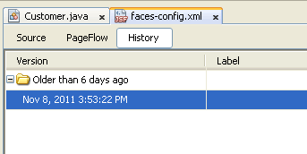
Versioning & Bug Tracking
Bundled Git support
Shelve feature for
Subversion & Mercurial
Local History tab inside
all NetBeans editors
Branching & tagging enhanced
API for registering additional
versioning systems

Slide 25
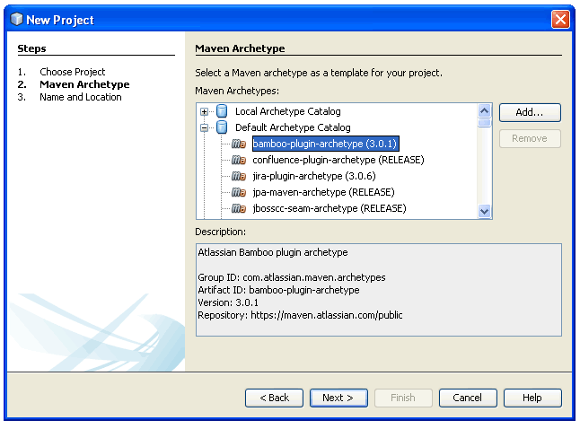
Maven
Industry leading
Maven support
Native integration,
templates, hints,
guidelines, and tips
Enhancements
in many areas
  code completion
  dependency resolution
  repository management

Slide 26
CSS
Support for CSS3
Code completion and
documentation for new
properties and values
Support for browser-specific
properties
Extensible to allow code completion
for specific CSS3 extensions

Slide 27
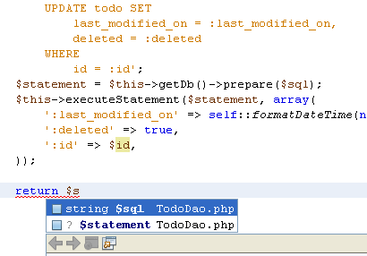
PHP
Smart method parameter completion
Enhanced code
completion for
try/catch
Smarty templates
support
Improved (S)FTP
client

Slide 28
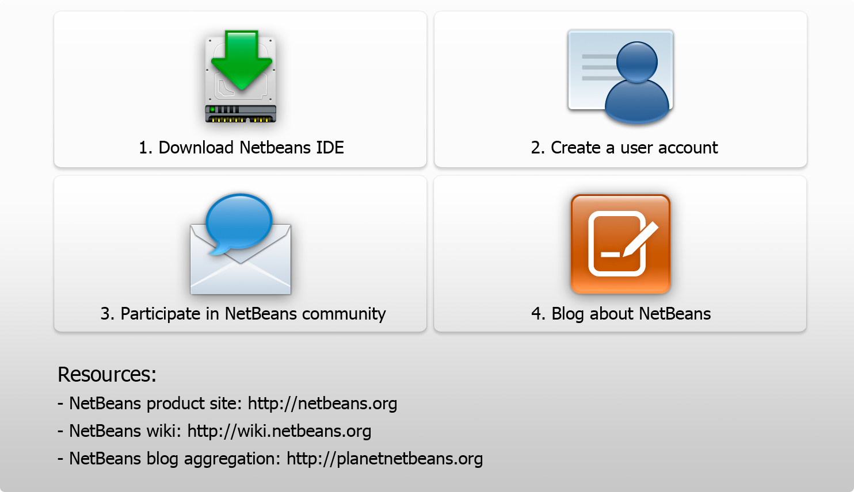
Next Steps

Slide 29

Thank You!

