Slide 1


Slide 2


What's New in NetBeans IDE 7.2

Slide 3
The following is intended to outline our general product direction. It is intended for information purposes only, and may not be incorporated into any contract. It is not a commitment to deliver any material, code, or functionality, and should not be relied upon in making purchasing decisions.
The development, release, and timing of any features or functionality described for Oracle’s products remains at the sole discretion of Oracle.

Slide 4
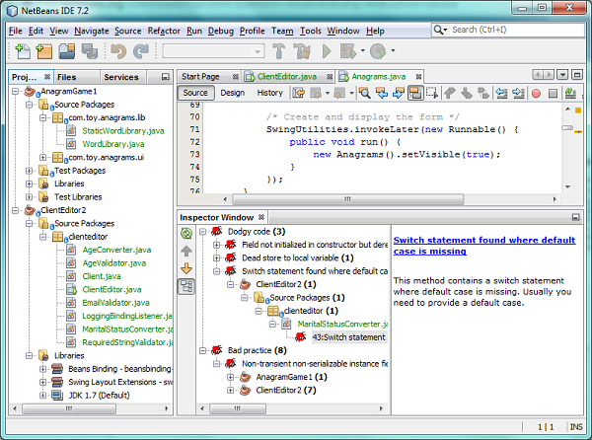
What is NetBeans?
A comprehensive, modular IDE
  Ready to use out of the box
  Support for latest Java
  specifications
  & standards
  Other languages too
  (PHP, C/C++, etc)
  Intuitive workflow
  Debugger, Profiler,
  Refactoring, etc.
  Binaries & ZIPs for Mac,
  Solaris, Linux, Windows
Simply download and
run on any OS!

Slide 5
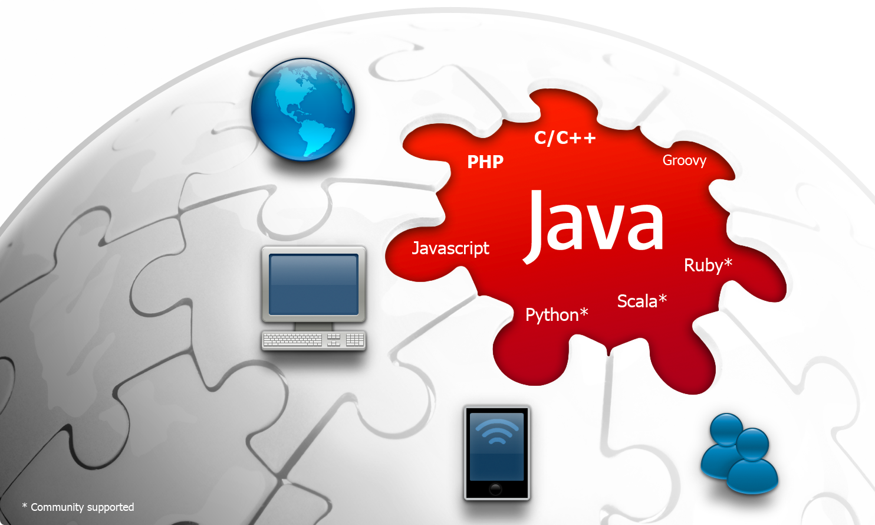
What is NetBeans?

Slide 6
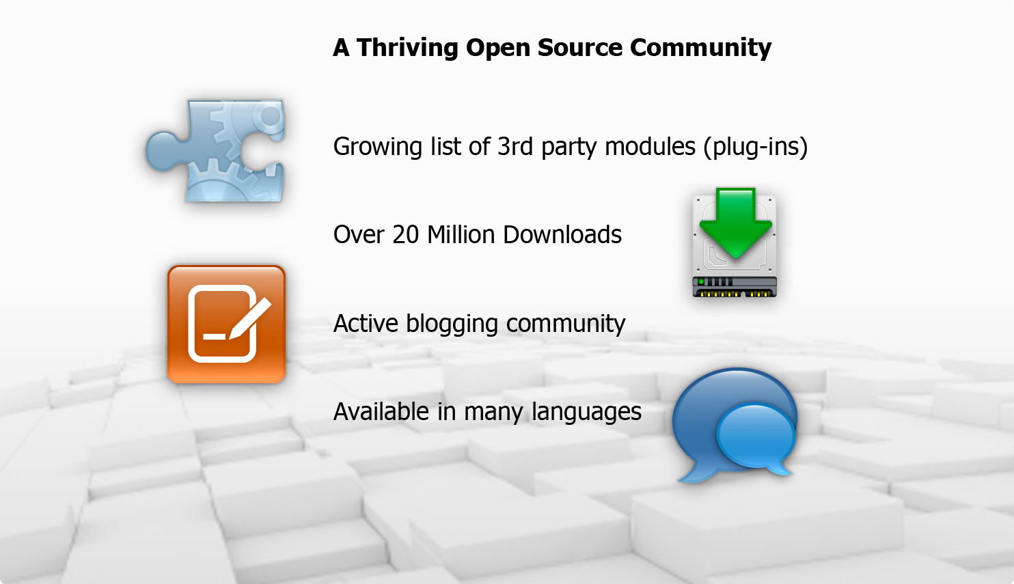
What is NetBeans?

Slide 7
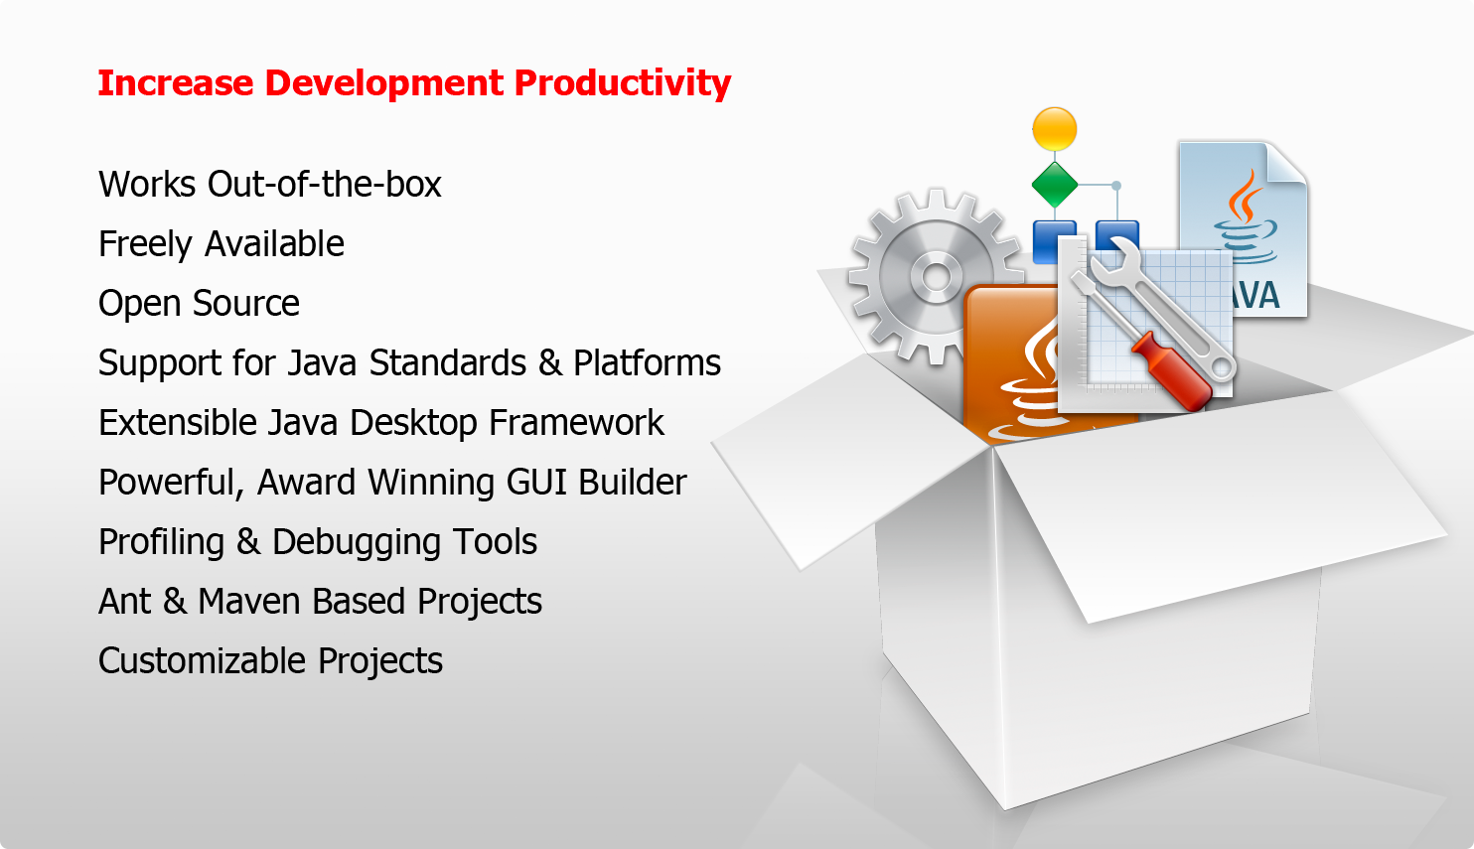
Why use NetBeans?

Slide 8
Focus Areas of NetBeans IDE 7.2
Improved performance
Be more productive when coding
Easily analyze large code bases
Seamless development with JavaFX Scene Builder
New features & enhancements to existing features

Slide 9
About the Performance Boost
What was done in NetBeans IDE 7.2?
  Significantly improved NetBeans startup time
  Significantly improved scanning to sync your code with NetBeans
Result
  Up to 65% improvement in startup time at first startup
  Up to 25% improvement in project scanning speed
Example: SilverPeas.org
Time to open very large project until ready-to-code:
  44 seconds in NetBeans IDE 7.2
  2 minutes and 37 seconds in NetBeans IDE 7.1.1

Slide 10
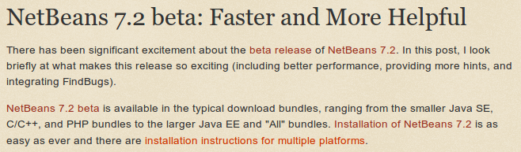
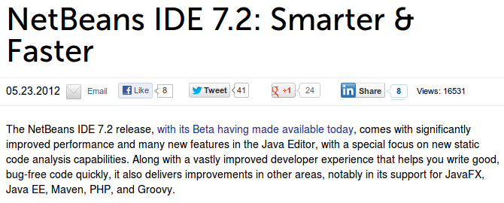
About the Performance Boost

Slide 11




Community Feedback

Slide 12

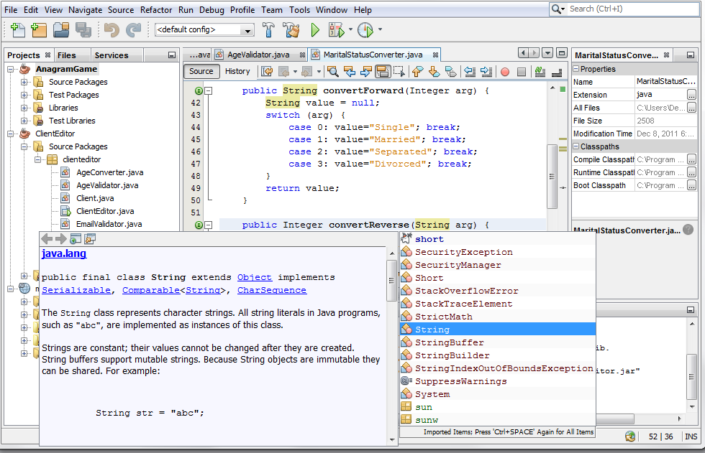
Be More Productive When Coding
Improved Java Editor
The main feature of NetBeans IDE
Developed in close co-operation
with Java SE Team
in Sun and in Oracle
First editor to support
Java 7 & JavaFX 2.0
“javac” is our parser
all language features
always in sync with Java

Slide 13

New in the NetBeans Java Editor
Static Analysis Tools Integration
FindBugs Integration
  Popular open source static analysis tool for Java
  Identifies bugs in many categories
    Bad Practice – Eg: Method may fail to close stream
    Correctness – Eg: equals method always returns false
    Internationalization – Eg: Reliance on default encoding
    Malicious code vulnerability – Eg: Expose internal rep by reference to mutable object
    Multithreaded correctness – Eg: method calls Thread.sleep() with a lock held
    Performance – Eg: Huge string constants duplicated across multiple class files
    Security – Eg: Hardcoded constant database password
    “Dodgy code” – Eg: Method ignores return value, is this OK?

Slide 14
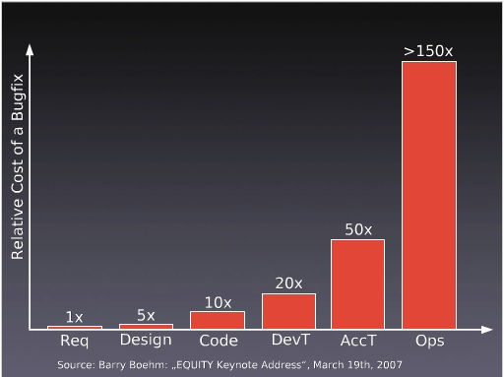
Why FindBugs? Cost of Bug Fixing
The earlier the better
The larger the software system, the more pronounced is the cost difference across the stages

Slide 15
Why FindBugs? Preventing Bugs
Programming style
  Helps in making it easier to spot bugs in code
  Defensive Programming
Programming techniques
  Programed to self monitor or check consistency of internal data
Development methodologies
Programming language support
  Eg. Type systems leading to compile time type checks
  Decision to not support pointers in Java
Code analysis
  Inspect the code for errors beyond what the compiler catches

Slide 16
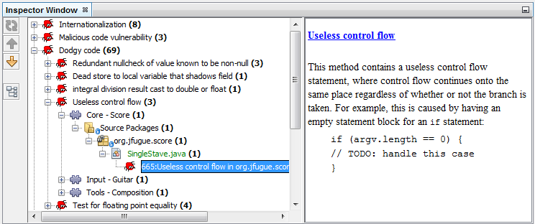
FindBugs Integration
Set scope of analysis on projects, packages, or files
Examine results and jump into editor

Slide 17
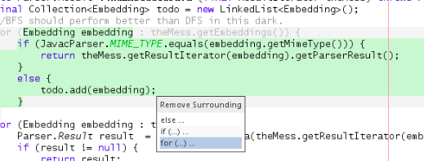
New in the NetBeans Java Editor
Remove Surrounding Code
  Quickly remove
  enclosing parts
  of nested
  statements
  Source > Remove
  Surrounding Code
  Alt-Backspace

Slide 18
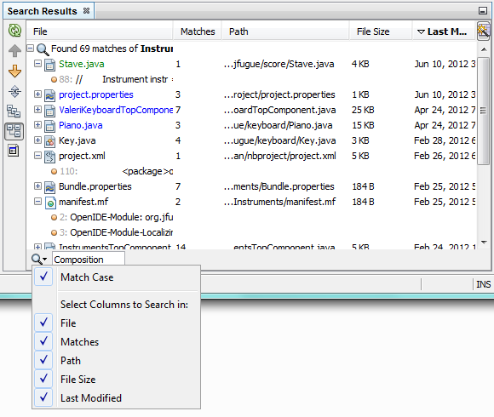
New in the NetBeans Java Editor
Reformat all code across
all projects, packages, files
Better Search Results
New package view
collapses empty packages
Export projects to ZIP
and import from ZIP
Replace constructor with
builder or factory
Multi-tab editor and
change position of tabs
And more!

Slide 19
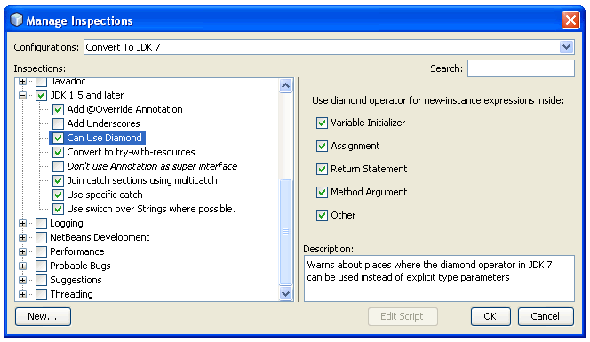
NetBeans Java Editor
Other Key Features
Batch Refactoring
  Fix problems across packages and projects
  Upgrade projects
  completely to JDK 7
  Customized scopes
  for refactoring
  Expression language
  for defining rules
  Introduced in 7.1

Slide 20
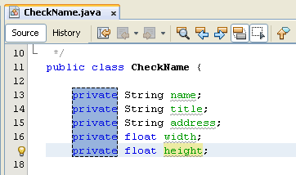
NetBeans Java Editor
Other Key Features
Block Selection
  One-click toggle button
  for selecting code blocks
  across multiple lines
  Scenarios:
    Delete rectangular block
    In-place editing
    Cut/Copy/Paste
    Move up/down
  Introduced in 7.1

Slide 21
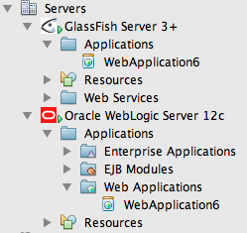
NetBeans Java EE Support
Developed in co-operation
with GlassFish Team
and WebLogic Team
Best-in-breed GlassFish
integration, strong
support for WebLogic
and other servers
Support for standards,
e.g., Java EE 6
Ready to use out of the box

Slide 22
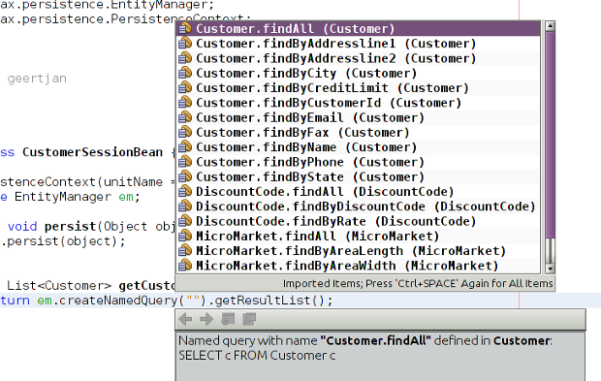
New in NetBeans Java EE Support
JPA code
completion in
named queries
and SQL queries
PrimeFaces 3.2
Spring 3.1.1

Slide 23
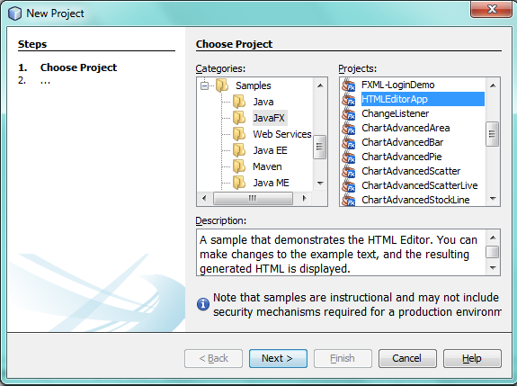
NetBeans JavaFX Support
First IDE
to provide
JavaFX tools
Developed in
co-operation
with JavaFX Team
Create, edit,
compile, deploy
Library of ready to use samples out of the box

Slide 24
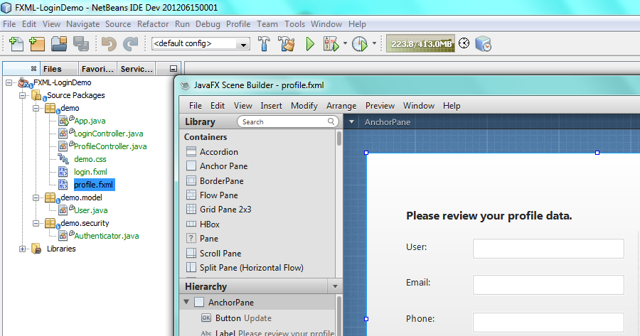
New in NetBeans JavaFX Support
Open
JavaFX
files in
Scene
Builder
Project
type for
JavaFX
in Swing
CSS code completion for JavaFX elements

Slide 25
New Features & Enhancements
TestNG
Maven
Groovy & Grails
Debugger & Profiler
PHP
C++

Slide 26
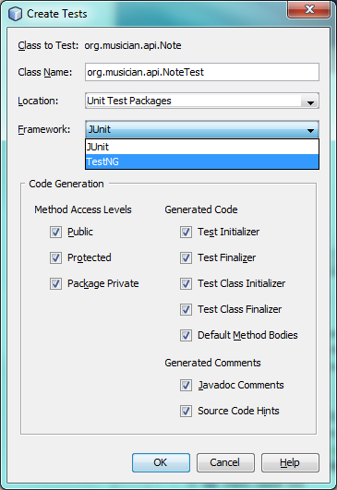
TestNG
Both TestNG
and JUnit
supported
Create new
tests, test cases,
test suites
Test results
in output window

Slide 27
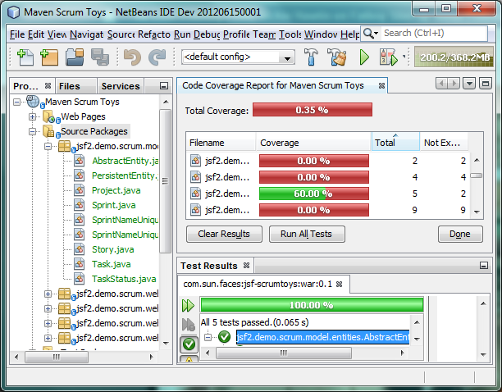
Maven
Maven 3.0.4
New JaCoCo
for code
coverage
Enhanced
scanning
performance
No. 1 reason
users switch
to NetBeans IDE

Slide 28
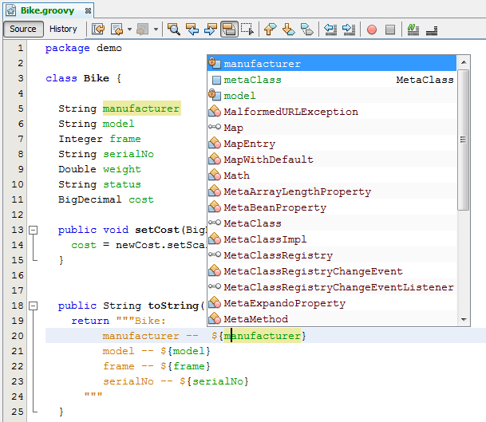
Groovy & Grails
Groovy 1.8.6
Faster
Groovy
indexing &
parsing
Faster
Groovy
code
completion

Slide 29
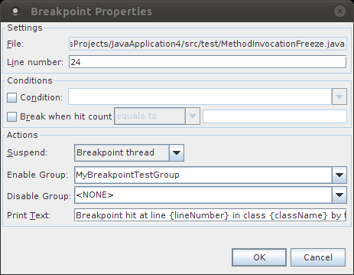
Debugger & Profiler
Debugger
  Breakpoints enable/disable other breakpoints
  Source scanning does
  not block debugger stepping
  Zoom added to
  Visual Debugger snapshots
  Tree view in Variables
  and Watches
  Code completion in
  New Breakpoint dialog

Slide 30
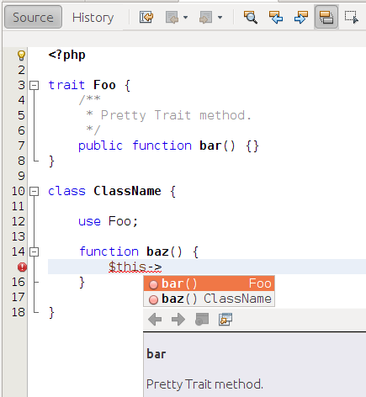
PHP 5.4
PHP 5.4
Support for
  Symfony2
  Twig
  Doctrine2
  ApiGen
  Neon
Tools
  New hints
  Hudson
  PHPUnit & Annotations

Slide 31
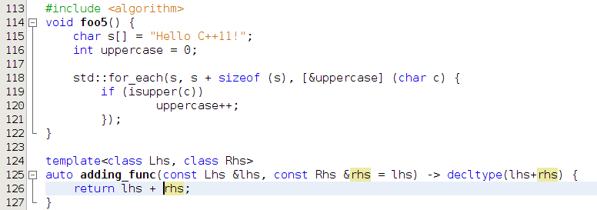
C++
C++11 Standard
Faster “Find in Projects”
Shell Syntax in Run Command
Remote Toolbar

Slide 32
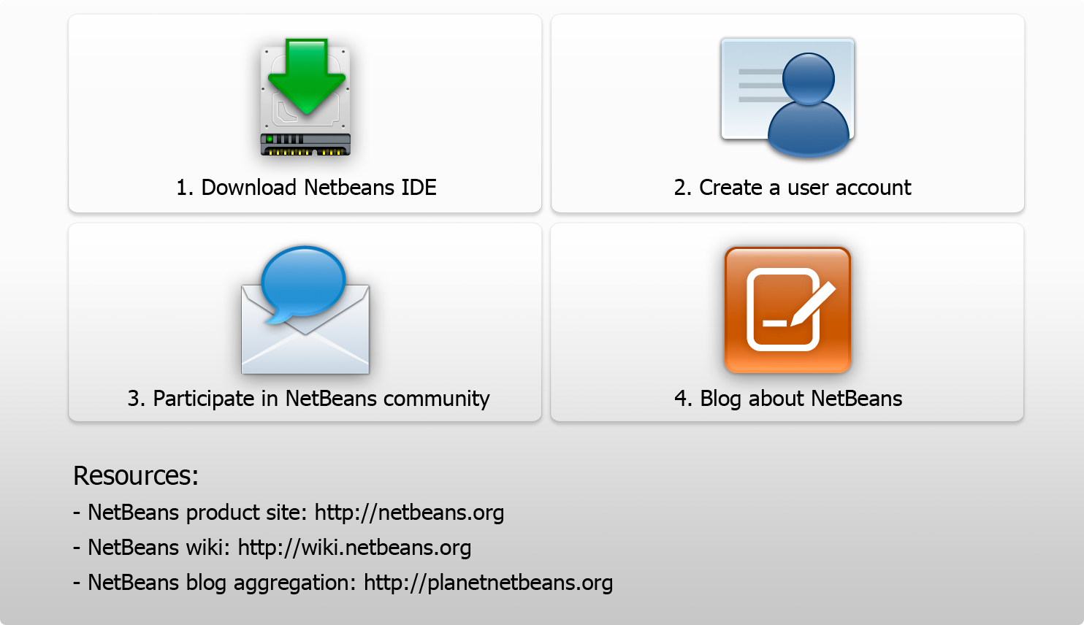
Next Steps

Slide 33

Thank You!

