Slide 1
HW4 Overview
Start Part 1 Today
Part 2 [Optional] later

Slide 2
Try the ATM Demo Program Again
Run ATM.exe and log in as test, 111
  Try all the menu choices
  Exit
Rerun and log in as admin, 999
  Choose hidden menu choice A to go to admin mode
  view sorted and unsorted records
  add a new customer, delete a customer

Slide 3
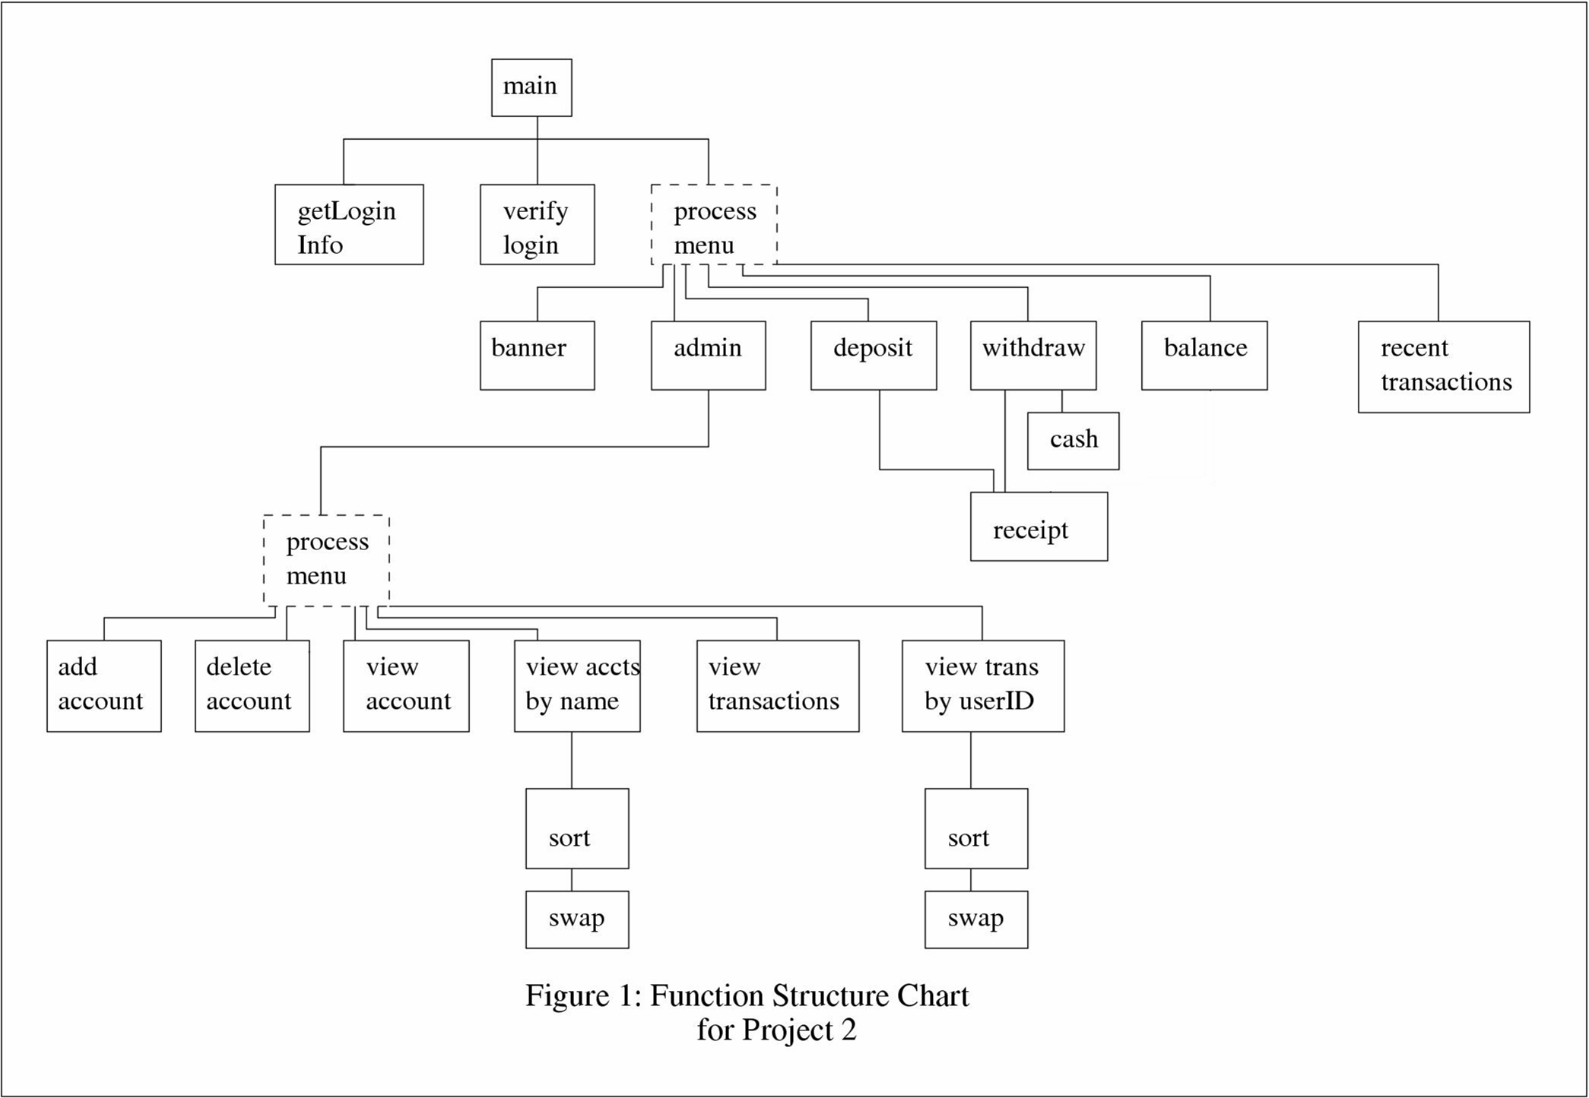

Slide 4
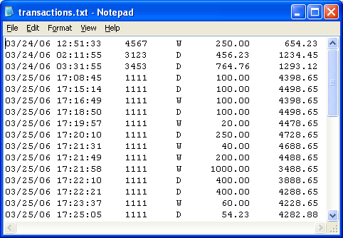
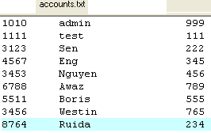
The ATM Simulator manages two files

Slide 5
New Skills Needed
Working with ASCII Art
How to append to an existing file
  ofstream trans(“transactions.txt”, ios::app);
Accessing Date/Time

Slide 6

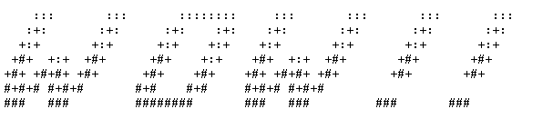
Working with ASCII Art
Visit www.schnoggo.com/figlet.html
  Type in text and choose a font
Copy into your program’s banner( ) fn
  add cout<<" "<<endl;
If a single \ appears in your figlet it may cause problems
  Do a Global Replace of single \ with \\

Slide 7
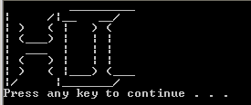
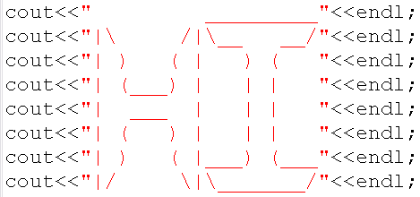

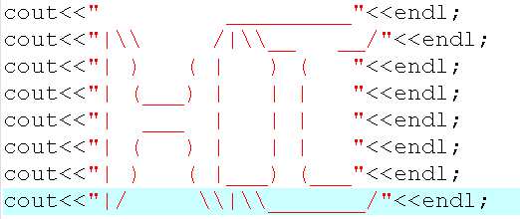
Working with ASCII Art
For Example:
After replacing \ with \\:

Slide 8
What does function deposit have to do?
List the steps

Slide 9
Pseudocode for Deposit Function
deposit( ): let customer add money to their account
  Ask the customer how much money to deposit
  read the customer’s money value (& check valid)
  Get the current balance from transactions file
  Calculate new balance
  Print a a receipt (using receipt function)
  append an entry to the end of the transactions.txt file with the appropriate information and transaction code

Slide 10
Appending Data to a File (step 6)
Normally, opening an output file stream erases any existing file with the same name
  ofstream outFile;
  outfile.open(“transactions.txt”);
Another way is to open the file
using the append option:
  ofstream outFile;
  outfile.open(“transactions.txt”, ios::app);
    Now anything you send to the file appears at the end of the pre-existing file
This would erase the existing transactions.txt
file

Slide 11
Example from deposit function
ofstream trans("transactions.txt", ios::app);
trans<<dateStr<<" "<<timeStr<<setw(8)
<<userID<<setw(6)<<'D'<<fixed<<setprecision(2)
<<setw(12)<<money<<setw(12)<<balance<<endl;
trans.close();
This information is added to the end of the file

Slide 12
Reading System Date and Time
char dateStr[9], timeStr[9]; // time and date vars
// (old style C-strings)
_strdate(dateStr); // dateStr now has date
_strtime(timeStr); // timeStr now has time
cout<<dataStr<<" "<<timeStr<<endl; // display
You also must include this library → #include<ctime>

Slide 13
This is the easy way!
string date, time;
getDateAndTime(date, time);
void getDateAndTime(string & date, string & time)
{
char dateStr[9], timeStr[9]; // time and date information
_strdate(dateStr); // dateStr now has date
_strtime(timeStr); // timeStr now has time
date=dateStr;
time=timeStr;
}

Slide 14
There is a lot more to learn…
Read the project 2 handout carefully and follow the instructions
Rest of the class is yours
Challenge students
  Recommend finishing part 1 by next week
Foundation students
  Only need to complete part 1

