Slide 1
Customer Relationship Prediction
Team 11 WMW: Wenting Su, Mohan Liu, Wei Huang

Slide 2
The KDD Cup 2009

Slide 3
The KDD Cup 2009
The KDD Cup 2009 offers the opportunity to work on large marketing databases from the French Telecom company Orange
An industrial customer analysis platform able to build prediction models with a very large number of input variables has been developed by Orange Labs.
The challenge is to beat the in-house system developed by Orange Labs.

Slide 4
What we could predict from CR data…
To predict the propensity of customers
switch provider (churn),
buy new products/services (appetency)
buy upgrades/add-ons proposed to them to make the sale more profitable (upselling).
Let’s analyze churn (switch provider)

Slide 5
Dataset

Slide 6
The feature of Dataset
Two marketing databases from Orange, the French Telecom company
A small dataset has 50,000 instances, 230 features
A large dataset has 50,000 instances, 15,000 features
The data were anonymized by replacing actual text or labels by meaningless codes and not revealing the meaning of the variables, to protect the privacy of the customers whose records were used

Slide 7
The challenges in Dataset
Heterogeneous data (numerical and categorical variables). The small dataset has 40 categorical features (out of 230), while the large dataset has 260 categorical features (out of 15000).
Noisy data
Unbalanced distributions of predictive variables, sparse target values (only 1 to 7 percent of the examples belong to the positive class)
Lots of missing values.

Slide 8
What technology we used…
Two steps:
Data Preprocessing by Python, Spark, PCA
Machine Learning by ANN

Slide 9
Data Preprocessing

Slide 10
How to address the challenges in Dataset
Problem
Solution
Lots of missing values.
Heterogeneous data (numerical and categorical variables).
Noisy data
Unbalanced distributions of predictive variables, sparse target values (only 1 to 7 percent of the examples belong to the positive class)

Slide 11
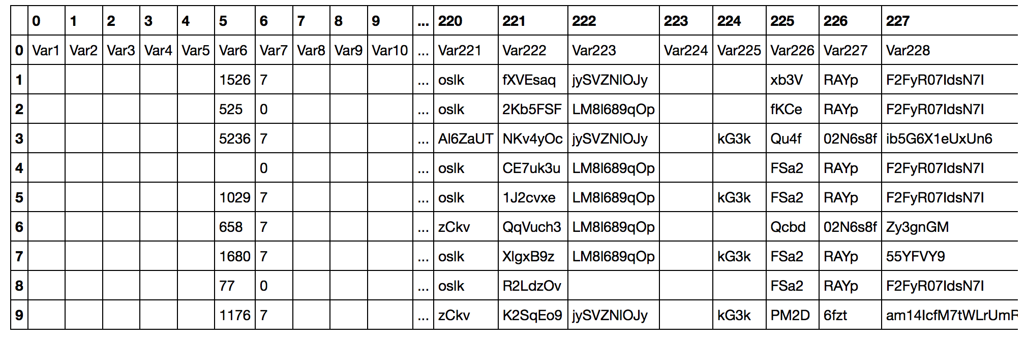
Step1: Collect train data and label data Technique: Spark, Python

Slide 12
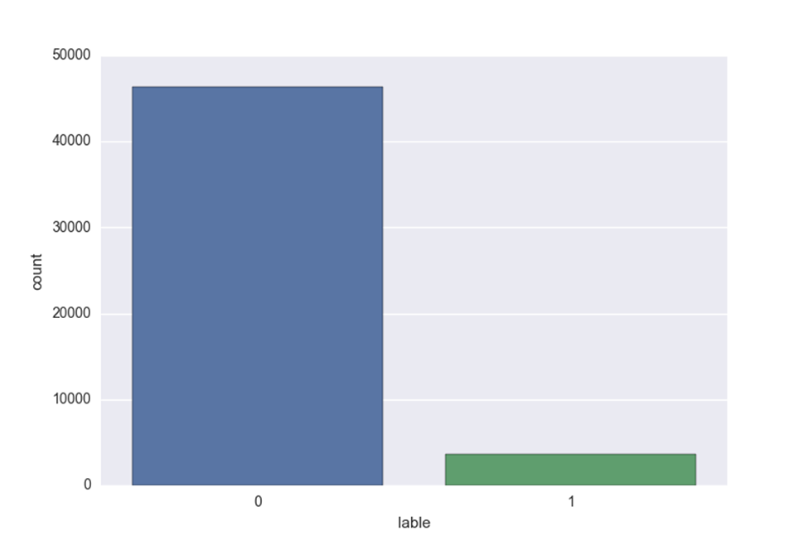
Step2: Processing Missing Data Technique: Panda
Dealing with String Empty Data
Dealing with Numerical Missing Data
Encoding categorical data
Combine the numerical data and categorical data.
Label Encoding

Slide 13
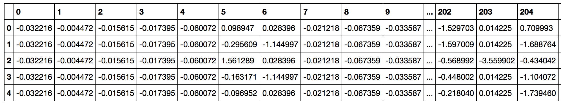
Step3: Feature Scaling

Slide 14
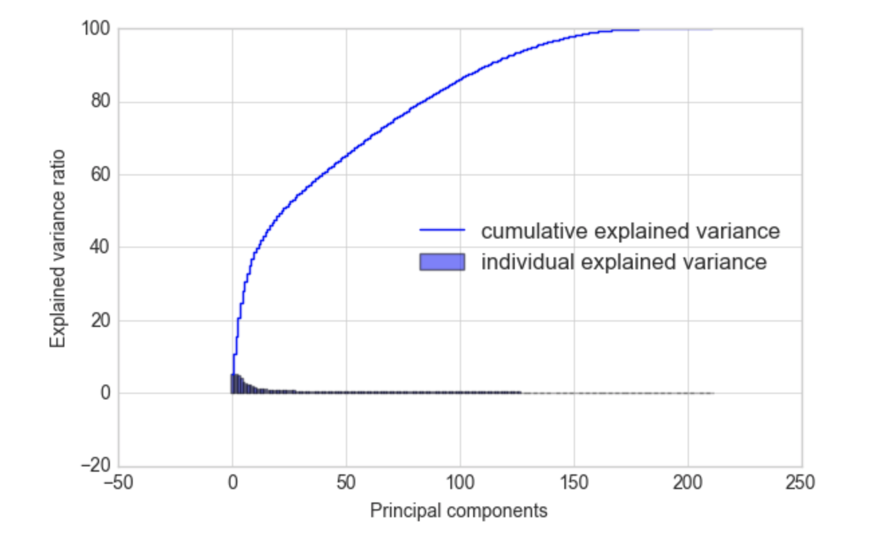
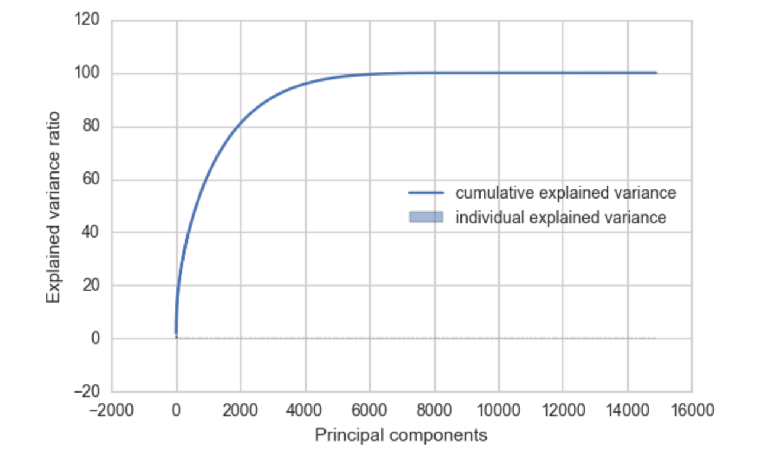
Step4: PCA
Small Dataset
Large Dataset

Slide 15
Outcome after data preprocessing
For the small dataset, after data preprocessing we reduced the column count to 212 (delete columns that are all empty).
For the large dataset, we reduced the column count to 6000 with PCA while retaining 98% of variance

Slide 16
Machine Learning (Artificial Neural Network)

Slide 17
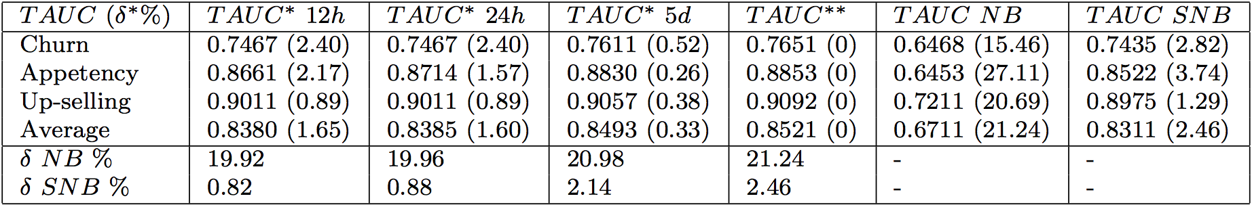
Orange Lab
An extension of the Naïve Bayes classifier, called “Selective Naïve Bayes classifier”
The base line Orange had provided for Churn is 0.7435

Slide 18
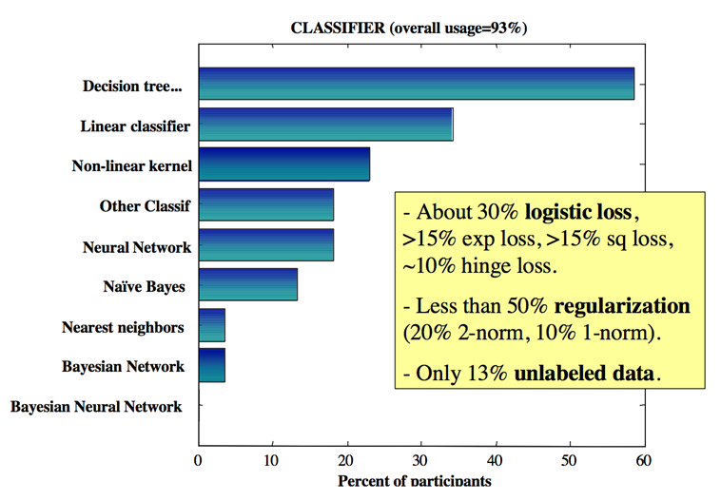
Choice of Classification Algorithms of original participants

Slide 19
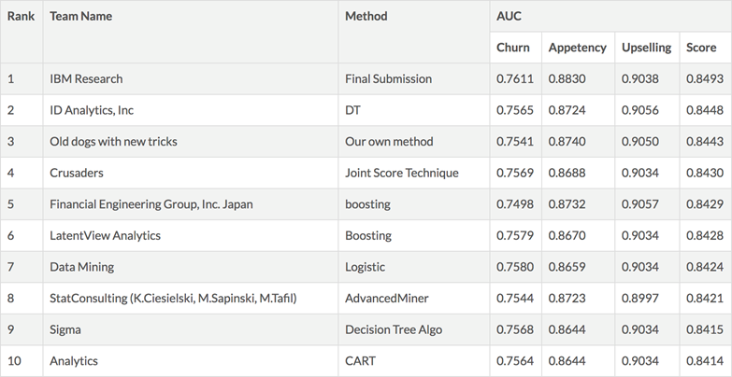
Top 10 results of original challenge

Slide 20
Comparison
Decision Tree Learning
Neural Networks
more efficient with large numbers of labeled examples
less efficient with large numbers of features or high dimensionality
much quicker than the typical neural network to build or learn a model
For highly non-linear boundaries between classes, neural networks are more likely to find appropriate boundaries because decision trees will have to approximate a non-linear boundary with a series of axis parallel splits.

Slide 21
Why no ANN? Why not ANN?
Artificial Neural Network was used, but only by around 20% percent of the original participants, while none of whom made it to the top 10.
Neural Network’s poor performance in the original challenge is hardware in 2009

Slide 22
Our outcome

Slide 23
Combination1 on small dataset
212 columns, 50,000 rows
Test size | No. of hidden layer | No. of neurons in hidden layer | Activation function | Activation function of output layer | Optimizer | Batch size | Epochs
30% | 2 | 106 | linear | sigmoid | Adam | 10 | 20

Slide 24
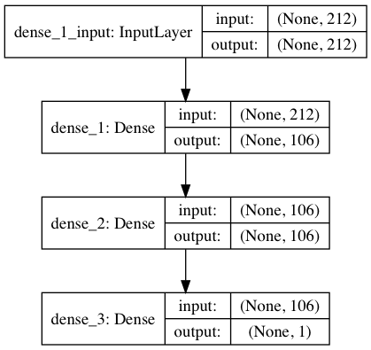
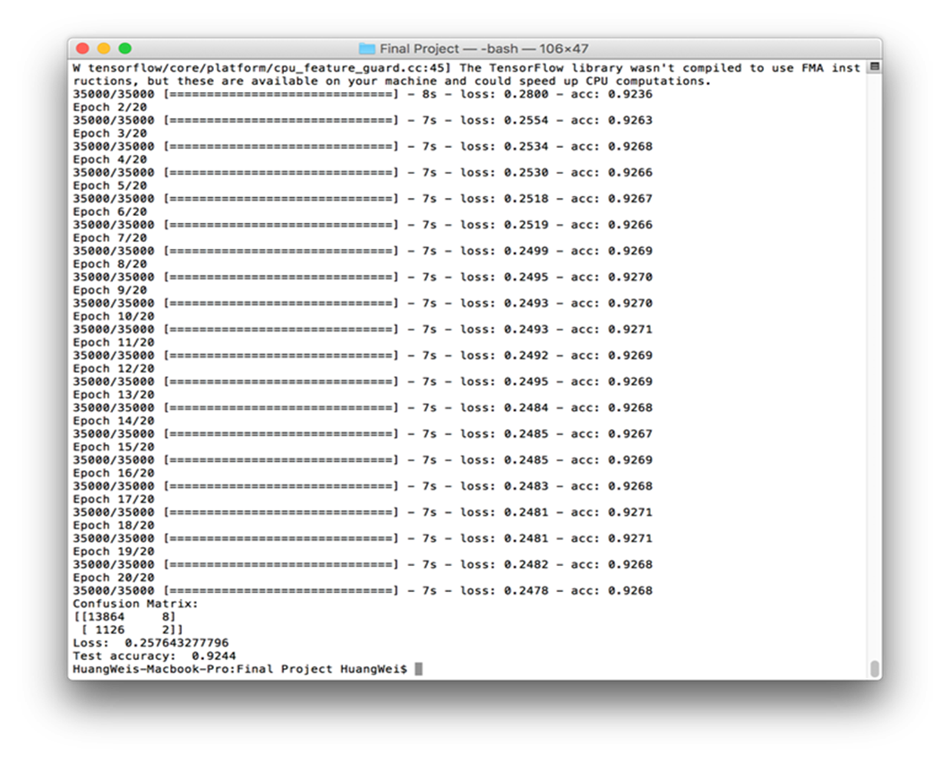
Combination1 on small dataset

Slide 25
Combination2 on small dataset
212 columns, 50,000 rows
Test size | No. of hidden layer | No. of neurons in hidden layer | Activation function | Activation function of output layer | Optimizer | Batch size | Epochs
30% | 2 | 106 | relu | sigmoid | Adam | 10 | 20

Slide 26
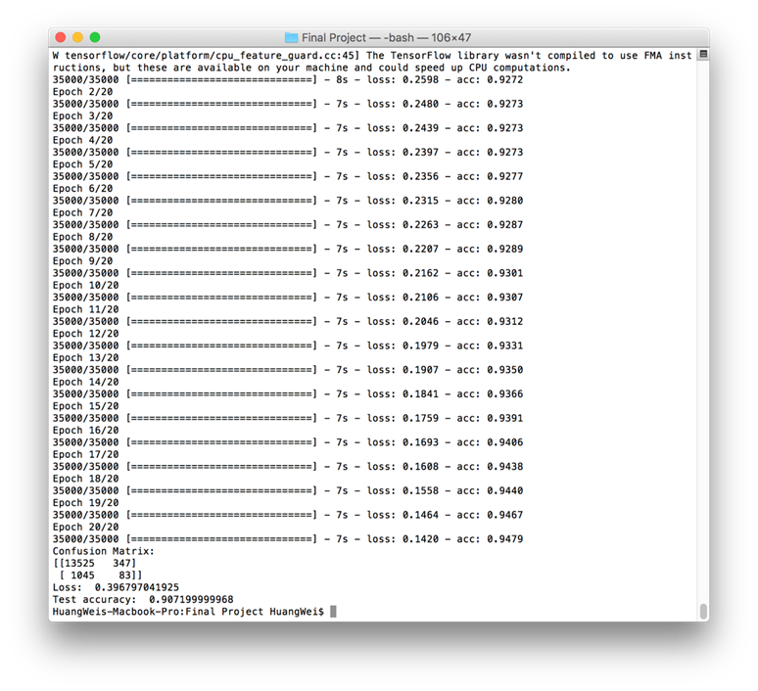
Combination2 on small dataset

Slide 27
Combination3 on small dataset
212 columns, 50,000 rows
Test size | No. of hidden layer | No. of neurons in hidden layer | Activation function | Activation function of output layer | Optimizer | Batch size | Epochs
30% | 3 | 106 | relu | sigmoid | Adam | 10 | 20

Slide 28

Combination3 on small dataset

Slide 29
Combination1 on large dataset
6,000 columns, 10,000 rows
Test size | No. of hidden layer | No. of neurons in hidden layer | Activation function | Activation function of output layer | Optimizer | Batch size | Epochs
30% | 2 | 3000 | linear | sigmoid | Adam | 10 | 10

Slide 30
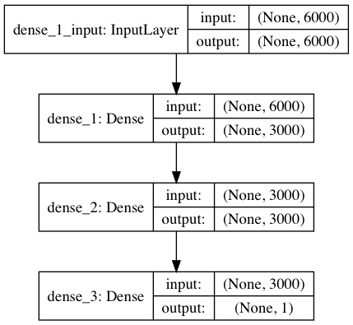
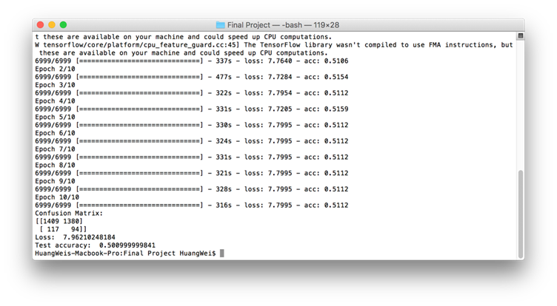
Combination1 on large dataset

Slide 31
Combination2 on large dataset
6,000 columns, 10,000 rows
Test size | No. of hidden layer | No. of neurons in hidden layer | Activation function | Activation function of output layer | Optimizer | Batch size | Epochs
30% | 1 | 3000 | relu | sigmoid | Adam | 10 | 10

Slide 32
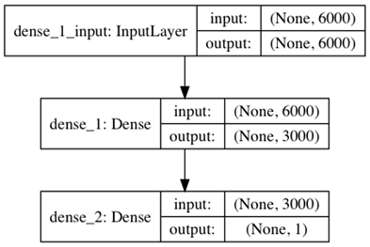
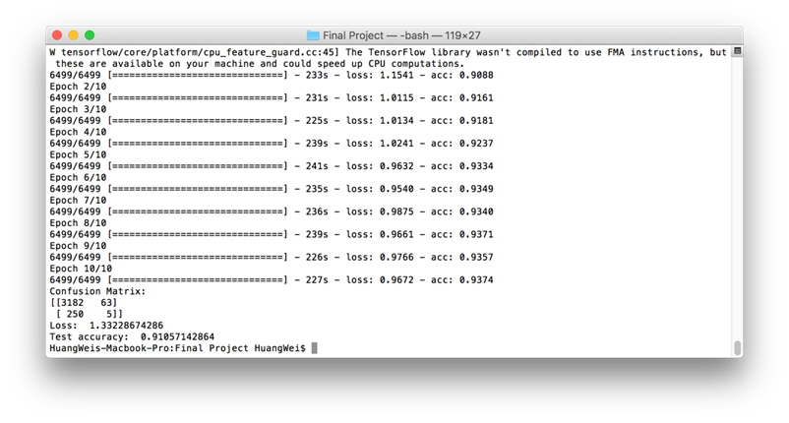
Combination2 on large dataset

Slide 33
ANN Parameter tuning
We found the ANN performed bad on predicting positive examples
The probable reason are:
the scarcity of positive example in the dataset (which is also one of the challenges of this dataset)
the ANN on large dataset is over-fitted.

Slide 34
Rearranged the small dataset
7,344 rows containing half positive and half negative examples
Test size | No. of hidden layer | No. of neurons in hidden layer | Activation function | Activation function of output layer | Optimizer | Batch size | Epochs
30% | 2 | 106 | relu | sigmoid | Adam | 10 | 20

Slide 35
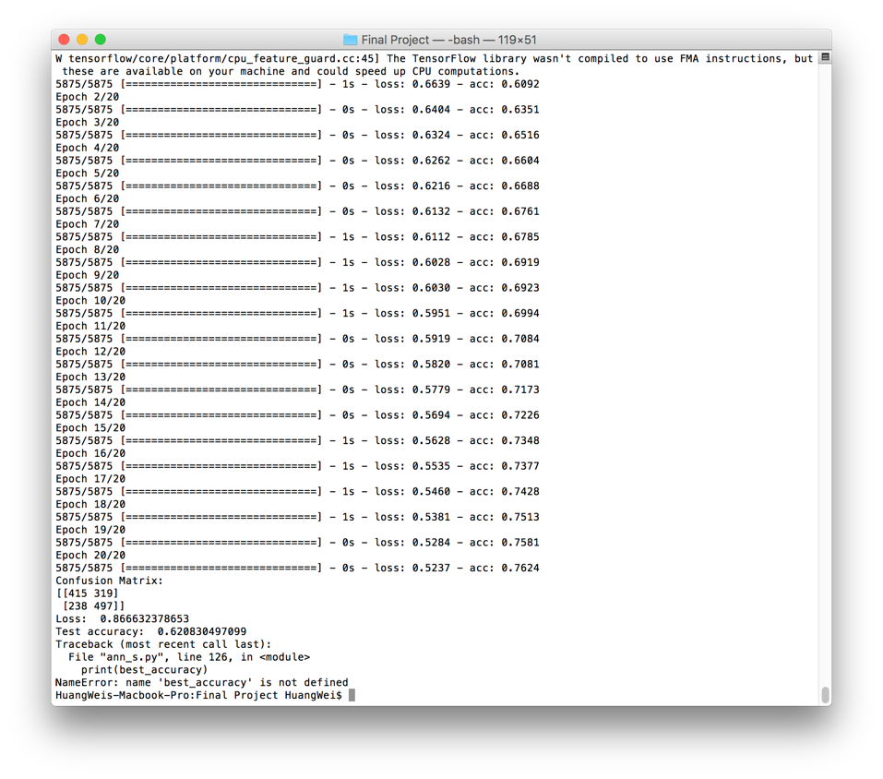
Rearranged the small dataset
As shown, training accuracy is much higher than testing. It’s over-fitted.

Slide 36
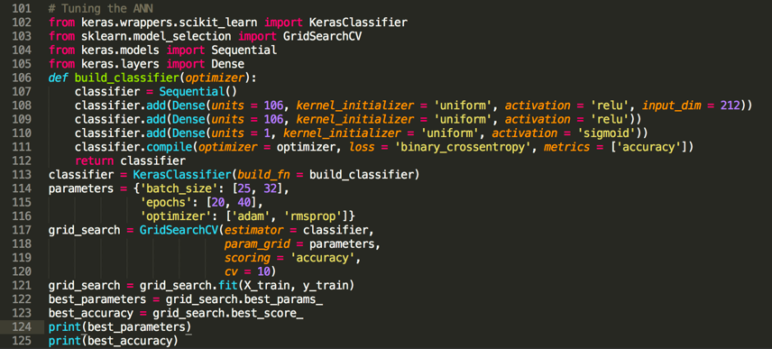
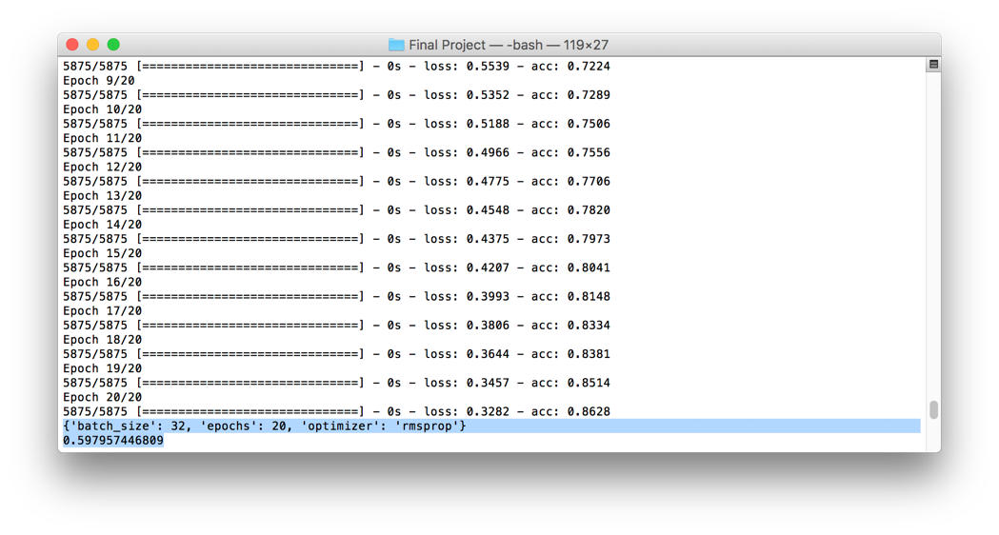
Tuning code on small dataset

Slide 37
Conclusion and Future Work

Slide 38
Conclusion
Small Dataset
Large Dataset
Successful on dataset preprocessing and ANN building
Got a better prediction accuracy than the original KDD competition
Although we did not completely process the dataset on our local machine and finish our work on a real cluster due to the tight time
We did finish the process for one chunk, which is 1/5 of the whole dataset, and our methodologies in both data processing and machine learning are working.
The accuracy for positive example prediction is generally bad for both size of dataset.

Slide 39
Future Work
Run data preprocessing on a real cluster.
Try to improve ANN training process with big data methodologies.
Add model selection for ANN and fine tune its parameters.
More in-depth analysis on positive example prediction accuracy.

Slide 40
Thank you for your patience

