Slide 1
FUNDAMENTALS OF ACCOUNTING FOR NON-ACCOUNTANTS

Slide 2
Journalizing Business Transactions – Merchandising Business

Slide 3
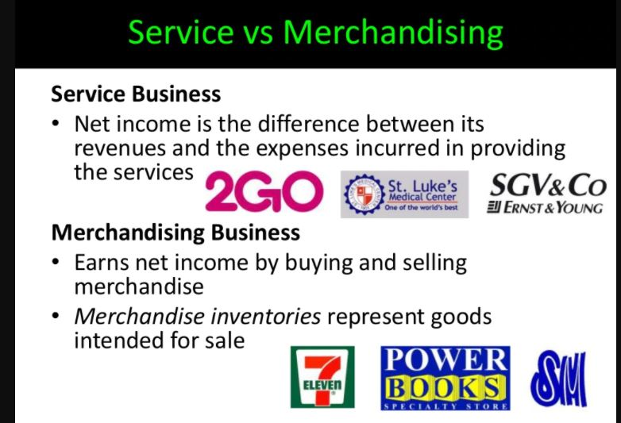

Slide 4
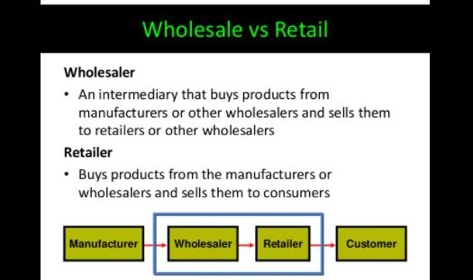

Slide 5
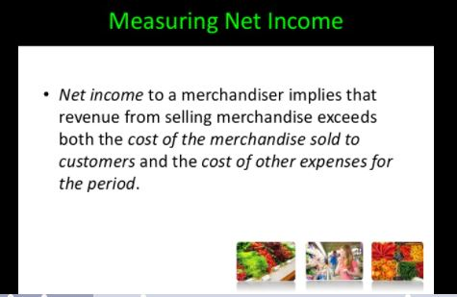

Slide 6
Operating Cycle:
• Purchase merchandise from vendors for inventory on account or for cash
• Sell inventory to customers on account
• Collect cash from customers
• Pay cash to vendors
• Repeat again and again
• Note that these steps overlap so that the cash collections from customers may occur before and/or after the cash payments to vendors.

Slide 7
Merchandise Inventory:
• Merchandise Inventory (Inventory or MI) refers to the goods the company has purchased and intends to sell to others.
• Inventory is a current asset since the company intends to sell it within one year.

Slide 8
Cost of Goods Sold:
• Inventory that has been sold becomes an expense, Cost of Goods Sold, in the period of sale.

Slide 9
Inventory Systems:
The periodic inventory system uses an occasional physical count to measure the level of inventory and the cost of goods sold. The perpetual inventory system keeps track of inventory balances continuously, with updates made automatically whenever a product is received or sold.

Slide 10
Purchasing Transactions:
• Inventory account is increased for the cost of the merchandise purchased plus the freight cost necessary to transport the inventory to the buyer’s place of business (FOB shipping point). FOB means freight on board.
• Inventory is always recorded at the final cost to the buyer, purchase price less allowances received from the seller and any cash discounts taken
• Trade discounts are deducted as part of the initial purchase transaction; they are not a purchase discount.

Slide 11
Purchase Returns:
• Inventory account is decreased for the cost of the merchandise returned to the seller less any allowances or discounts already recorded in the ledger.

Slide 12
Sales Transactions:
• Inventory account is decreased and cost of goods sold is increased for the cost of the merchandise sold.
• The freight cost necessary to transport the inventory to the buyer’s place of business is an expense in the period of sale (FOB Destination). Transportation Out or Freight Out are typical accounts used to record the expense.
• The selling price of the merchandise sold represents revenue to the seller and is recorded in a separate transaction.
• Trade discounts are deducted as part of the initial sale transaction; they are not a sales discount nor a contra-revenue.

Slide 13
Sales Returns:
• Inventory account is increased and cost of goods sold is decreased for the cost of the merchandise returned by the buyer.
• Sales returns and allowances is increased and cash or A/R is decreased for the selling price of the merchandise returned by the buyer.

Slide 14
Sample Transaction
Journalizing Business Transactions – Merchandising Business

Slide 15


Slide 16


