Slide 1
FUNDAMENTALS OF ACCOUNTING FOR NON-ACCOUNTANTS

Slide 2
T – ACCOUNT AND ITS USES

Slide 3
A T-Account is an accounting tool used to summarize the transactions for a particular period of time affecting a certain accounting value or account (Larson et al 2005) In which case, a T-account is prepared for all account of a business.

Slide 4
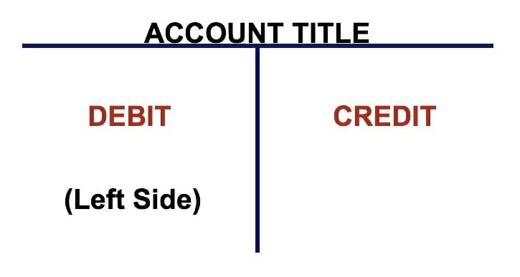
The T-account, however, is composed of 2 sides – the debit side, and the credit side and this is illustrated below.
The left side of the account is the debit side while the right side is the credit side.

Slide 5
T-accounts are used to track debits and credits made to an account.
Each T-account will only display one account.

Slide 6
Understanding T-Account
In double-entry bookkeeping, a widespread accounting method, all financial transactions are considered to affect at least two of a company's accounts. One account will get a debit entry, while the second will get a credit entry to record each transaction that occurs.

Slide 7
What do T accounts focus on?
T-accounts focus on account balances while journal entries focus on transactions.

Slide 8
How are T-accounts used in accounting?
T-accounts help to visualize the process making it clear what is occurring with each transaction.
They are a useful tool for both newcomers to accounting and veteran accountants alike to quickly map out the correct way to record a transaction.

Slide 9
How are T-accounts used in accounting?
Complex entries might have impacts in multiple account. By breaking transactions down into a simple, digestible form, you can visualize which accounts are being debited and which are being credited.
This visual guide helps you ensure figures are being posted in the correct way, potentially reducing data entry errors.

Slide 10


Slide 11


