Slide 1
FUNDAMENTALS OF ACCOUNTING FOR NON-ACCOUNTANTS

Slide 2
BUSINESS FORMS AND JOURNAL ENTRIES

Slide 3
1. How does accounting classify transactions? How does this manner of classifying transactions help users of financial information?
2. Why do you think is the ledger called the book of final entry?
3. What is importance of ledger? What is the use of ledger?
4 .What is difference between journal and ledger?
Discussion Questions

Slide 4
In this attachment to the chapter, business forms and how these business forms become journal entries in the books of accounts are presented. The reason why these are presented is to give students a view of how transactions are captured by source documents and how these are translated into actual journal entries in the books of accounts.

Slide 5
Source documents are business forms that capture the essence of a business transaction. Source documents are normally business forms designated by its primary user. For example, an official receipt, a source document which is a proof that cash is received by the business, is designed by the business who receives the cash. In this case, there can be two types of source documents. The first one is internal, which refers to those documents developed by the business and for use within the business itself. An example of this is a liquidation report, which shows the money received by an employee of a business and a report as to how this was used.

Slide 6
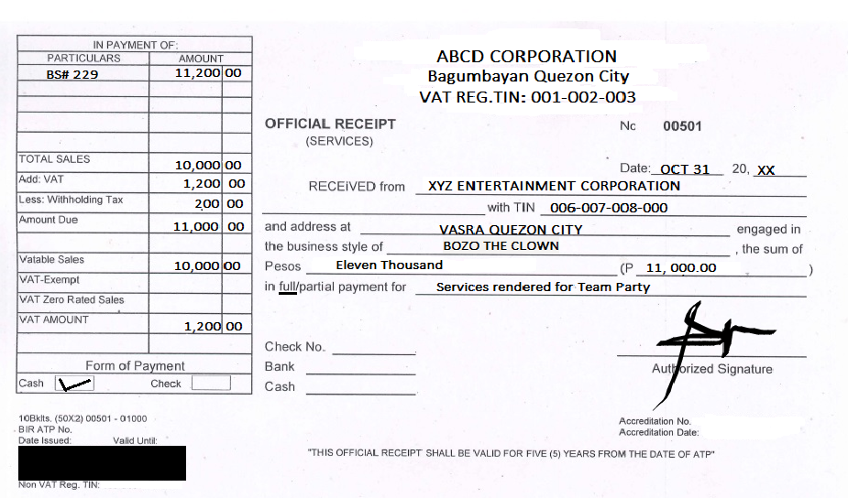
In most cases, we record transactions in the journal by referring to a source documents that captures the essence of the transaction. In this case, we present the samples below:
An official receipt is a form which documents cash received by the business from a customer. Note that the OR is prenumbered and is used in a sequence. To enhance integrity, these receipts need to be regularly audited so as to ensure that all cash receive by the business is actually recorded in the books of accounts.

Slide 7
How is the above transaction recorded in the books of accounts?
We present below the suggested journal entry to record this transactions:
Nature of transaction: Received cash for services rendered:
October 21, 2020 Cash P11,000.00
Service Income P11, 000.00
To record income from services rendered.
In the above, it is assumed that ABCD Corporation is the business, thus its official receipt is a proof of income or revenue.

Slide 8
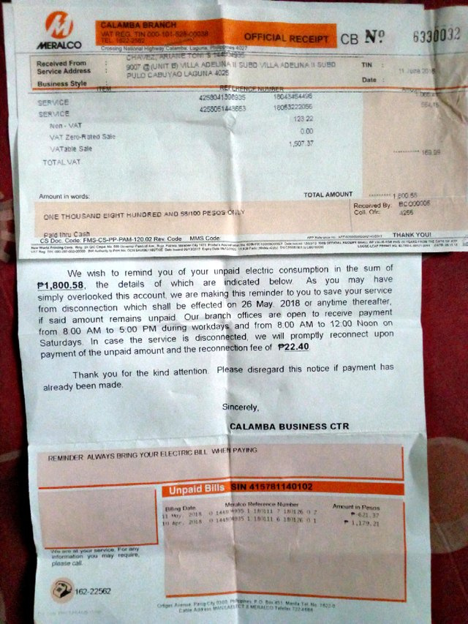
Official Receipt (Expense)

Slide 9
The receipt above is not a proof of revenue on the ABCD Corporation but a proof of paid expense. In this case, ABCD Corp. paid light and water to Meralco for the month of April. When ABCD Corp. paid, it receipt as a proof of payment. The above transaction is recorded in the books of accounts using the following entry:
Nature of Transactions: Payment o electric bill
June 11, 2020 Light and Water P1,800.58
Cash P1,800.58
To record payment of electric bill

Slide 10
Official Receipt (Purchase of an Asset)
If a business also purchase asset, it also receives an official receipt. When it made its payment to the vendor, in this case Thinking Tools, it received the computer as well as this receipt. In this case, the receipt is a proof of payment for the computer which the buyer also needs to show when claiming replacement, or warranty.
An entry to record this transaction is indicated below:
Nature of Transaction: Bought equipment for cash:
September 30, 2021 Equipment P26,000.00
Cash P26,000.00
To record purchase of equipment

Slide 11
Payroll Sheet
A payroll sheet is a summary of hours worked by and equivalent payment to each employee for a particular pay period. The payroll sheet is a form, when approved by appropriate authority, will become the basis for the payment of salaries. A sample of a payroll sheet is shown below.

Slide 12
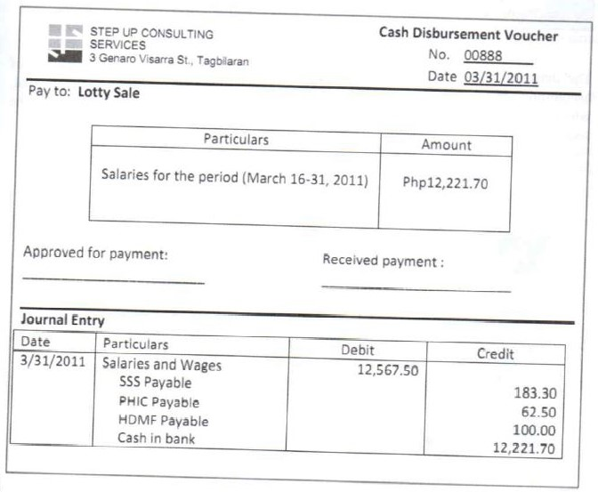
Cash Disbursement Voucher/Check Disbursement Voucher
A cash/check disbursement voucher is a form that authorizes a payment of a particular expense item like salaries, utilities, or even the purchase of supplies and equipment. As such, before we can actually pay a supplier of goods or service, we first get an authorization for it. The authorization is in the form of this voucher.

Slide 13
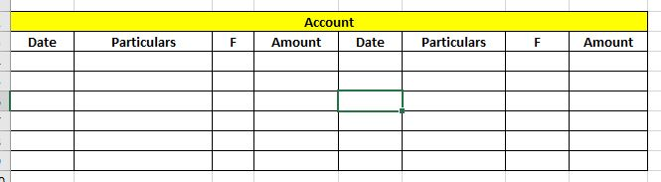
Classifying Transactions through the Ledger
Ledger – is a book or collection of accounts in which account transactions are recorded. Each account has an opening or carry forward balance, would record transactions as either a debit or credit in separate columns and the ending or closing balance.
F-Folio the corresponding journal page where the account posted come from as handy reference.

Slide 14
Why do you think is the ledger called the book of final entry?
The ledger is called the book of final entry because it is the book in which all the business transactions would ultimately find their place.

Slide 15
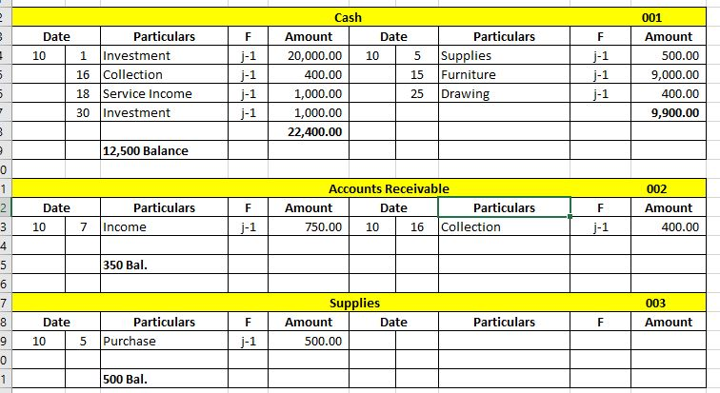
The transactions are posted below:

Slide 16
What is importance of ledger?
A ledger contains summarized information from the journals and is recorded as debits and credits. The ledger is used to prepare financial statements and contains a list of all the accounts, referred to as the chart of accounts, that are active.

Slide 17
What is the use of ledger?
The ledger contains the information that is required to prepare financial statements. It includes accounts for assets, liabilities, owners' equity, revenues and expenses. This complete list of accounts is known as the chart of accounts. The ledger represents every active account on the list.

Slide 18
What is difference between journal and ledger?
The key difference between Journal and Ledger is that Journal is the first step of the accounting cycle where all the accounting transactions are analyzed and recorded as the journal entries, whereas, ledger is the extension of the journal where journal entries are recorded by the company in its general ledger account ...

Slide 19
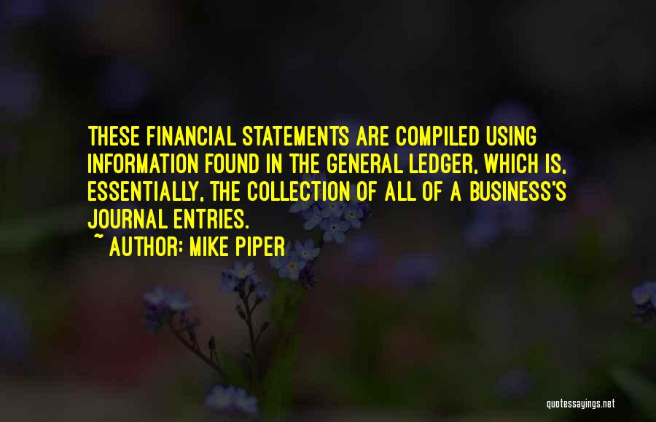

Slide 20
Please study in advance about adjusting entries.

Slide 21


