Slide 1
FUNDAMENTALS OF ACCOUNTING FOR NON-ACCOUNTANTS

Slide 2
ADJUSTING ENTRIES

Slide 3
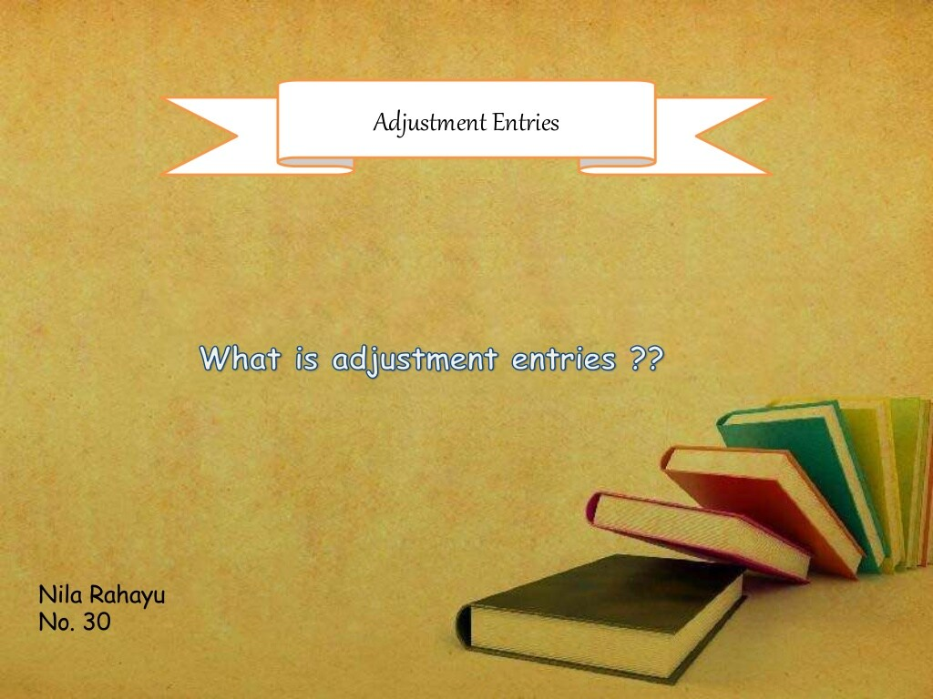

Slide 4


Slide 5
What is the meaning of adjustment entries?
Adjusting entries refers to a set of journal entries recorded at the end of the accounting period to have an updated and accurate balances of all the accounts. Adjusting entries are mere application of the accrual basis of accounting.

Slide 6
Why the adjusting entries are needed
The purpose of adjusting entries is to ensure that your financial statements will reflect accurate data. If adjusting entries are not made, those statements, such as your balance sheet, profit and loss statement, (income statement) and cash flow statement will not be accurate.

Slide 7
What is the purpose of adjusting journal entries?
Adjusting journal entries are used to reconcile transactions that have not yet close. These can be either payments or expenses whereby the payment does not occur at the same time as delivery.

Slide 8
What are adjustment entries explain using few examples?
Examples of Adjusting Entries
A company shipped goods on credit, but the company's sales invoice was not processed as of the end of the accounting period.
A company received some goods from a vendor but the vendor's invoice had not been processed by the company as of the end of the accounting period.

Slide 9
What are the 4 types of adjusting entries?
There are four types of account adjustments found in the accounting industry. They are accrued revenues, accrued expenses, deferred revenues and deferred expenses.

Slide 10
4 types of adjusting entries
1. Accrued Revenues - Accrued revenue is revenue that has been earned by providing a good or service, but for which no cash has been received. Accrued revenues are recorded as receivables on the balance sheet to reflect the amount of money that customers owe the business for the goods or services they purchased.
How do you determine accrued revenue?
When accrued revenue is recorded, accrued revenue is recognized on the income statement as revenue, and an associated accrued revenue account on the company's balance sheet is debited by the same amount, usually under accounts receivable.

Slide 11
2. Accrued Expenses – An accrued expense, also known as an accrued liability, is an accounting term that refers to an expense that is recognized on the books before it has been paid. ... Since accrued expenses represent a company's obligation to make future cash payments, they are shown on a company's balance sheet as current liabilities.
Examples of accrued expenses include: Utilities used for the month but an invoice has not yet been received before the end of the period. Wages that are incurred but payments have yet to be made to employees. Services and goods consumed but no invoice has been received yet.

Slide 12
3. Deferred Revenues - is when a company receives payment from a customer before the product or service has been delivered; however, the payment is not yet counted as revenue. Deferred revenue, which is also referred to as unearned revenue, is listed as a liability on the balance sheet because, under accrual accounting, the revenue recognition process has not been completed.
Examples:
Deferred revenue represents payments received by a company in advance of delivering its goods or performing its services.

Slide 13
4. Deferred Expenses - also known as deferred charges, refer to expenses that have been paid but not yet incurred by the business. Common prepaid expenses may include monthly rent or insurance payments that have been paid in advance
Examples of deferred expenses are: Interest costs that are capitalized as part of a fixed asset for which the costs were incurred. Insurance paid in advance for coverage in future months. The cost of a fixed asset that is charged to expense over its useful life in the form of depreciation.

Slide 14
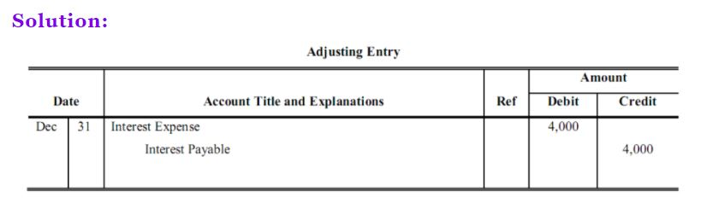
Problem 1:
At year end, unrecorded interest expense due to creditors was 4,000 (payable in the next year). Prepare the adjusting entry at year end (12/31):

Slide 15
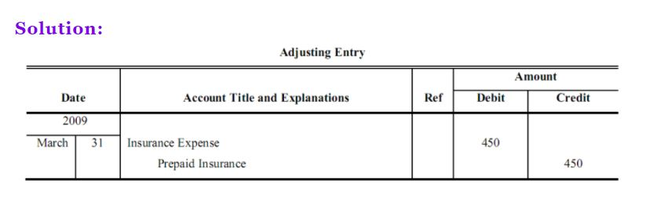
Problem 2:
Prepaid Insurance account began the year with a balance of 230. During the year, insurance in the amount of 570 was purchased. At the end of the year March 31st, 2009 the amount of insurance still unexpired was 350. Prepare the year end adjusting entry:

Slide 16
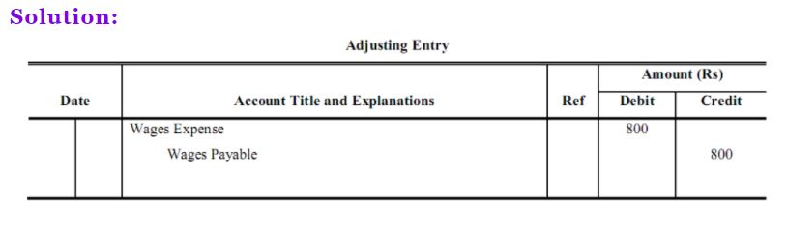
Problem 3:
Wages are paid every Saturday for a five day work week (Mon – Fri; two days are unpaid and free). Wages are 2,000 per week. Prepare the adjusting entry on June 30, assuming July 1 falls on a Wednesday:

Slide 17
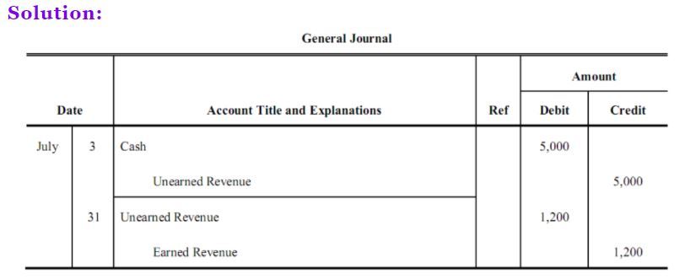
Problem 4:
On July 3, a deposit in the amount of 5,000 was received for services to be performed. By the end of the month, services in the amount of 1,200 were performed. Prepare journal entries for the original receipt of the deposit and the adjusting entry on 31st July:

Slide 18
Depreciation: Arnold Corporation records the 12,000 of depreciation associated with its fixed assets during the month. The entry is:
Depreciation Expense 12, 000
Accumulated Depreciation 12,000

Slide 19
Allowance for bad debts: Arnold Corporation adds 5,000 to its allowance for doubtful accounts. The entry is:
Bad Debts Expense 5,000
Allowance for Doubtful Accounts 5,000

Slide 20
Accrued revenue: Arnold Corporation accrues 50,000 of earned but unbilled revenue. The entry is:
A/R – Accrued 50,000
Sales 50,000

Slide 21
Accrued expenses: A supplier is late in sending Arnold Corporation a materials-related invoice for 22,000, so the company accrues the expense. The entry is:
Cost of goods sold (expense) 22,000
Accrued expenses (liability) 22,000

Slide 22
Short Drill
Get ½ sheet of paper

Slide 23
Exercises (Prepare Adjusting Entries) 10 points each
At year end, unrecorded interest expense due to creditors was 10,000 (payable in the next year). Prepare the adjusting entry at year end (12/31):
Wages are paid every Saturday for a five day work week (Mon – Fri; two days are unpaid and free). Wages are 2,500 per week. Prepare the adjusting entry on June 30, assuming July 1 falls on a Thursday:
Kyle Corporation pays 30,000 toward the next month's rent. The company records this as a prepaid expense. The entry is:

Slide 24
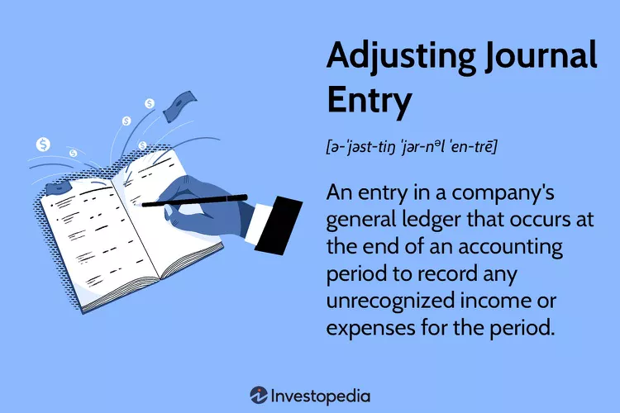

Slide 25


