Slide 1
WHAT IS LARAVEL?
PHP web application framework
Created by Taylor Otwell

Slide 2
Laravel’s Features
Elegant Syntax
Developer-Friendly Tools
Robust Ecosystem

Slide 3
Laravel is a Framework, not a Language!
Routing
Database Access
Security related packages
Working with files and storage
Handling requests and responses
Caching

Slide 4
Benefits of Using Laravel
PHP is the most widely used server-side language
Simplicity, speed, and scalability
Security
Community and Documentation

Slide 5
Model-View-Controller (MVC) Architecture

Slide 6
Model
Data related logic
Interactions with database (SELECT, INSERT, UPDATE, DELETE)
Communicates with controller

Slide 7
View
What the end user sees (UI)
Usually consists of HTML/CSS
Communicates with the controller
Can be passed dynamic values from the controller
Template Engines

Slide 8
Controller
Receives input (from view, url)
Process request (GET, POST, PUT, DELETE)
Gets data from the model
Passes data to the view

Slide 9
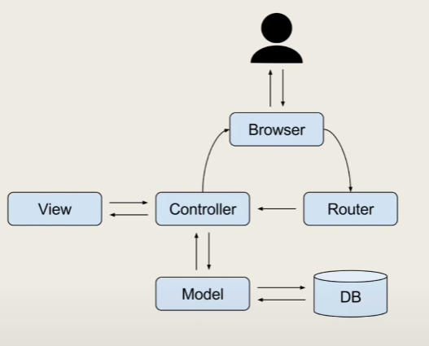

Slide 10
Activity
Give your understanding of the Model-View-Controller Development Paradigm

