Slide 1

Kennesaw Specials
Wade Whitten, Harrison Casey, Alex Helfrich,
Redouene Medjek, Alan Horner

Slide 2
Overview
Kennesaw Specials is a mobile software application that facilitate finding daily specials around your area. The user is able to view a list of specials nearby. The user also, can filter by day, restaurants, or by area.
This application will give users a way to find daily food/beverages deals and prices in their local area without having to search the internet, or call businesses.
The application will also notify users about new specials when they visit a new area.

Slide 3
Benefits
Kennesaw Specials not only benefits the user by giving them greater flexibility in finding all the specials in a specific area, but it will also help increase business advertisement. Currently there is not an easy way for customers to see daily and weekly specials, but this eliminates that problem.
The application would also provide necessary information about the business

Slide 4
Goals
Be able to find daily specials in close proximity, within second of opening the app
Be able to quickly tell the prices
See visuals representation of the restaurants on a map near me
Be able to see deals for the other days as well
Be able to receive notification about specials when visiting a new area

Slide 5
Features
Easy navigation of the application
Application displays the GPS location of the business around you that have specials
Allows you to click on that business and will display information including specials, prices, location , phone number, and hours of operation.
Allow you to direct your search by today or tomorrow, location, or name of business.
Push notification when something new is up , or when driving to a new area

Slide 6
Future Features
Provide the business owners with an account to allow them to change and update specials
Provide a way for customers to contact us about specials that are incorrect, or a new restaurant they would like to see on the application.
Increase the area of restaurants that Kennesaw Specials covers.

Slide 7
Scope
1. Starts with a landing page of visual graphics “Find specials now”
2. First page has two clickable buttons “For today”, “For tomorrow”
3. App displays location pin (asks for your location information) where the user is
4. Within last screen, show icon for daily special that qualify around KSU campus or within a radius
5.On map screen, be able to change radius of search/display. Drop down button
6. Click icon, will display a page about the special
7. Special information page: includes information about the special

Slide 8
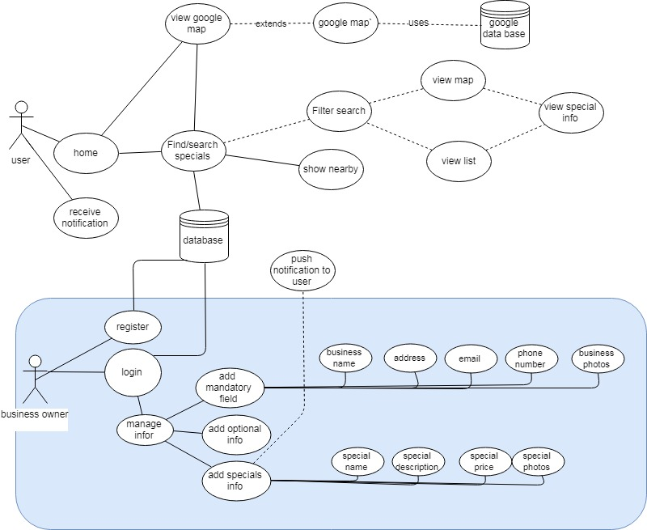
Use-case diagram

Slide 9
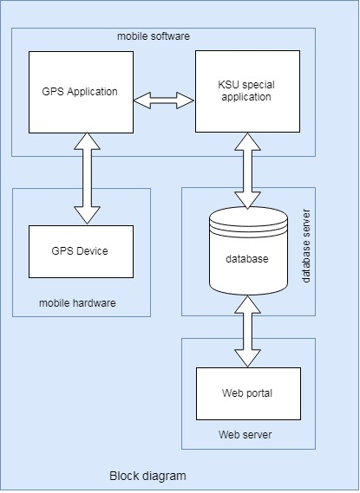
Block diagram

Slide 10
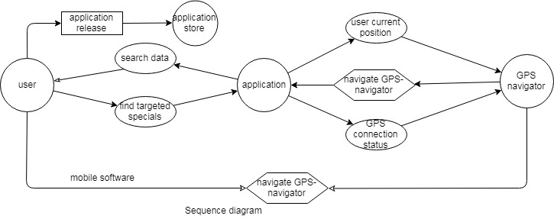
Sequence diag1

Slide 11
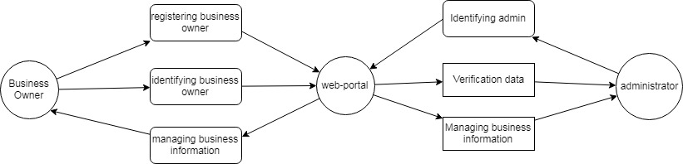
Sequence diag2

Slide 12
Low fidelity prototype
https://pidoco.com/en/prototype-repository

