Slide 1
Supervised machine leaning algorithms for Clustering and Regression for predication
Yoobee Colleges

Slide 2

LEARNING OBJECTIVES
Upon completing this tutorial, you should be able to do the following:
Apply the design process of clustering using a real dataset.
Build and interpret clusters of fitness users.
Transition from descriptive segmentation (clustering) to predictive modeling (regression).
Communicate findings effectively with visual and numerical evidence.

Slide 3
Stage 1: Objectives of Cluster Analysis
Research Questions in Cluster Analysis
Selection of Clustering Variables
Primary Goal
to partition a set of objects into two or more groups based on the similarity of the objects for a set of specified characteristics (the cluster variate).
Two key issues:
The research questions being addressed, and
The variables used to characterize objects in the clustering process.
How to form the taxonomy
creating an empirically based classification of objects.
How to simplify the data
grouping observations for further analysis.
Which relationships can be identified
revealing relationships among the observations within and between groups.

Slide 4
Selection of Clustering Variables
Variable Selection Is Critical Decision
Clustering variables represent to sole means of measuring similarity among objects
As a result, the analysis is constrained based on the variables included.
Two Issues in Variable Selection
Conceptual considerations
Variables characterize the objects being clustered.
Relate specifically to the objectives of the cluster analysis.
Practical considerations.
Should always use the “best” variables available (i.e., little measurement error, etc.)

Slide 5
Rules of Thumb – Objectives of Cluster Analysis
Cluster analysis is used for:
Taxonomy description – identifying natural groups within the data.
Data simplification – the ability to analyze groups of similar observations instead of all individual observations.
Relationship identification – the simplified structure from cluster analysis portrays relationships not revealed otherwise.
Theoretical, conceptual and practical considerations must be observed when selecting clustering variables for cluster analysis:
Only variables that relate specifically to objectives of the cluster analysis are included, since “irrelevant” variables can not be excluded from the analysis once it begins.
Variables are selected which characterize the individuals (objects) being clustered.

Slide 6
Stage 2: Research Design in Cluster Analysis
Types and Number of Clustering Variables
Sample size
Outlier detection
Measuring object similarity
Data standardization
Types and Number of Clustering Variables:
Types of Variables Included
Can employ either metric or non-metric, but generally not in mixed fashion.
Multiple measures of similarity for each type.
Number of Clustering Variables
Can suffer from “curse of dimensionality” when large number of variables analyzed.
Can have impact with as few variables.
Relevancy of Clustering Variables
No internal method of ascertaining the relevancy of clustering variables.
Researcher should always include only those variables with strongest conceptual support.

Slide 7
Is the Sample Size Adequate?
The sample size required is not based on statistical considerations for inference testing, but rather:
Sufficient size is needed to ensure representativeness of the population and its underlying structure.
Of particular interest is the ability to detect small groups within the population.
Minimum group sizes are based on the relevance of each group to the research question and the confidence needed in characterizing that group.
Increasing sample size (e.g., 1000 observations), however, may pose problems for hierarchical clustering methods and require “hybrid” approaches

Slide 8
Detecting Outliers
Outliers can severely distort the representativeness of the results if they appear as structure (clusters) that are inconsistent with the research objectives
They should be removed if the outlier represents:
Aberrant observations not representative of the population.
Observations of small or insignificant segments within the population.
They should be retained if the outlier represents:
an under-sampling/poor representation of relevant groups in the population. In this case, the sample should be augmented to ensure representation of these groups.
Outliers can be identified based on the similarity measure by:
Finding observations with large distances from all other observations – pairwise similarities or summated measure of squared differences from mean of each clustering variable.
Graphic profile diagrams or parallel coordinate graphs highlighting outlying cases.
Their appearance in cluster solutions as single-member or very small clusters.

Slide 9
Defining and Measuring Inter object Similarity
Inter object similarity
an empirical measure of correspondence, or resemblance, between objects to be clustered.
calculated across the entire set of clustering variables to allow for the grouping of observations and their comparison to each other.
Three methods most widely used in applications of cluster analysis:
Distance measures – most often used.
Correlational measures – less often used as they measure patterns, not distance.
Association measures – applicable for non-metric clustering variables.

Slide 10
Types of Distance Measures
Most widely used measure of similarity, with higher values representing greater dissimilarity (distance between cases), not similarity.
Many different distance measures, most common are:
Euclidean (straight line) distance is the most common measure of distance.
Squared Euclidean distance is the sum of squared distances and is the recommended measure for the centroid and Ward’s methods of clustering.
Given the sensitivity of some procedures to the similarity measure used, the researcher should employ several distance measures and compare the results from each with other results or theoretical/known patterns.

Slide 11
Data Standardization
Clustering variables should be standardized whenever possible to avoid problems resulting from the use of different scale values among clustering variables.
Two approaches to standardization
Relative to other cases:
most common standardization is Z scores.
Relative to other responses within an object
If groups are to be identified according to an individual’s response style, then within-case or row-centering standardization is appropriate.

Slide 12
Stage 3: Assumptions of Cluster Analysis
Structure Exists
Since cluster analysis will always generate a solution, researcher must assume that a “natural” structure of objects exists which is to be identified by the technique.
Representativeness of the Sample
Must be confident that the obtained sample is truly representative of the population.
Impact of multicollinearity
Multicollinearity among subsets of variables is an implicit “weighting” of the clustering variables
Potential remedies for multicollinear subsets of variables
Reduce the variables to equal numbers in each set of correlated measures.
Use a distance measure that compensates for the correlation, like Mahalanobis Distance.
Take a proactive approach and include only cluster variables that are not highly correlated.
Structure Exists
Representativeness of the sample.
Impact of multicollinearity.

Slide 13
Stage 4: Deriving Clusters and Assessing Overall Fit
Selecting the partitioning procedure.
Potentially respecify initial cluster solutions by eliminating outliers or small clusters.
Determining the number of clusters.
Other clustering approaches.
Two Approaches to Partitioning Observations
Hierarchical
Most common approach is where all objects start as separate clusters and then are joined sequentially such that each step forms a new cluster joining by two clusters at a time until only a single cluster remains.
Non-hierarchical
the number of clusters is specified by the analyst and then the set of objects are formed into that set of groupings.

Slide 14
Stage 5: Interpretation of the Clusters
Involves examining each cluster in terms of the cluster variate to name or assign a label accurately describing the nature of the clusters.
The cluster centroid, a mean profile of the cluster on each clustering variable, is particularly useful in the interpretation stage.
Interpretation involves examining the distinguishing characteristics of each cluster’s profile and identifying substantial differences between clusters.
Cluster solutions failing to show substantial variation indicate other cluster solutions should be examined.
The cluster centroid should also be assessed for correspondence with the researcher’s prior expectations based on theory or practical experience.

Slide 15
Stage 6: Validation and Profiling of the Clusters
Validation
Profiling
Validation is essential in cluster analysis since the clusters are descriptive of structure and require additional support for their relevance.
Two approaches
Cross-validation – empirically validates a cluster solution by creating two sub-samples (randomly splitting the sample) and then comparing the two cluster solutions for consistency with respect to number of clusters and the cluster profiles.
Criterion validity – achieved by examining differences on variables not included in the cluster analysis but for which there is a theoretical and relevant reason to expect variation across the clusters.

Slide 16
Profiling A Cluster Solution
Describing the characteristics of each cluster on a set of additional variables (not the clustering variables) to further understand the differences between clusters
Examples include descriptive variables (e.g., demographics) as well as other outcome-related measures.
Provides insight to researchers as to nature and character of the clusters.
Clusters should differ on these relevant dimensions. This typically involves the use of discriminant analysis or ANOVA.

Slide 17
Rules of Thumb: Deriving the Final Cluster Solution
There is no single objective procedure to determine the ‘correct’ number of clusters.
Rather the researcher must evaluate alternative cluster solutions on the following considerations to select the “best” solution:
Single-member or extremely small clusters are generally not acceptable and should generally be eliminated.
For hierarchical methods, several ad hoc stopping rules are available to indicate the number of clusters based on the rate of change in a total similarity measure as the number of clusters increases or decreases or measures of heterogeneity.
All clusters should be significantly different across the set of clustering variables.
Cluster solutions ultimately must have theoretical validity assessed through external validation.

Slide 18
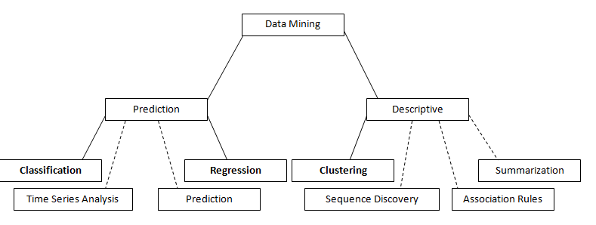
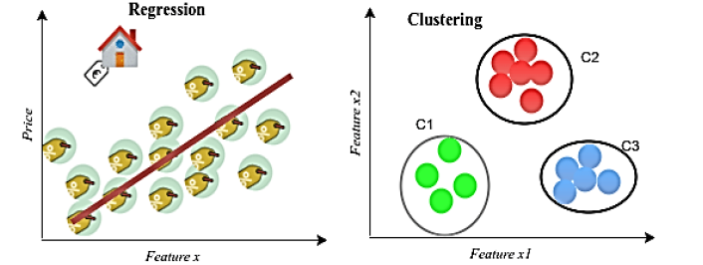
Transition: From Clustering to Regression

Slide 19
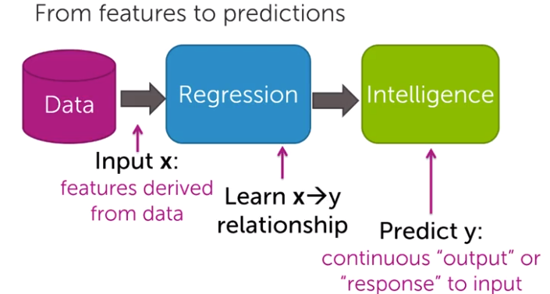
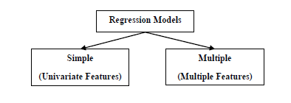
Regression Concept
Regression analysis is a statistical method to model the relationship/correlation between a dependent (target) and independent (predictor) variables with one or more independent variables.
Regression analysis helps us to understand how the value of the dependent variable is changing corresponding to an independent variable when other independent variables are held fixed.
Regression analysis is a way of mathematically sorting out which of those variables does indeed have an impact.
Types of Regression Models
Regression models are of following two types −
Simple regression model − This is the most basic regression model in which predictions are formed from a single, univariate feature of the data.
Multiple regression model − As the name implies, in this regression model, the predictions are formed from multiple features of the data.

Slide 20
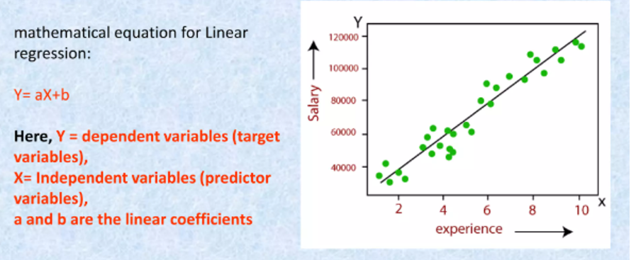
Linear Regression
Linear regression is the most commonly used regression model in machine learning. It may be defined as the statistical model that analyses the linear relationship between a dependent variable with a given set of independent variables. A linear relationship between variables means that when the value of one or more independent variables changes (increase or decrease), the value of the dependent variable will also change accordingly (increase or decrease).
Linear regression is further divided into two subcategories: simple linear regression and multiple linear regression (also known as multivariate linear regression).
In simple linear regression, a single independent variable (or predictor) is used to predict the dependent variable.
Mathematically, the simple linear regression can be represented as follows − Y=mX+b; Y is the dependent variable we are trying to predict, X is the dependent variable we are using to make predictions, m is the slope of the regression line, which represents the effect X has on Y, b is a constant known as the Y-intercept. If X=0, Y would be equal to b

Slide 21
Regression Analysis
Involves identifying and evaluating the relationship between a dependent variable and one or more independent variables, which are also called predictor or explanatory variables.
Useful to assess and adjusting for confounding
Explores relationships that can be readily described by straight lines or their generalization to many dimensions
Single continuous dependent variable + single independent variable, the analysis is called a simple linear regression analysis
Multiple regression explores relationship between several independent or predictor variables and a dependent variable.

Slide 22
Why Use Regression in Data Analytics
Estimate the Effect of One Variable on Another.
Regression tells us how much change in one variable affects another.
Predict Future or Unknown Outcomes.
Regression lets us forecast based on known relationships.
Balance and Compare Group Behavior.
Regression helps compare patterns between clusters
Handle Missing or Incomplete Data.
Regression can estimate missing values logically.
Detect Outliers and Anomalies.
Regression helps identify when something doesn’t fit the usual pattern.

Slide 23
How Regression Differs from Clustering
Concept | Clustering | Regression
Goal | Group similar users based on patterns | Predict one variable from others
Question it answers | Who behaves similarly? | How strongly does X affect Y
Output | User segments or clusters | A prediction equation or trendline
Type of learning | Unsupervised (no labeled outcome) | Supervised (known dependent variable)
Example in Fitness Data | Group users by Steps, Workouts, Duration: e.g., Active / Moderate / Casual | Predict Duration based on Steps and Workouts

Slide 24

Conclusion
Clustering explores natural groupings within data, while regression predicts a specific outcome based on input variables.
Clustering is unsupervised it finds structure without predefined labels. Regression is supervised it learns from known outcomes.
Clustering produces segments or profiles (e.g., Active, Moderate, Casual users). Regression produces a mathematical relationship (e.g., how Steps predict Duration).
Clustering answers “Who are the similar users?”; regression answers “How much does one variable affect another?”
Both can use the same dataset (Steps, Duration, Workouts), but clustering finds hidden patterns; regression quantifies relationships.
Clustering can identify user groups first, and regression can then analyze what drives behavior within each group giving both strategic and predictive insights.
In the fitness dataset, clustering helps define user segments for engagement strategy, while regression helps forecast outcomes like session duration from daily steps.

