Slide 1
Data Visualization with Seaborn
Yoobee Colleges

Slide 2
Lecture Outline
01
Distribution Plots
02
Categorical Plots
displot, jointplot, pairplot, kdeplot, rugplot
barplot, boxplot, violinplot, swarmplot, catplot
03
Matrix Plots
04
Grids
heatmap, clustermap
PairGrid, FacetGrid, JointGrid
05
Regression Plots
06
Style & Color
lmplot, regplot, faceted regressions
themes, context, spines, palettes

Slide 3
PART 1
Distribution Plots

Slide 4
Setup & Built-in Datasets
import seaborn as sns
import matplotlib.pyplot as plt
%matplotlib inline
# Seaborn ships with built-in example datasets
tips = sns.load_dataset('tips')
tips.head()
Datasets reference: https://github.com/mwaskom/seaborn-data

Slide 5
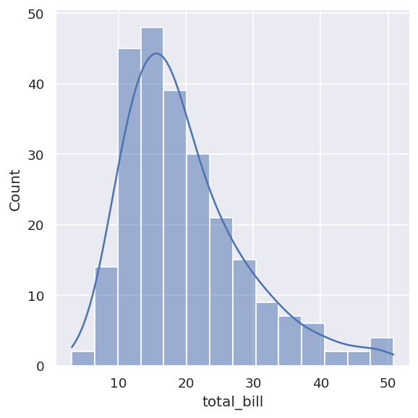
displot — Univariate Distributions
displot() visualizes the distribution of a single (univariate) variable.
Set kde=True to overlay a smoothed Kernel Density Estimate curve.
Use bins=N to control histogram resolution.
Replaces the deprecated distplot() function.

Slide 6
displot — Code Example
# Basic histogram with KDE overlay
sns.displot(tips['total_bill'], kde=True)
# Adjust the number of bins for finer resolution
sns.displot(tips['total_bill'], kde=True, bins=100)

Slide 7
jointplot — Bivariate Relationships
jointplot() pairs two distplots for bivariate data — a scatter (or other) plot in the center with marginal distributions on each axis.
The kind parameter controls the central plot: 'scatter', 'reg', 'hex', 'kde'.
Add hue= to compare groups (e.g., species, sex) within the same plot.
JointGrid is the underlying class — use it for full manual control.

Slide 8
jointplot — Code Examples
# Scatter, regression, and hex-bin variants
sns.jointplot(x='total_bill', y='tip', data=tips, kind='scatter')
sns.jointplot(x='total_bill', y='tip', data=tips, kind='reg')
sns.jointplot(x='total_bill', y='tip', data=tips, kind='hex')
# Grouped KDE with hue
sns.jointplot(data=penguins, x="bill_length_mm", y="bill_depth_mm",
hue="species", kind="kde")
# Full manual control with JointGrid
g = sns.JointGrid(data=penguins, x="bill_length_mm", y="bill_depth_mm", hue="species")
g.plot_joint(sns.scatterplot, size=penguins["body_mass_g"], sizes=(10,100), alpha=0.5)
g.plot_marginals(sns.rugplot, height=0.5, alpha=0.5)

Slide 9
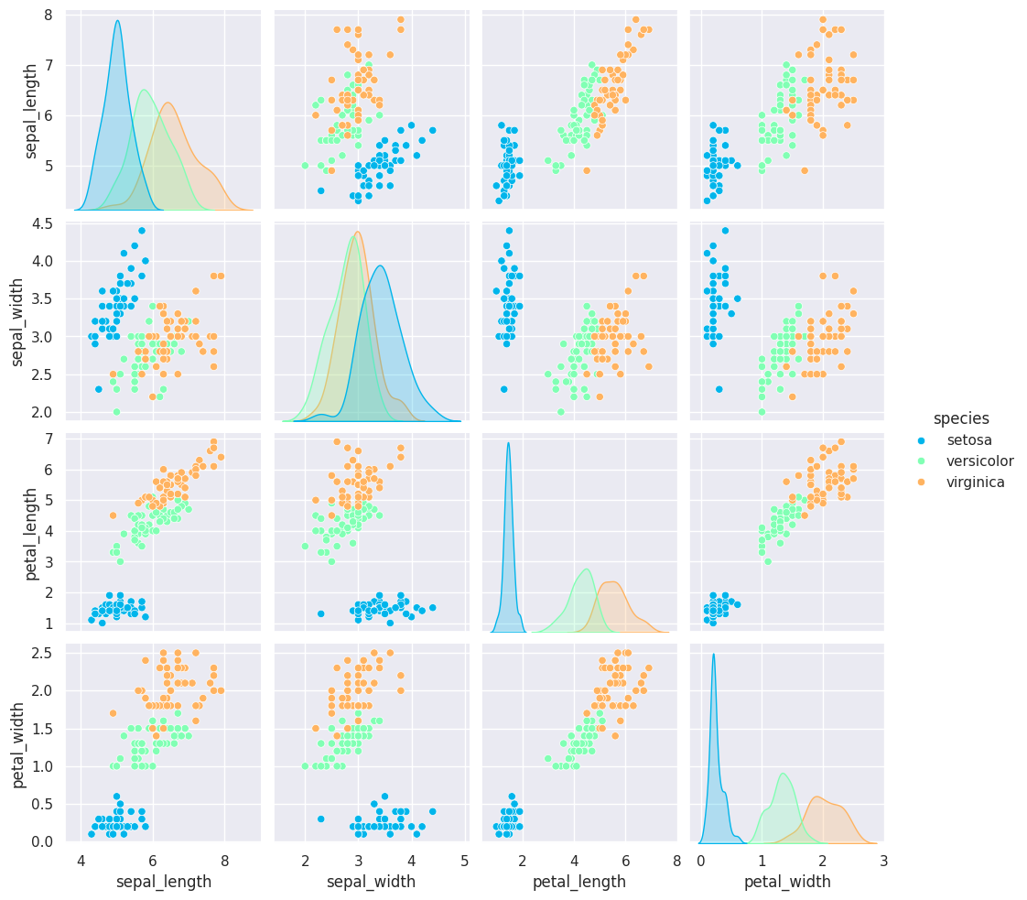
pairplot — Pairwise Relationships
pairplot() plots pairwise relationships across every numeric column in a DataFrame — a full grid of scatter plots plus diagonal histograms.
hue= colors points by a categorical column (e.g., species, smoker).
kind='hist' changes off-diagonal plots to 2D histograms.
corner=True shows only the lower triangle, avoiding redundancy.
x_vars / y_vars restrict the grid to a chosen subset of columns.

Slide 10
pairplot — Code Examples
sns.pairplot(tips)
sns.pairplot(tips, hue="smoker")
sns.pairplot(tips, hue='sex', palette='coolwarm')
sns.pairplot(penguins, hue="species", markers=["o","s","*"])
sns.pairplot(penguins, hue="species", markers=["o","s","*"], corner=True)
# Restrict to a subset of variables
sns.pairplot(
penguins,
x_vars=["bill_length_mm","bill_depth_mm","flipper_length_mm"],
y_vars=["bill_length_mm","bill_depth_mm"],
hue="species"
)

Slide 11
rugplot & kdeplot
rugplot() draws a small tick mark for every observation along an axis — the simplest visualization of a univariate distribution.
kdeplot() draws a Kernel Density Estimate: a smoothed, continuous curve replacing every observation with a small Gaussian.
These are typically layered on top of histplot() / displot() to add detail to the underlying data.

Slide 12
rugplot & kdeplot — Code Examples
# Histogram with rug marks below
sns.histplot(tips['total_bill'], bins=20)
sns.rugplot(tips['total_bill'], color="r")
# KDE curve with rug marks
sns.kdeplot(tips['total_bill'])
sns.rugplot(tips['total_bill'])
# Combine all three: histogram + KDE + rug
sns.displot(tips['total_bill'], kind="hist", kde=True, bins=20)
sns.rugplot(tips['total_bill'], color="r")
Kernel Density Estimation: https://en.wikipedia.org/wiki/Kernel_density_estimation

Slide 13
PART 2
Categorical Plots

Slide 14
barplot & countplot
barplot() aggregates a numeric variable across categories — by default showing the mean with a confidence interval.
Pass a custom estimator (e.g., np.std) to aggregate differently.
countplot() is a special case: it counts occurrences per category, so it takes only x= (no y=).
Both work with hue= to add a second categorical split.

Slide 15
barplot & countplot — Code Examples
import numpy as np
# Mean total_bill by sex, with confidence interval
sns.barplot(x='sex', y='total_bill', data=tips)
# Custom aggregation function
sns.barplot(x='sex', y='total_bill', data=tips, estimator=np.std)
# countplot: counts observations per category
sns.countplot(x='sex', data=tips)

Slide 16
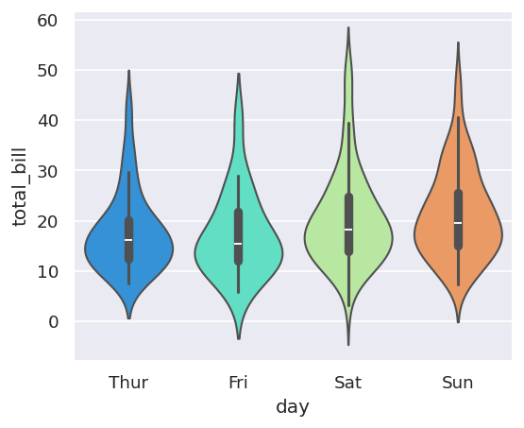
boxplot & violinplot
boxplot() (box-and-whisker) shows the quartiles, median, and outliers of a distribution across categories.
violinplot() shows the same distribution information but with a full KDE shape — useful for seeing multi-modal distributions.
Add hue= for grouped comparisons; split=True on violinplot overlays both halves.
orient='h' switches to horizontal layout for the whole DataFrame.

Slide 17
boxplot & violinplot — Code Examples
# Boxplot by day, colored by smoker status
sns.boxplot(x="day", y="total_bill", hue="smoker", data=tips, palette="coolwarm")
# Horizontal boxplots for the whole DataFrame
sns.boxplot(data=tips, palette='rainbow', orient='h')
# Violin plot split by sex
sns.violinplot(x="day", y="total_bill", data=tips, hue='sex',
split=True, palette='Set1')

Slide 18
stripplot & swarmplot
stripplot() draws a scatterplot where one axis is categorical — every individual observation is visible.
jitter=True spreads overlapping points horizontally for readability.
swarmplot() arranges points to avoid overlap entirely — a 'beeswarm' layout.
Combine with violinplot or boxplot to show both the summary shape and the raw data points.

Slide 19
stripplot, swarmplot & Combinations
sns.stripplot(x="day", y="total_bill", data=tips, jitter=True,
hue='sex', palette='Set1')
sns.swarmplot(x="day", y="total_bill", hue='sex', data=tips, palette="Set1")
# Layer a swarmplot over a violinplot
sns.violinplot(x="tip", y="day", data=tips, palette='rainbow')
sns.swarmplot(x="tip", y="day", data=tips, color='black', size=3)

Slide 20
catplot — The General Interface
catplot() is the unified entry point for all categorical plots.
The kind= parameter selects the plot type: 'strip' (default), 'swarm', 'box', 'violin', 'bar', 'count', 'point'.
Built on FacetGrid, so col= and row= work for automatic faceting.
Recommended starting point for categorical visualization — switch kind to explore.

Slide 21
catplot — Code Example
# General categorical plot — kind controls the underlying plot type
sns.catplot(x='sex', y='total_bill', data=tips, kind='box')
# Other options: kind='violin', 'bar', 'count', 'swarm', 'strip', 'point'
# Faceting works automatically:
# sns.catplot(x='sex', y='total_bill', data=tips, kind='box', col='time')

Slide 22
PART 3
Matrix Plots

Slide 23
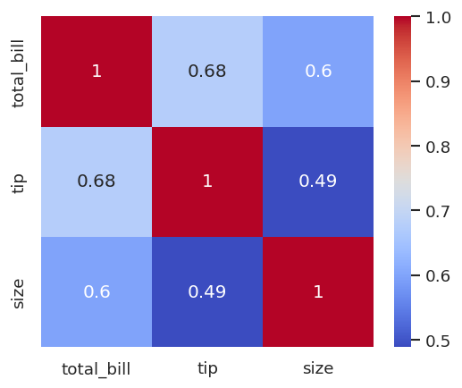
heatmap — Color-Encoded Matrices
heatmap() colors a 2D matrix according to value — your data must already be in matrix form.
Common use: visualize a correlation matrix via df.corr().
annot=True overlays the numeric value on each cell.
For non-correlation data (e.g., flights), use pivot_table() to reshape rows × columns before plotting.
linecolor / linewidths add grid separators between cells.

Slide 24
heatmap — Code Examples
# Correlation matrix heatmap
tip_corr = tips[["total_bill","tip","size"]].corr()
sns.heatmap(tip_corr, cmap='coolwarm', annot=True)
# Reshape time-series data into a matrix first
pvflights = flights.pivot_table(values='passengers', index='month',
columns='year', observed=False)
sns.heatmap(pvflights, cmap='magma', linecolor='white', linewidths=3)

Slide 25
clustermap — Hierarchical Clustering
clustermap() applies hierarchical clustering to both rows and columns, then displays the result as a reordered heatmap.
Rows/columns are grouped by similarity — revealing structure invisible in a plain heatmap (e.g., seasonal patterns in flight passenger counts).
standard_scale=1 normalizes columns so magnitude differences don't dominate the clustering.

Slide 26
clustermap — Code Example
# Cluster months/years by similarity in passenger counts
sns.clustermap(pvflights)
# Normalize for clearer clustering structure
sns.clustermap(pvflights, cmap='coolwarm', standard_scale=1)
Note: axis order changes — rows/columns are grouped by similarity, not original order.

Slide 27
PART 4
Grids

Slide 28
PairGrid — The Engine Behind pairplot
PairGrid() creates an empty grid of axes for pairwise relationships — pairplot() is a convenient wrapper around it.
Use .map() to apply the same plot function to every cell.
Use .map_diag(), .map_upper(), .map_lower() for full control over each region of the grid — e.g., histograms on the diagonal, scatter above, KDE below.

Slide 29
PairGrid — Code Examples
# Create the empty grid, then map a function to every cell
g = sns.PairGrid(iris)
g.map(plt.scatter)
# Different plot types per region of the grid
g = sns.PairGrid(iris)
g.map_diag(plt.hist)
g.map_upper(plt.scatter)
g.map_lower(sns.kdeplot)

Slide 30
FacetGrid — Multi-Panel Plots by Category
FacetGrid() is the general way to create a grid of subplots split by one or two categorical variables.
col= and row= define the grid dimensions (e.g., col='time', row='smoker').
After creating the grid, use .map() to draw the same plot in every panel.
hue= adds a third grouping dimension via color; finish with .add_legend().

Slide 31
FacetGrid — Code Examples
# Create the empty 2x2 grid (smoker x time)
g = sns.FacetGrid(tips, col="time", row="smoker")
# Map a histogram into every cell
g = sns.FacetGrid(tips, col="time", row="smoker")
g = g.map(plt.hist, "total_bill")
# Add a third dimension via hue, plus a legend
g = sns.FacetGrid(tips, col="time", row="smoker", hue='sex')
g = g.map(plt.scatter, "total_bill", "tip").add_legend()

Slide 32
JointGrid — The Engine Behind jointplot
JointGrid() is the general-purpose version of jointplot() — full manual control over the central and marginal plots.
Useful when you need to combine plot types that jointplot's kind= parameter doesn't directly support.
Most of the time, jointplot() and pairplot() are sufficient — reach for the Grid classes only when you need fine-grained customization.

Slide 33
JointGrid — Code Example
# Manual joint + marginal plot composition
g = sns.JointGrid(x="total_bill", y="tip", data=tips)
g = g.plot(sns.regplot, sns.distplot)
# Reference the documentation for advanced grid customization —
# most day-to-day work uses pairplot() / jointplot() / catplot()

Slide 34
PART 5
Regression Plots

Slide 35
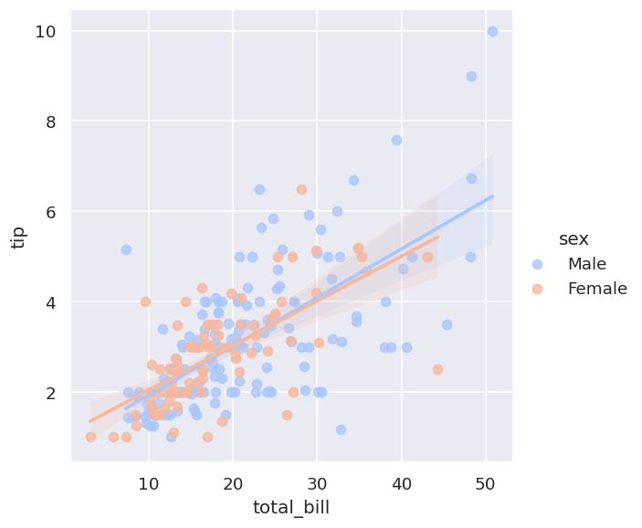
lmplot — Linear Model Plots
lmplot() combines a scatterplot with a fitted linear regression line and confidence interval.
hue= fits and displays separate regression lines per group, with palette= controlling colors.
markers= customizes point shapes per hue group; scatter_kws passes extra arguments (e.g., size) to the underlying scatter.

Slide 36
lmplot — Basic Examples
# Basic linear fit
sns.lmplot(x='total_bill', y='tip', data=tips)
# Separate regression line per group
sns.lmplot(x='total_bill', y='tip', data=tips, hue='sex', palette='coolwarm')
# Customize markers and point size
sns.lmplot(x='total_bill', y='tip', data=tips, hue='sex', palette='coolwarm',
markers=['o','v'], scatter_kws={'s': 100})

Slide 37
Faceted Regressions with Grids
col= and row= split the regression plot into a grid of panels — one regression per facet.
Combine col=, row=, and hue= for rich multi-dimensional comparisons (e.g., day × time × sex).
aspect= and the deprecated height/size= control the size and shape of each facet.

Slide 38
lmplot — Faceted Grid Examples
# Separate column per category
sns.lmplot(x='total_bill', y='tip', data=tips, col='sex')
# Full row/column facet grid
sns.lmplot(x="total_bill", y="tip", row="sex", col="time", data=tips)
# Combine facets with hue, and control aspect ratio / size
sns.lmplot(x='total_bill', y='tip', data=tips, col='day', hue='sex',
palette='coolwarm', aspect=0.6, height=8)
Note: 'size' was renamed to 'height' in modern seaborn versions.

Slide 39
PART 6
Style & Color

Slide 40
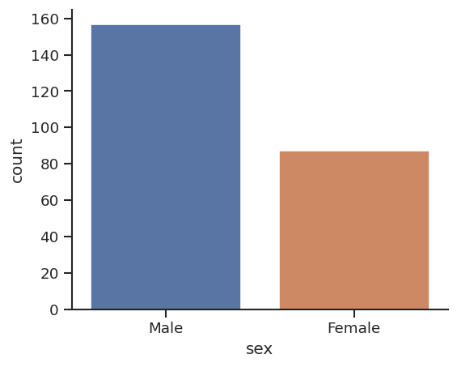
Themes, Spines & Context
sns.set_style() switches the overall theme: 'white', 'dark', 'whitegrid', 'darkgrid', 'ticks'.
sns.despine() removes the top/right plot borders (spines) for a cleaner look; left=True removes more.
sns.set_context() scales fonts/line widths for different output targets: 'paper', 'notebook', 'talk', 'poster'. font_scale= fine-tunes further.
plt.figure(figsize=(w,h)) controls size for non-grid plots; aspect= controls grid-based plots.

Slide 41
Style & Color — Code Examples
# Switch theme styles
sns.set_style('white')
sns.countplot(x='sex', data=tips)
sns.set_style('ticks')
sns.countplot(x='sex', data=tips, palette='deep')
sns.despine() # remove top & right spines
sns.despine(left=True) # also remove left spine
# Control figure size for non-grid plots
plt.figure(figsize=(12, 3))
sns.countplot(x='sex', data=tips)
# Control aspect ratio for grid plots
sns.lmplot(x='total_bill', y='tip', aspect=4, data=tips)
# Scale fonts/lines for presentations
sns.set_context('poster', font_scale=4)
sns.countplot(x='sex', data=tips, palette='coolwarm')
Notes:
Reference: https://stanford.edu/~mwaskom/software/seaborn/tutorial/aesthetics.html

Slide 42
Great Job!
Practice with the Seaborn Exercises notebook to reinforce these concepts.
Reference: https://seaborn.pydata.org

