Slide 1

Week 4 Effective Data Visualization in Data Analytics
Yoobee Colleges

Slide 2
Learning Outcomes: a) Describe the basics of data visualization. b-1) Review the appropriate visualizations for different analytics. b-2) Identify poor vs. strong visuals. c) Use appropriate tools for visualization. d) Integrate storytelling techniques to present data insights. e) Collaborate to analyze and improve real-world visualizations

Slide 3

Common Data visualization libariries in Python
The most widely used and essential libraries for any Python developer are:
Matplotlib: The foundational library for creating static, high-quality 2D and 3D plots. It offers extensive customization but requires more verbose code for complex visuals.
Seaborn: Built on top of Matplotlib, it provides a high-level interface for creating attractive statistical graphics. It simplifies complex plots like heatmaps and violin plots while maintaining Pandas integration.
Plotly: A leading tool for interactive, web-based visualizations. It supports zoom, pan, and hover features and is the engine behind the Dash dashboard framework.

Slide 4
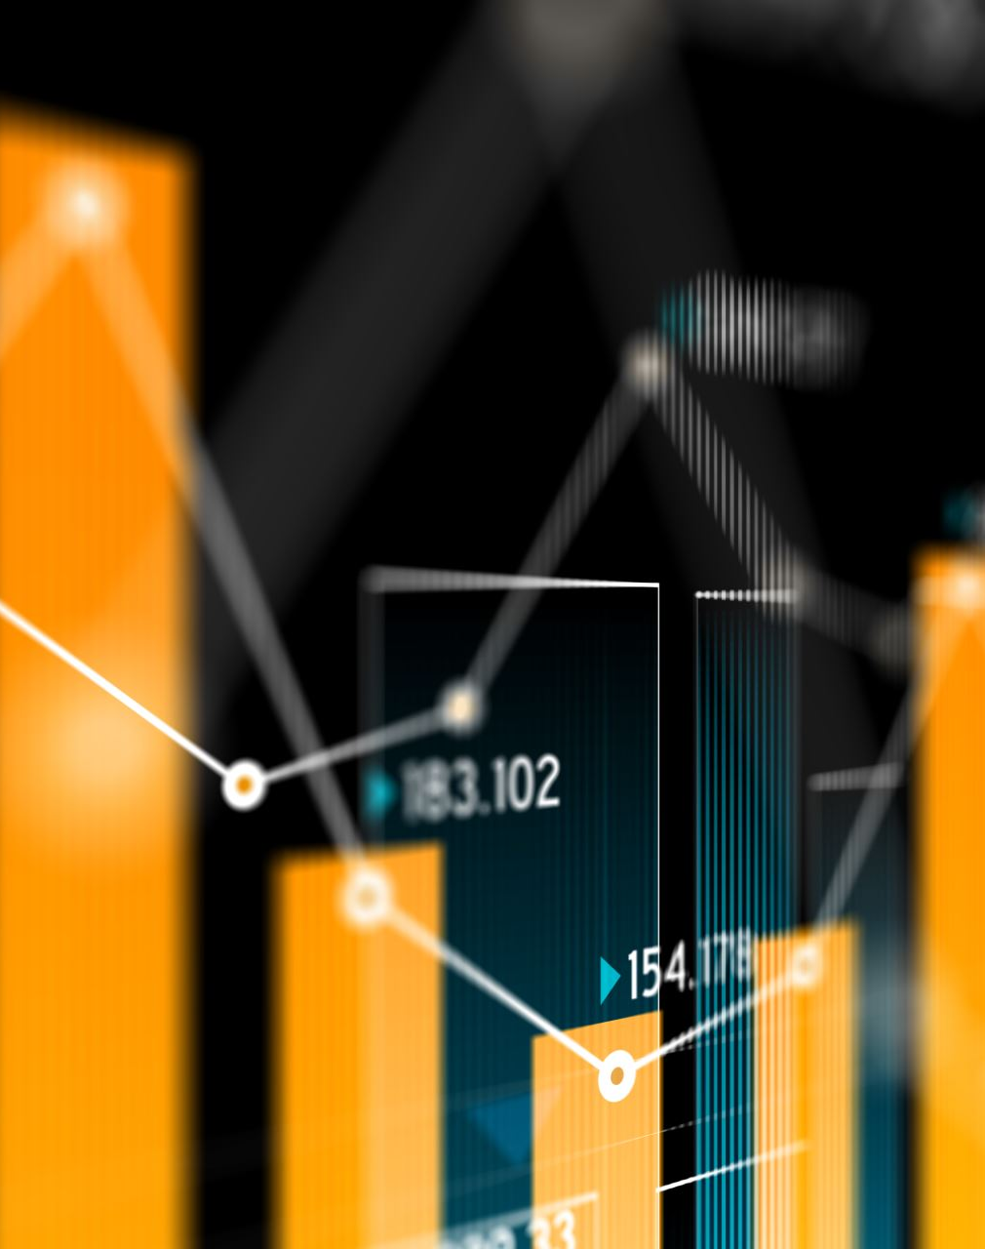
Interactive Tools for Data Visualization
For specific use cases like web deployment or large datasets, these tools are often preferred:
Bokeh: Designed for creating interactive visualizations in modern web browsers. It is particularly effective for real-time streaming data and large-scale datasets.
Altair: A declarative statistical visualization library based on Vega-Lite. Users specify what the chart should show rather than how to draw it, leading to concise and readable code.
plotnine: A Python implementation of the "Grammar of Graphics" used in R's ggplot2. It is ideal for users transitioning from R who prefer a layered approach to building plots.
Pygal: Specializes in high-quality SVG (Scalable Vector Graphics) output. It is best suited for small datasets where visual quality and web embedding are priorities.

Slide 5
Comparison Table for common Tools and libraries for data virilization for software
Feature | Best Libraries | Primary Use Case
Static Plots | Matplotlib, Seaborn | Scientific papers, reports
Interactivity | Plotly, Bokeh, Altair | Web apps, exploratory analysis
Statistical | Seaborn, Altair, plotnine | Exploring data distributions
Geospatial | GeoPandas, Folium, Geoplotlib | Maps and spatial analysis
Dashboards | Dash (Plotly), Streamlit, Panel | Building analytical web apps

Slide 6
Quetion
What is the difference between all these data visualization tools and libraries with Microsoft Bower BI or similar tools?

Slide 7
Better understanding about the comparisons between data visualization tools
1. Python libraries (Matplotlib, Seaborn, Plotly, etc.)
These are code-based tools used inside programming environments (like Python notebooks or apps).
You write code to create visualizations and analysis. Very flexible and customizable. Great for research, prototyping, and advanced analytics.
Can be integrated into AI/ML pipelines.
Example:
Matplotlib → static charts for papers
Plotly → interactive charts in apps
GeoPandas → spatial analysis
Think: “I build everything myself using code.”
2. Dashboard frameworks (Streamlit, Dash, Panel)
These are also code-based but focus on turning your Python code into web apps/dashboards. Still require programming (Python).
Designed to build interactive analytical apps quickly. Often used for sharing models or results with others.
Think: “I build a lightweight web app from my code.”
3. Microsoft Power BI (and similar tools like Tableau)
These are low-code / no-code BI (Business Intelligence) platforms. Mostly drag-and-drop interface (minimal coding).
Designed for business reporting and decision-making. Strong built-in data connectors (Excel, SQL, cloud, etc.).
Focus on dashboards, KPIs, and reporting.
Think: “I connect data and visually build dashboards quickly without coding.”

Slide 8

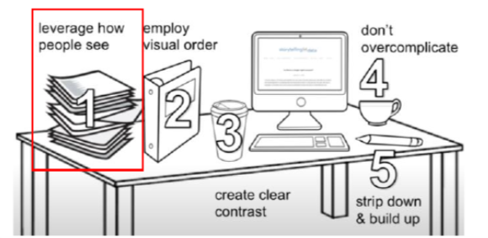
Clutter is your Enemy in Data Visualization
Which one do you think the audience will be able to draw more information/attention from?
Simple is better:
Searching on Google is the simplest thing and this people-centric and ease-of-use approach is what the brand is known for. Therefore, the logo of such a brand needed to be simplistic as well.
Every single element you add to a blank page takes up cognitive load on the part of your audience
Conclusion:
Anything that doesn’t add enough informative value should be removed
Identifying and eliminating such clutter is a key!

Slide 9
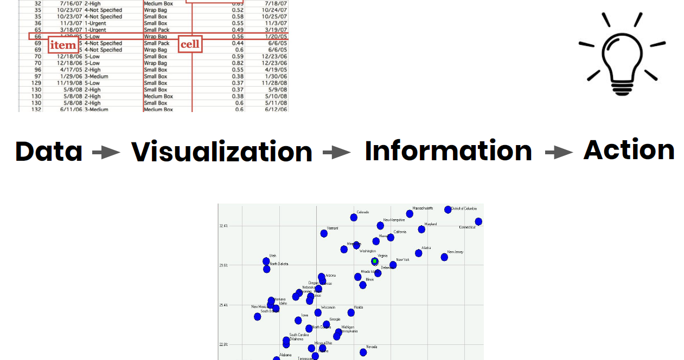

Slide 10
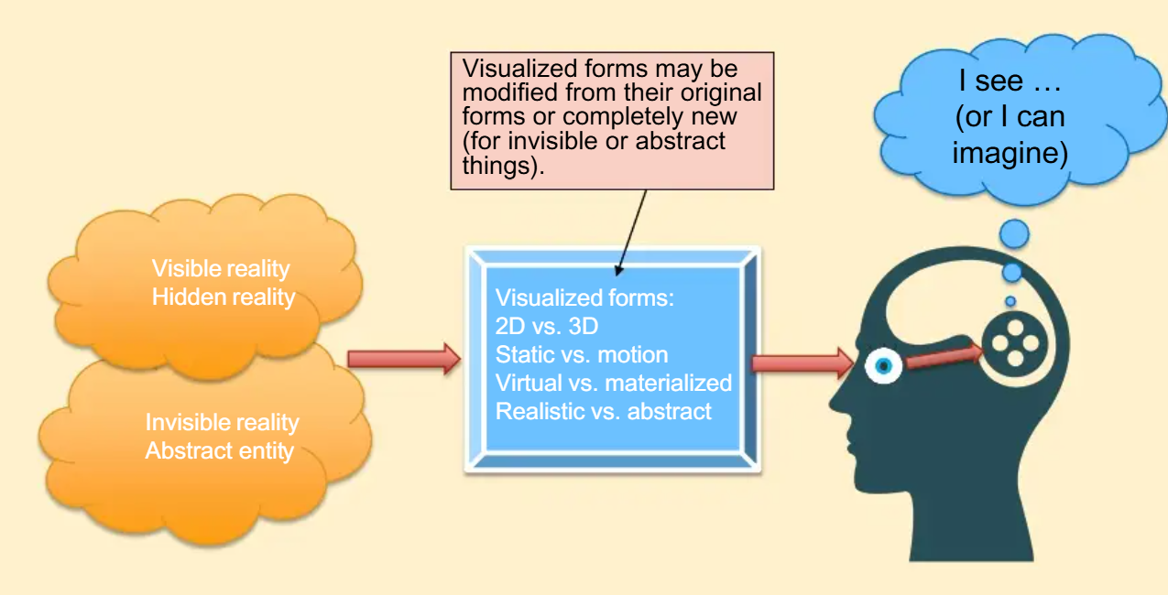
The Basic of Visualization
Visualization is related to vision (seeing through eyes), one of the major human senses to interact with the world.
Visualization is the process of forming visual image of things that can be seen through eyes (or imagined in human mind).
What can be visualized?
Visible reality: person, animal, building, mountain.
Hidden reality: earth core, blood vessel, universe.
Invisible reality: wind, air, heat, electron, sound, smell, magnetic fields.
Abstract entity: data, information, idea, hierarchy, process, relationship.
How to visualize them? – Types/features of visualization forms.
2D vs 3D.
Static vs motion.
Virtual vs materialized.
Realistic vs abstract.
The visualization process (and the result) may change the original form of things (or create a new form) for better understanding and communication.

Slide 11
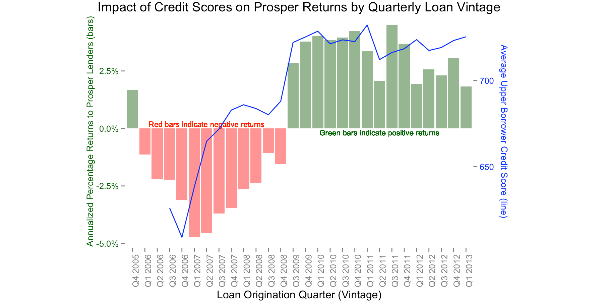
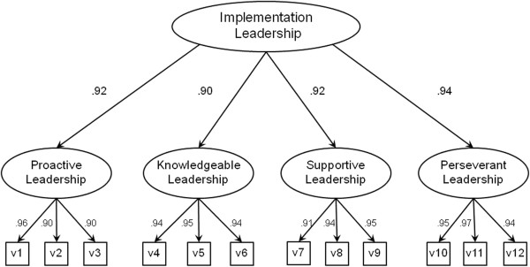
WHAT IS DATA VISUALIZATION?
Makes data understandable: turns raw numbers into visuals people can quickly grasp.
Reveals hidden insights: patterns, trends, and relationships emerge that tables alone can’t show.
Clear communication is the goal: visuals should make the message obvious without confusion.
Balance form and function: attractive visuals are good, but clarity must always come first.
Data is like oil: raw data has little value until processed and refined.
Visualization refines data: helps transform complex datasets into actionable insights.
Interactive visuals matter: allow non-experts to explore and discover insights themselves.
Exploratory Analysis: to identify relationships or unusual cases in the data
Confirmatory Analysis: to confirm our understanding and analysis of the data

Slide 12
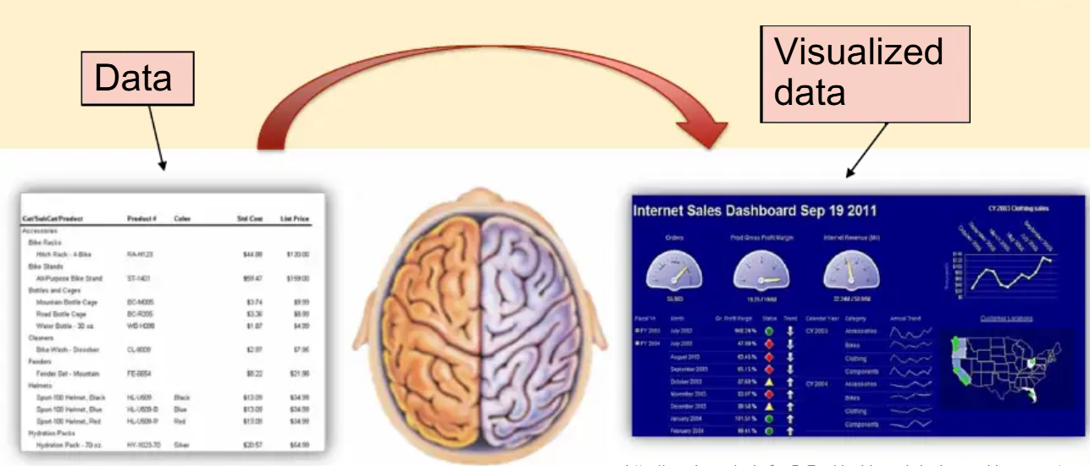
Data Visualization

Slide 13
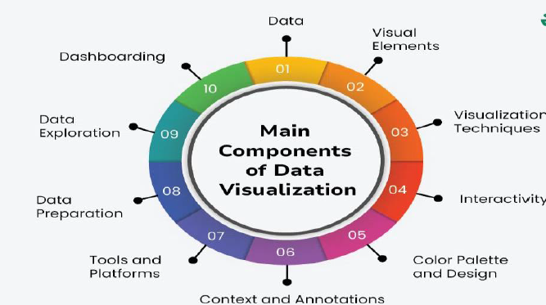
Main components of Data Visualization
Data: First of all, we need lots of data. Data can be of any type like numerical data, text data or geospatial data.
Visual Elements: For instance, Graphics, charts, Overlays, diagrams, figures, maps, tables and other types of data presentations and resumes that comprise infographics.
Visualization Techniques: This also includes aspects such as transforming and scaling data, and in some cases indeed selecting the right type of visualization to use.
Interactivity: Influential aspects of visualization which could include; The blinking bubbles whenever the cursor is over a particular part of the graph, zooming up or down the size of the graph, or even rotating the graph and/or options to have the different groups or categories on or off among others.

Slide 14
Color Palette and Design: New choices on color utilization, font selection, position of elements in unison with the style of design to enhance the usability, visibility and the aesthetic appeal of visualization.
1
Context and Annotations: The additional roles of Titles and Subtitles in the Visualizations and some of the other labels for captions, annotations and legends for further understanding of the analysis.
2
Tools and Platforms: Software that falls under "Other Tools and Applications while developing visualization" Some of the prominent ones are , and more TableauPower BI programming languages and Libraries are D3. js ,Matplotlib and more.
3
Data Preparation: which involves cleaning of data, that is, data Data preparation cleaning processing, data selection, data reshaping and data condensation that gets a data in the right form so that it can be analyzed and visualized.
4
Data Exploration: Simple methods for analyzing the data for searching the pattern, trend, noise, similarity and correlation other than the techniques.
5
Dashboarding: An aggregate display of the two screens to give an overall view of the data collected as well as endlessly monitoring the indicators by having the two tabbed views on the same screen.
6

Slide 15
Why data visualization is such a powerful tool:
Intuitive: Presenting a graph as a node-link structure instantly makes sense, even to people who have never worked with graphs before.
Fast: It is fast because our brains are great at identifying patterns, but only when data is presented in a tangible format. Armed with visualization, we can spot trends and outliers very effectively.
Flexible: The world is densely connected, so as long as there is an interesting relationship in your data somewhere, you will find value in graph visualization.
Insightful: Exploring graph data interactively allows users to gain more in-depth knowledge, understand the context and ask more questions, compared to static visualization or raw data.

Slide 16
Importance of Data Visualization
Data explosion: 2.5 quintillion bytes created daily; raw data is overwhelming without visuals.
Purpose: Transforms complex, unstructured data into patterns and insights people can grasp.
Interactive advantage: Drill down, filter, and explore scenarios for deeper understanding.
Business relevance: Vital for decisions, communication, and consumer clarity (e.g., energy bills).
Criteria for effectiveness:
Informative: conveys the right message
Efficient: free from ambiguity
Appealing: visually engaging
Interactive/Predictive: supports exploration of scenarios
Industry example: Financial services use visualization for fraud detection, quick reviews, and risk insight.
Core takeaway: Connected data hides risks; visualization surfaces insights for confident decisions.
Long history: From early maps and statistics to today’s dashboards — not new, but constantly evolving.

Slide 17
Why Effective Visualization Matters & Anderson’s Principles
Why it matters
Expanding audiences: not just analysts, but business leaders & general users.
Ease of consumption: visuals must be clear for non-experts.
Communicating data is both art + science: many data scientists overlook design.
Melissa Anderson’s Principles
Balance: distribute elements (color, space, titles) evenly.
Emphasis: highlight the key message or insight.
Movement: guide the eye naturally (top → across → down).
Pattern & Repetition: show relationships by repeating shapes or styles.
Proportion: size reflects importance; avoid distortion.
Rhythm: create flow that is visually pleasing.
Variety: keep users engaged with controlled diversity.
Unity: harmony across all elements of the design.

Slide 18
Design Frameworks for Effective Data Visualization
Gestalt Principles (grouping data visually)
Proximity: group with spacing.
Similarity: similar objects are seen as related.
Enclosure: boxes or shading define groups.
Symmetry: balanced visuals avoid confusion.
Closure & Continuity: minds complete shapes/paths.
Connection: linking elements shows relationships.
Figure & Ground: distinguish main focus from background.
Tufte’s Principle (clarity & density in visuals)
Maximize Data-Ink Ratio: remove non-data clutter.
Mobilize Every Graphical Element: all visual components should encode data (avoid “graphical puzzles”).
Maximize Data Density: show more data in less space (small multiples, parallel sequencing, thin lines).
Provide Overview + Details on Demand: allow macro + micro insights in one view.
Layering & Separation: use color/spacing to avoid clutter; test and refine for clarity.
Narratives of Space & Time: show stories of position, order, and chronology.

Slide 19
Best Practices for Data Visualization
Data Visualization as a Storytelling Tool
Visualizations don’t automatically tell a story; they reveal insights that need to be interpreted and connected.
A good storyteller (analyst/presenter) weaves these insights into a clear narrative for the audience.
Five key points for effective storytelling:
Find the compelling narrative: identify the most important insight to highlight.
Understand your audience: tailor the complexity and explanation to their knowledge.
Be objective and balanced: present data fairly without bias.
Don’t censor: show relevant information, even if it challenges assumptions.
Edit carefully: remove distractions, focus on clarity and flow.
Choosing the Right Form of Visualization
5-Second Rule: Capture attention quickly. Titles, instructions, and key takeaways should be immediately clear.
Design and layout matter: Follow design principles like balance, emphasis, movement, pattern, repetition, proportion, rhythm, variety, and unity.
Keep it simple: Avoid overloading charts; only include necessary elements. Simplicity aids understanding.
Pretty doesn’t equal effective: Attractive visuals are good, but clarity and accuracy are more important.
Use color purposefully: Colors should help convey meaning, maintain consistency, and avoid distraction.

Slide 20
Choosing the Right Visualization for Different Data Analysis Tasks
Trend Analysis (Showing changes over time)
Charts: Line charts, bar charts, sparklines, motion charts, scatter plots.
Visual suggestion:
Show a line chart example with a rising trend.
Include a sparkline in a small dashboard panel.
Optional: a motion chart GIF showing multiple trends over time.
Correlation (Finding relationships between variables)
Charts: Scatter plot, bubble chart, heatmap.
Visual suggestion:
Scatter plot with clear correlation vs. no correlation.
Bubble chart showing three variables (x, y, size).
Heatmap matrix for multiple correlations.

Slide 21
3. Part-to-Whole (Showing proportions of a whole)
Charts: Pie chart, stacked bar, side-by-side bar, tree map, square pie.
Visual suggestion:
Side-by-side pie and stacked bar for comparison.
Tree map showing hierarchical data.
Use contrasting colors to differentiate categories.
4. Geographical Data (Showing spatial distribution)
Charts: Choropleth map, symbol map, map with embedded pie/bar charts.
Visual suggestion:
Map of a country/region with color intensity representing values.
Pie charts overlaid on map to show breakdown by region.

Slide 22
Common Mistakes to Avoid
Start
Too much complexity: Trying to show every detail at once overwhelms users. Tip: Start with an MVP (Minimum Viable Product) — just the most important metrics and charts. Build, test, and improve step by step.
Using
Using metrics no one understands: Technical jargon or obscure numbers confuse the audience. Tip: Use plain language. Labels like “Active Users Last 7 Days” are clearer than “7d Monthly Active Users (MAU)”. Add explanations if needed.
Cluttering
Cluttering with unimportant graphics: Fancy widgets, colors, or 3D effects can hide the main message. Tip: Keep visuals simple. Focus on the story you want to tell with the data. Less is more.
Waiting
Waiting for big BI projects: Long, complex software projects can delay insights. Tip: Prototype quickly with small tools or spreadsheets. Iterate and improve gradually.
Underestimating
Underestimating effort: A dashboard looks simple, but it takes time to clean data, design charts, and maintain. Tip: Plan for ongoing updates, QA checks, and someone responsible for keeping it accurate.
Failing
Failing to match metrics to goals: Showing activity doesn’t always show impact. Tip: Make sure each chart connects to a real objective. For example, tracking “page views” isn’t helpful if your goal is “customer retention.”
Confuse or mislead
Poorly designed graphs/charts: Wrong chart type or misleading visuals can confuse or mislead. Tip: Match the chart type to the data. Use line charts for trends, bar charts for comparisons, and always label axes clearly.

Slide 23
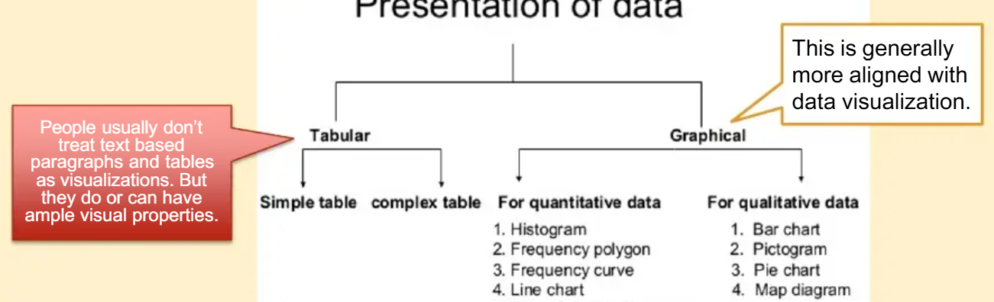
Examples of Data Visualization
Bar Chart:
Purpose: Comparing quantities across categories.
Example: Bar chart showing monthly sales figures for different products.
Line Chart:
Purpose: Displaying trends or changes over a continuous interval.
Example: Line chart illustrating stock prices over a period of six months.
Pie Chart:
Purpose: Showing the proportion of parts to a whole.
Example: Pie chart representing the percentage distribution of expenses in a budget.

Slide 24
Heat Map:
1
Purpose: Visualizing the intensity of values in a matrix.
Example: Heat map indicating website traffic patterns across different time slots.
Scatter Plot:
2
Purpose: Revealing relationships between two variables.
Example: Scatter plot depicting the correlation between advertising spending and sales.
Treemap:
3
Purpose: Displaying hierarchical data using nested rectangles.
Example: Treemap illustrating the distribution of project budgets across departments.
Bubble Chart:
4
Purpose: Combining three dimensions into a two-dimensional space.
Example: Bubble chart representing countries with the size of bubbles indicating population and color indicating GDP.

Slide 25
Comparison of related visualization fields
 | Content | Visual/ Forms Tools | Purpose
Business data visualization | Quantitative data related to business activities; metrics, key performance indicators (KPIs) | Charts, diagrams, dashboards | Data exploration, analysis decision making
General data visualization | General quantitative data | Charts, diagrams, dashboards | Data exploration, analysis decision making
Information visualization | All kinds of information, quantitative and qualitative | Infographics, illustrational diagrams | Information seeking, artistic illustration, casual communication, and story telling
Illustration | Process, structure concepts, ideas | Diagram, image, graphics | Making the content more vivid and engaging, easier to understand the complexity.
Scientific visualization | Real world object or phenomenon, mathematical functions and formulas | Computer generated graphics, 3D reality | Recreate or simulate the real-world object or phenomenon, or visuzlise to algorithm effect
Simulation | Calculated data based on formulas or rules | Animated diagram or virtual reality | Demonstrate the effect of scenarios under certain rules

Slide 26
Future of Data Visualization
Data visualization is evolving
Emerging intelligence sources, multidimensional imaging, and theoretical advances are reshaping analytics.
Visualization is moving from art to science, but core principles remain.
Timeless Principles:
Substance: Every visual element must convey real content (Tufte: “Every pixel should testify directly to content”).
Context & Accuracy: Relative, connected data provides the full picture.
Actionability: Visuals must facilitate decision-making; insights must be actionable.

Slide 27

Q/A?

