Slide 1

Data Cleaning & Visualization Using Power BI
Yoobee Colleges

Slide 2
Learning Outcomes
Understand the Power BI ecosystem
Data Preparation (Import & clean datasets using Power Query)
Create interactive visualizations
Build and publish a dashboard
Apply filters, slicers, and formatting

Slide 3
Session Agenda
Introduction to Power BI
Importing and Cleaning Data
Creating Visualizations
Activity 1 – Data Cleaning Task (20 mins)
Building Interactive Dashboards
Activity 2 – Dashboard Challenge (20 mins)
Wrap-up and Q&A (10 mins)

Slide 4
What is Power BI?
Business Intelligence and Data Visualization Tool
Developed by Microsoft
Connects to Excel, SQL, Web APIs, CSV, and Cloud Data Sources
Used for dashboards, KPIs, and reporting

Slide 5
Power BI Components
Power BI Desktop – report development
Power BI Service – sharing and collaboration
Power BI Mobile – access dashboards on mobile devices
Power Query – data transformation tool
DAX – calculation language

Slide 6
Getting Started with Power BI Desktop
Open
Install & Open Power BI Desktop
Select
Select Get Data
Import
Import Excel or CSV dataset
Explore
Explore Data View, Report View, and Model View

Slide 7
Data Cleaning with Power Query
Rename
Rename columns
Remove
Remove duplicates and null values
Change
Change data types
Filter and transform
Filter and transform rows
Apply and load
Apply and load cleaned data

Slide 8

Activity 1 – Data Cleaning
Objective: Clean a messy chocolate sales dataset
Tasks:
• Remove blank rows
• Rename columns
• Correct data types
• Filter invalid values
Expected Outcome: A clean dataset ready for reporting

Slide 9
Creating Visualizations
Create bar charts, line charts, and pie charts
Use KPI cards for summary metrics
Add slicers for interactivity
Customize titles, colors, and labels

Slide 10
Basic DAX Calculations
Create measures using DAX
Examples:
Total Sales = SUM(Sales[Amount])
Average Profit = AVERAGE(Sales[Profit])
Profit Margin = DIVIDE([Profit],[Sales])

Slide 11
Building Interactive Dashboards
Arrange
Arrange visuals into a report layout
Add
Add filters and slicers
Enable
Enable drill-down functionality
Use
Use bookmarks and navigation buttons

Slide 12
Activity 2 – Dashboard Design Challenge
Objective: Build an interactive dashboard
Requirements:
• Add at least 3 visuals
• Include one slicer
• Create one KPI card
• Apply formatting and theme
Expected Outcome: Interactive dashboard presentation

Slide 13
Best Practices
Keep
Keep dashboards simple and readable
Use
Use consistent colors and formatting
Avoid
Avoid cluttered visuals
Focus on
Focus on key KPIs and business insights
Test
Test dashboard interactivity

Slide 14
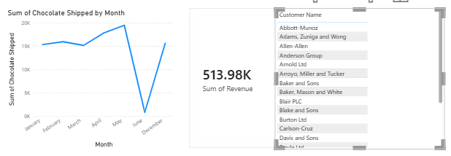
Best Practices –Activity 1

Slide 15
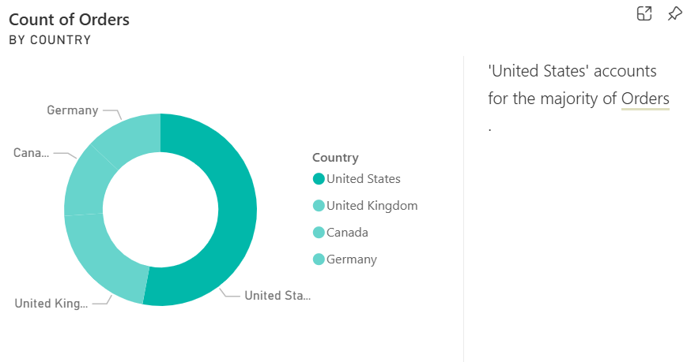
Best Practices –Activity 2 – Sample 1

Slide 16
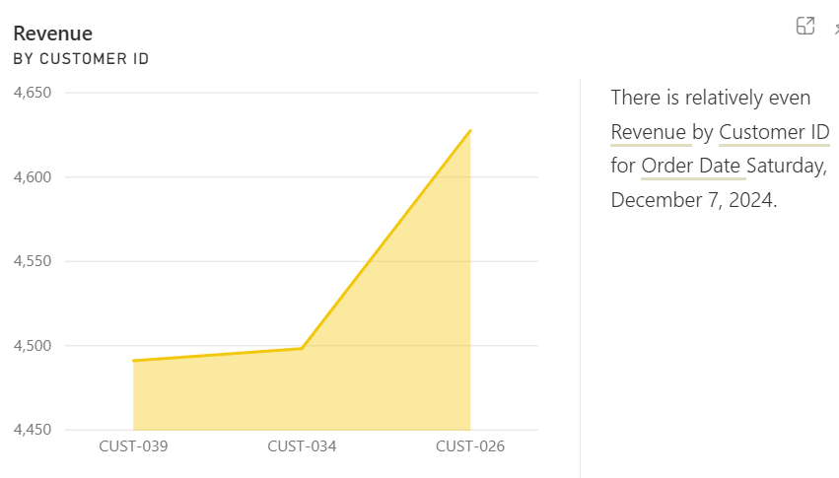
Best Practices –Activity 2 – Sample 2

Slide 17
Resources for Learning
Microsoft Learn – Power BI
Practice sample datasets from Kaggle
Tutorial & eBook Oreilly:
https://learning.oreilly.com/course/microsoft-power-bi/9781837634682/
https://learning.oreilly.com/library/view/the-definitive-guide/9780138244767/
https://learning.oreilly.com/library/view/analytics-engineering-with/9798341645868/
Notes:
Help link: https://www.youtube.com/watch?v=VaOhNqNtGGE

Slide 18
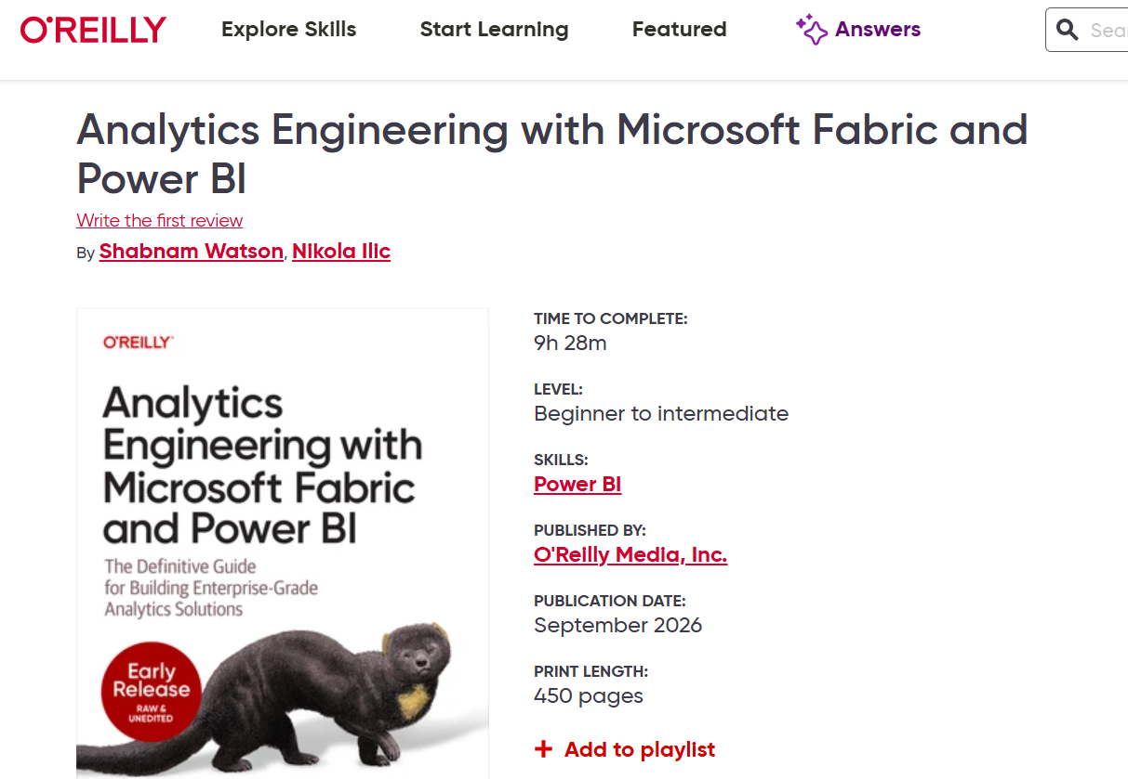

Slide 19
Q&A and Wrap-Up
Recap of key concepts
Share dashboards with classmates via Teams
Practice with your own datasets for next session
Thank you!

