Slide 1

Advanced Data Analysis with AI and ML

Slide 2
Overview
Supervised vs. Unsupervised Learning - ML algorithms overview (Regression, Classification)
Data preprocessing, feature selection
Overview of predictive modelling

Slide 3
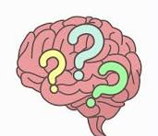
Supervised vs. Unsupervised Learning - ML algorithms
What is Supervised and Unsupervised Learning?
Understand the Classification of ML……

Slide 4
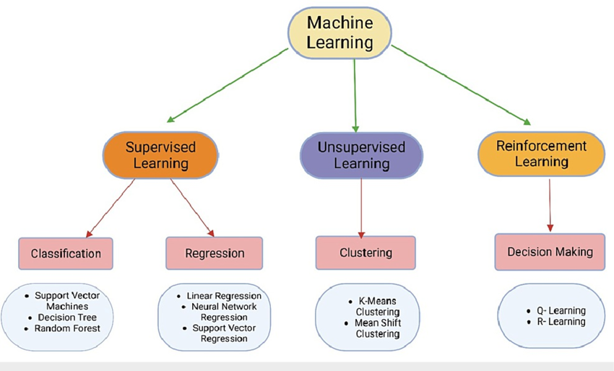
Supervised vs. Unsupervised Learning - ML algorithms
Classification of ML:
Machine learning algorithms are broadly classified into three types:
Supervised learning
Unsupervised learning
Reinforcement learning

Slide 5
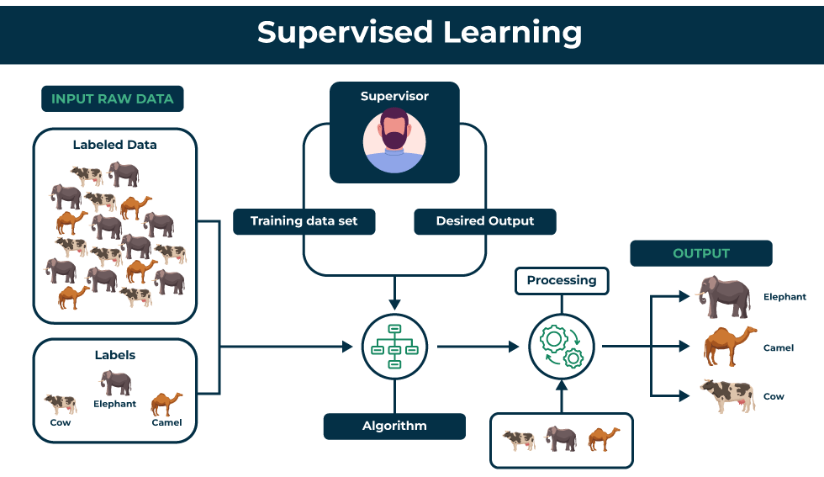
Introduction to AI/ML in Business Context

Slide 6
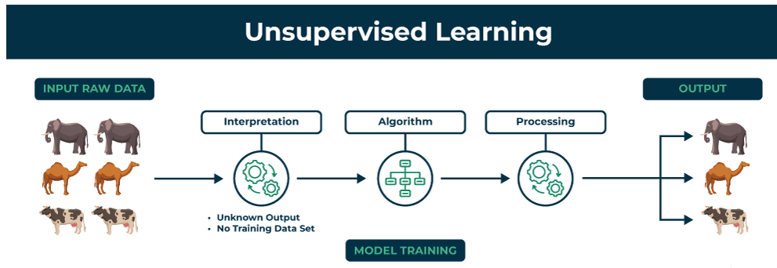
Introduction to AI/ML in Business Context

Slide 7
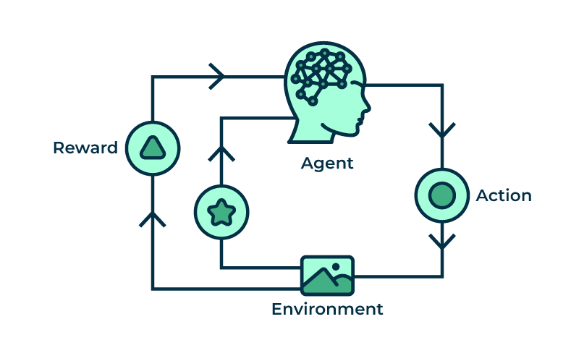
Introduction to AI/ML in Business Context
Reinforcement Learning:

Slide 8
Supervised vs. Unsupervised Learning - ML algorithms
Classification of ML:
Machine learning algorithms are broadly classified into three types:
Supervised learning
Unsupervised learning
Reinforcement learning

Slide 9
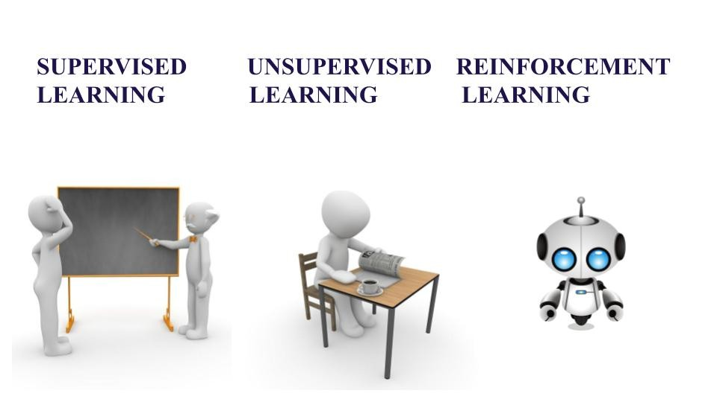
Supervised vs. Unsupervised Learning - ML algorithms
Classification of ML:
Supervised learning
Learning with a teacher.
The model is trained on a labeled dataset, meaning each input has a corresponding output.
Labeled Data: Training data has predefined labels.
Types of Problems: Used for classification tasks like spam detection and regression tasks like predicting house prices.
Algorithms: Linear Regression, Logistic Regression, SVM, Decision Trees, Neural Networks.

Slide 10
Supervised vs. Unsupervised Learning - ML algorithms
Classification of ML:
Unsupervised learning
Works with data that has no predefined labels.
The model identifies patterns, clusters, or associations independently.
Unlabeled Data: No predefined outputs.
Types of Problems: Used for clustering tasks like customer segmentation and association tasks like market basket analysis.
Algorithms: K-Means, Hierarchical Clustering, Autoencoders.

Slide 11
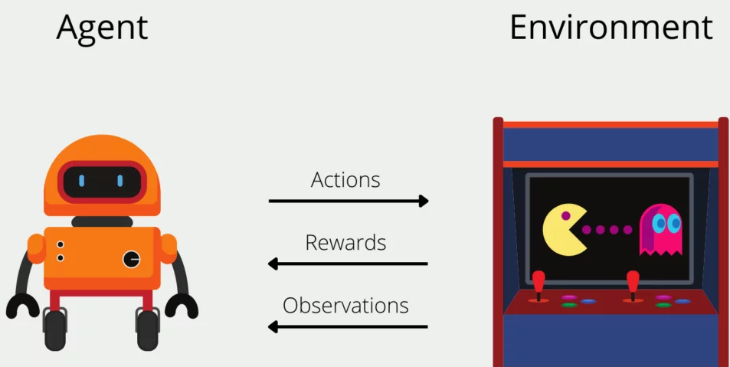
Supervised vs. Unsupervised Learning - ML algorithms
Classification of ML:
Reinforcement learning
Involves an agent that interacts with an environment, learning through rewards and penalties to maximize long-term success.
Interaction-Based Learning: The agent learns by taking actions and receiving feedback.
No Labeled Data: Learns from trial and error.
Algorithms: Q-learning, Deep Q-Networks (DQN).

Slide 12
Supervised vs. Unsupervised Learning vs. RL - ML algorithms
Criteria | Supervised Learning | Unsupervised Learning | Reinforcement Learning
Definition | Learns from labeled data | Identifies patterns in unlabeled data | Learns through interaction with environment
Type of Data | Labeled data | Unlabeled data | No predefined data learn from environment
Type of Problems | Classification, Regression | Clustering, Association | Sequential decision-making
Supervision | Requires external supervision | No supervision | No supervision, learns from feedback
Algorithms | SVM, Decision Trees, Neural Networks | K-Means, Autoencoders | Q-learning, DQN
Goal | Predict outcomes accurately | Discover hidden patterns | Optimize actions for maximum rewards
Applications | Medical diagnosis, fraud detection | Customer segmentation, anomaly detection | Self-driving cars, robotics, gaming

Slide 13
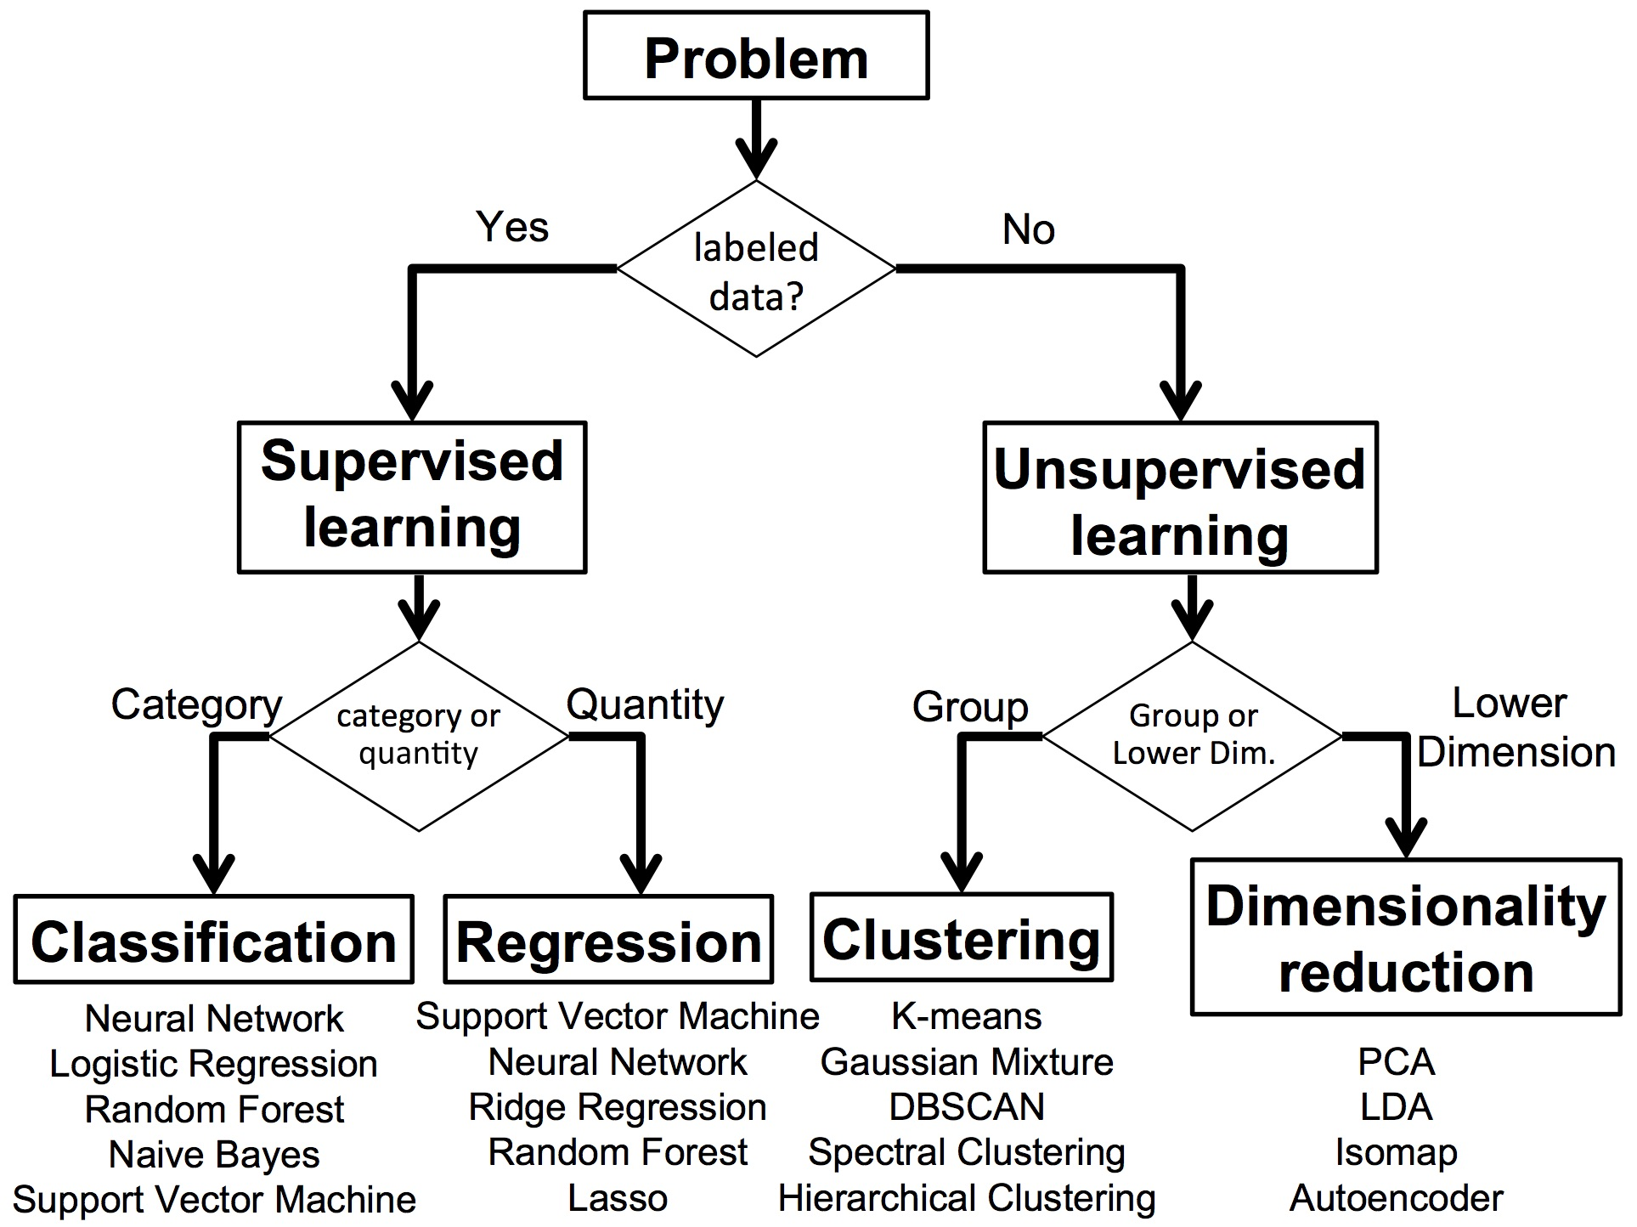
Supervised vs. Unsupervised Learning- ML algorithms

Slide 14
Supervised vs. Unsupervised Learning- ML algorithms

Slide 15
Supervised Learning - ML algorithms
Classification Algorithm:
Regression Algorithm:
The model tries to predict the correct label of a given input data.
Classification is used when you want to categorize data into different classes or groups.
For example, classifying emails as "spam" or "not spam" or predicting whether a patient has a certain disease based on their symptoms or Image classification (cat or dog).
It estimates the relationships between variables to predict.
Regression algorithms predict a continuous value based on input data.
This is used when you want to predict numbers such as income, height, weight, or even the probability of something happening (like the chance of rain).

Slide 16
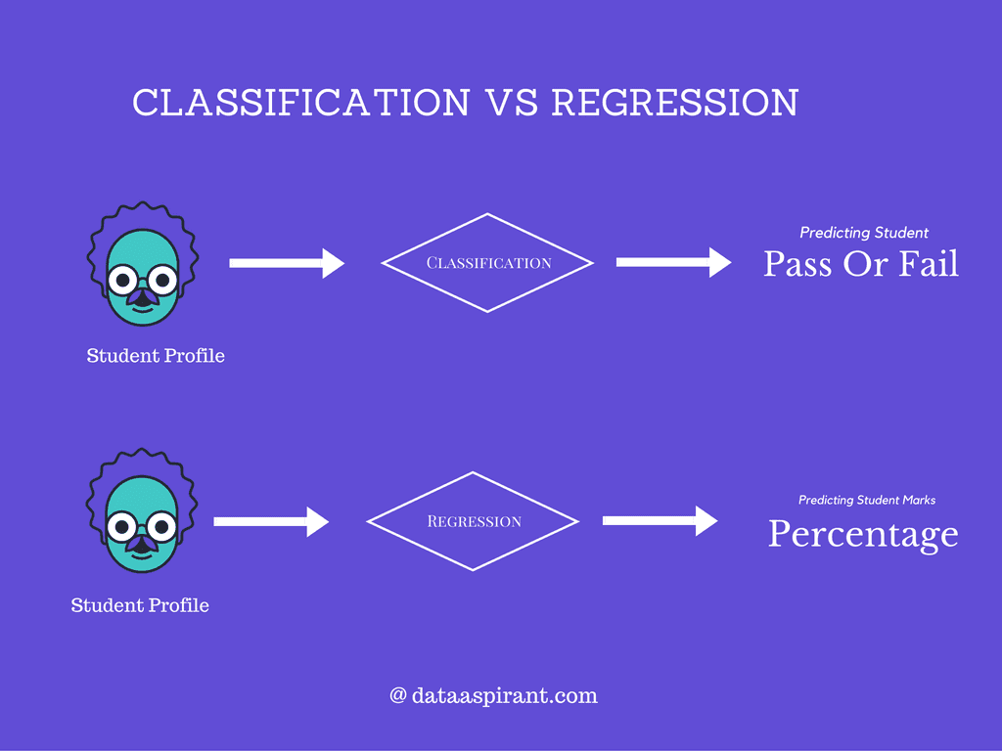
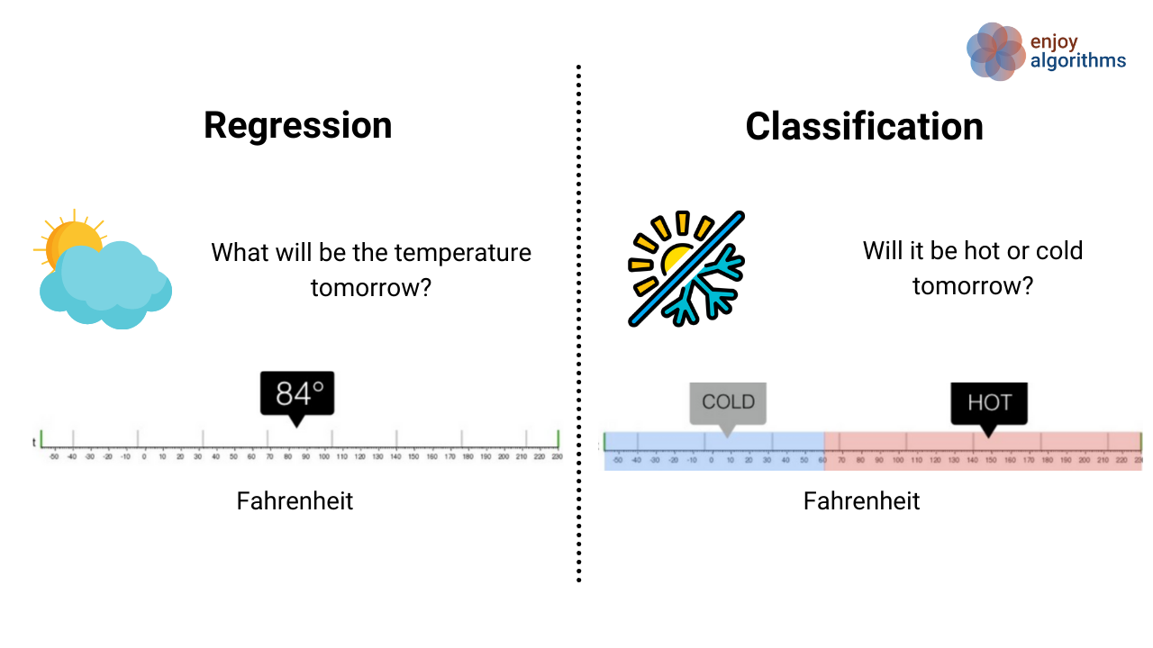
Supervised Learning - ML algorithms
Classification and Regression Algorithm:

Slide 17
Supervised vs. Unsupervised Learning- ML algorithms

Slide 18
Unsupervised Learning - ML algorithms
Clustering Algorithm:
Dimensionality Reduction Algorithm:
Clustering is a technique for exploring raw, unlabeled data and breaking it down into groups (or clusters) based on similarities or differences.
The goal of clustering is to identify patterns and relationships in the data without any prior knowledge of the data's meaning.
For example: anomaly detection
Reduces the number of features, or dimensions, in a dataset.
The process of reducing the number of features in a dataset while preserving as much information as possible.
Imagine a dataset of 100 features about students (height, weight, grades, etc.). To focus on key traits, you reduce it to just 2 features: height and grades, making it easier to visualize or analyze the data.

Slide 19
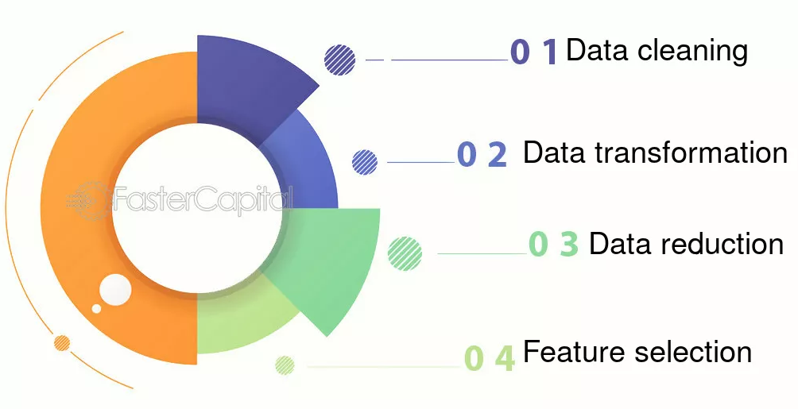
Data Preprocessing and Feature Selection
What is Data Preprocessing and Feature Selection?
Data Preprocessing:
Data preprocessing involves cleaning, transforming, and structuring data, while feature selection focuses on identifying and selecting the most relevant subset of features from the dataset.
Preprocessing aims to clean the data, remove any noise and unwanted information, and prepare the data for further analysis.
This step is important because it can help improve the accuracy of the results and make the data more manageable.

Slide 20
Data Preprocessing and Feature Selection
What is Data Preprocessing?
Data Cleaning:
Addresses missing values, inconsistencies, and outliers through techniques like imputation, outlier removal, or data transformation.
Data Transformation:
Converts data into a suitable format for analysis, including scaling, normalization, and encoding categorical variables.
Data Reduction:
Reduces the number of data points or features to improve efficiency, such as through dimensionality reduction.

Slide 21
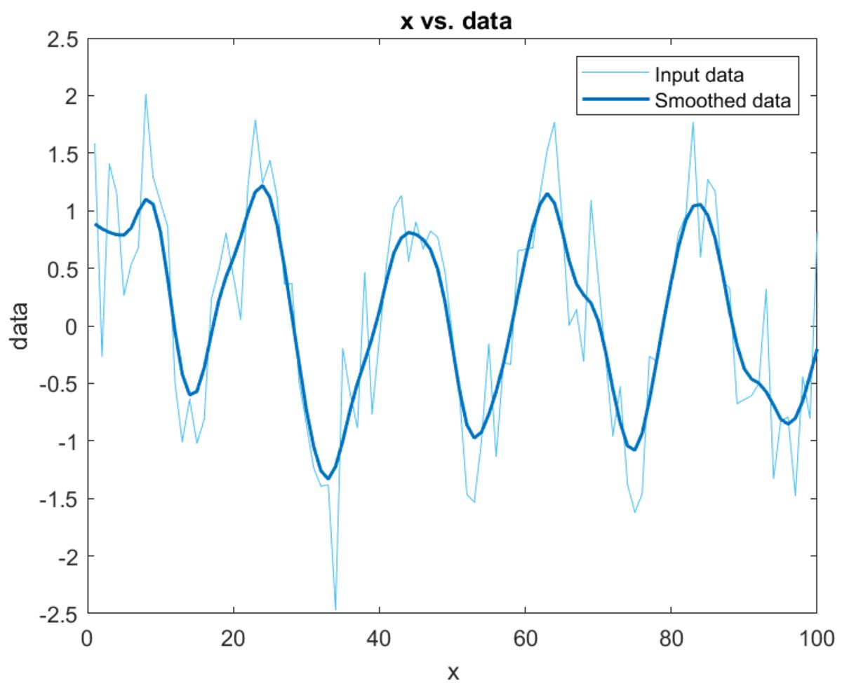
Data Preprocessing and Feature Selection
What is Data Preprocessing?

Slide 22
Data Preprocessing and Feature Selection
What is Feature Selection?
Feature Selection:
Feature selection focuses on identifying and selecting the most relevant features from the dataset for model training.
Feature engineering is the process of creating new features from existing data.
Steps to consider for Feature Selection:
Understand the data and the problem that you are trying to solve. This will help you come up with better features.
Keep it simple. Complex features can be hard to interpret and may not be worth the extra performance.
Automate as much as possible.

Slide 23
Data Preprocessing and Feature Selection
What is Feature Selection?
Filter Methods:
These methods evaluate features independently of the learning algorithm. They use statistical measures to rank features and select the top-ranked ones.
Wrapper Methods:
These methods evaluate feature subsets by using the learning algorithm itself as a "black box." They try different combinations of features and select the subset that yields the best performance.
Embedded Methods:
These methods perform feature selection as part of the model training process. The algorithm learns which features are most important during the training phase.

Slide 24
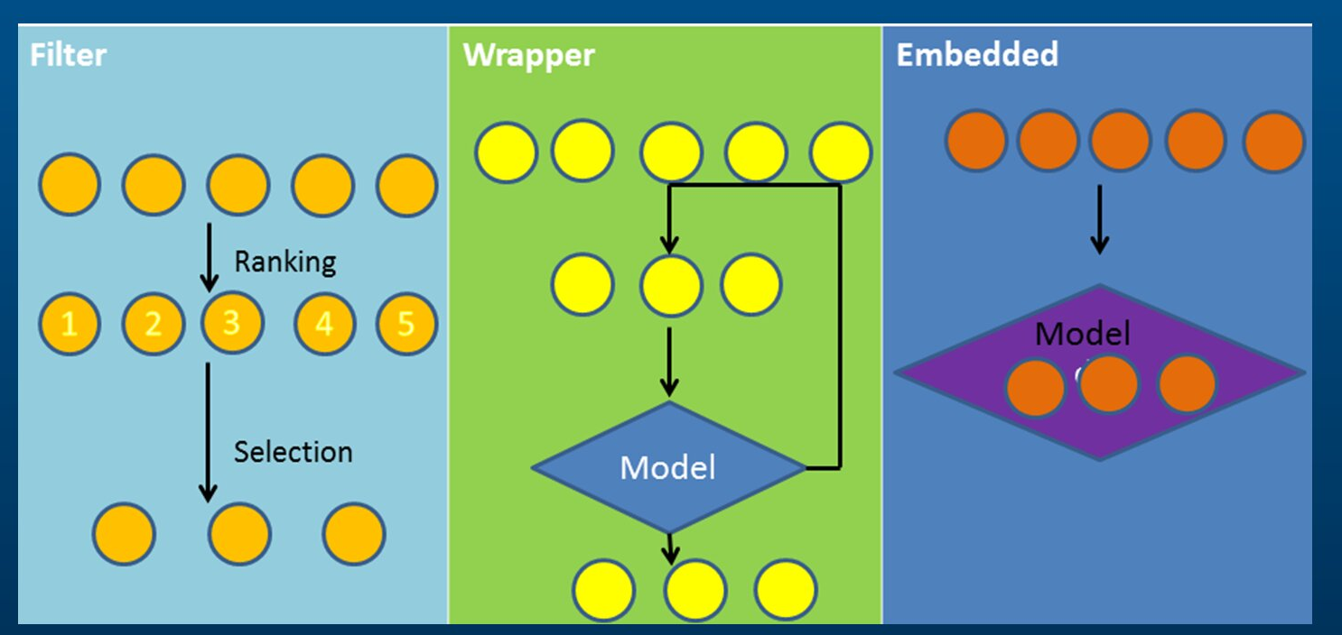
Data Preprocessing and Feature Selection
What is Feature Selection?

Slide 25
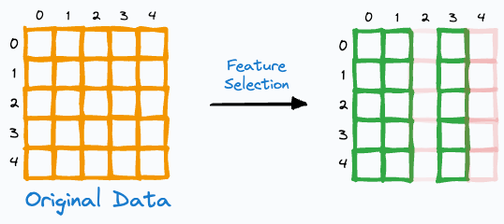
Data Preprocessing and Feature Selection
What is Feature Selection?

Slide 26
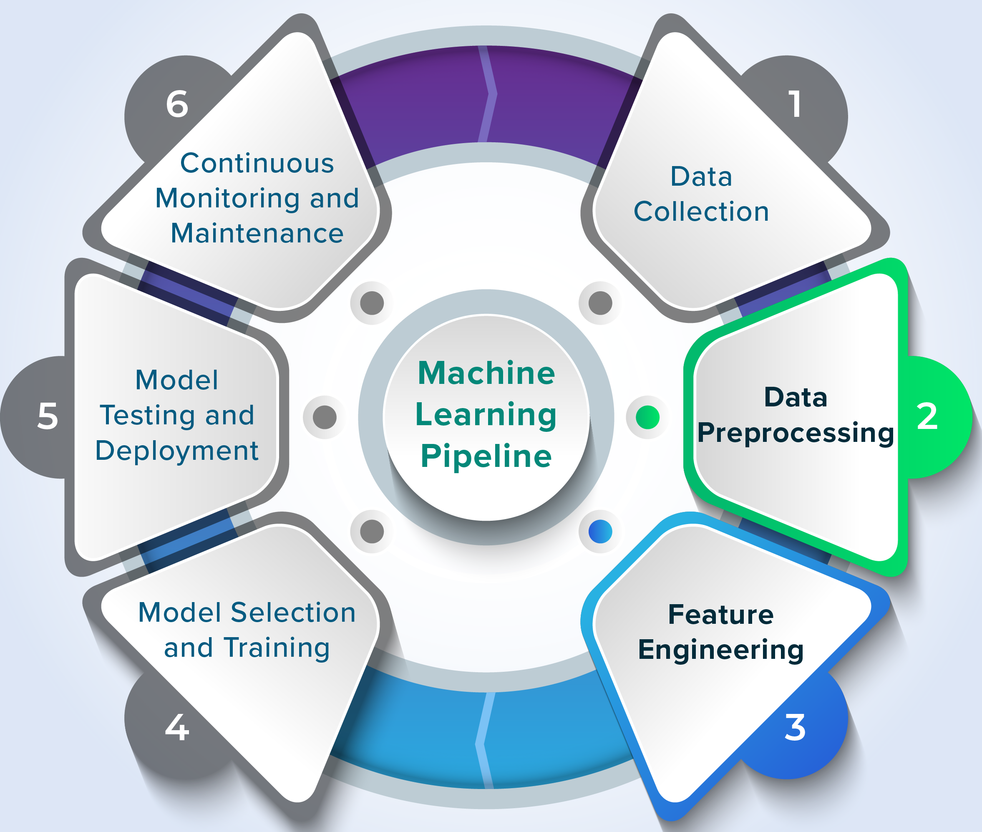
Data Preprocessing and Feature Selection
Why is Data Preprocessing and Feature Selection important?
Data preprocessing and feature selection are crucial steps in machine learning, working together to prepare raw data for model training and improve performance.

Slide 27
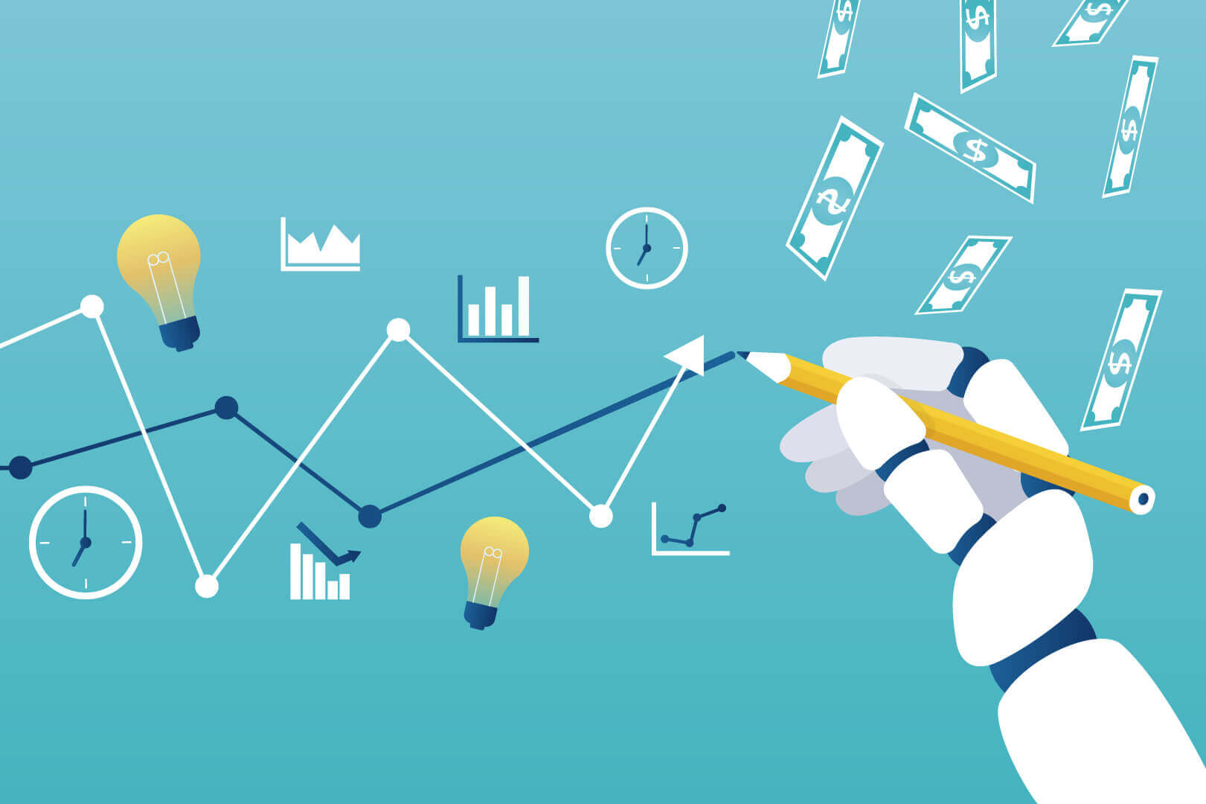
Overview of Predictive Modelling
What is Predictive Modelling?
https://www.youtube.com/watch?v=JOArz7wggkQ

Slide 28
Overview of Predictive Modelling
What is Predictive Modelling?
Predictive modelling is a process used in data science to create a mathematical model that predicts an outcome based on input data.
It involves using statistical algorithms and machine learning techniques to analyze historical data and make predictions about future or unknown events.
In predictive modelling, the goal is to build a model that can accurately predict the target variable (the outcome we want to predict) based on one or more input variables (features).
The model is trained on a dataset that includes both the input variables and the known outcome, allowing it to learn the relationships between the input variables and the target variable.

Slide 29
Overview of Predictive Modelling
Applications of Predictive Modelling
Finance
Risk Assessment
Fraud Detection
Healthcare
Disease Prediction
Resource Allocation
Marketing and Customer Relationship Management (CRM)
Customer Segmentation
Churn Prediction
Supply Chain Management
Demand Forecasting
Logistics Optimization
Human Resources
Talent Acquisition
Employee Retention
https://www.geeksforgeeks.org/data-science/what-is-predictive-modeling/

Slide 30
Overview of Predictive Modelling
Importance of Predictive Modelling
Decision Making
Risk Management
Resource Optimization
Customer Insights
Competitive Advantage
Cost Reduction
Improved Outcomes
https://www.geeksforgeeks.org/data-science/what-is-predictive-modeling/

Slide 31
Overview of Predictive Modelling
Types of Predictive Modelling
Linear Regression
Logistic Regression
Decision Trees
Random Forests
Support Vector Machines (SVM)
Neural Networks
Gradient Boosting Machines
Time Series Models
https://www.geeksforgeeks.org/data-science/what-is-predictive-modeling/

Slide 32
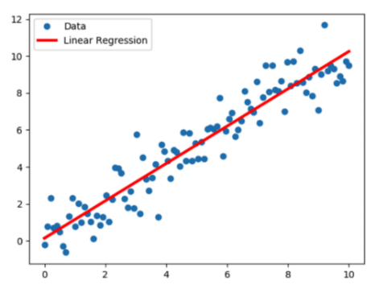
Overview of Predictive Modelling
Types of Predictive Modelling
Regression Models:
Regression models are used to predict a continuous numerical value based on one or more input variables.
The goal of a regression model is to identify the relationship between the input variables and the output variable, and use that relationship to make predictions about the output variable.
Ex: used in various fields, including financial analysis, economics, and engineering, to predict outcomes such as sales, stock prices, and temperatures.
https://www.geeksforgeeks.org/data-science/what-is-predictive-modeling/

Slide 33
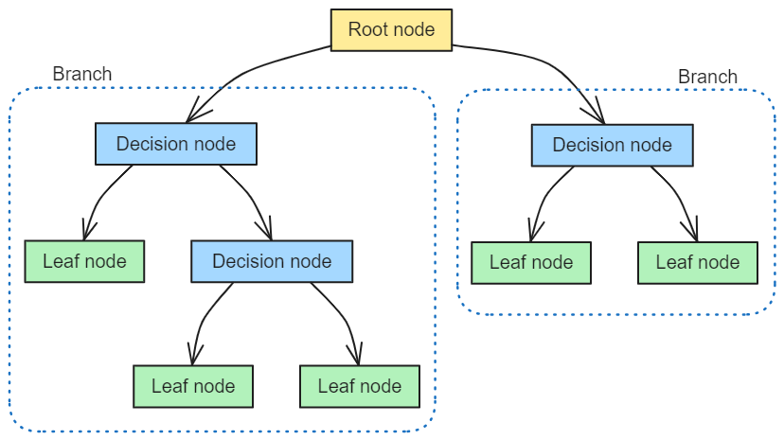
Overview of Predictive Modelling
Decision Tree Models:
Decision tree models use a tree-like structure to model decisions and their possible consequences.
The tree consists of nodes that represent decision points, with branches representing the possible outcomes or consequences of each decision.
The goal of a decision tree model is to predict the value of a target variable based on the values of the predictor variables.
The model uses the tree structure to determine the most likely outcome for a given set of predictor variable values.
https://www.geeksforgeeks.org/data-science/what-is-predictive-modeling/

Slide 34
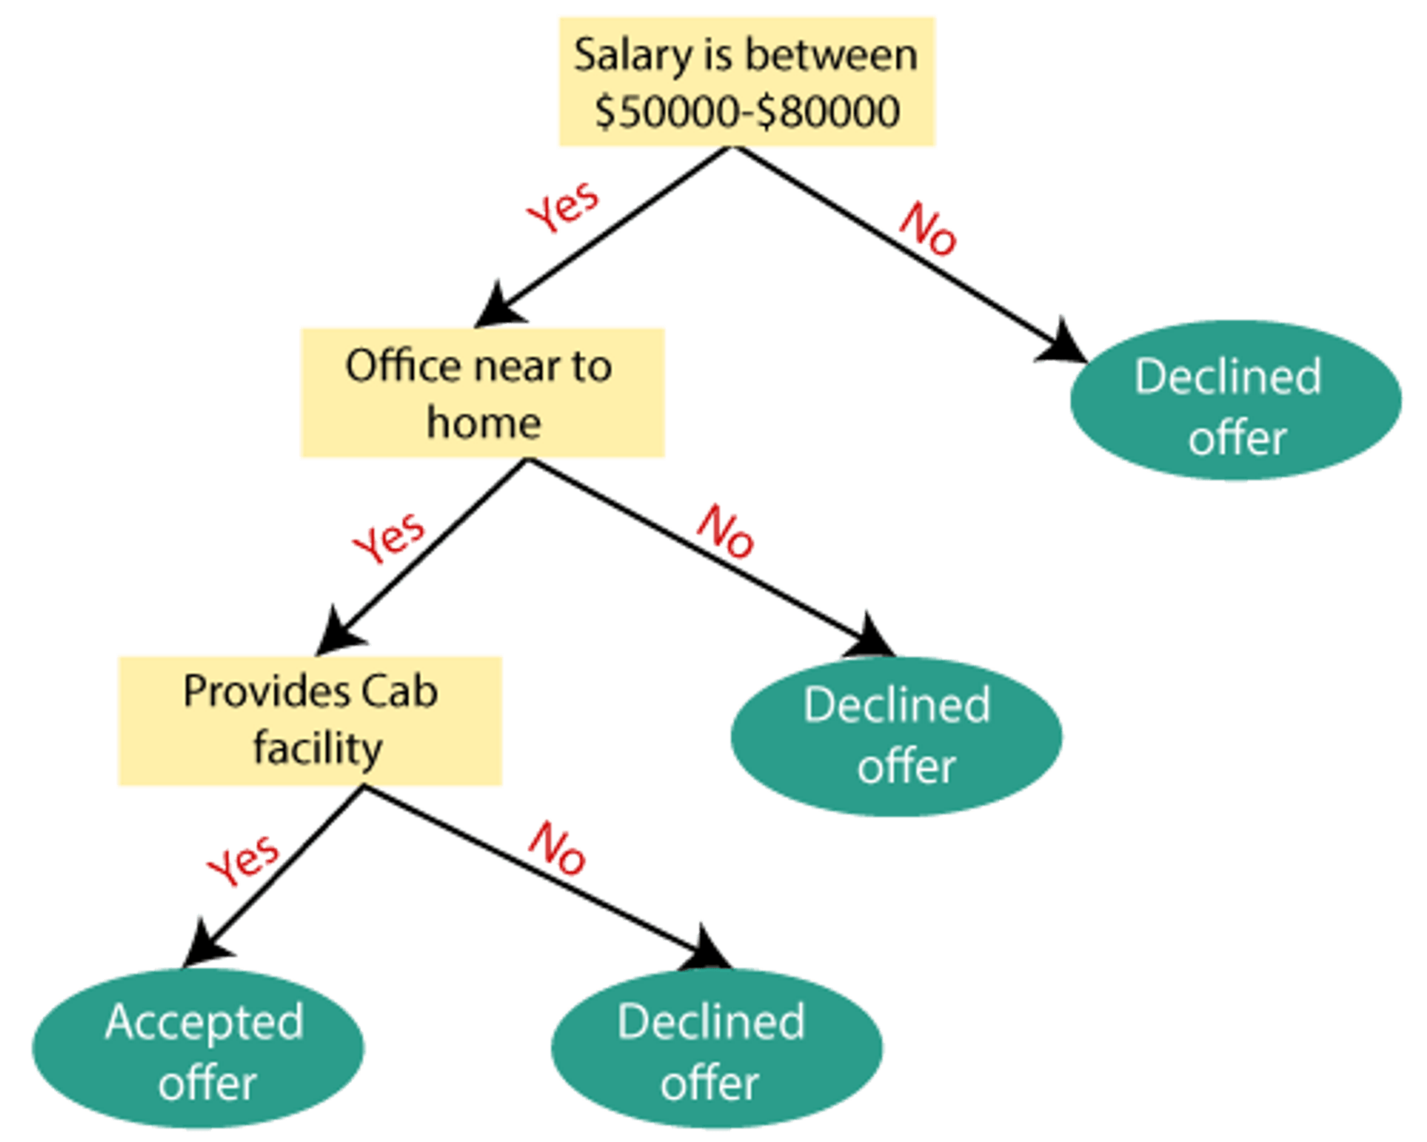
Overview of Predictive Modelling
Decision Tree Models:

Slide 35
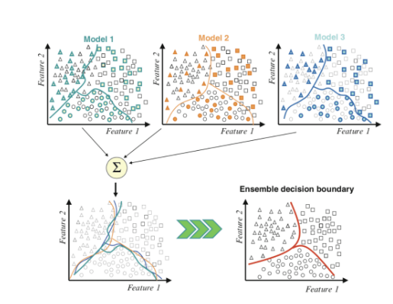
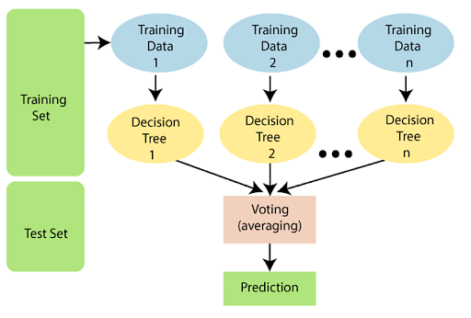
Overview of Predictive Modelling
Random Forest:
It combines multiple decision trees to improve accuracy and reduce errors.
Random Forest creates multiple decision trees on different subsets of the training data, and then aggregates their predictions to make the final prediction.
https://www.geeksforgeeks.org/data-science/what-is-predictive-modeling/

Slide 36
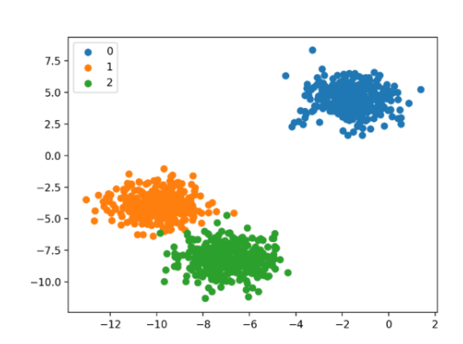
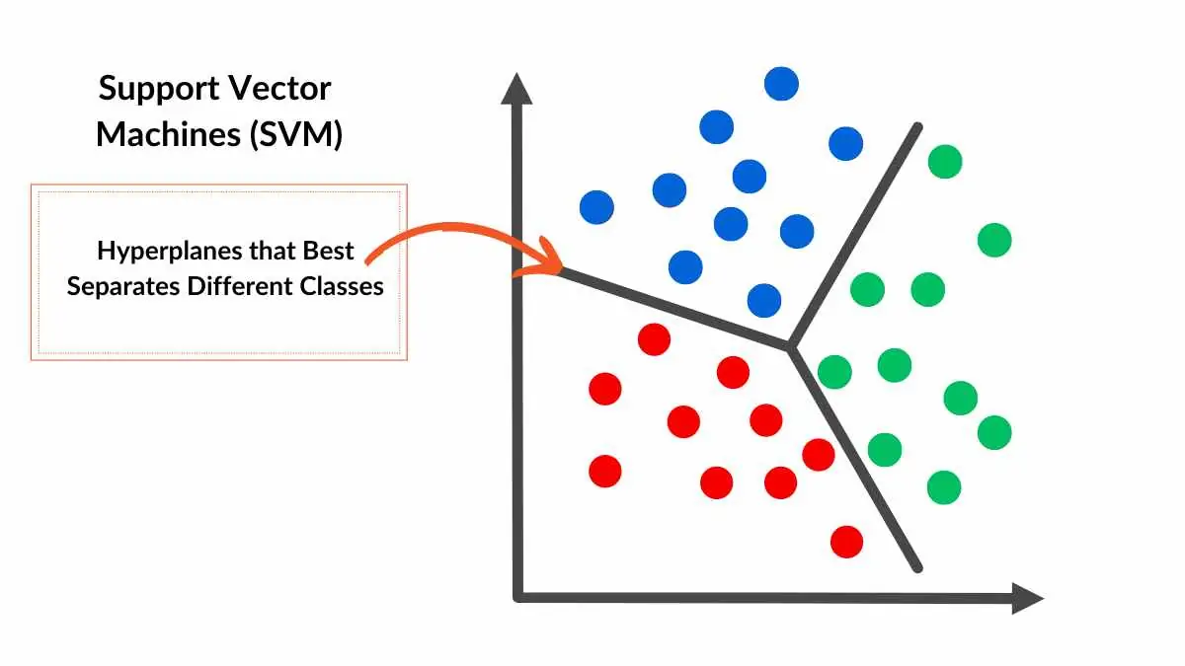
Overview of Predictive Modelling
Support Vector Machine (SVM):
Distance-based models that use mathematical algorithms to classify data.
Classification models are used to classify data into one or more categories based on one or more input variables.
https://www.geeksforgeeks.org/data-science/what-is-predictive-modeling/

Slide 37
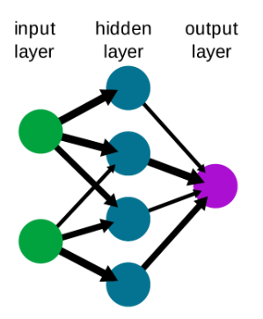
Overview of Predictive Modelling
Neural Networks:
Neural network models are a type of predictive modeling technique inspired by the structure and function of the human brain.
The goal of these models is to learn complex relationships between input variables and output variables, and use that information to make predictions.
Neural network models are often used in fields such as image recognition, natural language processing, and speech recognition to make predictions such as object recognition, sentiment analysis, and speech transcription.
https://www.geeksforgeeks.org/data-science/what-is-predictive-modeling/

Slide 38
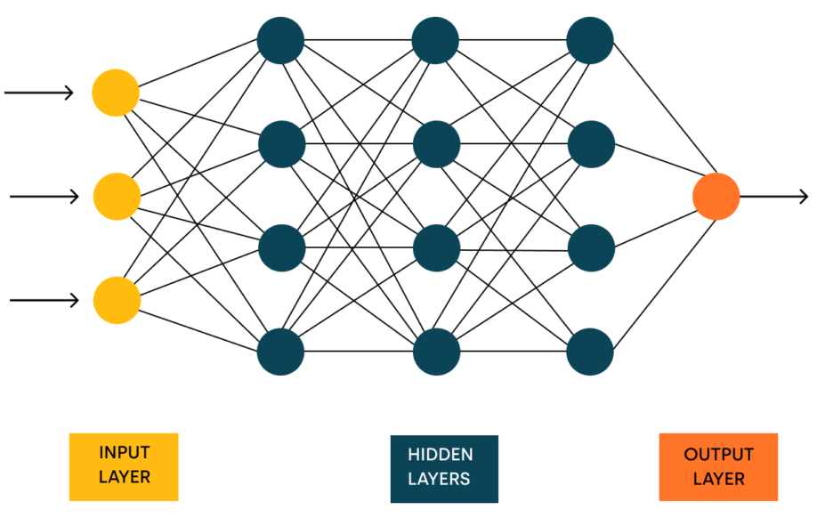
Overview of Predictive Modelling
Neural Networks:
https://www.geeksforgeeks.org/data-science/what-is-predictive-modeling/

Slide 39
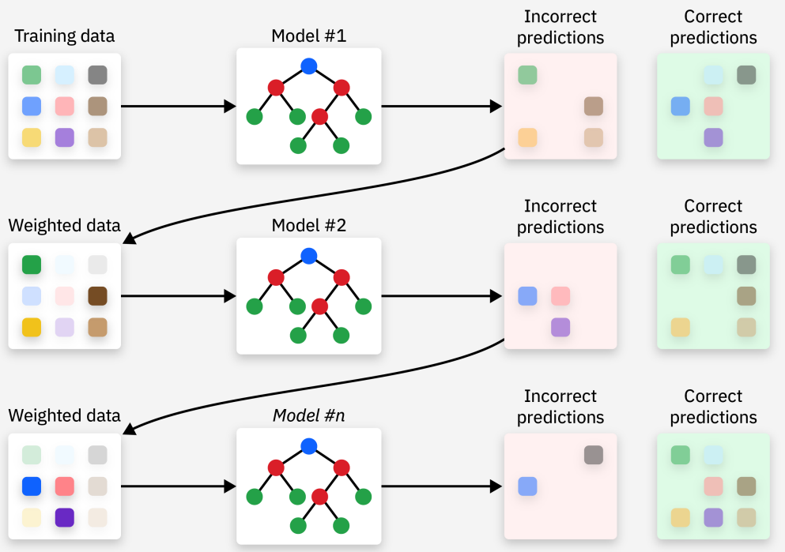
Overview of Predictive Modelling
Gradient Boost:
It builds models sequentially, each new model correcting errors made by the previous ones.
They are often used for regression and classification tasks.
https://www.geeksforgeeks.org/data-science/what-is-predictive-modeling/

Slide 40
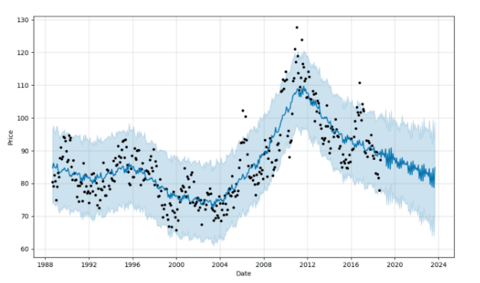
Overview of Predictive Modelling
Time Series:
Time series models are used to analyze and forecast data that varies over time.
Time series models help you identify patterns and trends in the data and use that information to make predictions about future values.
Time series models are used in a wide variety of fields, including financial analytics, economics, and weather forecasting, to predict outcomes such as stock prices, GDP growth, and temperatures.
https://www.geeksforgeeks.org/data-science/what-is-predictive-modeling/

Slide 41
Overview of Predictive Modelling
How to select the Right Model?
Define the Problem
Understand the Data
Choose Candidate Models
Split the Data (Train – Test)
Evaluate Performance
Tune Hyperparameters
Select the Best Model
Evaluate on Test Set
https://www.geeksforgeeks.org/data-science/what-is-predictive-modeling/

Slide 42
References:
Reading
https://www.datasciencewizards.ai/beginners-guide-to-feature-selection/
https://levelup.gitconnected.com/the-data-wizards-guide-to-preprocessing-and-feature-engineering-e44ac2268739
https://medium.com/@WojtekFulmyk/feature-selection-in-data-preprocessing-421d5b527005
https://www.youtube.com/watch?v=SzpcUC7D7vg&t=838s
Sample code for data : Data Preprocessing for Machine Learning – See link: https://github.com/atef-ataya/data_preprocessing_tool/
Activity for Data Analysis - Dataset - Online retail: https://archive.ics.uci.edu/dataset/352/online+retail

Slide 43
Business Decision-Making with AI and ML
Thank You

