Slide 1
Probability
Yoobee Colleges

Slide 2
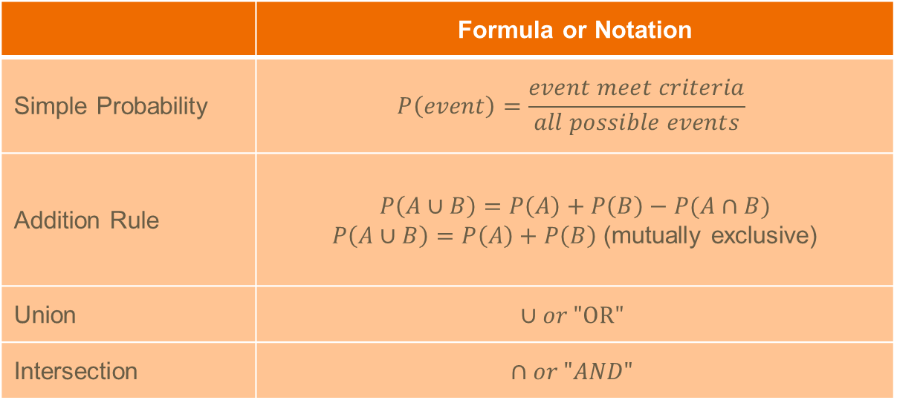
Probability, Addition Rule, Union vs. Intersection
 | Formula or Notation
Simple Probability | $$P\left(event\right)=\frac{event meet criteria}{all possible events}$$
Addition Rule | $$P\left(A∪B\right)=P\left(A\right)+P\left(B\right)−P(A∩B)$$ $P\left(A∪B\right)=P\left(A\right)+P\left(B\right)$ (mutually exclusive)
Union | $$∪or "OR"$$
Intersection | $$∩or "AND"$$

Slide 3
Example
We want to find the probability of drawing a jack from a deck of 52 cards, and then drawing another jack, assuming we put the first jack back in the deck before drawing the second. So, what is the probability of drawing a jack from a deck of 52 cards and drawing another jack from the cards?
What if we do not put the first jack back into the cards?

Slide 4
Exercise
Events A and B are independent events. Find P(B) if P(A and B) = 0.25 and P(A) = 0.5.
Events A and B are dependent. If P(A and B)=0.7 and P(B)=0.875, what is P(A)?
Suppose that you roll a six-sided dice twice. Event A is that the first roll is a 6, so P(A) is the probability that the first roll is a 6. Event B is that the second roll is a 6, so P(B) is the probability that the second roll is a 6. How can you express the probability P(A and B)?
Notes:
= 0.5
Not enough information
= -0.1282.

Slide 5
Sample Answer:
Answer Q1: P(B) = P(A and B)/P(A) = 0.5
01
Answer Q2:
02
we do not have P(B∣A), So we still can calculate the P(A) = P(A and B)/ P(B), P(A) = ~0.8.
Answer Q3:
03
P(A∩B)=1/6 ​×1/6​= 1/36 (A and B are independent)​

Slide 6
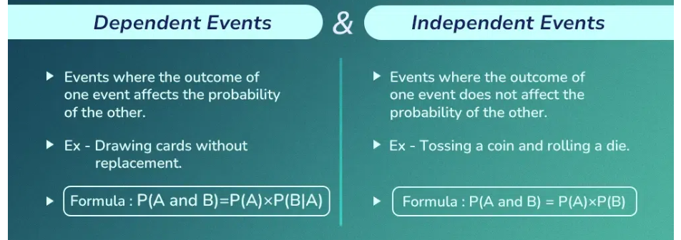
Q/A?

