Slide 1
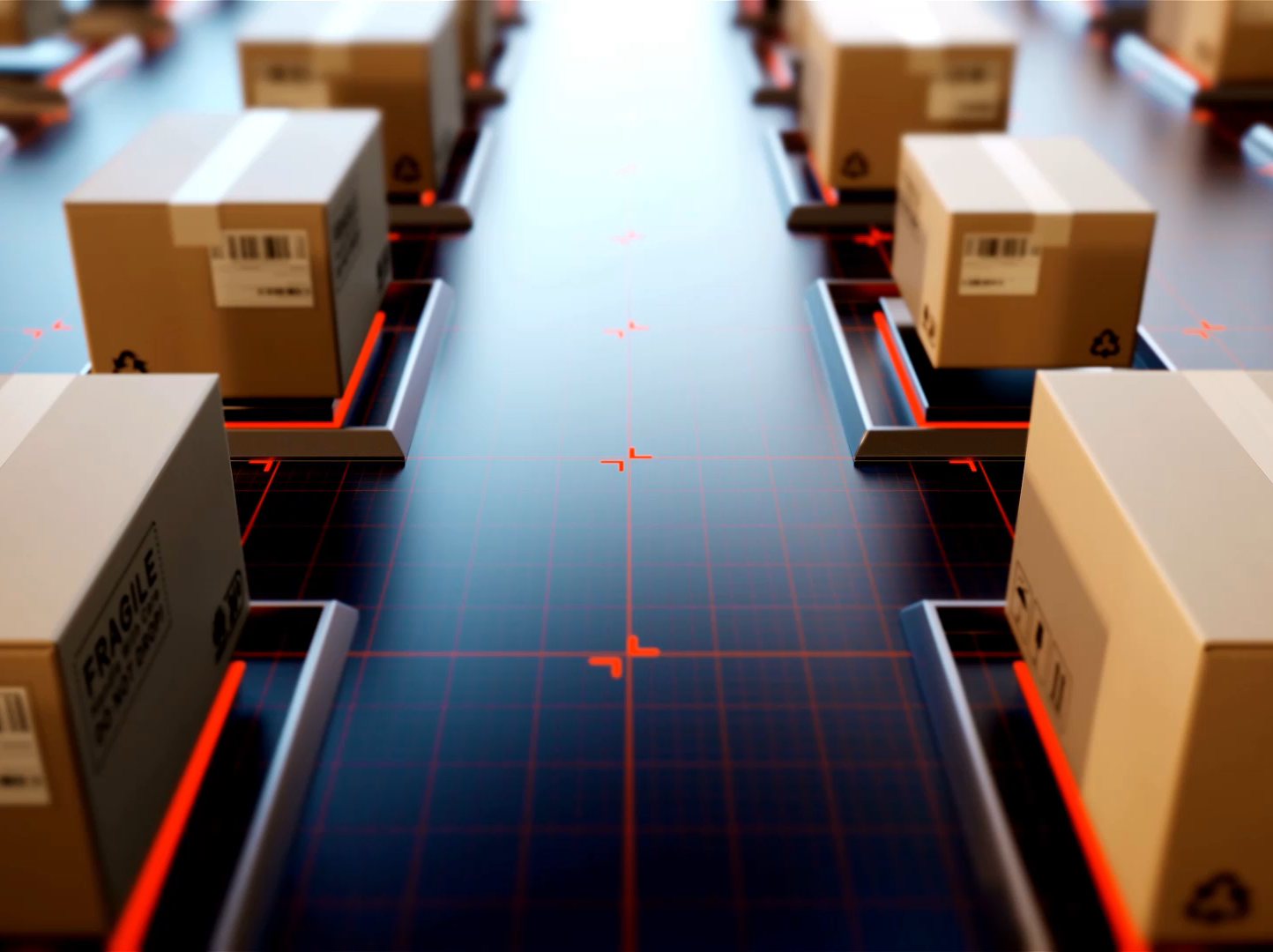
Image Classification and Semantic Segmentation
YoobeeColleges
Notes:
Using CIFAR-10 and U-Net

Slide 2

Outline:
• Introduction to Image Classification & Semantic Segmentation
• Overview of CIFAR-10 Dataset
• U-Net Architecture for Semantic Segmentation
• Practical Implementation
• Results and Evaluation
• Resources & Further Reading

Slide 3

Image Classification

Slide 4
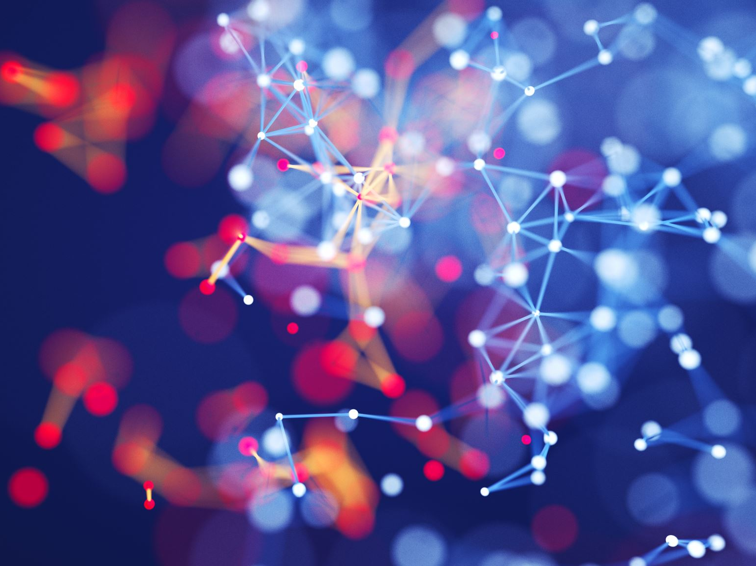
CNN algorithms for image Classification

Slide 5
CIFAR-10 Dataset

Slide 6
Image Classification Using CIFAR-10 Dataset
• Contains 60,000 32x32 RGB images
• 10 classes: airplanes, cars, birds, cats, deer, dogs, frogs, horses, ships, trucks
• Used for benchmarking classification algorithms

Slide 7
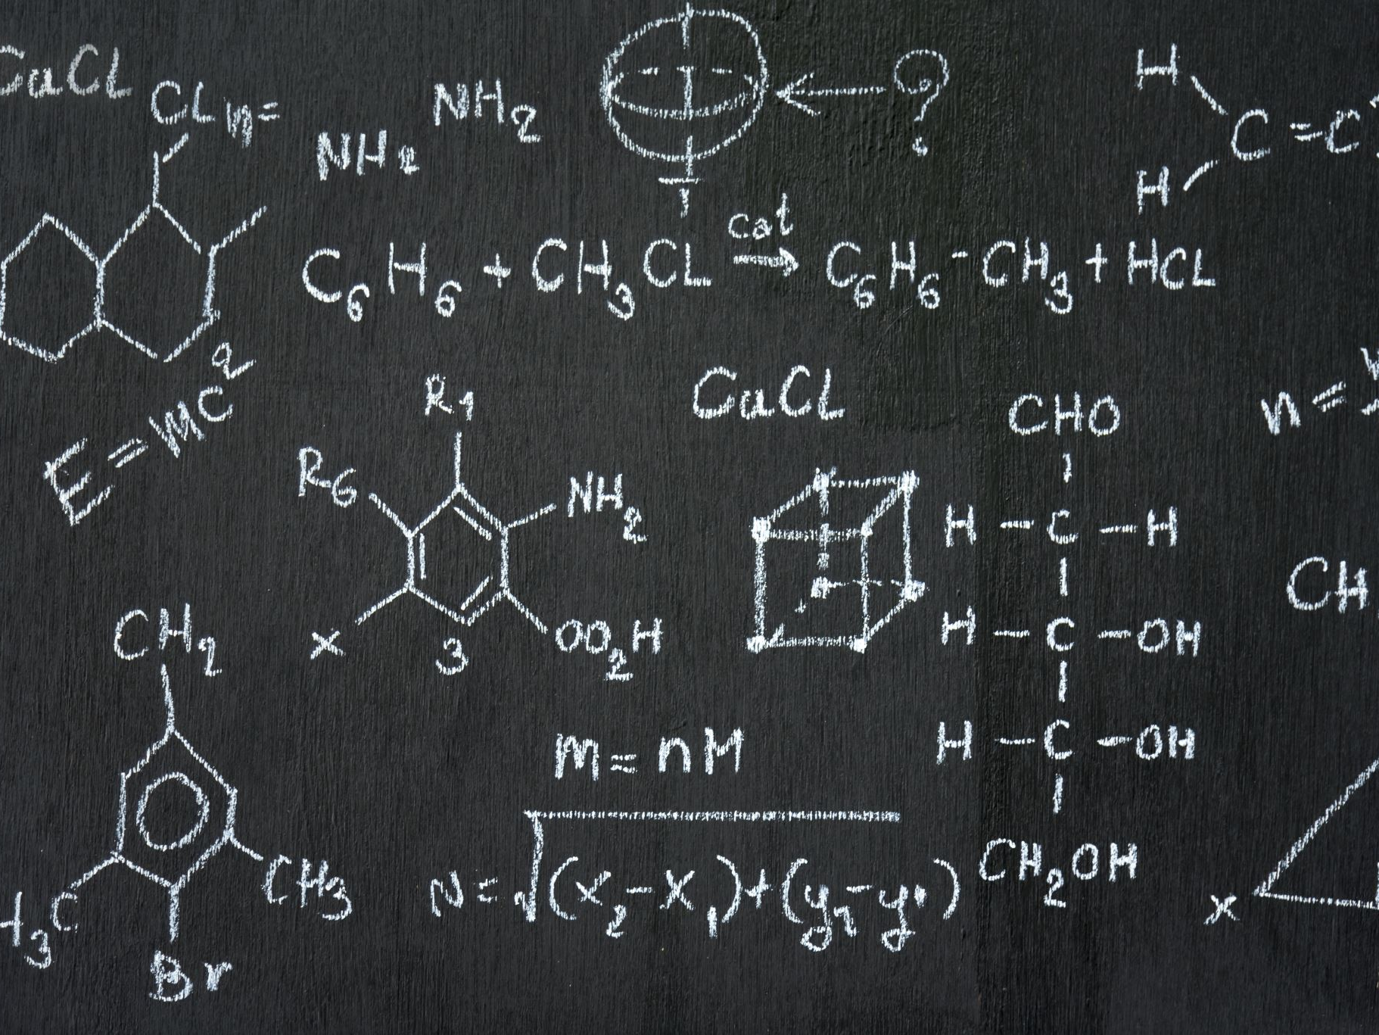
Image calcification Activity using sample code based on CNN algorithm
See file in BlackBoard

Slide 8
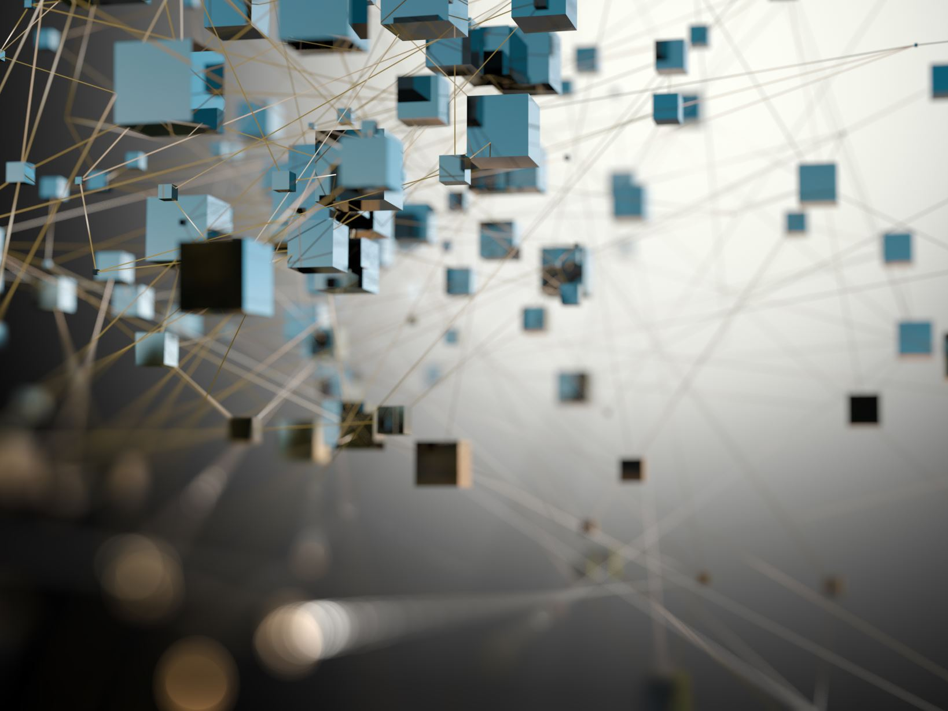
Unstructured data segmentation

Slide 9

Semantic Segmentation with U-Net
• Semantic segmentation classifies each pixel of an image
• U-Net architecture is widely used:
- Encoder-decoder structure
- Skip connections for precise localization
• Particularly useful in medical imaging

Slide 10

Schematic view of U-Net Algorithm

Slide 11
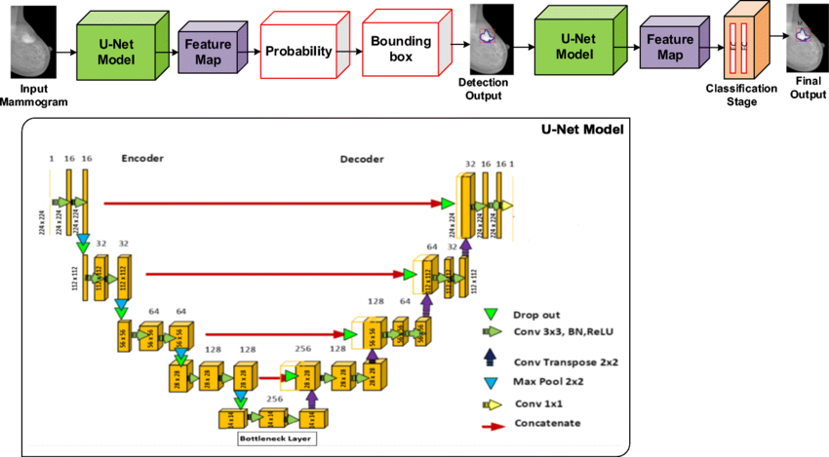
Schematic diagram of the proposed U-Net based deep learning network to detect and classify breast cancer masses
Notes:
Ref: 10.1007/s11042-023-14757-8

Slide 12
Practical Considerations
• Data Preprocessing and Augmentation
• Choosing loss functions & metrics
• Training procedures
• Evaluating model performance:
- Accuracy, Precision, Recall, F1-score (Classification)
- IoU (Intersection over Union), Dice coefficient (Segmentation)

Slide 13
Demo and Results
• Walkthrough of provided notebooks:
- CIFAR-10 classification results
- U-Net segmentation results
• Interpretation of output metrics
• Visualization of predictions

Slide 14
Sample Code for Multi-level Image Classification
See below link: https://colab.research.google.com/drive/1nydbXLcuA6W6ghe7rYczZAgx4y5V103Y#scrollTo=5CA4LafI6i4R

Slide 15

Q&A
Feel free to ask questions about today's topics.

Slide 16
Activity
Develop a code to do the image sematic segmentation using U-Net model

