Slide 1
CNN Algorithms
With a Schematic View of Multi-Level Classification using CNN
Presented by Dr Mohammad Norouzifard
YoobeeColleges

Slide 2

Introduction to CNN
• Convolutional Neural Networks (CNNs) are deep learning algorithms designed for image classification.
• They consist of multiple layers, including convolutional layers, pooling layers, and fully connected layers.
• CNNs are widely used in image recognition, medical imaging, and computer vision applications.

Slide 3
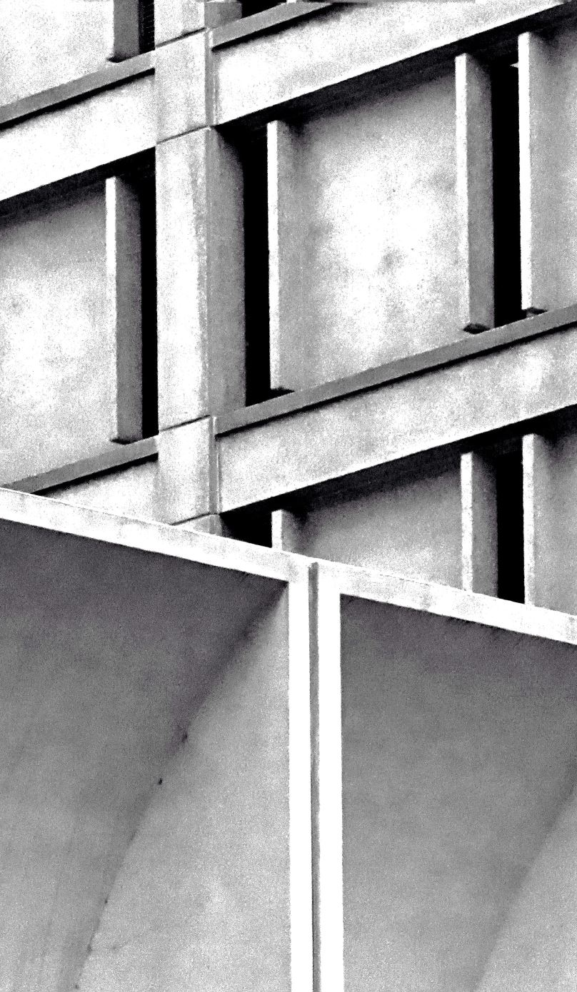
CNN Architecture Overview
Input Layer: Accepts image input (e.g., 28x28 grayscale or RGB image).
Convolutional Layers: Extract features from the image using filters.
Activation Function (ReLU): Introduces non-linearity.
Pooling Layer: Reduces spatial dimensions while preserving features.
Fully Connected Layers: Maps extracted features to output classes.
Softmax Function: Converts logits into class probabilities.

Slide 4
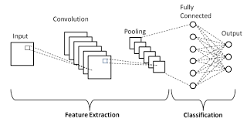
Schematic View of CNN Model
Insert a CNN schematic diagram here showing multi-level classification.
Notes:
Ref: DOI:10.3390/jimaging8030055

Slide 5

Popular CNN Models
LeNet-5: One of the earliest CNN architectures.
AlexNet: Introduced deep CNNs for large-scale classification.
VGGNet: Uses small 3x3 convolution filters for deeper networks.
ResNet: Introduces skip connections for deeper networks without vanishing gradients.
EfficientNet: Optimized for efficient performance with fewer parameters.

Slide 6
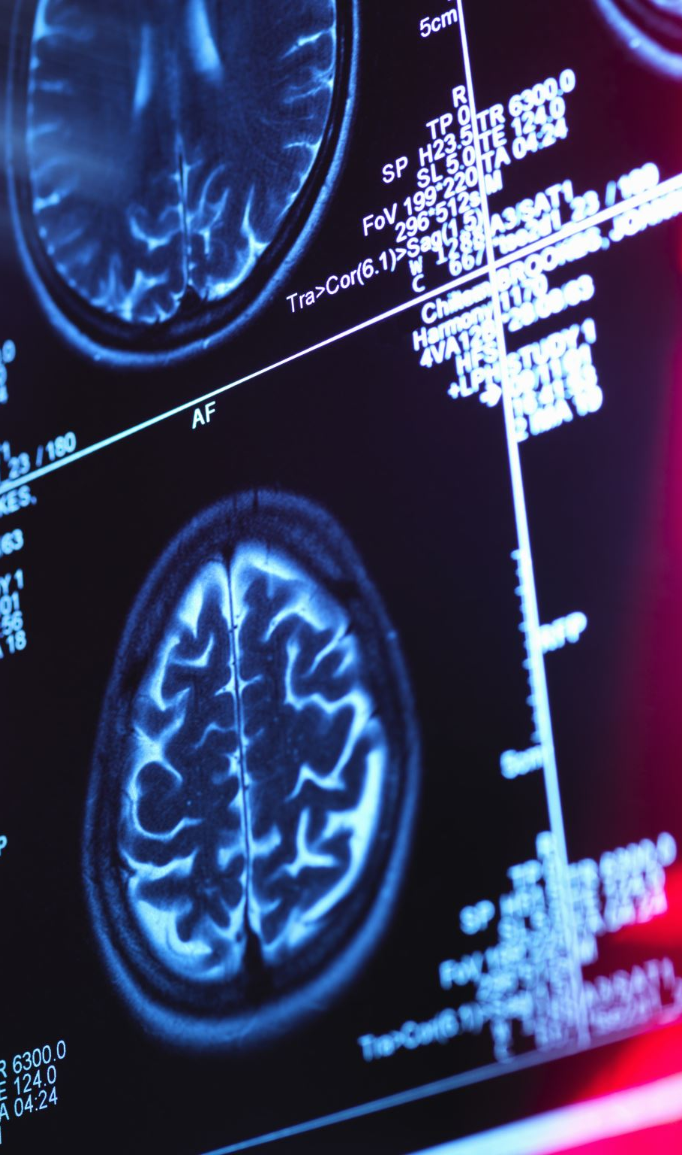
Applications of CNNs
Object Detection (YOLO, Faster R-CNN)
Face Recognition (FaceNet, DeepFace)
Medical Imaging (X-ray, MRI Classification)
Self-driving Cars (Lane Detection, Pedestrian Detection)
Image Segmentation (U-Net, Mask R-CNN)

Slide 7

Conclusion
• CNNs have revolutionized image classification by automatically extracting features from images.
• Multi-level classification allows detailed hierarchical categorization of objects.
• Advanced CNN models like ResNet and EfficientNet improve accuracy and efficiency.
• CNNs are widely applied in healthcare, security, and autonomous systems.

Slide 8

Q&A?

