Slide 1
AI-Powered Resume Matching Engine
Proof of Concept | Talent Acquisition Automation
Presented by: Radhika

Slide 2
Problem Statement
Manual resume screening is broken at scale
The current process:
A recruiter reads 50–200 resumes per role — averaging 6–7 seconds per resume
Screening quality is inconsistent: different recruiters weight skills differently
Qualified candidates get missed because their resume doesn't use exact keywords
No audit trail: why was this candidate rejected?
The ask: Build a system that scores and ranks resumes against a JD — automatically, consistently, and explainable.

Slide 3
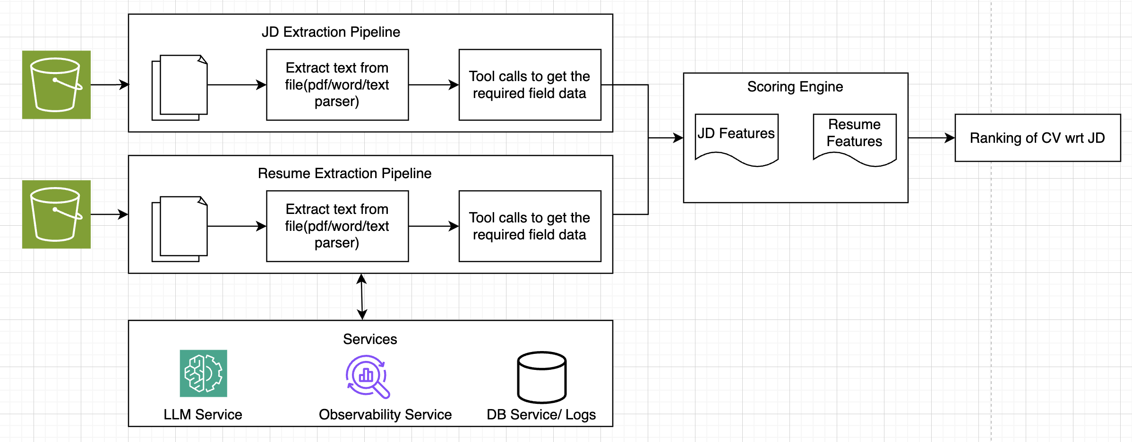
Solution Overview

Slide 4
JD Extraction Pipeline
- role identity:
Title, seniority level, company type, employment type, Remote work policy
- hard requirements:
Skills, Year of experience, Education, Certifications
- soft requirements:
Skills, Domain experience, Education, Company Background
- role character:
Ownership style: IC, Manager, Lead, Junior

Slide 5
Resume Extraction Pipeline
Role identity:
Name, title, seniority, email
Education:
Highest Degree, Highest Institute Tier, Certifications, Publications, OS Contributions
Explicit skills:
Skills, skill_depth_signal
Implicit skills:
skills, skill_depth_Signal
Work history:
Years of experience, Highest Company tier, Leadership Experience, Domain exp

Slide 6
Alignment Score
Skill score -> skill match
Experience score -> [YOE alignment, Seniority level, Domain Experience]
Quality Score -> [Depth score, bonus signals, penalty signals]
Final Score
Skill score weight = 0.55
Experience weight = 0.25
Quality Score weight = 0.20

Slide 7
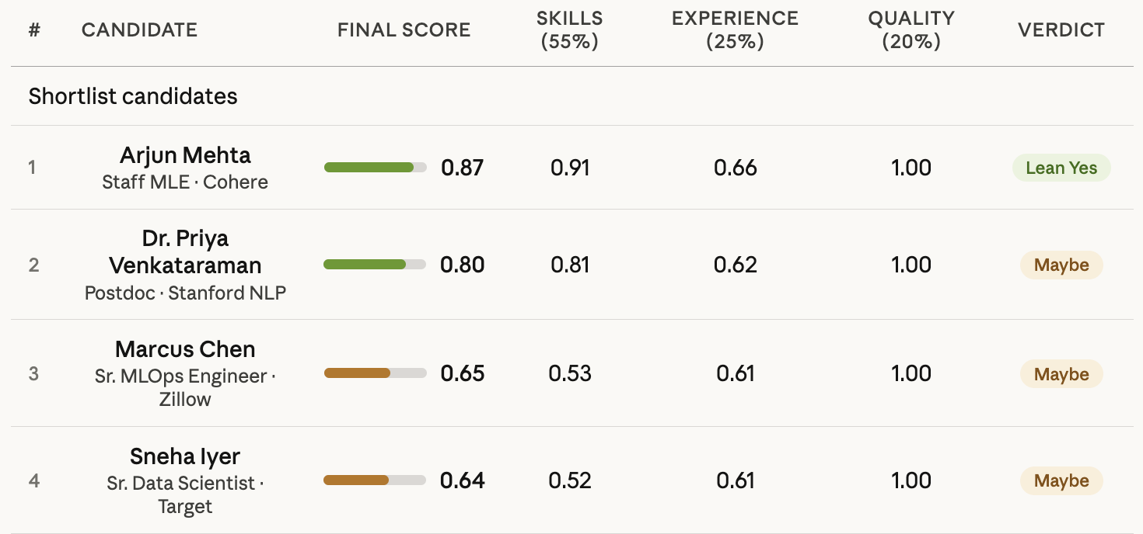
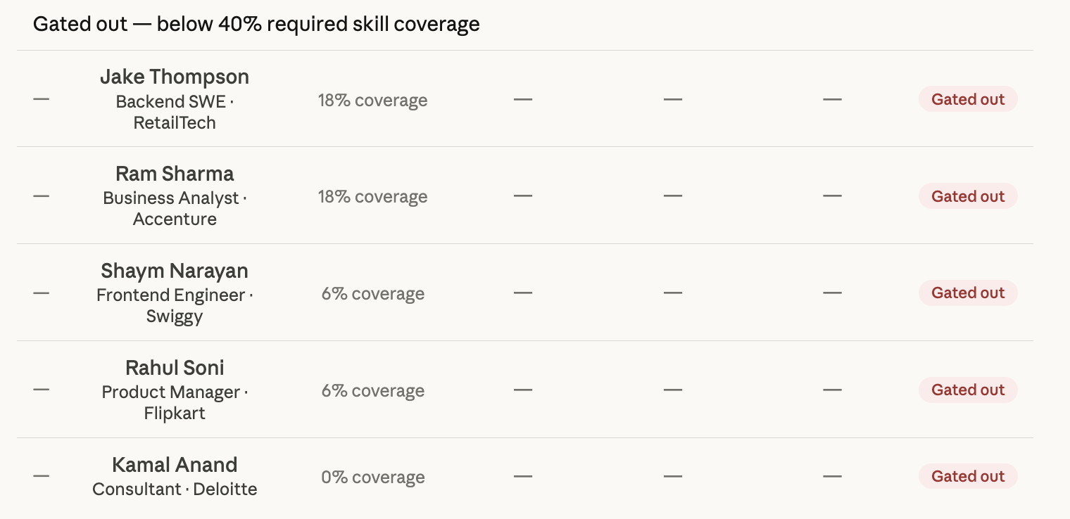
Results
The gate works. 5 of 9 resumes never reach the scoring engine — frontend dev, consultant, PM, BA, backend SWE all correctly filtered before wasting a recruiter's time. The gate threshold of 40% required skill coverage is doing exactly what it should.
The top 2 tell an interesting story. Arjun Mehta (0.87, Lean Yes) is the clear hire — broad skills, proven production experience, publications. Dr. Priya Venkataraman (0.80, Maybe) scores nearly as high on skills and quality but is 2 seniority levels below for a Lead role with only 1 year of post-PhD experience. The system surfaces both — the recruiter makes the call.
Marcus Chen and Sneha Iyer are honest partials. Both score 0.64–0.65 because they're strong on data engineering and ML fundamentals but missing the NLP/LLM/retrieval depth the JD requires. The skill breakdown column makes this transparent — a recruiter can see exactly what's missing.
The quality score (tier 3 = 1.0 for all passers) is worth explaining — it reflects mastery depth signals and bonus credentials. All four passing candidates had strong depth signals; the differentiation is entirely on skill coverage and experience, which is the right outcome for this JD.

Slide 8
Design Trade Offs
Decision | What we chose | What we rejected | Why
Skill matching | LLM binary match + reasoning | Embedding cosine similarity | It is difficult to set threshold using cosine similarity to identify strong vs weak match
Extraction | Deterministic sequential calls | ReAct agent | Fixed call order = same cost, half the complexity, fully debuggable
Skill separation | Explicit vs implicit split | Single skill list | Conflating them hides the difference between what a candidate claims and what they've demonstrated. Avoids Hallucination as well

Slide 9
Challenges
🧩 Skill Synonym Problem
Problem: NLP ≠ Natural Language Processing for exact matching
Solution: LLM matcher with explicit synonym rules + one-sentence reasoning per decision
Result: Every match decision is auditable
🤖 Buzzword Stuffing (Adversarial)
Problem: Keyword-rich resume with no real evidence scores perfectly on TF-IDF
Solution: Explicit ≠ Implicit. Penalty score reduce the overall score if resume is made up. Gate rejects < 40% verified coverage
Result: Less matched skill coverage → score 0.0 ✓
📊 LLM Hallucination
Problem: If LLM is expected to extract all information in one go, it starts to hallucinate
Solution: Built separate dedicated tools for each information extraction type
Result: More deterministic and reliable outputs

Slide 10
Evaluation Strategy
Component Level Evaluation
JD Extraction Pipeline – Precision / Recall on extracted skills
Resume Extraction Pipeline – Precision / Recall on extracted skills
E2E evaluation
Did we rank correctl? nDCG@3, Spearman ρ
Eval reads from saved run artifacts — no re-running the pipeline, no extra API spend, fully reproducible
Skill matcher is LLM-free — normalization + alias lookup only; keeps evaluation independent of the system being evaluated

Slide 11
Future Steps
Skill canonicalization for both JD and resume. Current scores are low. Current system is programmatic, using LLM As Judge can help here.
Gather feedback from the real users: Try to work through each component and look for evaluation metrics there. Re-calibrate score weights based on feedback received from the users.
Observability Integration: In order to track behaviour of each component. It help keeping check of drift and error alterts
Make the system event driven: As soon as the JD is received, JD extraction pipeline is triggered and outputs saved. Same with resume extraction pipeline avoiding batch processing and real time scoring

