Slide 1


Lending Club Case Study

Slide 2
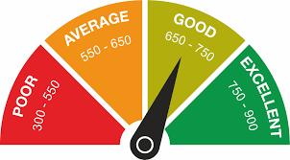
Problem Statement
For a consumer finance company understand the driving factors (or driver variables) behind loan default | loan charged off.
Given dataset which contains the complete loan data for all loans issued through the time period 2007 to 2011.
Each column meanings are defined a given data dictionary.

Slide 3
Approach
Data Understanding
Using given dictionary and excel understand data in loan.csv
Data Cleaning
Based on understanding, using klib library or pandas performing cleaning operation
Data Interpretation
With the cleaned data plot graphs to mention the observations

Slide 4
Let us understand the factors which Influence Charged Off

Slide 5
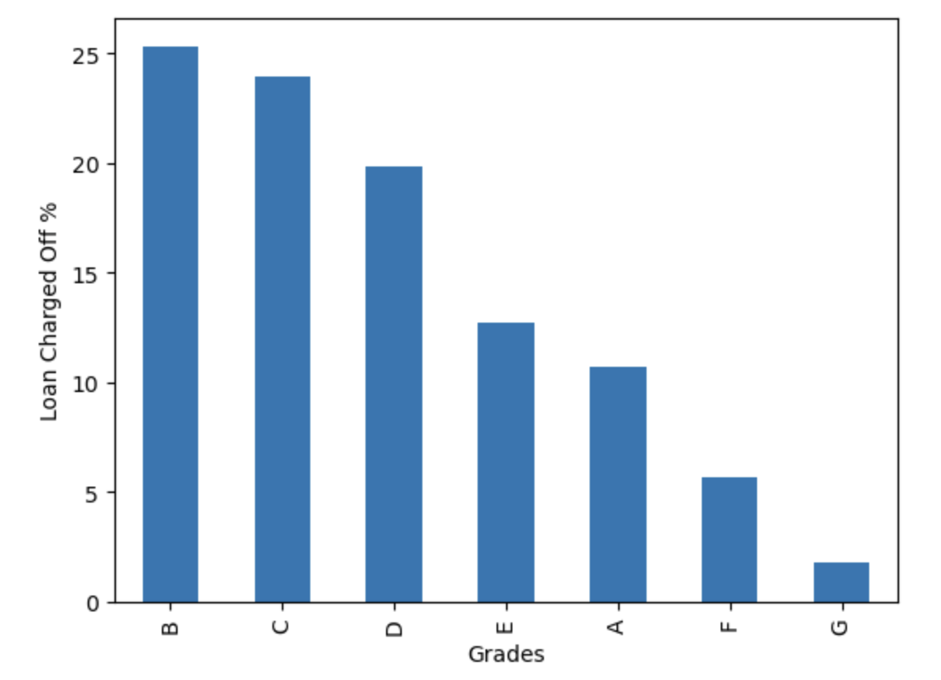
Members in grade B are the ones who charged off the most, followed by Grade c and D

Slide 6
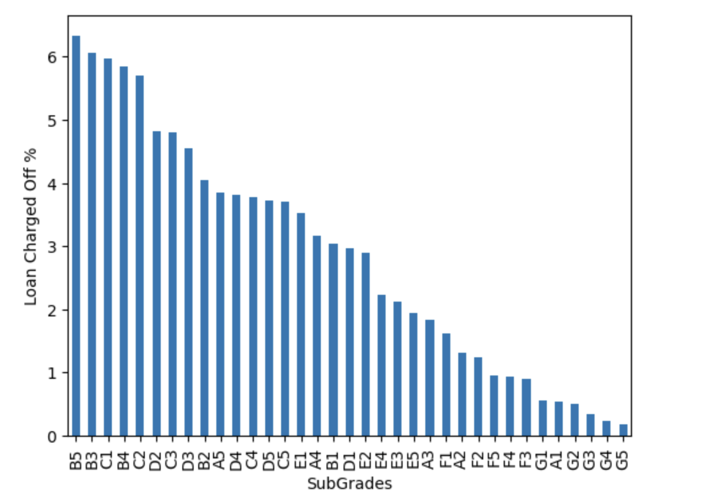
Members with Sub-grade B5 are the ones who charged off the most, followed by sub-Grade b3, c1,b4, c2

Slide 7
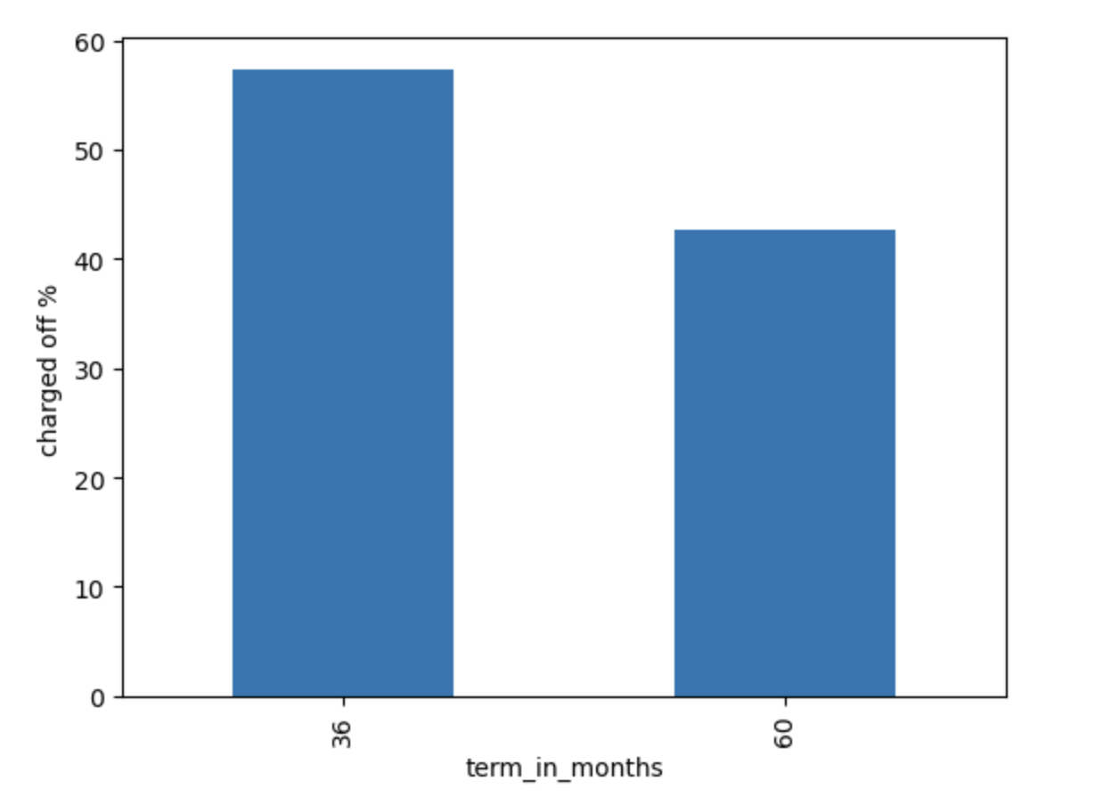
People who thought to repay loan by 36 months defaulted more than the ones who took it for 60 months.
A bank may consider to increase tenure to reduce the defaults

Slide 8
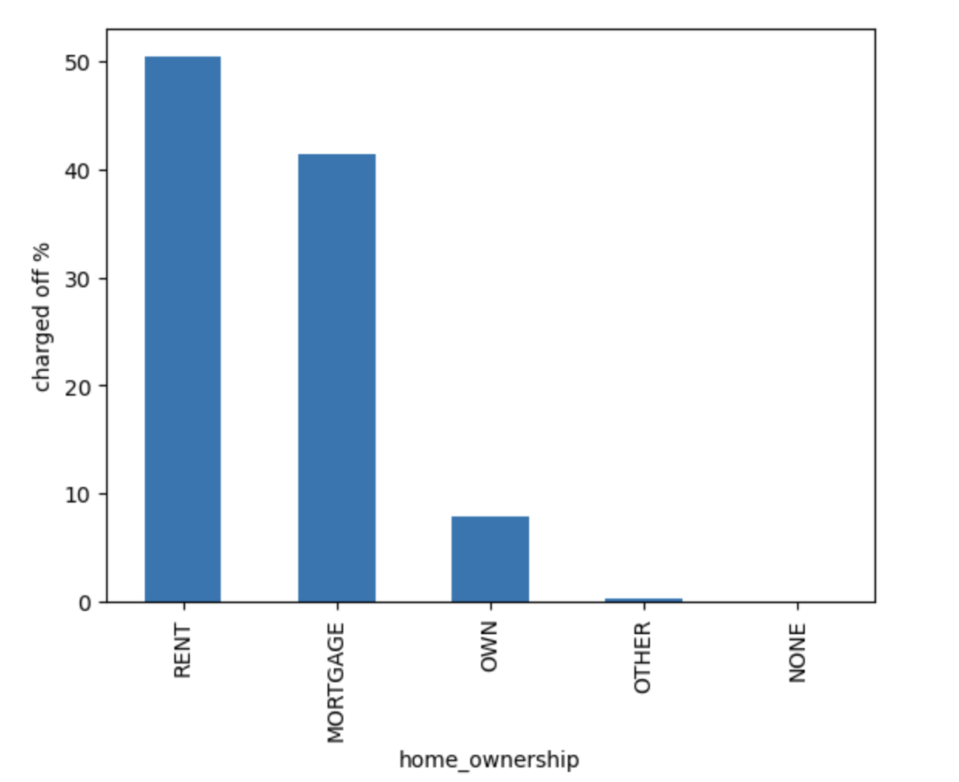
People who were on rent seems to have defaulted the most while those who owned home were comparatively less in %
A bank may consider home owning candidates over the ones living on rent

Slide 9
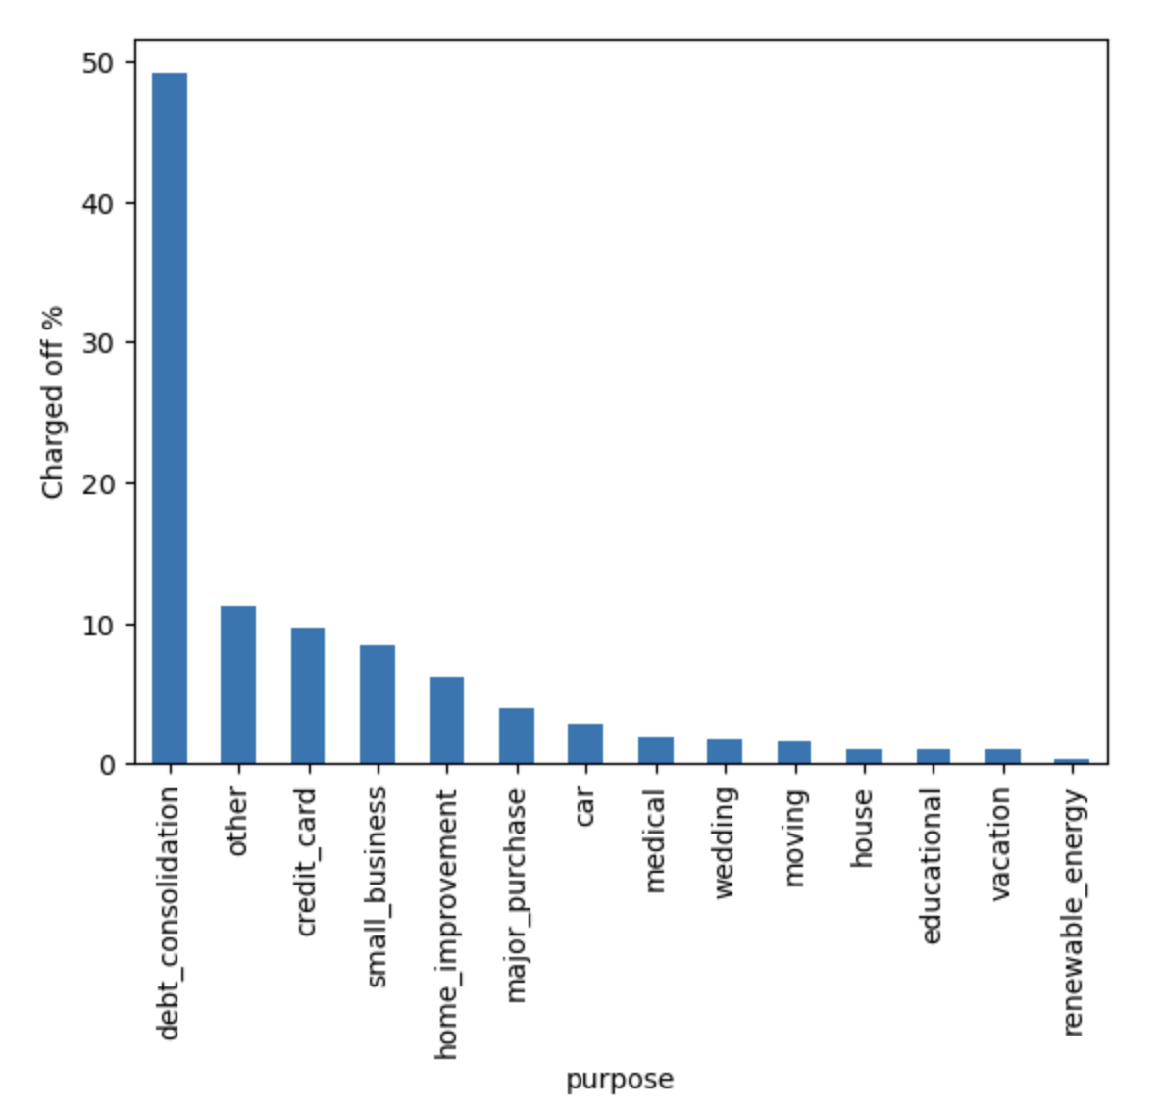
Loan seekers, whose purpose was det consolidation defaulted to the max
A bank should be very cautious while considering the applicants who intend to take loan for debt consolidation

Slide 10
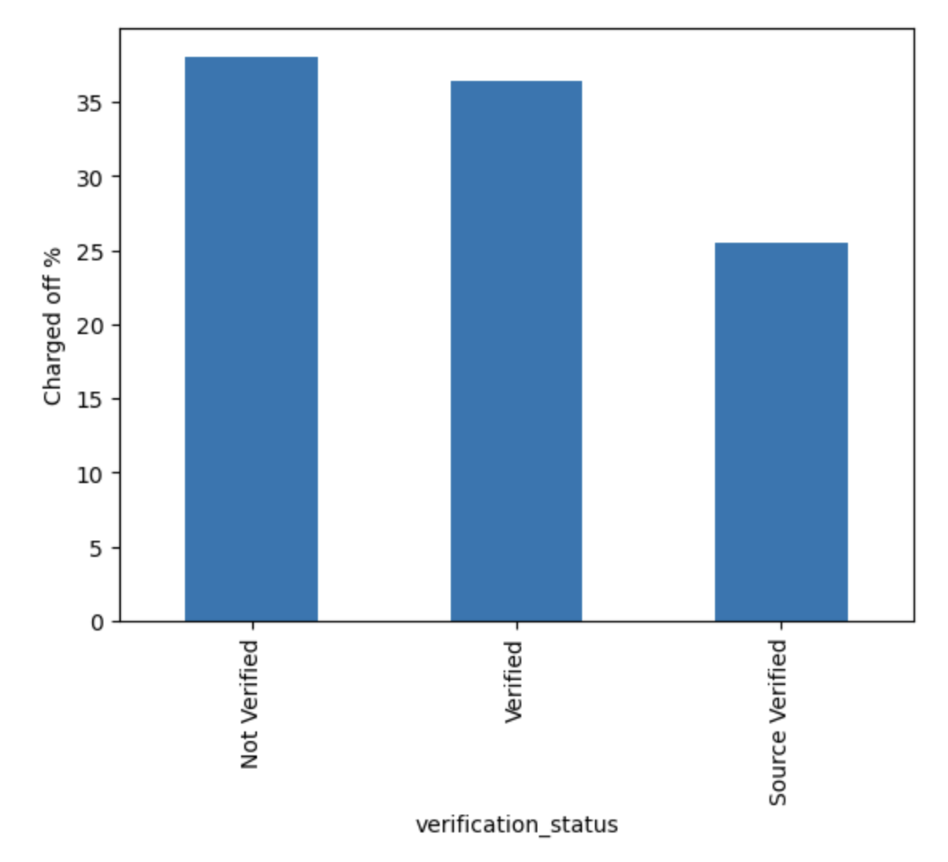
Applicant’s verification status if Not verified, then most changes for defaulting
A bank may consider Source Verified over Verified/Not Verified

Slide 11
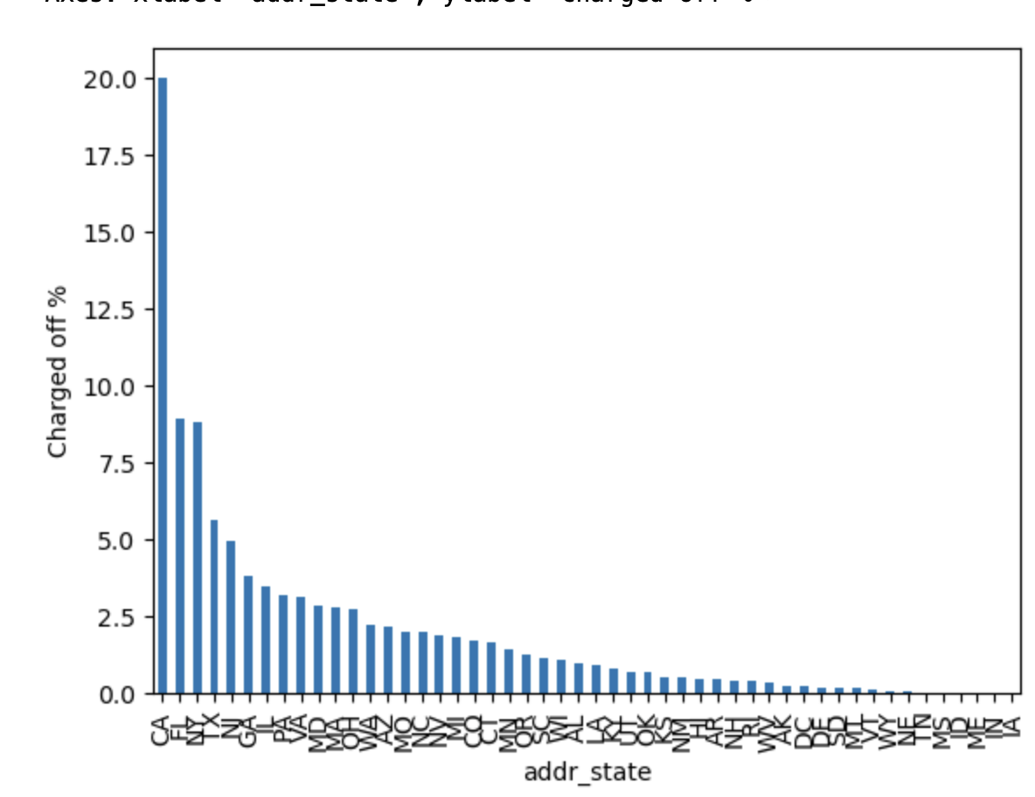
Applicants’ probability of defaulting is high if he/she is from California state
A bank can take extra steps/scrutiny before giving loan to CA residents

Slide 12
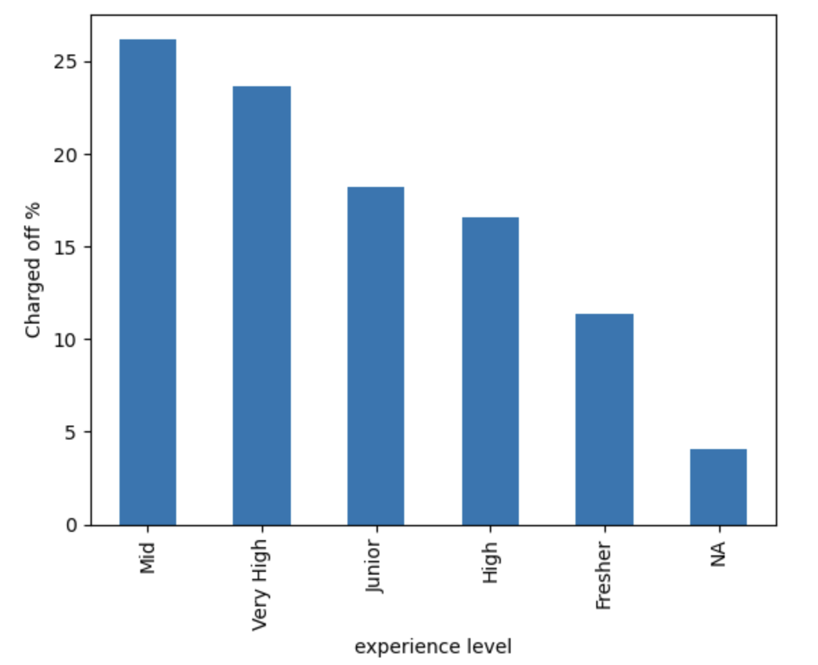
Based on experience level, Mid level (3-6 years) applicants are likely to default more than the rest.
A bank should consider more parameters before loan is sanctioned for Mid/Very High experience level candidates

Slide 13
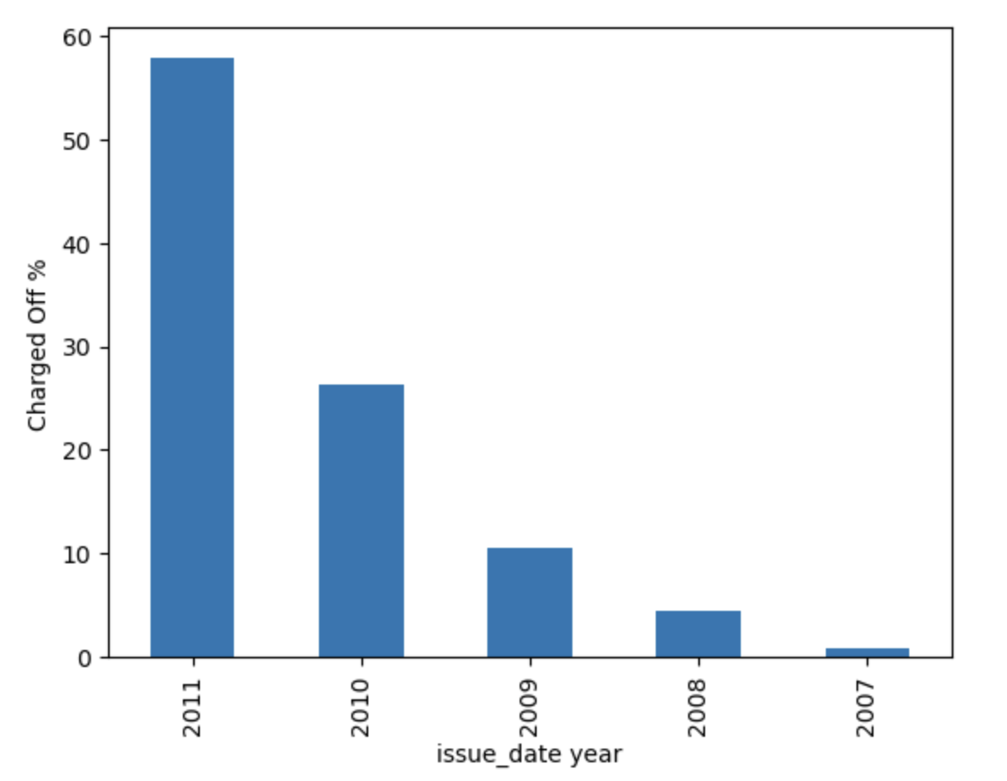
Based on the available data, applicants defaults the most in 2011 and fell almost by 50%. Though This is an interesting insight, doesn’t help conclude as it is one time spike
There may have been recession or natural calamity during 2011, because of which people couldn’t pay back and hence defaulted

Slide 14
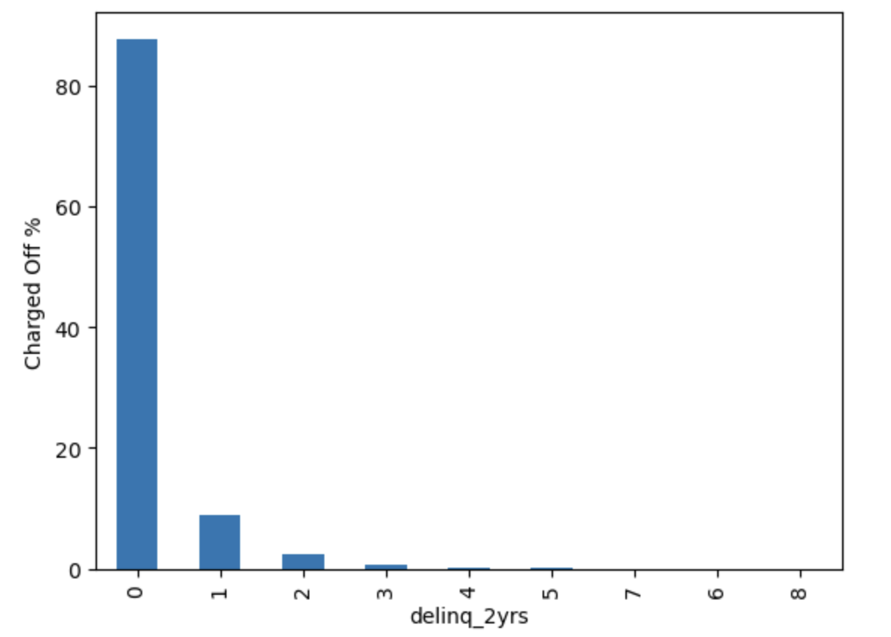
Based on the data, if an applicant deliquated for 2 years in category 0 then he/she is likely to default more than anyone else

Slide 15
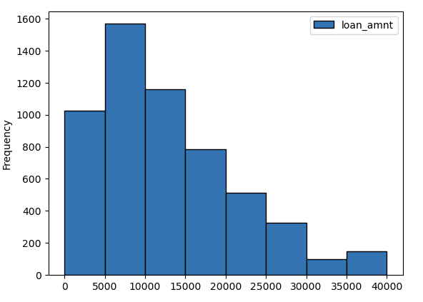
From Histogram we can see max people who took loan of amount ranging from 5k-10k charged off

Slide 16
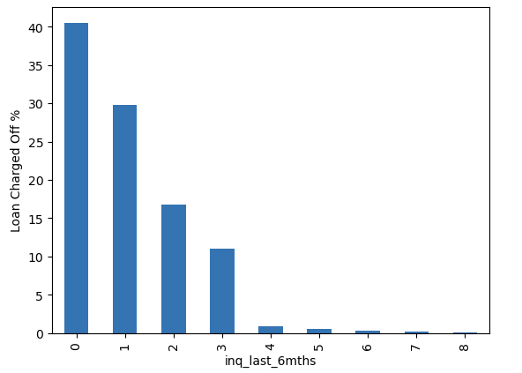
People who doesn't enquire in last 6 months have charged off around 90%

Slide 17
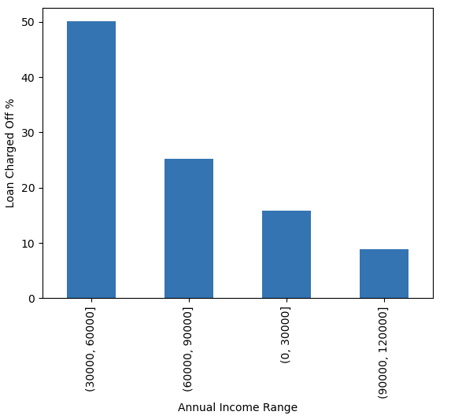
We can analyze that people in range of 30-60k are doing 50% charged off
We can say annual income below 50k are doing 70% charged off . So, Annual Income is an important parameter for the charged off

Slide 18
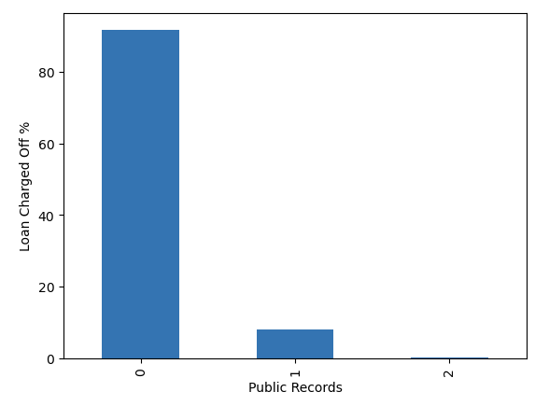
One who doesn't have derogatory public records are doing > 90% charged off

Slide 19
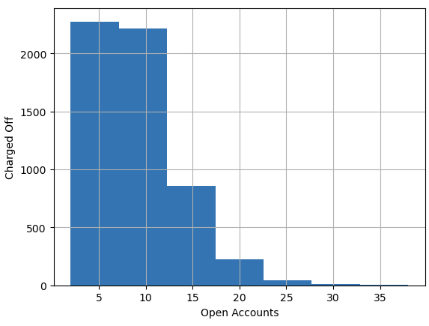
People who have around 1-12 open accounts are doing more charged off

Slide 20
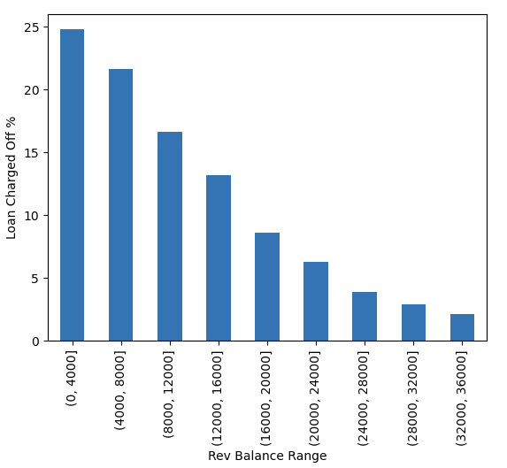
As Revol Balance increases , Charged off percent deceases i.e Charged off is more when rev balance is low i.e in range of 0-4000 and 4000-8000

Slide 21
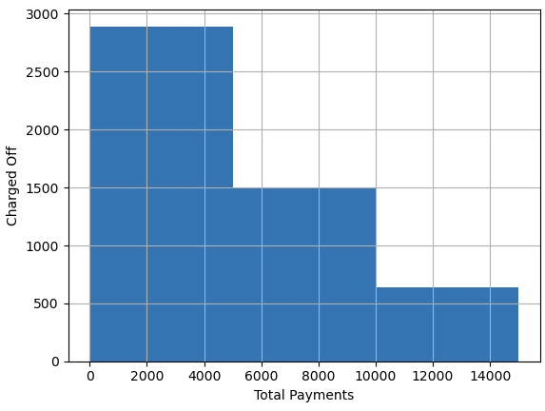
As Total Payment is increasing charged off is decreasing . For low total payment (0-5000) charged off is more

Slide 22
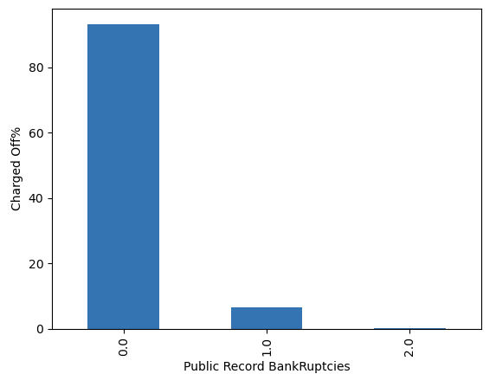
People who have 0 public record bankruptcies have done the most charged off

Slide 23
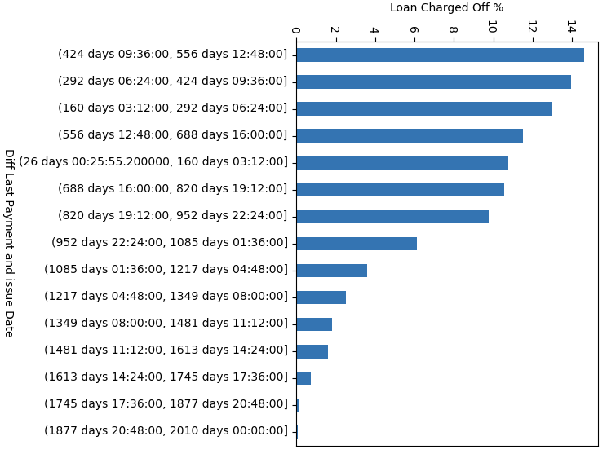
We can observe from this that As Last payment is done close to issue date then there is more chances of charged off Last payment date is within 2 years of issue date then there is more chances of default .

Slide 24
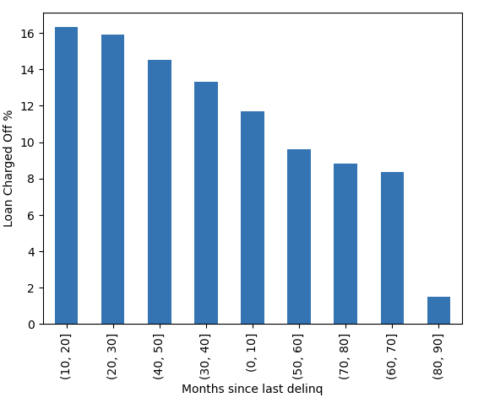
As the number of months since the borrower's last delinquency increases the charged off percent decreases . So, If borrower's has done delinquency recently then charged off chance is more .

Slide 25
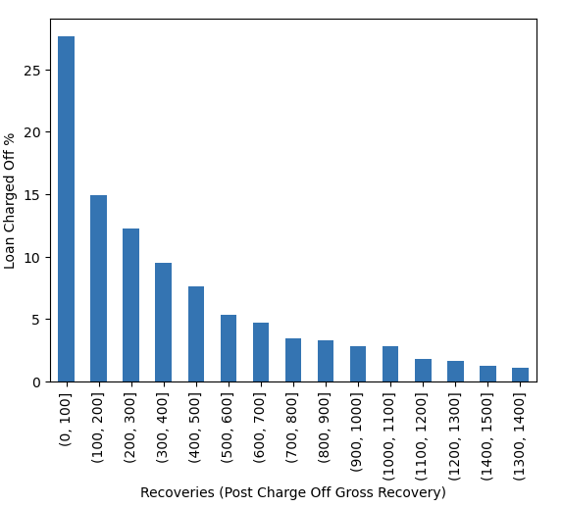
As recoveries decreases charged off percent decreases . Recoveries in range of (0, 100 ) has the max charged off .

Slide 26
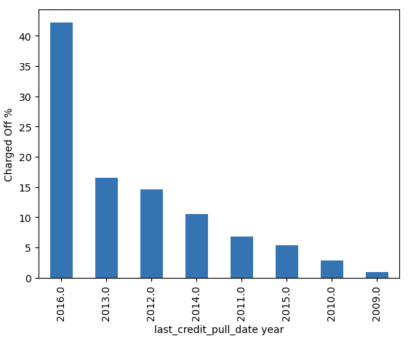
In 2016 last credit pull date year charged off is maximum . Will find out patterns in month

Slide 27
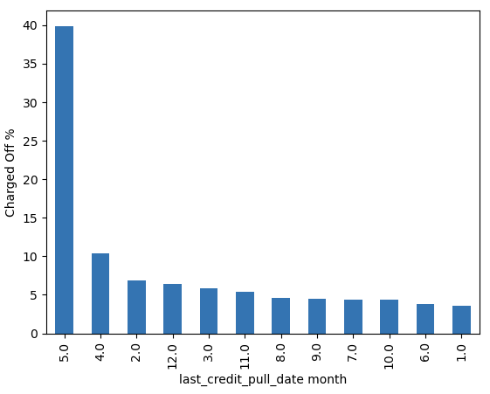
In Month 5 i.e May last_credit_pull_date maximum charged off

Slide 28
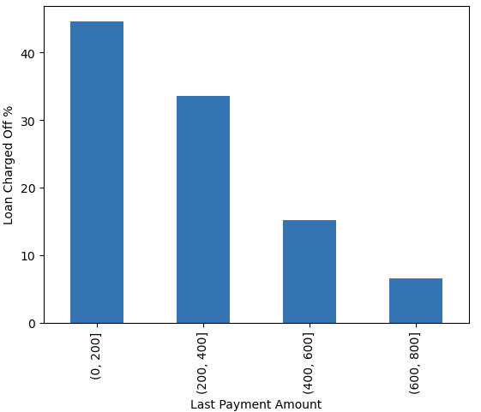
As last payment amount increases charged off percent decreases. Last Payment Amount <200 means very high chances of charged off . <400 chances of charged off is high

