Slide 1


Lending Club Case Study

Slide 2
Let us understand the factors which Influence Charged Off

Slide 3
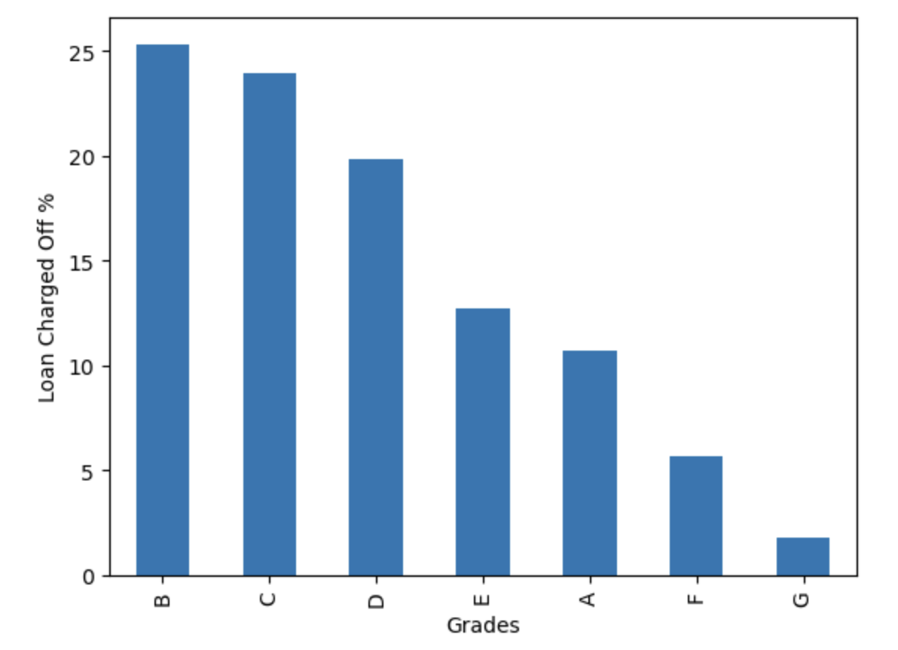
Members in grade B are the ones who charged off the most, followed by Grade c and D

Slide 4
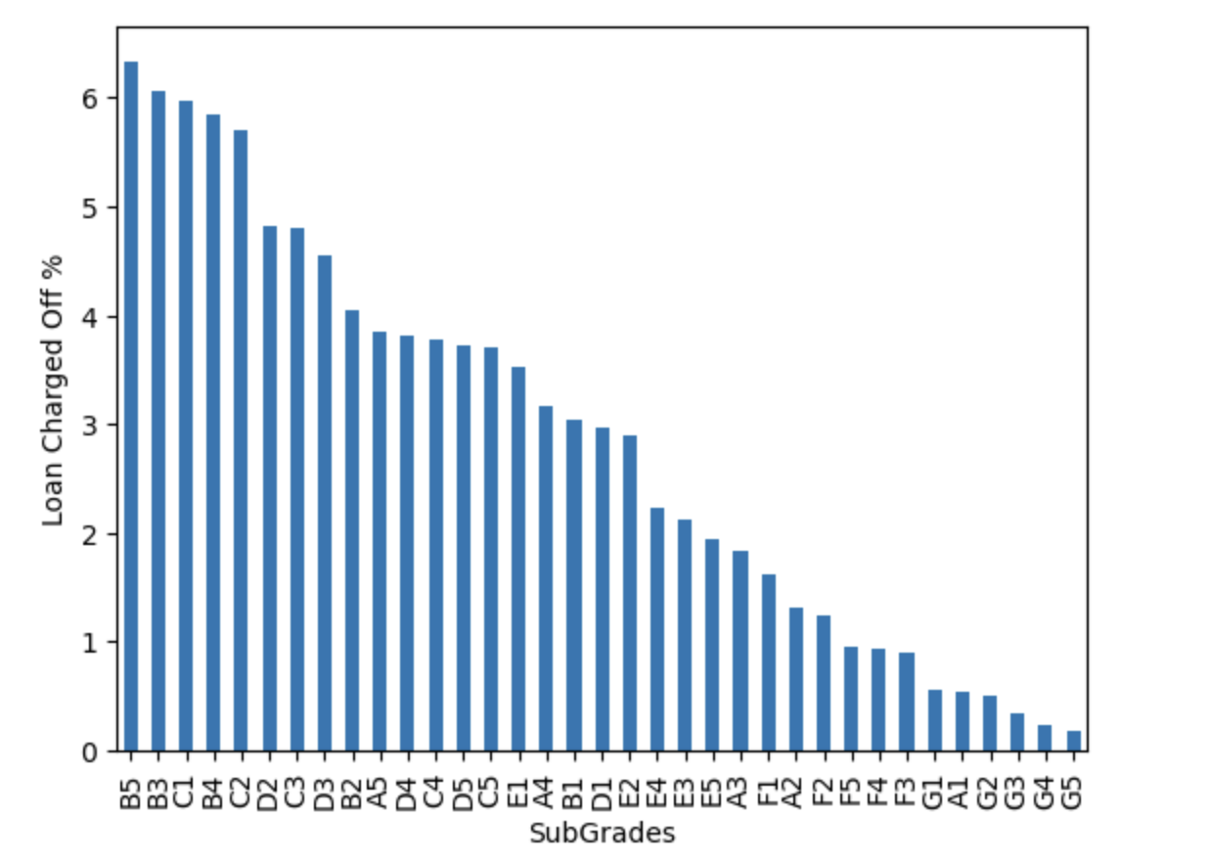
Members with Sub-grade B5 are the ones who charged off the most, followed by sub-Grade b3, c1,b4, c2

Slide 5
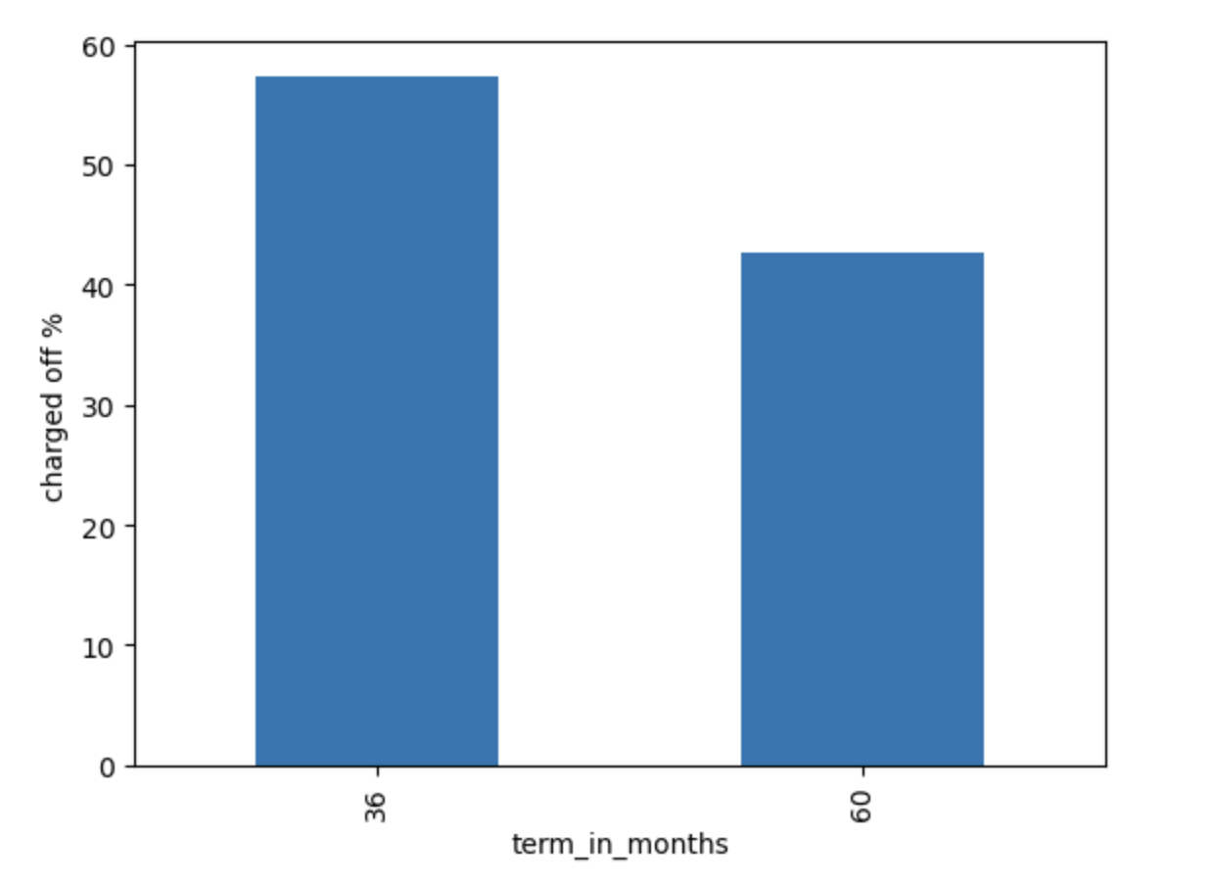
People who thought to repay loan by 36 months defaulted more than the ones who took it for 60 months.
A bank may consider to increase tenure to reduce the defaults

Slide 6
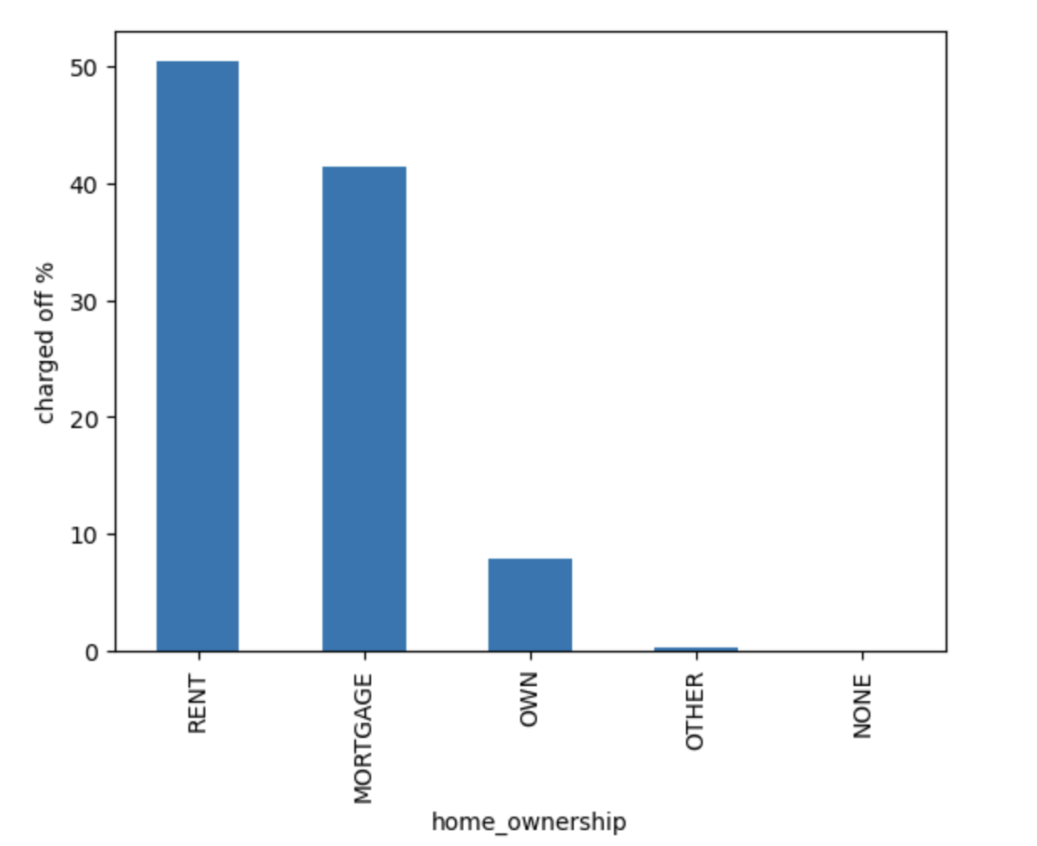
People who were on rent seems to have defaulted the most while those who owned home were comparatively less in %
A bank may consider home owning candidates over the ones living on rent

Slide 7
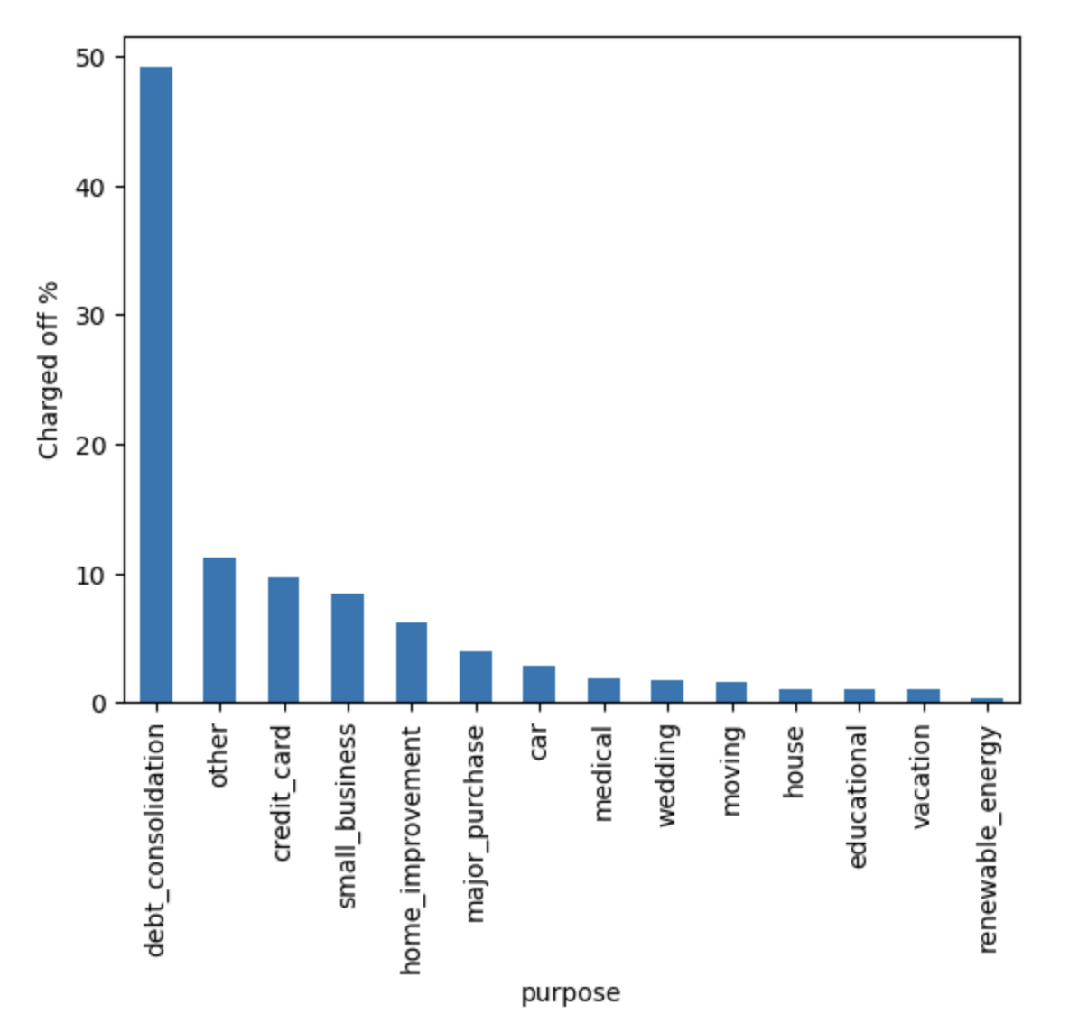
Loan seekers, whose purpose was det consolidation defaulted to the max
A bank should be very cautious while considering the applicants who intend to take loan for debt consolidation

Slide 8
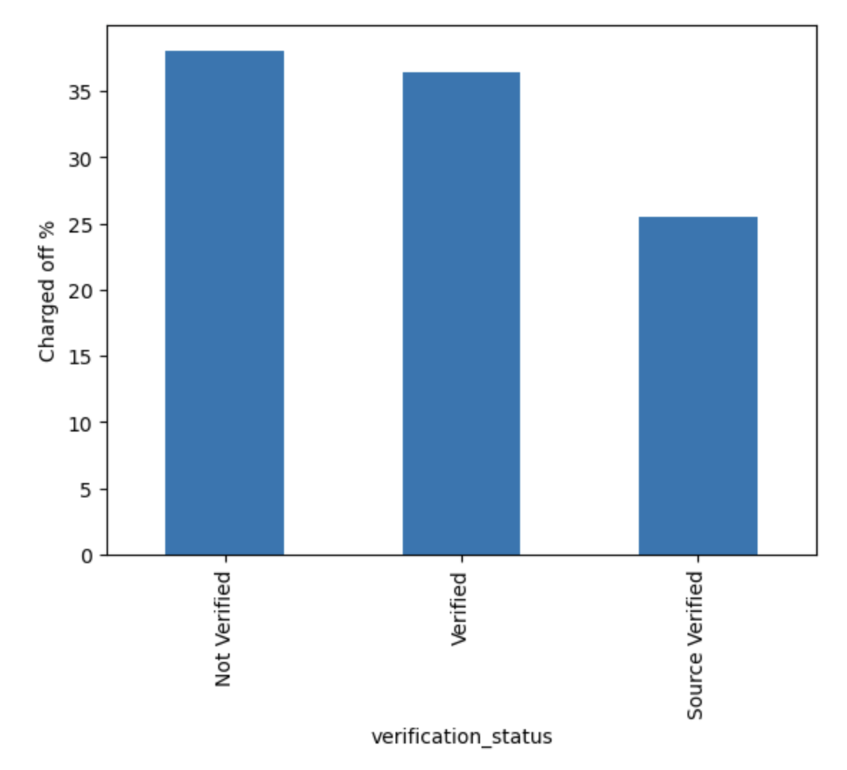
Applicant’s verification status if Not verified, then most changes for defaulting
A bank may consider Source Verified over Verified/Not Verified

Slide 9
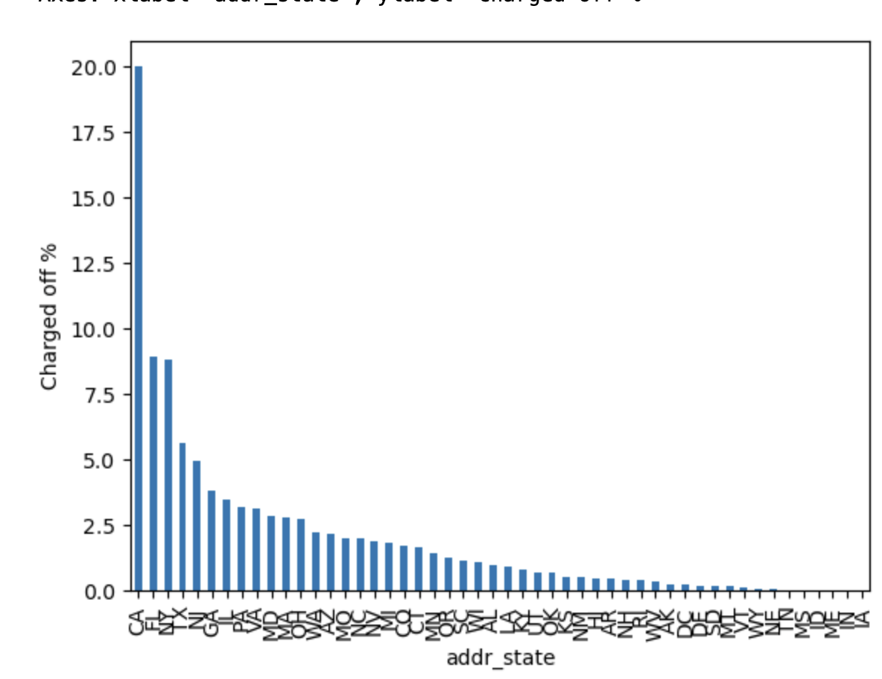
Applicants’ probability of defaulting is high if he/she is from California state
A bank can take extra steps/scrutiny before giving loan to CA residents

Slide 10
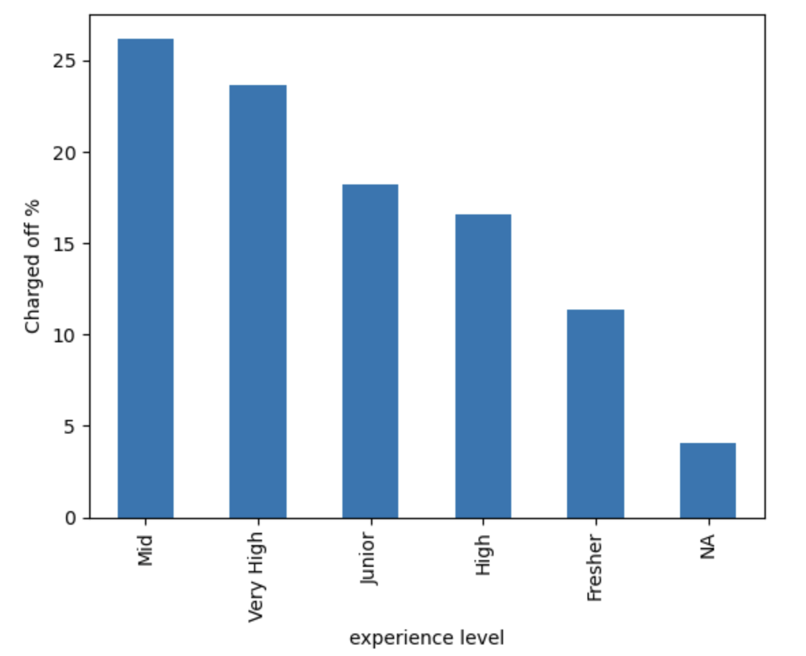
Based on experience level, Mid level (3-6 years) applicants are likely to default more than the rest.
A bank should consider more parameters before loan is sanctioned for Mid/Very High experience level candidates

Slide 11
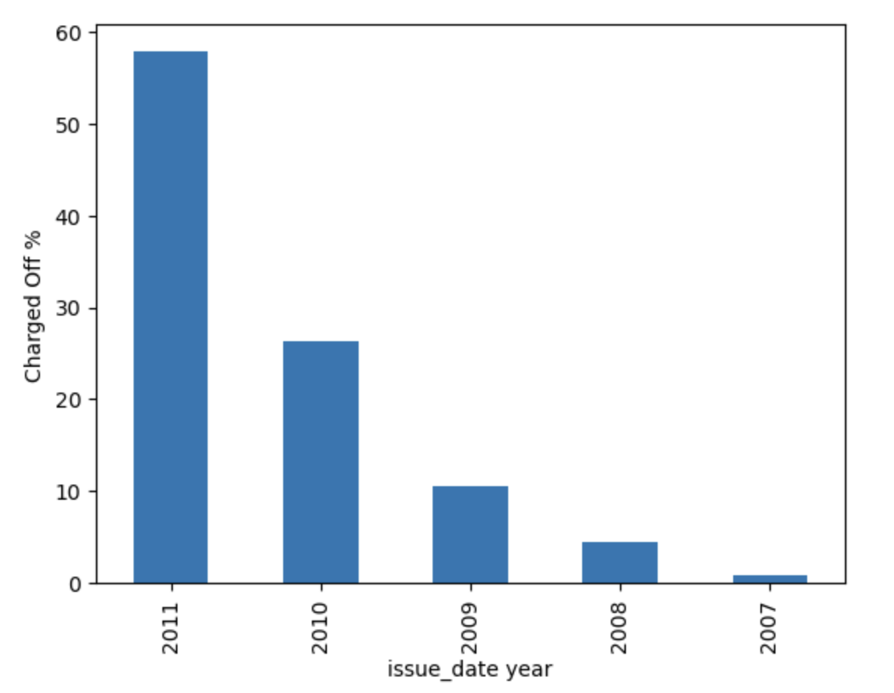
Based on the available data, applicants defaults the most in 2011 and fell almost by 50%. Though This is an interesting insight, doesn’t help conclude as it is one time spike
There may have been recession or natural calamity during 2011, because of which people couldn’t pay back and hence defaulted

Slide 12
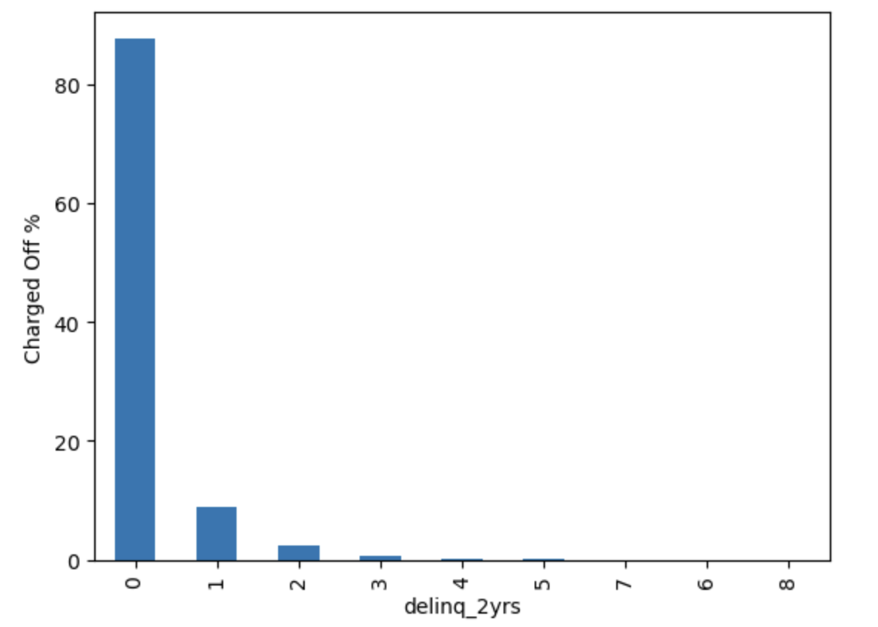
Based on the data, if an applicant deliquated for 2 years in category 0 then he/she is likely to default more than anyone else

