Slide 1


Lending Club Case Study

Slide 2
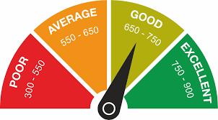
Problem Statement
For a consumer finance company understand the driving factors (or driver variables) behind loan default | loan charged off.
Given dataset which contains the complete loan data for all loans issued through the time period 2007 to 2011.
Each column meanings are defined a given data dictionary.

Slide 3
Approach
Data Understanding
Using given dictionary and excel understand data in loan.csv
Data Cleaning
Based on understanding, using klib library or pandas performing cleaning operation
Data Interpretation
With the cleaned data plot graphs to mention the observations

Slide 4
Let us understand the factors which Influence Charged Off

Slide 5
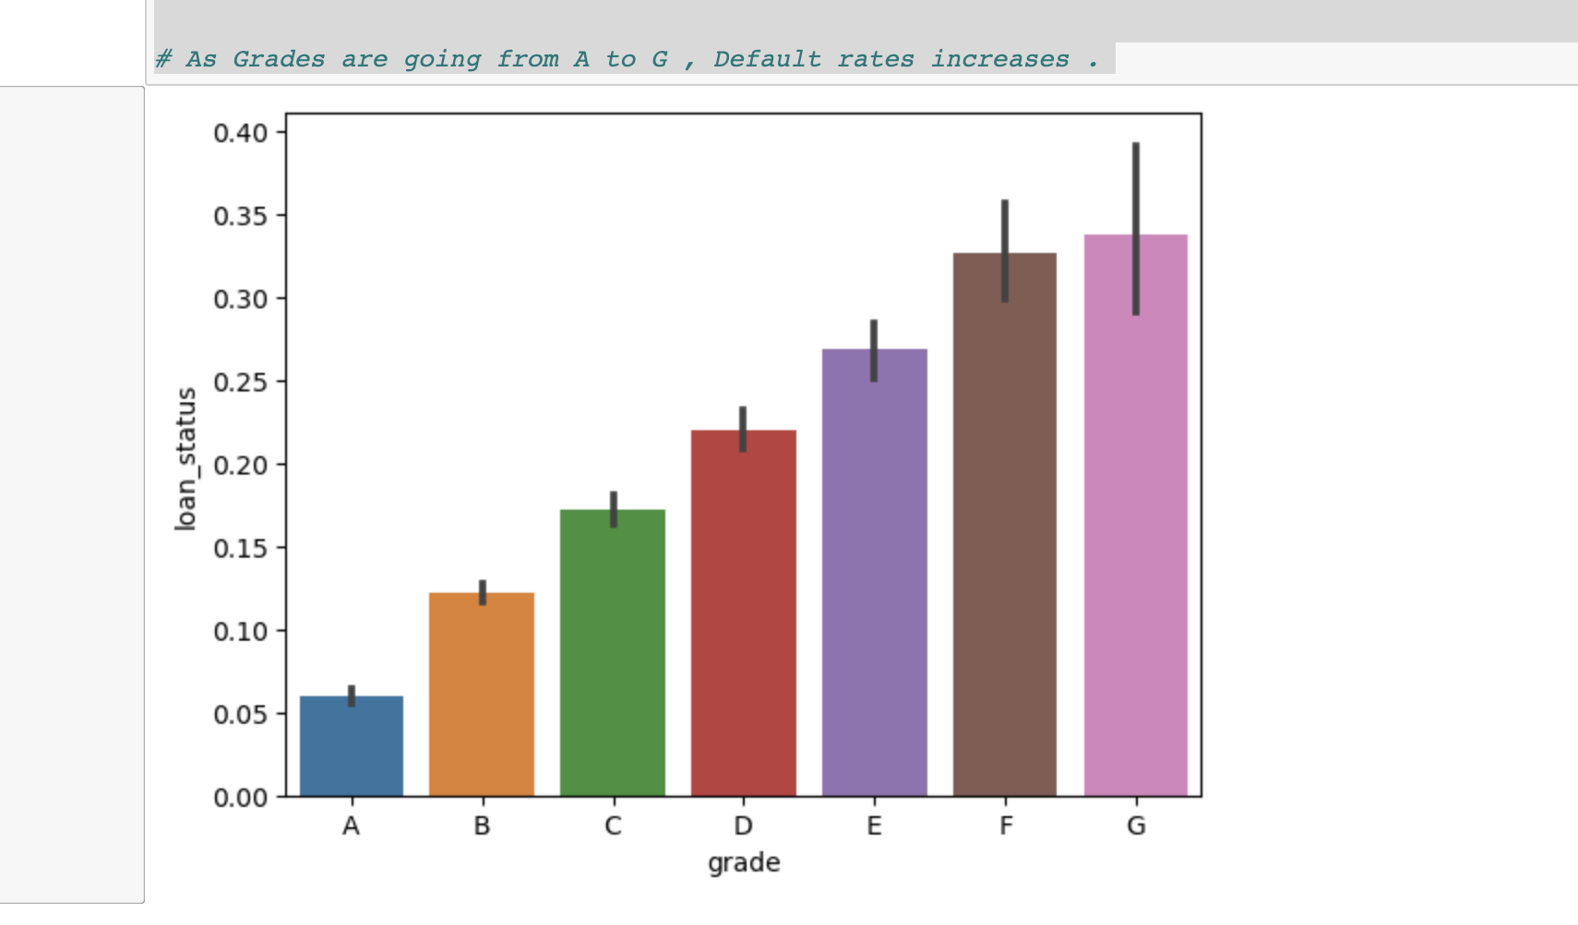
GRADES : as Grades Going from A to G , Charged Off Increases. GRADE G ARE MORE DEFAULTING. GRADES CATEGORIES Loan based on SAFE level to LEND . A Level being SAFER . G LEVEL WORST

Slide 6
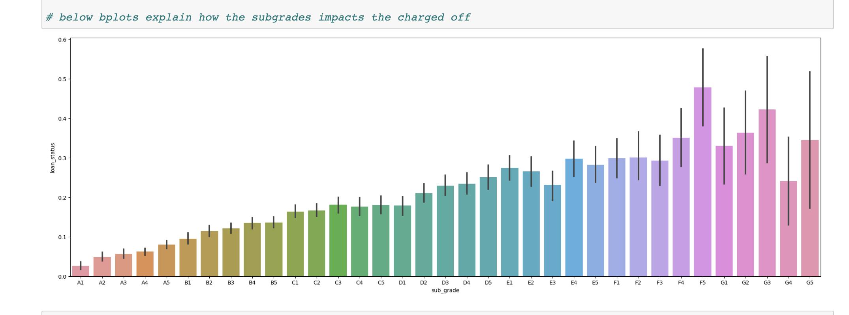
SUBGRADES : Plots Showing How Subgrades within EACH Grades Varies

Slide 7
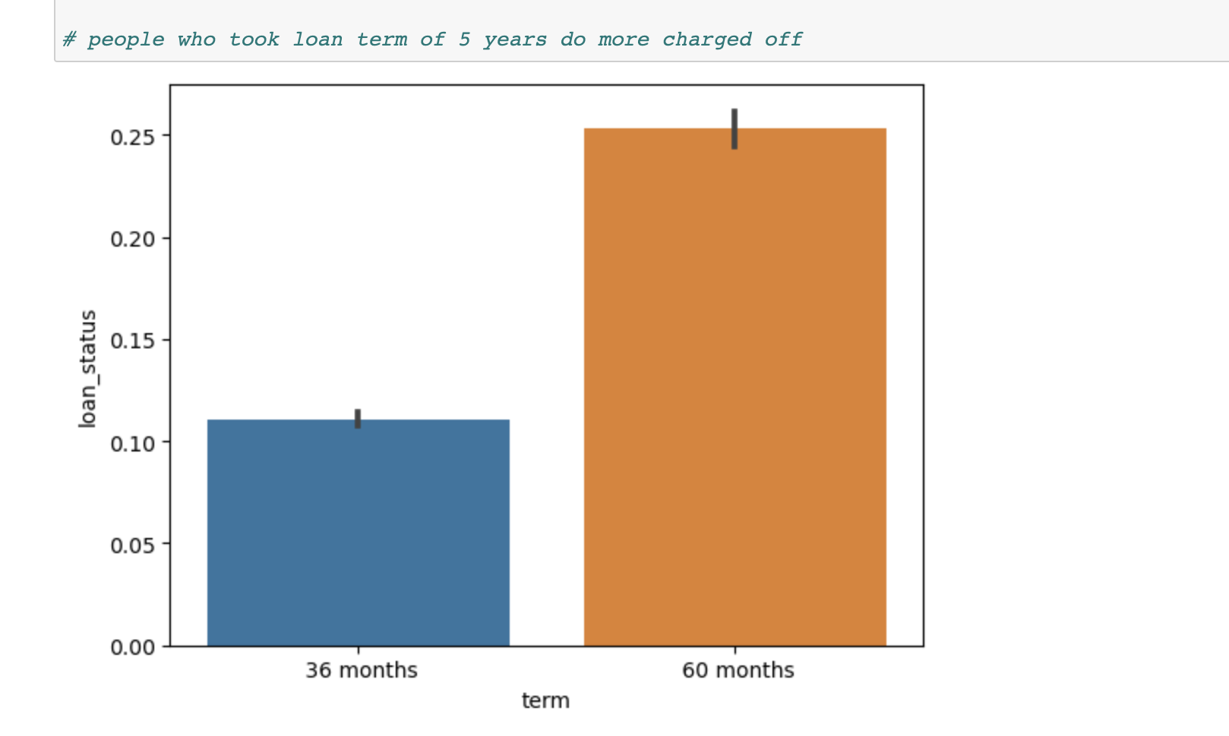
TERM : People who repay loan by 60 months defaulted more than the ones who took it for 36 months.

Slide 8
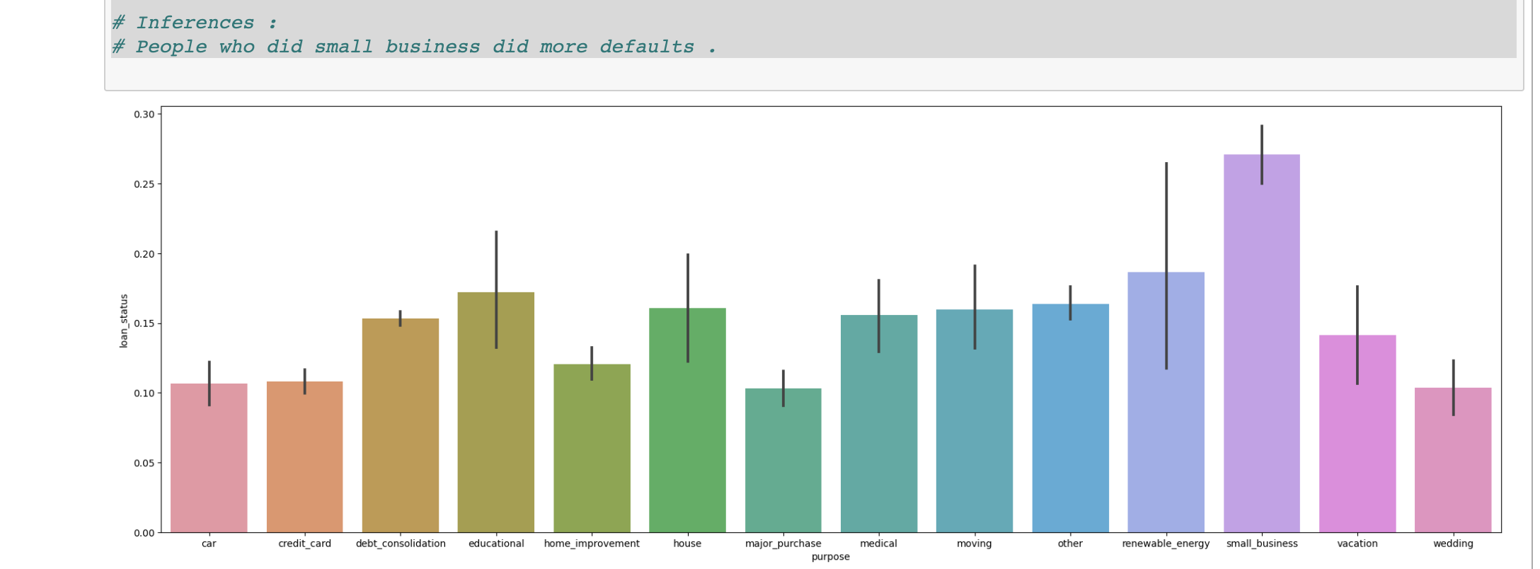
PURPOSE : People Who Do Small Business Defaults More . Banks Should validate people of SUCH Business More and Decide Accordingly

Slide 9
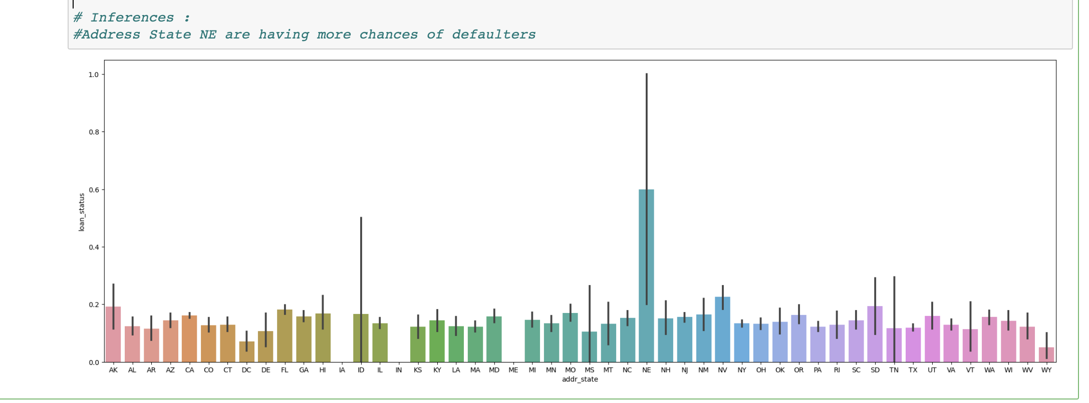
STATE : ApplicaNT from ‘NE’ State Are Defaulting More.

Slide 10
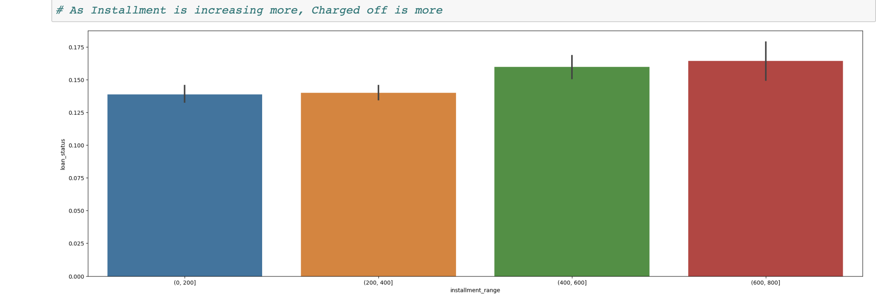
Installment : As Installment Increases , Default Increases .

Slide 11
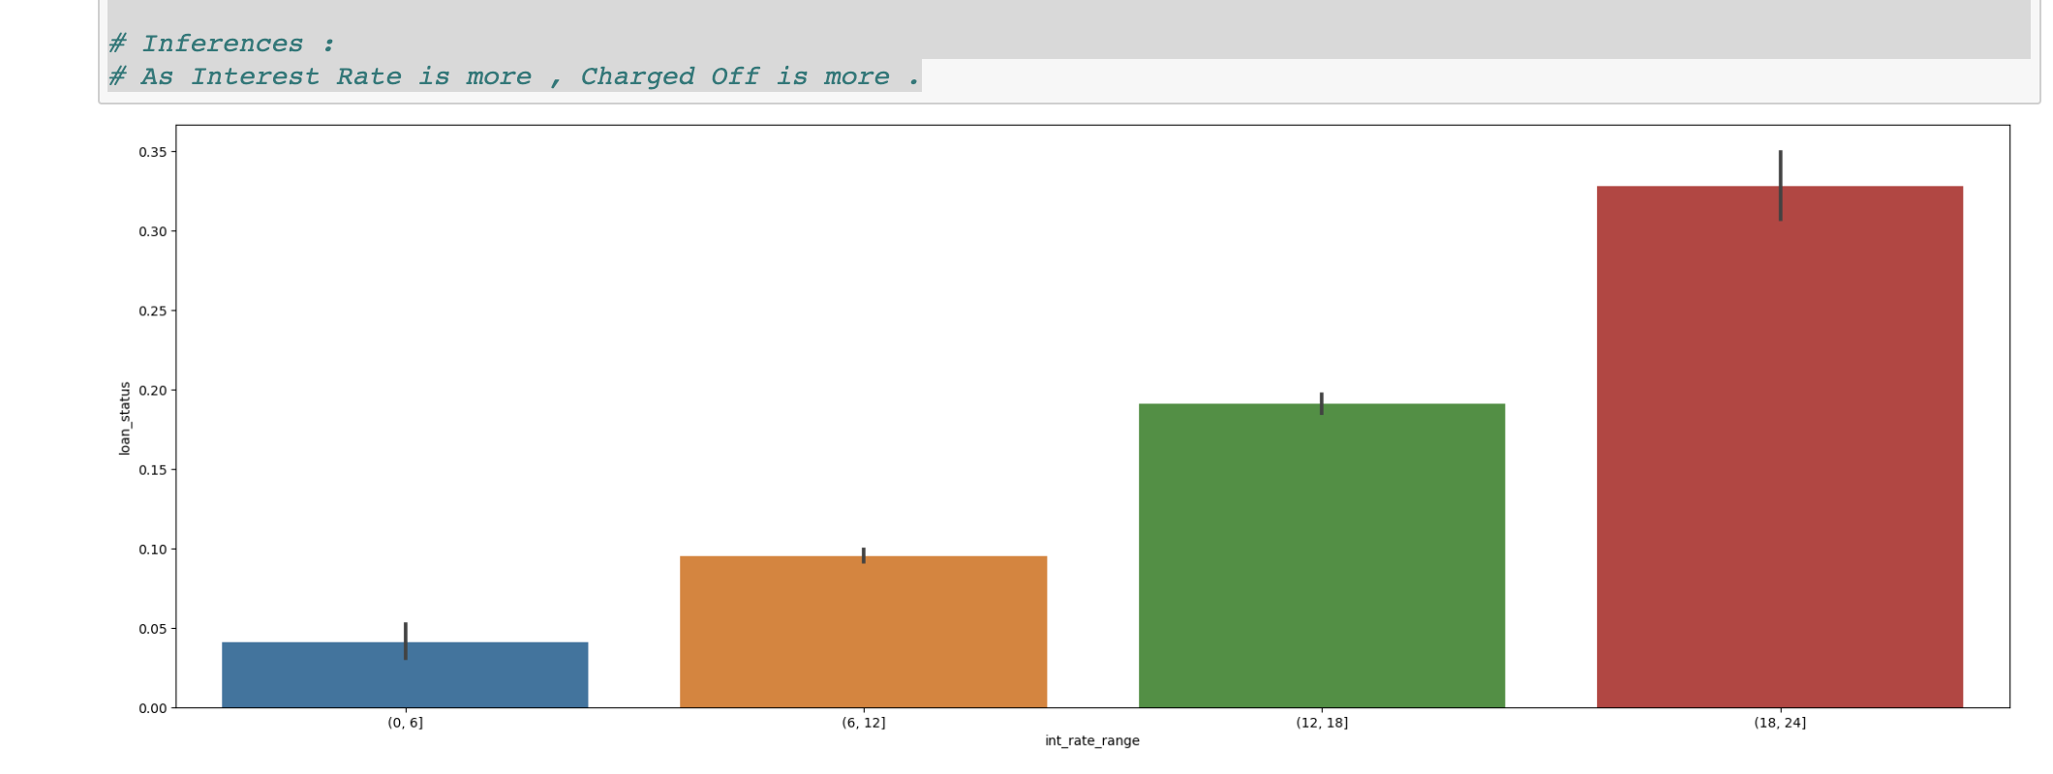
INTEREST RATE : InteREST Rate Impacts The Default RATE . As Interest Rate Increases , Default Rate IncreaseS

Slide 12
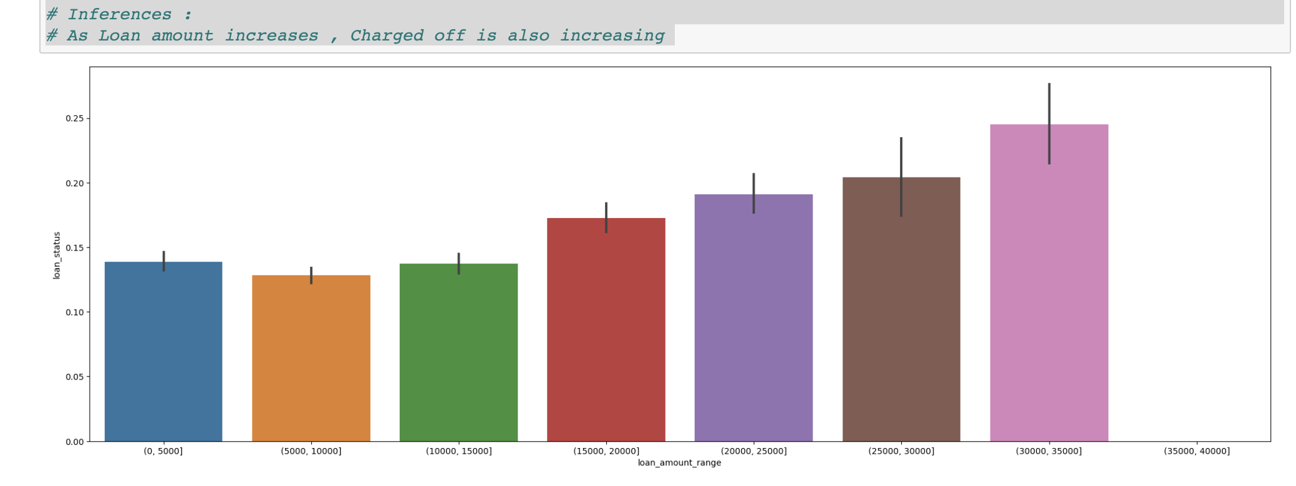
LOAN AMOUNT : Based on the data, As Loan Amount Increases , Loan Charged Off Also Increases

Slide 13
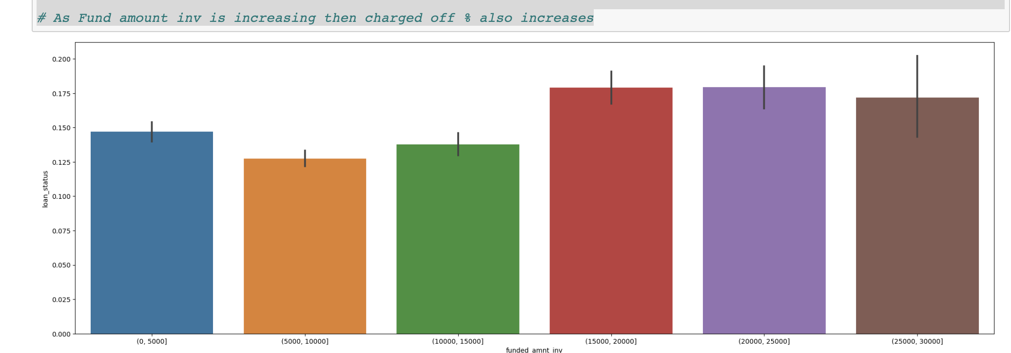
FUNDED AMOUNT INV : Based on GraPH , We can ANALYSE THAT As Loan Amount Invested Increases , Default also Increases

Slide 14
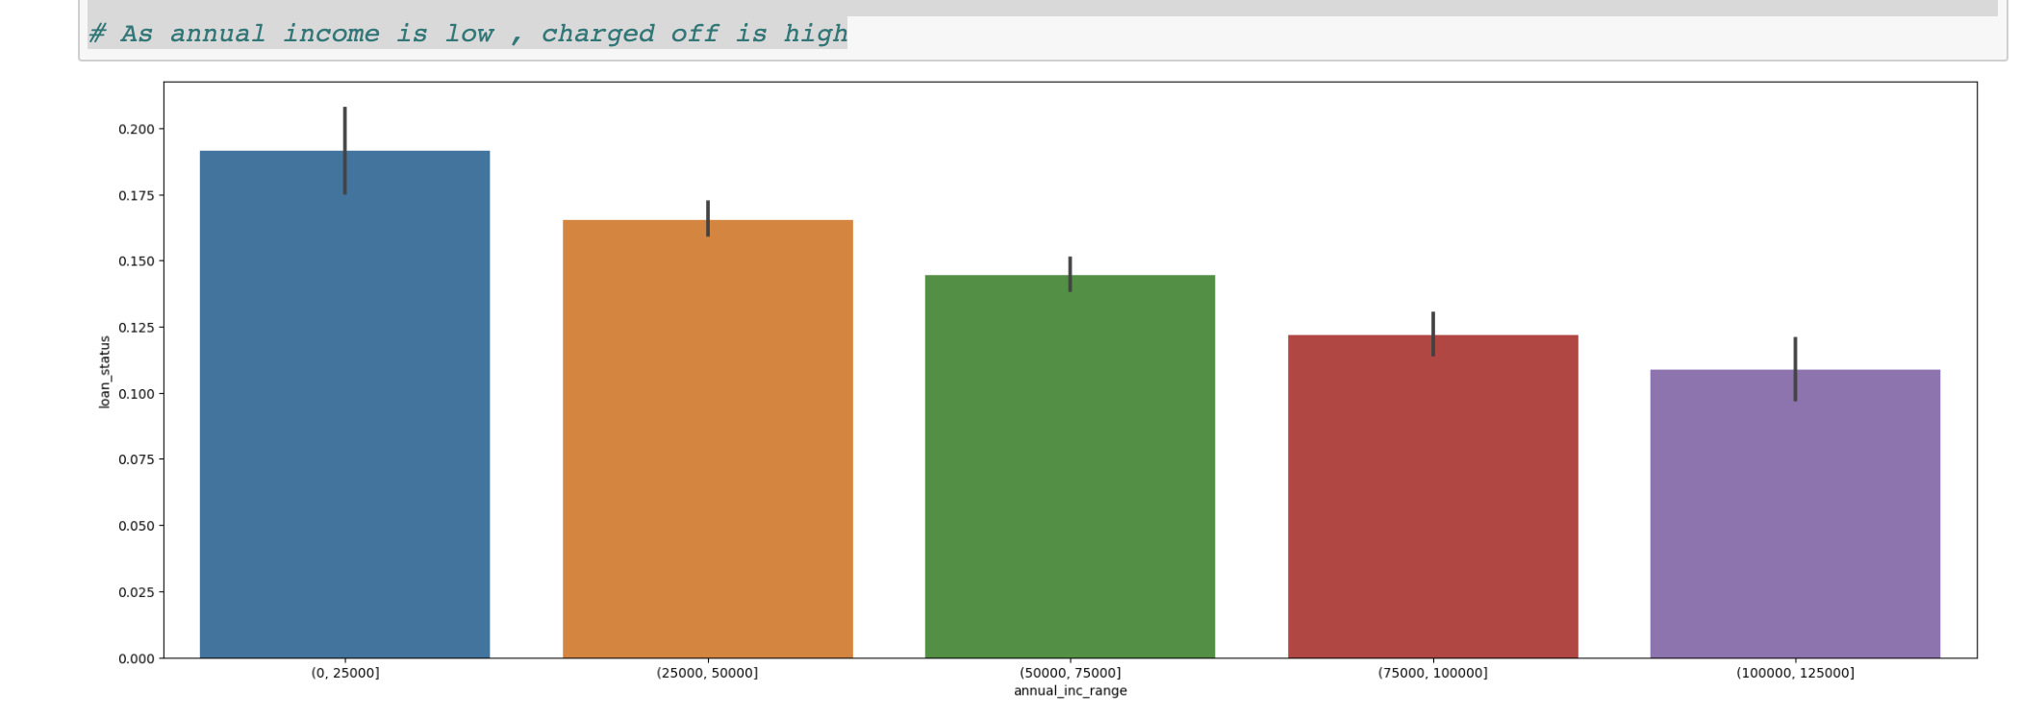
ANNUAL INCOME : As ANNual Income Increases , CHARGED OFF DECREASES . PEOPLE OF LOW INCOME ARE DOING MORE DEFAULTS

Slide 15
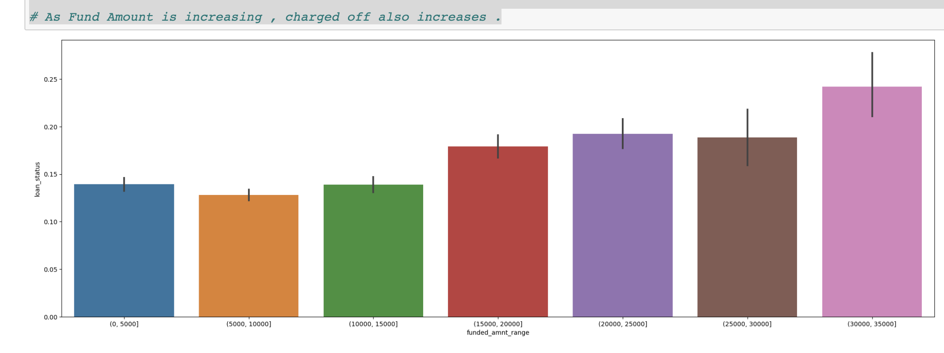
FUNDED AMOUNT : As Funded Amount Increases , CHARGED OFF INCREASES

Slide 16
PATTERNS OF ATTRIBUTE ‘PURPOSE’ WITH OTHER CATEGORICAL VARIABLES

Slide 17
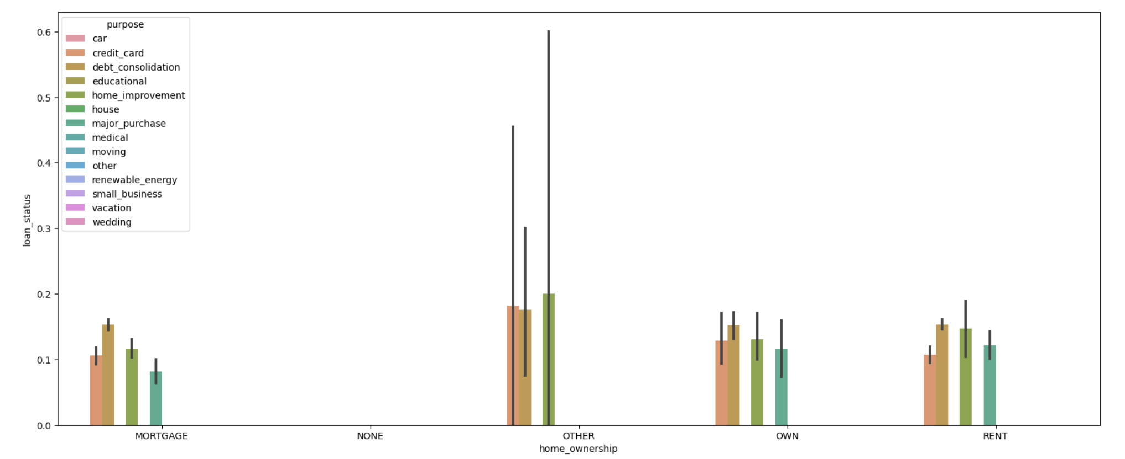

WITH HOME OWNERSHIP

Slide 18
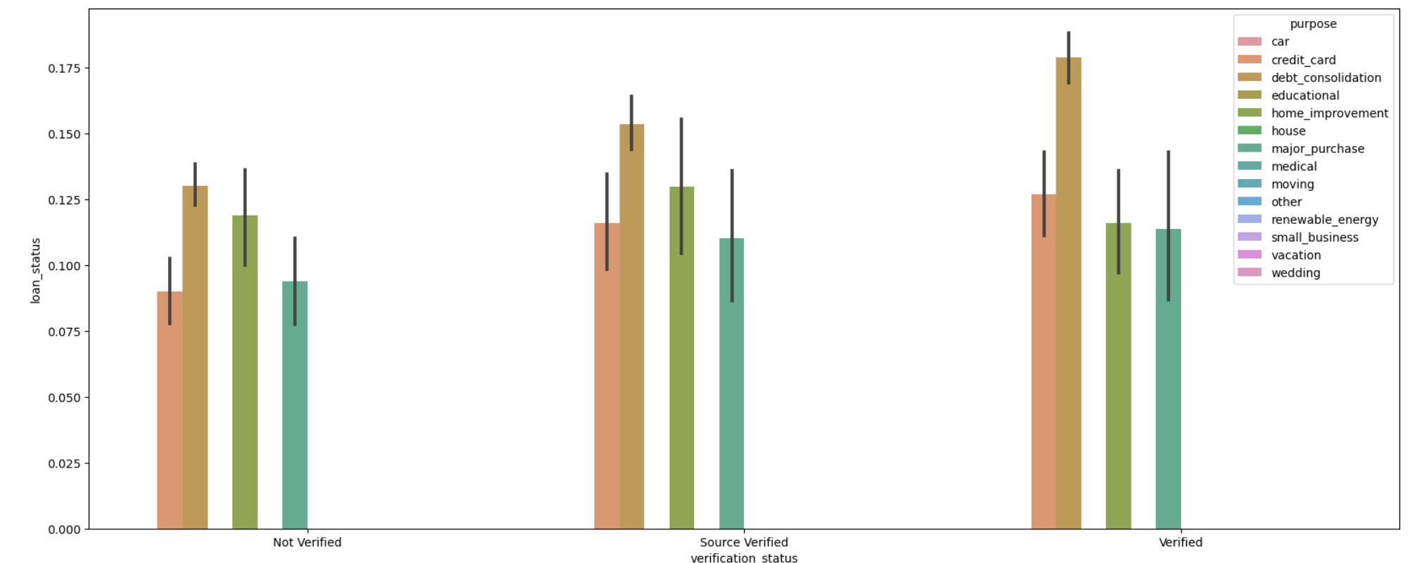
WITH VERIFICATION STATUS

Slide 19
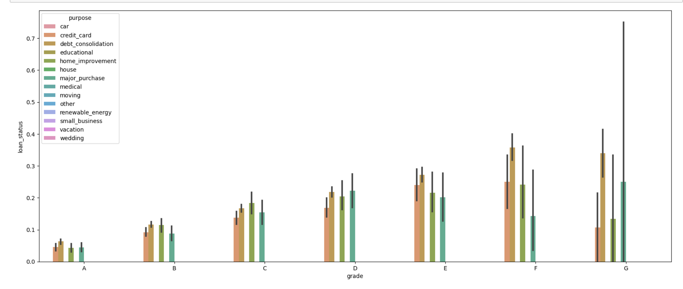
WITH GRADES

Slide 20
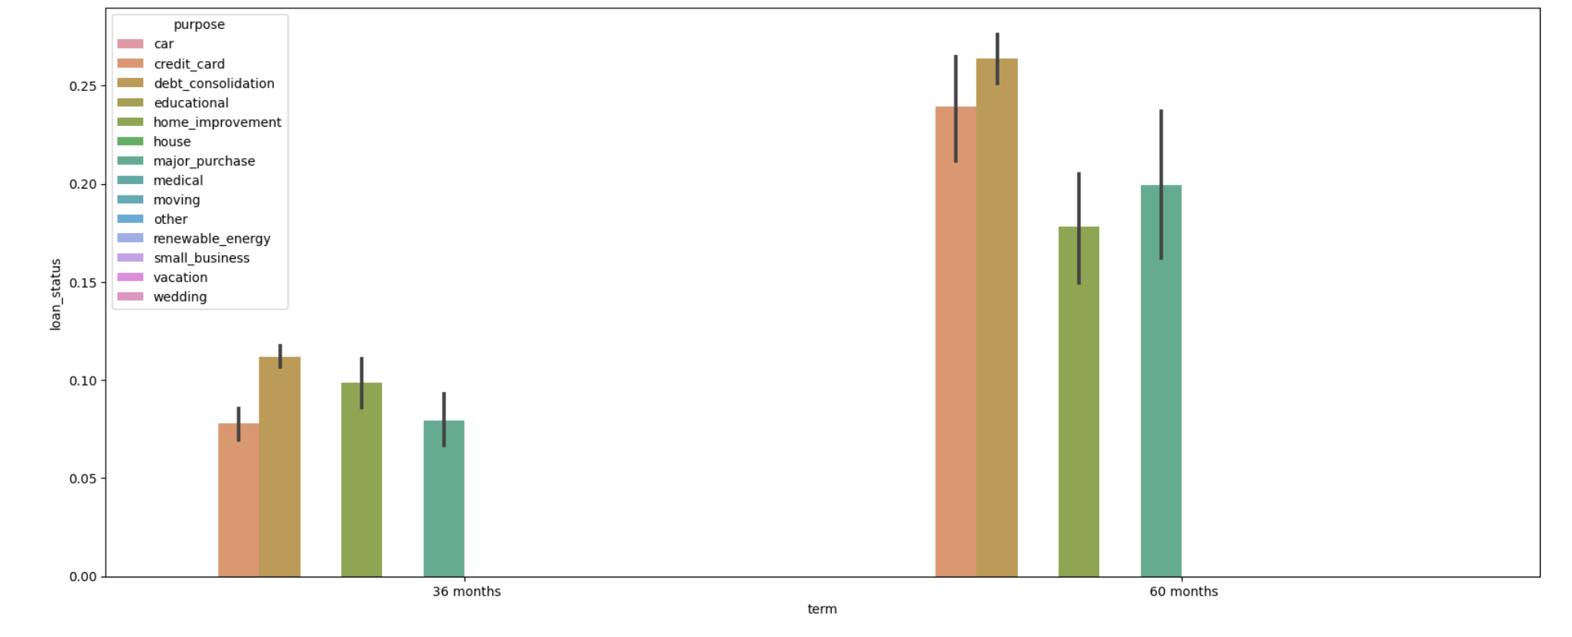
WITH TERM

Slide 21
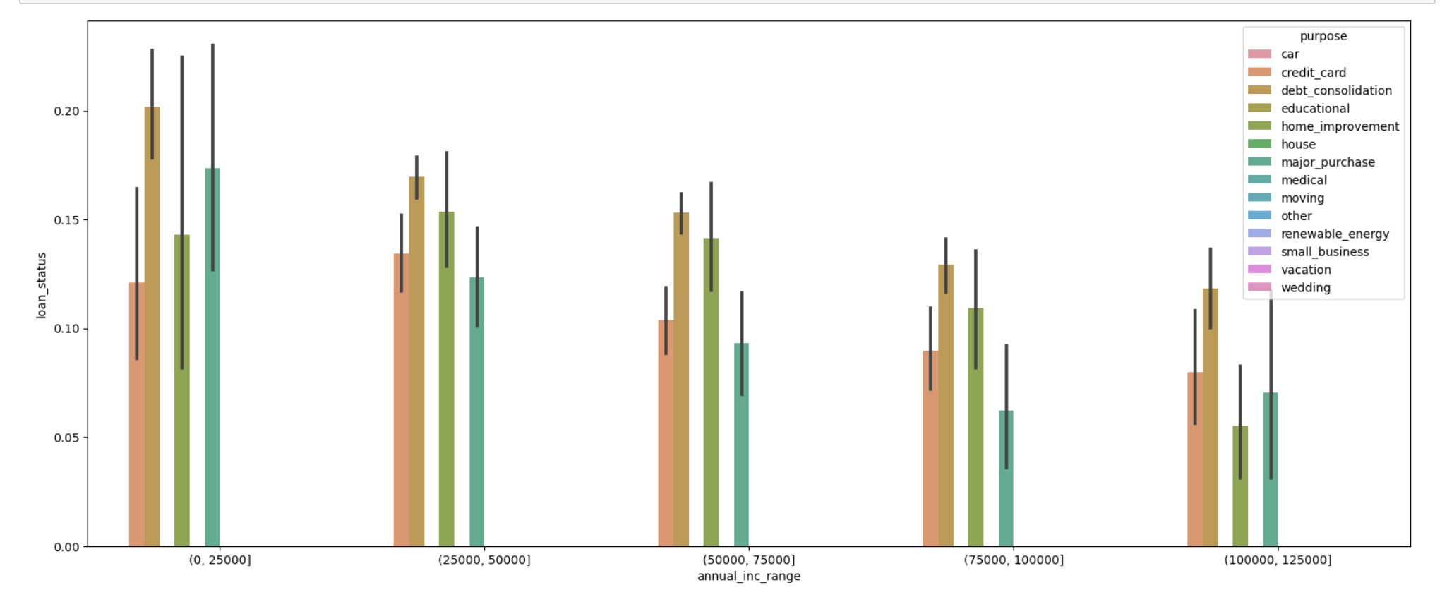
WITH ANNUAL INCOME

Slide 22
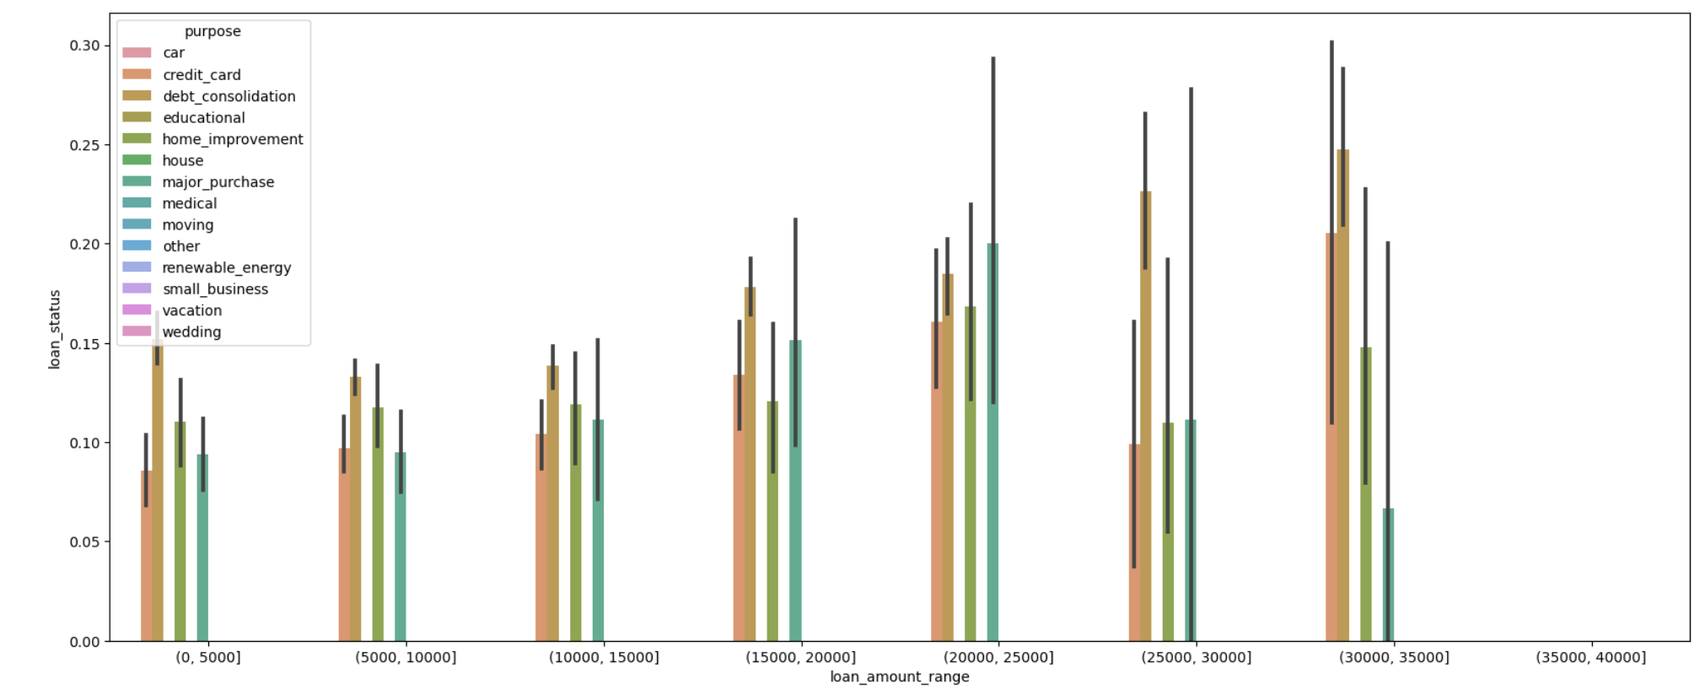
WITH LOAN AMOUNT

