Slide 1
GPU Computing
Rohan Saxena, FMG Portfolio Modeling Analytics
12th April 2018

Slide 2
OVERVIEW
What is GPU
GPU vs CPU
CUDA – CPU+GPU
PROCESS FLOW OF CUDA PROGRAM
SUPPORT TO GPU’s
APPLICATIONS
SPEEDUP
DOWNSIDE

Slide 3
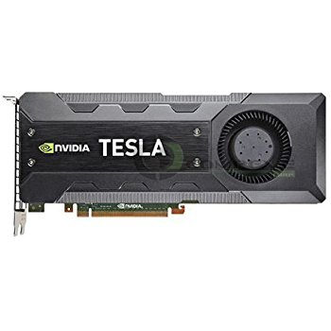
GPU
•The Graphic Processing Unit (GPU) is a processor that was specialized for processing graphics. Earlier used more in the gaming industry.
•The GPU has recently evolved towards a more flexible architecture.
•OPPORTUNITY: We can implement *any algorithm*, not only graphics.
•CHALLENGE: obtain efficiency and high performance.

Slide 4
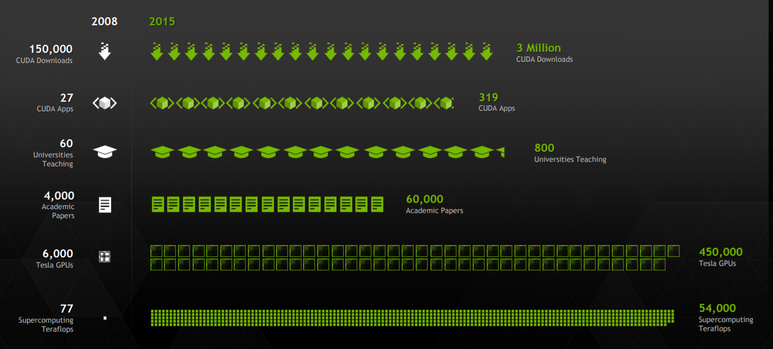
GROWTH IN GPU COMPUTING

Slide 5
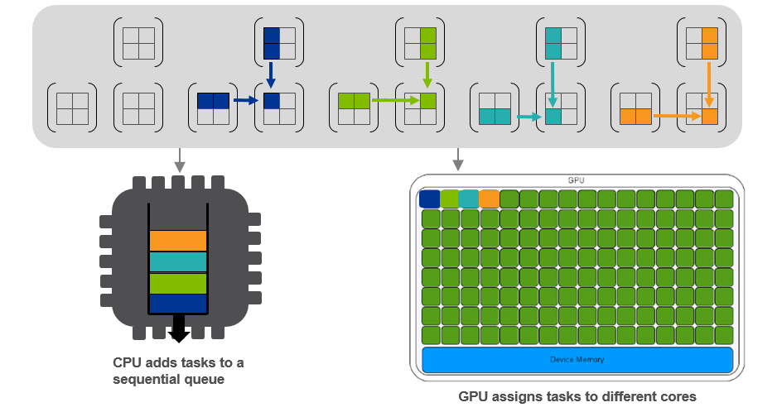
GPU vs CPU
A CPU consists of a few cores optimized for sequential serial processing
A GPU consists of thousands of smaller cores designed for parallel processing

Slide 6
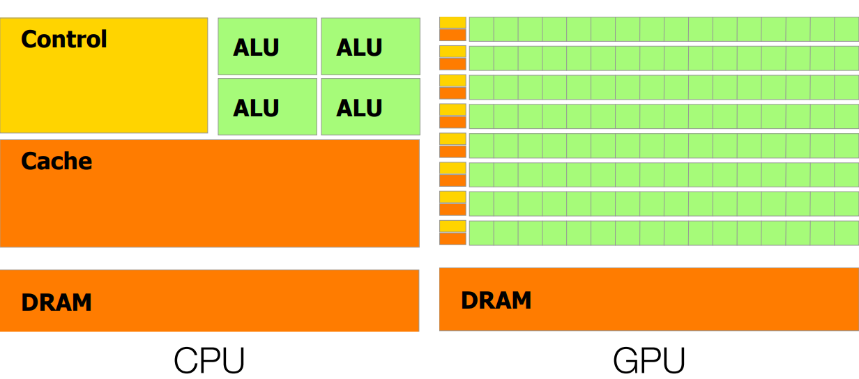
CPU vs GPU
GPU is more aimed towards data processing

Slide 7
CUDA: Heterogeneous Parallel Computing
CPU optimized for fast single-thread execution
Cores designed to execute 1 thread or 2 threads concurrently
Large caches attempt to hide DRAM access times
Cores optimized for low latency cache access
Complex control logic for speculation and out of order execution
GPU optimized for high multi thread output
Cores designed to execute many parallel threads concurrently
Cores optimized for data-parallel, throughput computation
Chips use extensive multithreading to tolerate DRAM access times
+

Slide 8
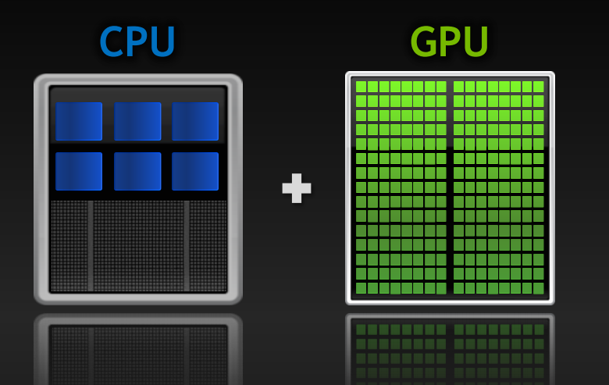
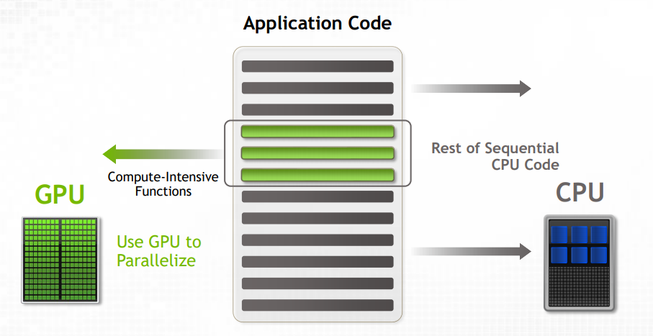
GPU’s with CPU
Few cores in CPU
v/s
1000s of cores in GPU
New Code Structure

Slide 9
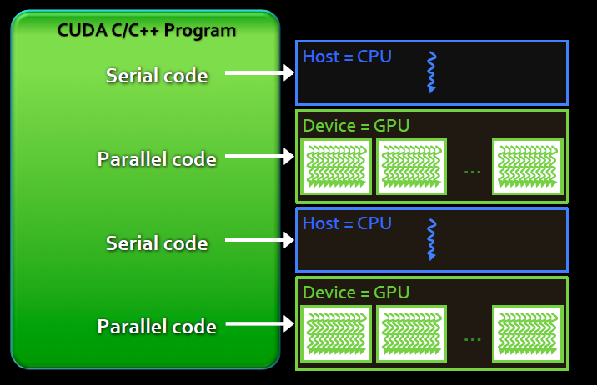
Anatomy of CUDA C Program
Serial code executes in a Host(CPU) thread
Parallel code executes in many concurrent device (GPU) threads across multiple parallel processing elements

Slide 10
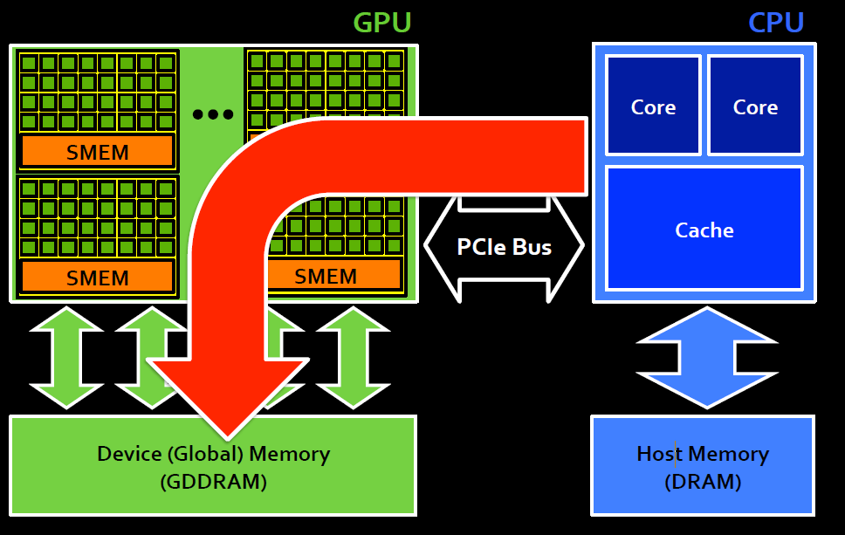
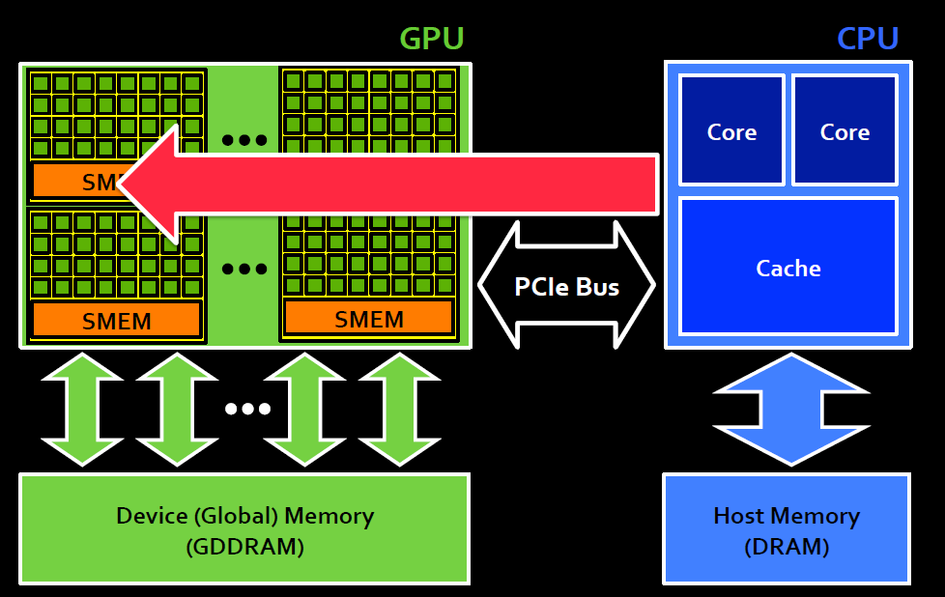
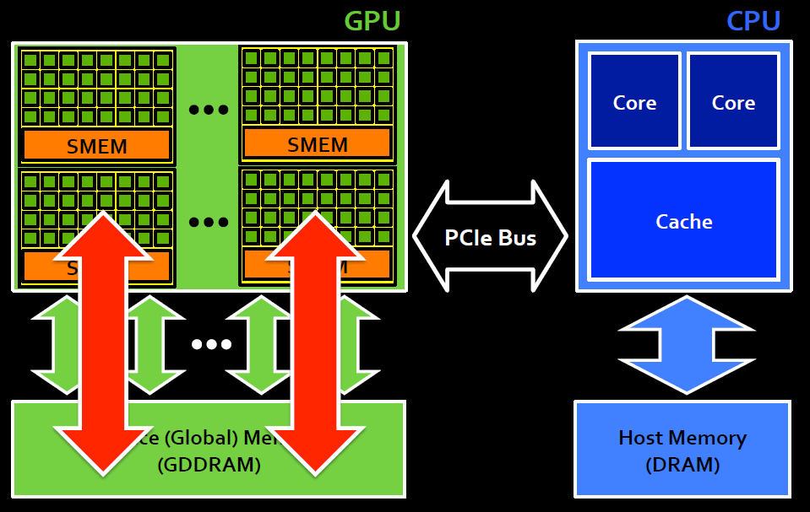
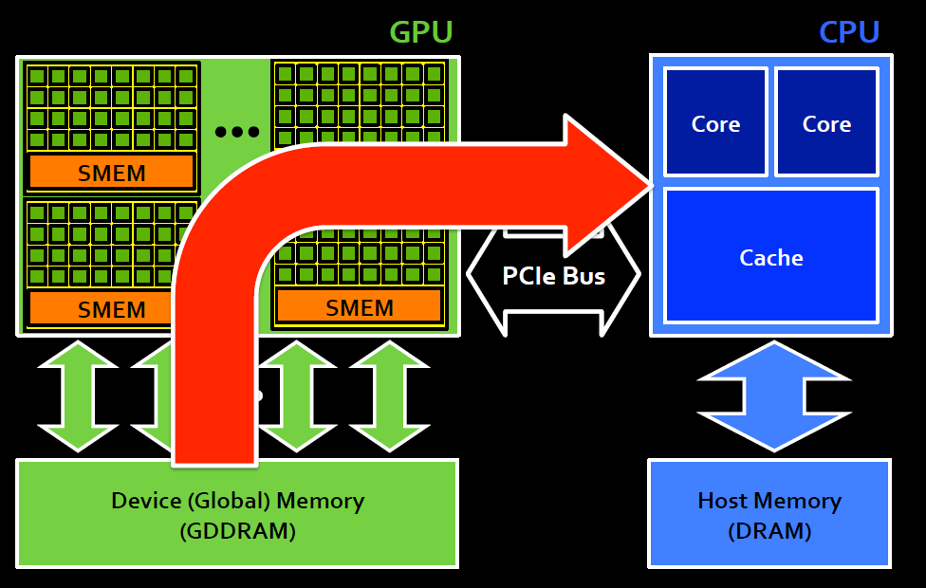
PROCESS FLOW
1. COPY DATA FROM CPU TO GPU
2. LAUNCH KERNEL
3. EXECUTE KERNEL COMMANDS
4. COPY BACK DATA TO CPU

Slide 11
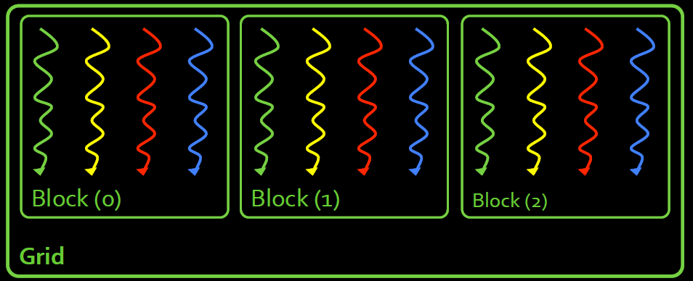
CUDA THREAD ORGANIZATION
Threads are grouped into blocks
Blocks are grouped into a grid
A Kernel is executed as a grid of blocks of threads

Slide 12
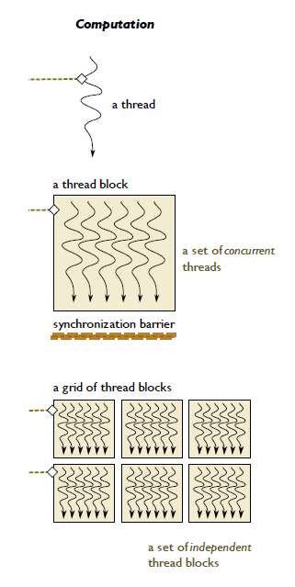
THREAD HIERARCHY
•Kernels are executed by thread.
•A kernel is a simple C program.
•Each thread has it own ID
•Thousands of threads execute same kernel. (Parallel Computation)
•Threads in a block can synchronize execution
•Blocks are independent (Must be able to be executed in any order, Parallel or Sequential)

Slide 13
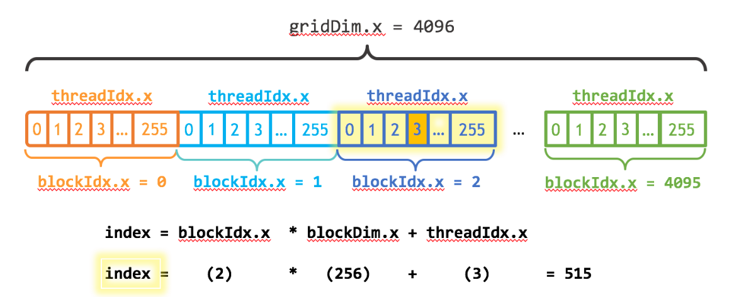
IDENTIFYING EXECUTION FLOW

Slide 14
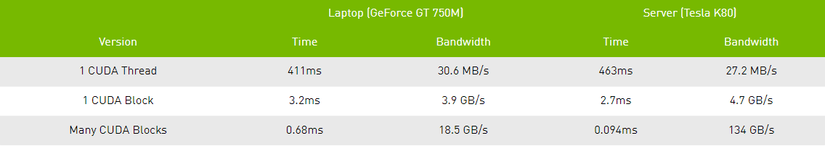
SIMPLE NUMBERS TO SHOW SPEEDUP
A simple addition program
__global__ void add(int n, float *x, float *y)
{ int index = blockIdx.x * blockDim.x + threadIdx.x;
int stride = blockDim.x * gridDim.x;
for (int i = index; i < n; i += stride)
y[i] = x[i] + y[i];
}

Slide 15
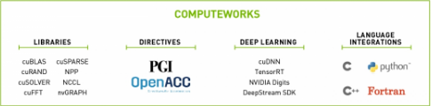

SUPPORT
New GPU generation every ~18 months.
•Strong support to GPU computing:
•Hardware side: developing flexible GPUs.
•Software side: releasing and improving development tools.
•Community side: support to academics.

Slide 16
APPLICATIONS
FMG analytics has a huge scope to integrate out process with GPU’s to scale our applications to the next level
Some Areas:
COMPUTING
SIMULATIONS
MODELLING

Slide 17
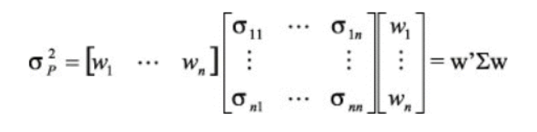
COMPUTATION : AVAR
VARIANCE – COVARIANCE METHOD

Slide 18

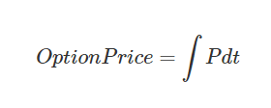
SIMULATIONS
OPTION PRICING:
-Simulating a price of stock assuming Normal Distribution
-Price calculated from expected pay-off
VERY SIMILAR USE-CASE : MonteCarlo VAR in Portfolio Risk Analytics

Slide 19

MODELLING
REGRESSION
-Speedup is marginal in case of small data, speedup visible when data being utilised is in Millions
MACHINE LEARNING/DEEP LEARNING
-GPU Architecture supports large data
computations very well
-NVIDIA CuDNN is a leader in Deep Learning

Slide 20
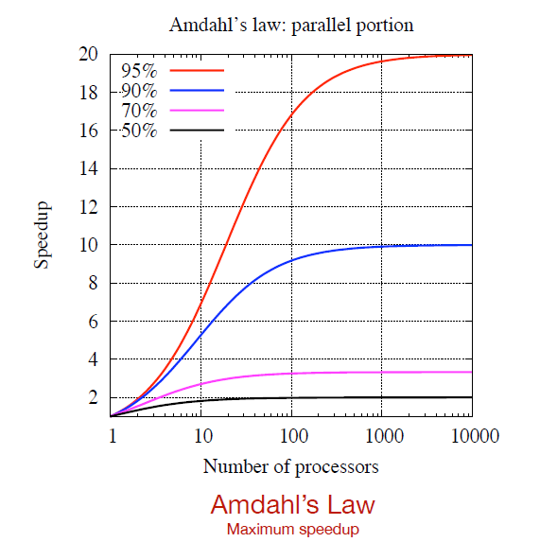
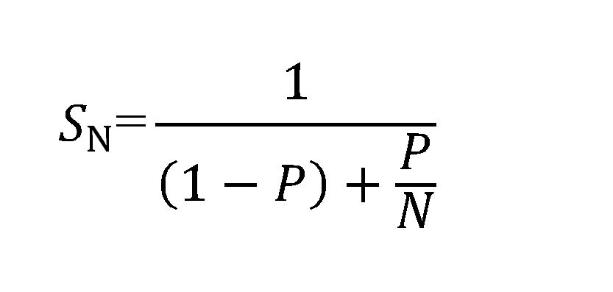
SPEEDUP
•You can get hundred-fold speedup for some algorithms
•It depends on the non-parallel part:
Amdahl’s law.
•Complex application normally make use of many algorithms.
•Look for alternative ways to perform the computations that are more parallel.
•Significance: An accelerated program is going to be as fast as its serial part!

Slide 21
THE DOWNSIDE
GPU can’t speed up everything
E.g. Process involving complex calculations
Alternatives exist
Batch/overnight process for time consuming but time insensitive tasks
Estimated costs of GPU
Hardware cost: ~$100K for 4 boxes
COST VS USE-CASE?

Slide 22

Additional Information
CUDA Resources:
For access to FMG owned Compute Engine: David Li, Patrick Guo

