Slide 1


Wadii Sahnoun
Development Plan
How does the web work?
What do you need to be a web developer?
Why did you choose to learn web development?

Slide 2
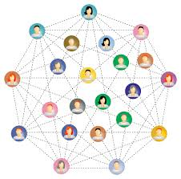
How does the web work?
What Is the Web?
The World Wide Web is a collection of electronic documents linked together like a spider web.
These documents are stored on computers called servers located around the world.
The Web has evolved into a global electronic publishing and commerce medium.

Slide 3
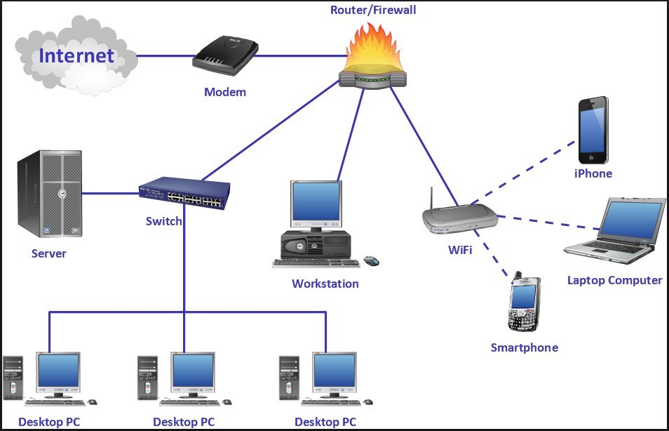
What Is the Web Made of?
The Web consists of:
Your personal computer
Web browser software to access the Web
A connection to an Internet service provider (ISP)Servers to host the data
Routers and switches to direct the flow of data

Slide 4
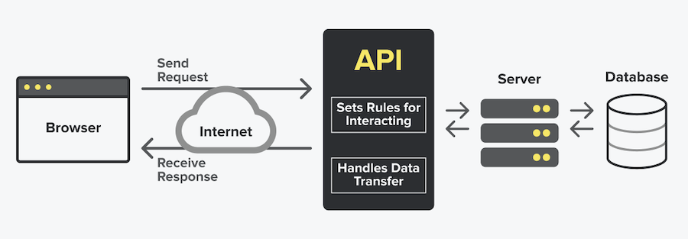
How the Web Works?
Web pages are stored on web servers located around the globe.
Entering the Uniform Resource Locator or URL of a web page in your web browser or clicking a link sends a request to the server that hosts the page.
The server transmits the web page data to your computer and your web browser displays it on your screen.

Slide 5
What do you need to be a web developer?
To become a Web Developer, you should have an understanding of HTML, CSS, and JavaScript. It’s also recommended to learn about CSS and CSS frameworks. Developing these fundamental web development skills will give you the foundation and logic for communicating with programming languages.
How to become a Web Developer in five steps:
Learn web development fundamentals
Choose a development specialization
Learn key programming languages for web development
Work on projects to develop your Web Developer skills
Build a web development portfolio

Slide 6
Why did you choose to learn web development?
Best career Opportunity
It’s much simpler to do and learn
Creative & Expanding Field
Work from where you want
Web Developers Have Flexibility

Slide 7


