Slide 1
WADJET GRC — Master Platform Report
Generated: 2026-08-27T22:53:10.483Z

Slide 2
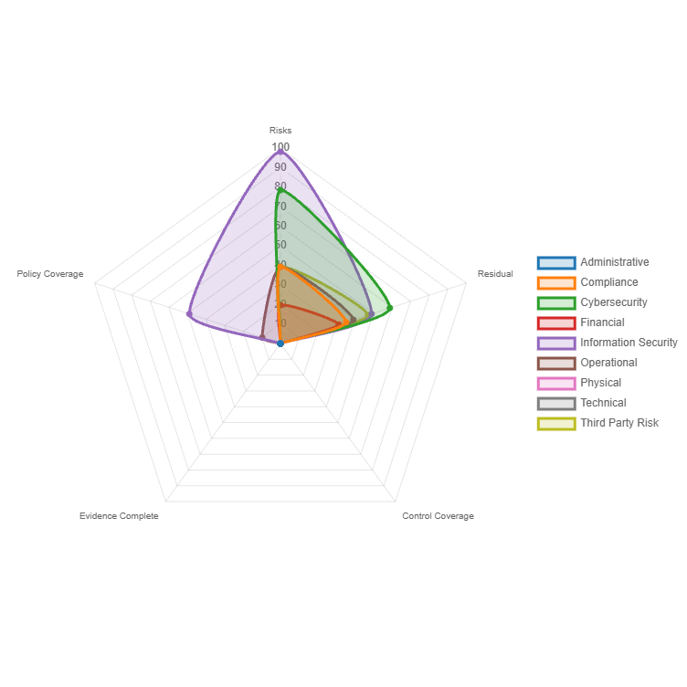
Domain spider (radar) — Key metrics

Slide 3
Top 10 Risks (by residual)
Risk ID | Title | Domain | Residual Score

