Slide 1
KeYTestGen2
An automatic, glass box test case generator for Java
Introduction:
  Software testing
  Coverage criteria
  Towards automatic test case generation
KeY
  Symbolic execution
  Symbolic debugging
KeYTestGen2
  Implementation overview
Ongoing and future work
Questions

Slide 2
Background
Software Testing
  Widely used verification technique in contemporary software engineering.
  General idea: execute software under controlled conditions, examine resulting output and changes in system state with regard to the specification for the software.

Slide 3
Background
Testing
Unit Testing
  Tests atomic units of functionality in a software system.
    In most languages: routines, functions, and methods.
    Possibly classes in Object Oriented languages (question of definition).

Slide 4
Background
Testing
Test Case / Unit Test
  (Ss,I, Or) for some unit u
    Ss is an initial state of the system
    I is a set of inputs to u
    Or is a test oracle for u
  Or
    Oracle(R,Sf) → {pass, fail}
      R is the return value of u(I)
      Sf is a system state after u terminates
Test Suite
  A set of unit tests for a given unit.

Slide 5
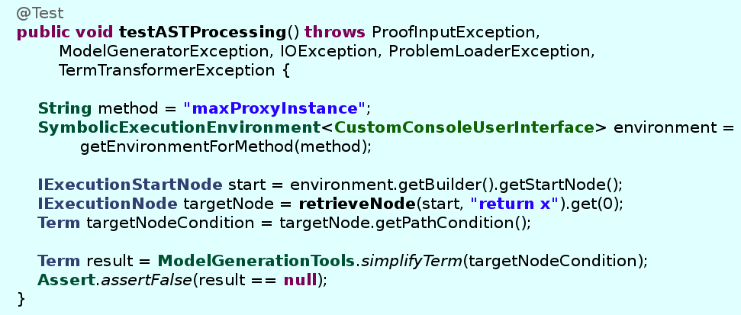
Background
Testing
Example: a JUnit test case

Slide 6
Background
Testing
Benefits of testing
  Intuitive approach to verification
    Formalizes what programmers naturally do to check the correctness of their code.
  Flexible
    Can be applied to several aspects of software engineering processes.
    Several processes are defined through testing (i.e. Test Driven Development).
  Mature
    Well developed theory and rich tool support.
  Relevant
    Used almost everywhere in industry.

Slide 7
Background
Testing
Problems with testing
  Non-exhaustive
    “Testing can demonstrate the presence of errors, not their absence” (E.W. Dijkstra).
    Formal test suite quality metrics can be used to assert that a test suite is “good enough” for a given end.

Slide 8
Background
Coverage criteria
Coverage Criteria
  Judges the quality of a test suite by the extent to which it covers specific aspects or models of the unit under test.
  Input partitioning coverage, execution graph coverage, logic coverage, etc.

Slide 9
Background
Coverage criteria
Structural Coverage Criteria
  Test suite quality determined by how well it covers the structure of the source code itself.
    Prominent categories:
      Execution graph coverage
        Coverage of statements, branches, execution paths etc.
      Logic / Decision coverage
        Coverage of logical decisions and branch conditions in the code.
    Several hybrid criteria exist
      Modified Condition / Decision Coverage
        Used in avionics industry

Slide 10
Background
Coverage criteria
Example – Statement Coverage
  Each statement in the source code executed by at least one test case in the test suite.
public int max(int a, int b) {
if(a > b)
return a;
else
return b;
}
a > b
return a
return b

Slide 11
Background
Coverage criteria
Example – Statement Coverage
  Each statement in the source code executed by at least one test case in the test suite.
public int max(int a, int b) {
if(a > b)
return a;
else
return b;
}
a > b
{a=2,b=1}
return a
return b

Slide 12
Background
Coverage criteria
Example – Statement Coverage
  Each statement in the source code executed by at least one test case in the test suite.
public int max(int a, int b) {
if(a > b)
return a;
else
return b;
}
a > b
{a=1,b=2}
{a=2,b=1}
return a
return b

Slide 13
Background
Testing
Problems with testing
  Non-exhaustive
    “Testing can demonstrate the presence of errors, not their absence” (E.W. Dijkstra).
    Formal test suite quality metrics can be used to assert that a test suite is “good enough” for a given end.
  Expensive
    We normally need to write at least as much test code as system code (often much more).
    Constructing test suites satisfying robust coverage criteria is non-trivial, even with tool support.

Slide 14
Motivation
Could we automate test suite generation?
  Potentially enormous boost to programmer productivity.
  Great complement to increase the flexibility of KeY.
What about quality criteria?
  Input coverage?
  Code coverage?

Slide 15
Motivation
Input coverage?
  Specification-based, or Black Box test case generators.
Code coverage?
  Implementation-based, or White Box test case generators.
Both / Hybrid coverage?
  Glass Box test case generators.

Slide 16
Motivation
Towards a Glass Box system
  Input coverage?
    Analyze the formal specification of units in order to understand input constraints.
    Mature tools exist: JMLUnit, JMLUnitNG, et al.
  Code coverage?
    Analyze the source code of the unit under test to understand possible execution paths and the conditions under which they are taken.
    Our idea: use KeY for this.

Slide 17
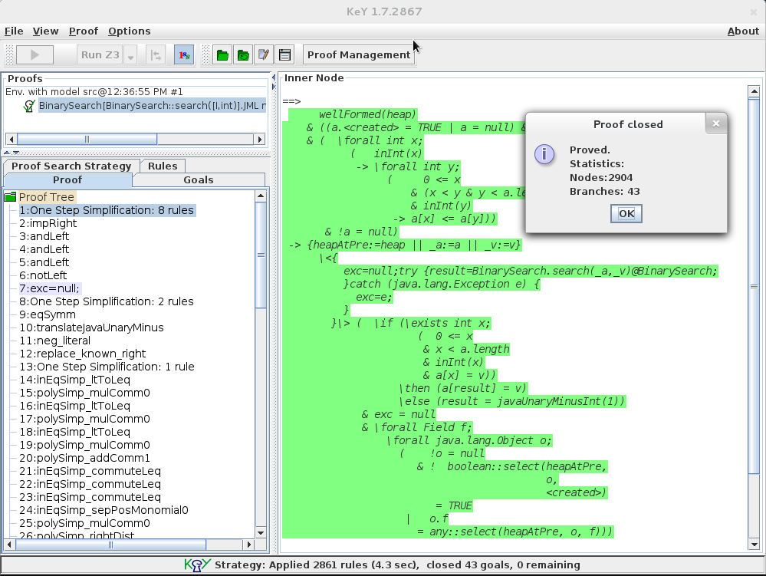
KeY – an overview
Development tool integrating the design, specification, implementation and verification of software.
Developed by several European universities, including Chalmers.

Slide 18
KeY – an overview
KeY is a formal verification tool
  Deductive approach to verification.
  Much more rigorous than testing, but also (generally) much more demanding in terms of effort and user knowledge.
  We wish to extend KeY to offer testing capabilities as well, by making use of the verification mechanism already present. How?

Slide 19
KeY verification
Translate Java code + specification to a proof obligation in dynamic logic (JavaDL).
  α and β first-order expressions
  π is a segment of Java code
  "Given precondition α, program π terminates in a state satisfying postcondition β.
Close proof obligation by symbolic execution of source code.
α ⇒ <π> β

Slide 20
KeY verification
Translate Java code + specification to a proof obligation in dynamic logic (JavaDL).
  α and β first-order expressions
  π is a segment of Java code
  "Given precondition α, program π terminates in a state satisfying postcondition β.
Close proof obligation by symbolic execution of source code.
α ⇒ <π> β

Slide 21
Symbolic Execution
Variables are initiated with first-order values, giving the system a “symbolic state” for each step of it's execution.
Code is interpreted on a statement-by-statement basis.
The effect of each statement is encoded in terms of DL.
A partial proof tree is constructed.

Slide 22
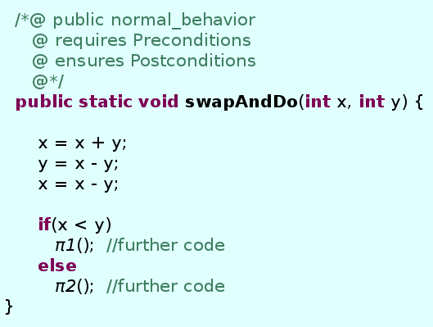
Symbolic Execution

Slide 23
Symbolic Execution
Corresponding DL formula:
Preconditions ⇒
<x=x+y; y=x-y; x=x-y; if(x>y) {π1 } else {π2 }> Postconditions

Slide 24
Symbolic Execution
The assignments are encoded as symbolic updates, effectively reflecting the symbolic state of the program at this stage of the execution process.
Preconditions ⇒
<x=x+y; y=x-y; x=x-y; if(x>y) {π1 } else {π2 }> Postconditions

Slide 25
Symbolic Execution
The assignments are encoded as symbolic updates, effectively reflecting the symbolic state of the program at this stage of the execution process.
Preconditions ⇒
<x=x+y; y=x-y; x=x-y; if(x>y) {π1 } else {π2 }> Postconditions
Preconditions ⇒
<[x=y || y=x]; if(x>y) {π1 } else {π2 }> Postconditions

Slide 26
Symbolic Execution
Next, the if-else statement causes the proof to branch into two separate proof obligations:
Preconditions ⇒
<[x=y || y=x]; if(x>y) {π1 } else {π2 }> Postconditions

Slide 27
Symbolic Execution
Next, the if-else statement causes the proof to branch into two separate proof obligations:
Preconditions ⇒
<[x=y || y=x]; if(x>y) {π1 } else {π2 }> Postconditions
Preconditions & ({x=y || y=x} x>y ⇒ {x=y || y=x} <{π1}> Postconditions
Preconditions & ({x=y || y=x} x≤y ⇒ {x=y || y=x} <{π2}> Postconditions

Slide 28
Symbolic Execution
We can identify some important properties of the symbolical execution process here:
Preconditions & (y>x) ⇒ {x=y || y=x} <{π1}> Postconditions
Preconditions & (y≤x) ⇒ {x=y || y=x} <{π2}> Postconditions

Slide 29
Symbolic Execution
We can identify some important properties of the symbolical execution process here:
Preconditions & (y>x) ⇒ {x=y || y=x} <{π1}> Postconditions
Preconditions & (y≤x) ⇒ {x=y || y=x} <{π2}> Postconditions
Logical branches in the source code correspond to proof branches.

Slide 30
Symbolic Execution
We can identify some important properties of the symbolical execution process here:
Preconditions & (y>x) ⇒ {x=y || y=x} <{π1}> Postconditions
Preconditions & (y≤x) ⇒ {x=y || y=x} <{π2}> Postconditions
The premise of each sequent provides us with information on how to reach each logical branch.
Logical branches in the source code correspond to proof branches.

Slide 31
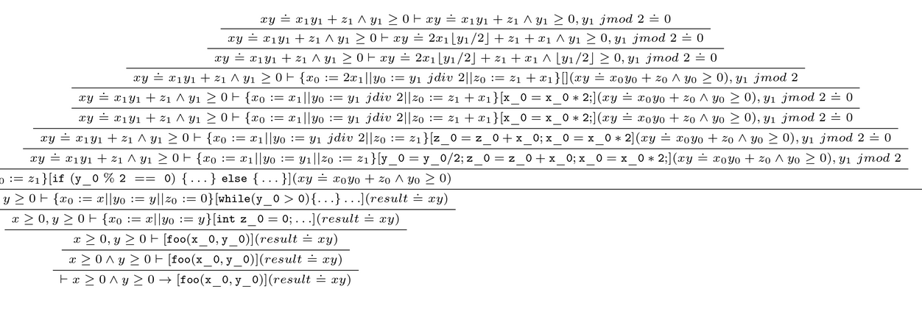
Symbolic Execution
Through symbolic execution, KeY generates a proof tree for the code.
The data in this tree acts as a basis from which details about possible execution runs through the system can be extracted, as well as the conditions under which they are executed.

Slide 32
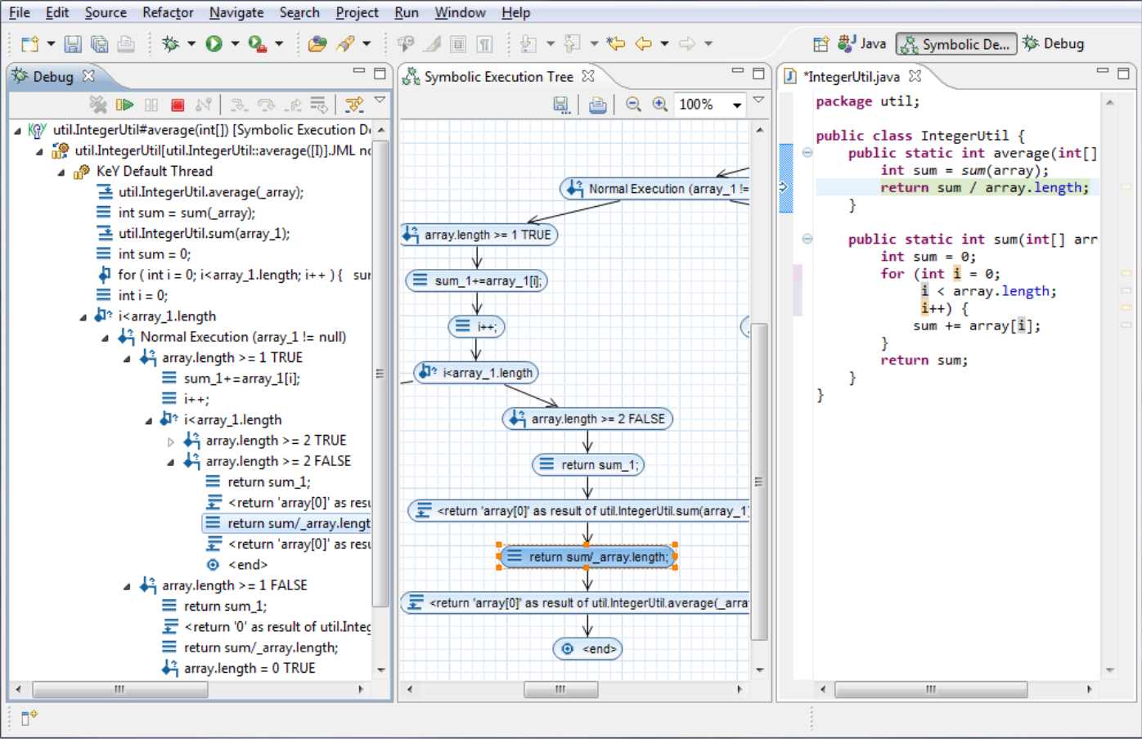
KeY Symbolic Debugger

Slide 33
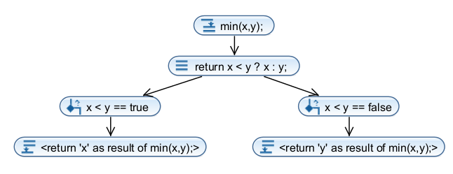
KeY Symbolic Debugger
Provides powerful API for extracting symbolic execution trees based on the proof trees generated by KeY.
Nodes implemented as Java interface hierarchy representing possible program elements in the system.
  IExecutionStartNode
  IMethodCallNode
  IExecutionBranchNode
  Etc
Each node contains a path condition, consisting of a constraint on the pre-state of the system for an execution path via this node to be taken.

Slide 34
KeYTestGen2
Overview
KeYTestGen2 consumes the symbolic execution trees created by the Symbolic Debugger, using them as a basis for white box test case generation.
General mode of operation:
  Consume Java source files (with or without specification).
  Generate an abstract test suite for each selected method in the source file.
  Convert abstract test suites to concrecte ones (JUnit, TestNG etc).

Slide 35
KeYTestGen2
Overview
Symbolic execution tree to abstract test suite
  Isolate execution paths needed to satisfy structural coverage criteria for the unit under test.
  Generate an Oracle for the unit under test.
  Create an abstract test case for each such path:
    Generate a model for the path condition of the path.
    Encode together with Oracle.
  Encode test cases and metadata as abstract test suite.
Abstract test suite to concrete test suite
  Let IFrameWorkConverter instance consume abstract test suite.

Slide 36
KeYTestGen2
Finding required execution paths
Not fully implemented! Prototype guarantees only very rudimentary exit-node criteria (all return statements executed at least once).
Method: process symbolic execution tree with regard to coverage requirements, extract nodes which together satisfy them.
Problem: conceptual mismatch between symbolic and “actual” execution tree.
  Symbolic tree contains all possible execution paths
    Massive datastructure to iterate over.
    The “same” program statement can occur as a node several times – no clear distinction on implementation level.

Slide 37
KeYTestGen2
Model generation
Method: construct abstract heap state representing a program state satisfying the path condition of the node.
Needed variables are deduced from the path condition itself.

Slide 38
KeYTestGen2
Model generation
Generating values for extracted variables depend on their type:
  Boolean
    Derived from the path condition itself.
  References
    Derived from the path condition itself.
  Non-float numeric types
    Converted to SMT constraint and solved by embedded SMT solver.
    Currently major performance bottleneck.

Slide 39
KeYTestGen2
Model generation
Generating values for extracted variables depend on their type:
  Boolean
    Derived from the path condition itself.
  References
    Derived from the path condition itself.
  Non-float numeric types
    Converted to SMT constraint and solved by embedded SMT solver.
    Currently major performance bottleneck.

Slide 40
KeYTestGen2
Oracle generation
Oracles can be generated only if the user has provided a formal specification of the code, else this step is ignored.
Oracles are generated by processing the functional contract of the unit under test:
  The functional contract is converted to Conjunctive Normal Form and simplified.
  The simplified contract is converted into an intermediary, tree-like abstraction for easy processing by the backend.

Slide 41
KeYTestGen2
Output Generation
KeYTestGen2 provides lightweight framework for constructing converters between abstract and concrete test suites.
Currently supported:
  XML
  JUnit4

Slide 42
Ongoing and future work
Support for additional coverage criteria
Support for additional target frameworks
  TestNG is currently the focus of development.
Full integration with mainline KeY, notably the Eclipse plugins.
Performance tuning
  Replace SMT solvers with custom constraint solvers.
Natural state transitions
  Create “natural” fixtures for test suites (suitable thesis project).

Slide 43
Ongoing and future work
We are always looking for interested students to join our work.
  Supervision and other guidance provided.
  Email chrsva@chalmers.se for further information.

Slide 44
Questions?

