Slide 1
Systems of Equations
SPI 3102.3.9 Solve systems of linear equation/inequalities in two variables.

Slide 2
Methods Used to Solve Systems of Equations
Graphing
Substitution
Elimination (Linear Combination)
Cramer’s Rule
Gauss-Jordan Method
… and others

Slide 3
A Word About Graphing
Graphing is not the best method to use if an exact solution is needed.
Graphing is often a good method to help solve contextual problems.

Slide 4
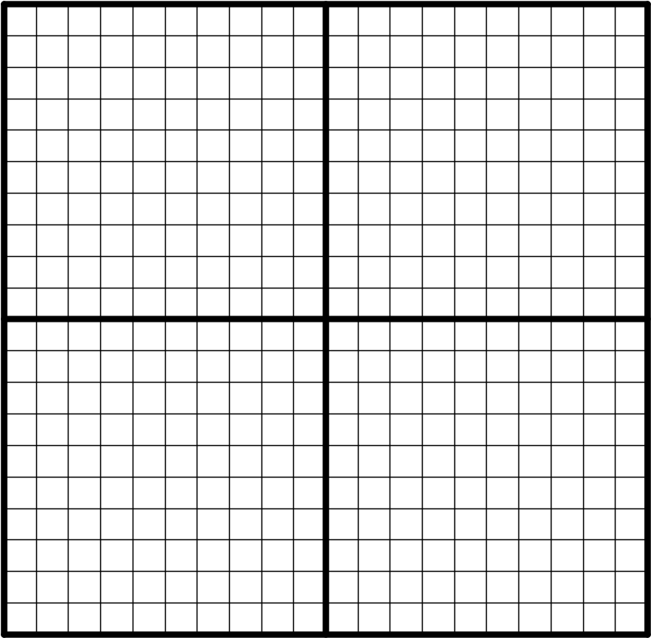
Why is graphing not always a good method?
Can you tell EXACTLY
where the two lines
intersect?
With other methods, an
exact solution can be
obtained.

Slide 5
More About Graphing
Graphing is helpful to visualize the three types of solutions that can occur when solving a system of equations.
The solution(s) to a system of equations is the point(s) at which the lines intersect.

Slide 6
Types of Solutions of Systems of Equations
One solution – the lines cross at one point
No solution – the lines do not cross
Infinitely many solutions – the lines coincide

Slide 7
A Word About Substitution
Substitution is a good method to use if one variable in one of the equations is already isolated or has a coefficient of one.
Substitution can be used for systems of two or three equations, but many prefer other methods for three equation systems.

Slide 8
A Word About Elimination
Elimination is sometimes referred to as linear combination.
Elimination works well for systems of equations with two or three variables.

Slide 9
A Word About Cramer’s Rule
Cramer’s Rule is a method that uses determinants to solve systems.
Cramer’s Rule works well for systems of equations with two or three variables.

Slide 10
A Word About the Gauss-Jordan Method
The Gauss-Jordan method uses matrices to solve systems.
Cramer’s Rule works well for systems of equations with three or more variables.

Slide 11

Let’s Work Some Problems Using Substitution.

Slide 12

Substitution
The goal in substitution is to combine the two
equations so that there is just one equation with
one variable.

Slide 13
Substitution
Solve the system using substitution.
y = 4x
x + 3y = –39
x + 3(4x) = – 39
x + 12x = –39
13x = –39
x = – 3 Continued on next slide.
Since y is already isolated in the first equation,
substitute the value of y for y in the second equation.
The result is one equation with one variable.

Slide 14
Substitution
After solving for x, solve for y by substituting
the value for x in any equation that contains 2 variables.
y = 4x y = 4(–3)
y = –12
Write the solution as an ordered pair. (–3, –12)
There’s more on the next slide.

Slide 15
Substitution
Check the solution in BOTH equations.
y = 4x
x + 3y = –39
–12 = 4(–3)
–12 = –12
–3 + 3(– 12) = –39
–3 – 36 = –39
–39 = –39
The solution is (– 3, –12).



Slide 16
Substitution
Solve the system using substitution.
x – 3y = –5
2x + 7y = 16
x = 3y – 5
2x + 7y = 16
2(3y – 5) + 7y = 16
If a variable is not already isolated, solve for one
variable in one of the equations. Choose to solve
for a variable with a coefficient of one,if possible.

Slide 17
Substitution
2(3y – 5) + 7y = 16
6y – 10 + 7y = 16
13y – 10 = 16
13y = 26
y = 2
x = 3y – 5
2x + 7y = 16
x = 3(2) – 5
x = 6 – 5
x = 1
The solution is (1, 2).
* Be sure to check!

Slide 18
Now for Elimination…

Slide 19
Elimination
The goal in elimination is to manipulate the
equations so that one of the variables “drops
out” or is eliminated when the two equations
are added together.

Slide 20
Elimination
Solve the system using elimination.
x + y = 8
x – y = –2
2x = 6
x = 3
Continued on next slide.
Since the y coefficients are already the same with
opposite signs, adding the equations together would
result in the y-terms being eliminated.
The result is one equation with one variable.

Slide 21
Elimination
Once one variable is eliminated, the process to find the other variable is exactly the same as in the substitution method.
x + y = 8
3 + y = 8
y = 5
The solution is (3, 5).
Remember to check!

Slide 22
Elimination
Solve the system using elimination.
5x – 2y = –15
3x + 8y = 37
20x – 8y = –60
3x + 8y = 37
23x = –23
x = –1
Continued on next slide.
(4)
Since neither variable will drop out if the equations
are added together, we must multiply one or both of
the equations by a constant to make one of the
variables have the same number with opposite signs.
The best choice is to multiply the top equation by
4 since only one equation would have to be
multiplied. Also, the signs on the y-terms are
already opposites.

Slide 23
Elimination
Solve the system using elimination.
4x + 3y = 8
3x – 5y = –23
20x + 15y = 40
9x – 15y= –69
29x = –29
x = –1
Continued on next slide.
(5)
For this system, we must multiply both equations
by a different constant in order to make one of the
variables “drop out.”
(3)
It would work to multiply the top equation by –3
and the bottom equation by 4 OR to multiply the
top equation by 5 and the bottom equation by 3.

Slide 24
Elimination
3x + 8y = 37
3(–1) + 8y = 37
–3 + 8y = 37
8y = 40
y = 5
The solution is (–1, 5).
Remember to check!
To find the second variable, it will work to
substitute in any equation that contains two
variables.

Slide 25
Elimination
4x + 3y = 8
4(–1) + 3y = 8
–4 + 3y = 8
3y = 12
y = 4
The solution is (–1, 4).
Remember to check!

