Slide 1
Project Title
Simple Linear Regression Model
Salary Prediction Based on Experience
This project demonstrates how a machine learning model predicts salary using years of experience.
Notes:
Waeil Mohamadi

Slide 2


Import Libraries
NumPy, Pandas, and Matplotlib are used for numerical operations, data handling, and visualization.
scikit-learn is used for splitting data and training the model.
Notes:
Waeil Mohamadi

Slide 3
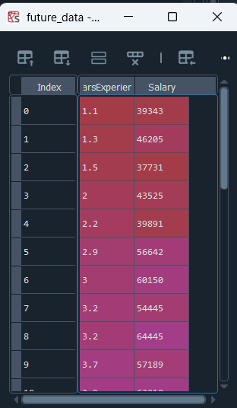

Load Dataset
The CSV file containing Years of Experience and Salary is loaded using Pandas.
This allows us to work with structured tabular data.
future_data = pd.read_csv(r"C:\Users\waeil\OneDrive\Desktop\ML_AI\Salary_Data.csv")
Notes:
Waeil Mohamadi

Slide 4
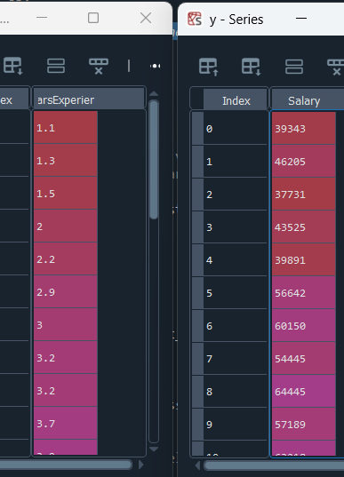
Feature & Target Separation
X (features): Years of Experience
Y (target): Salary
This separation is required for supervised learning.
Notes:
Waeil Mohamadi

Slide 5
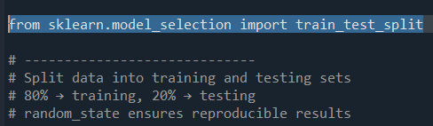
Train-Test Split
The dataset is split into 80% training and 20% testing data.
This helps evaluate model performance on unseen data.
Notes:
Waeil Mohamadi

Slide 6

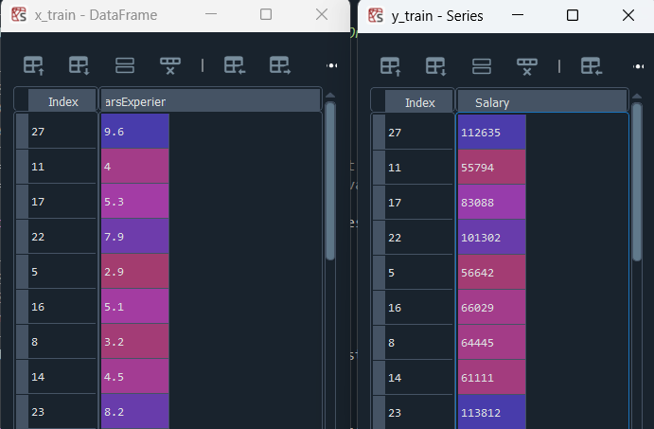
Model Creation & Training
LinearRegression() creates the model.
.fit() trains the model by learning slope and intercept.
Notes:
Waeil Mohamadi

Slide 7
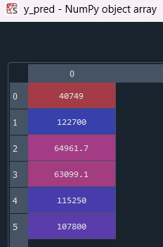
Prediction
The trained model predicts salaries for the test dataset.
Predictions are compared with actual values.
Notes:
Waeil Mohamadi

Slide 8
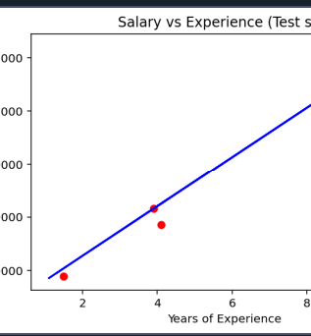
Visualization
Red dots show actual salaries.
Blue line shows regression line.
This visualizes how well the model fits the data.
Notes:
Waeil Mohamadi

Slide 9
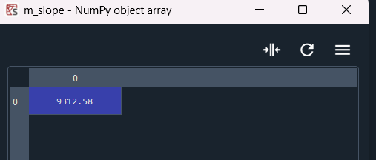
Model Parameters
Slope (m): Rate of salary increase per year.
Intercept (c): Base salary when experience is zero.
Notes:
Waeil Mohamadi

Slide 10
Model Evaluation
R² score measures accuracy.
Training score checks bias.
Testing score checks variance.
Closer values indicate a good model.
Notes:
Waeil Mohamadi

