Slide 1
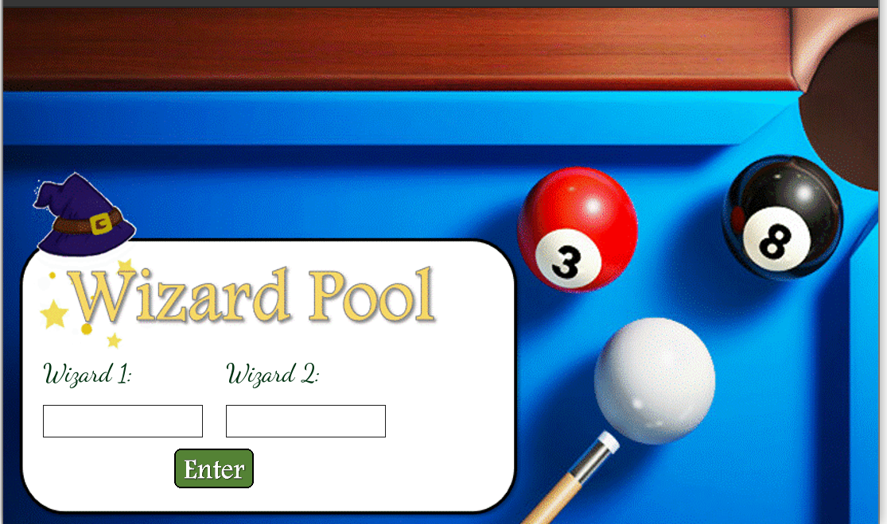

Slide 2
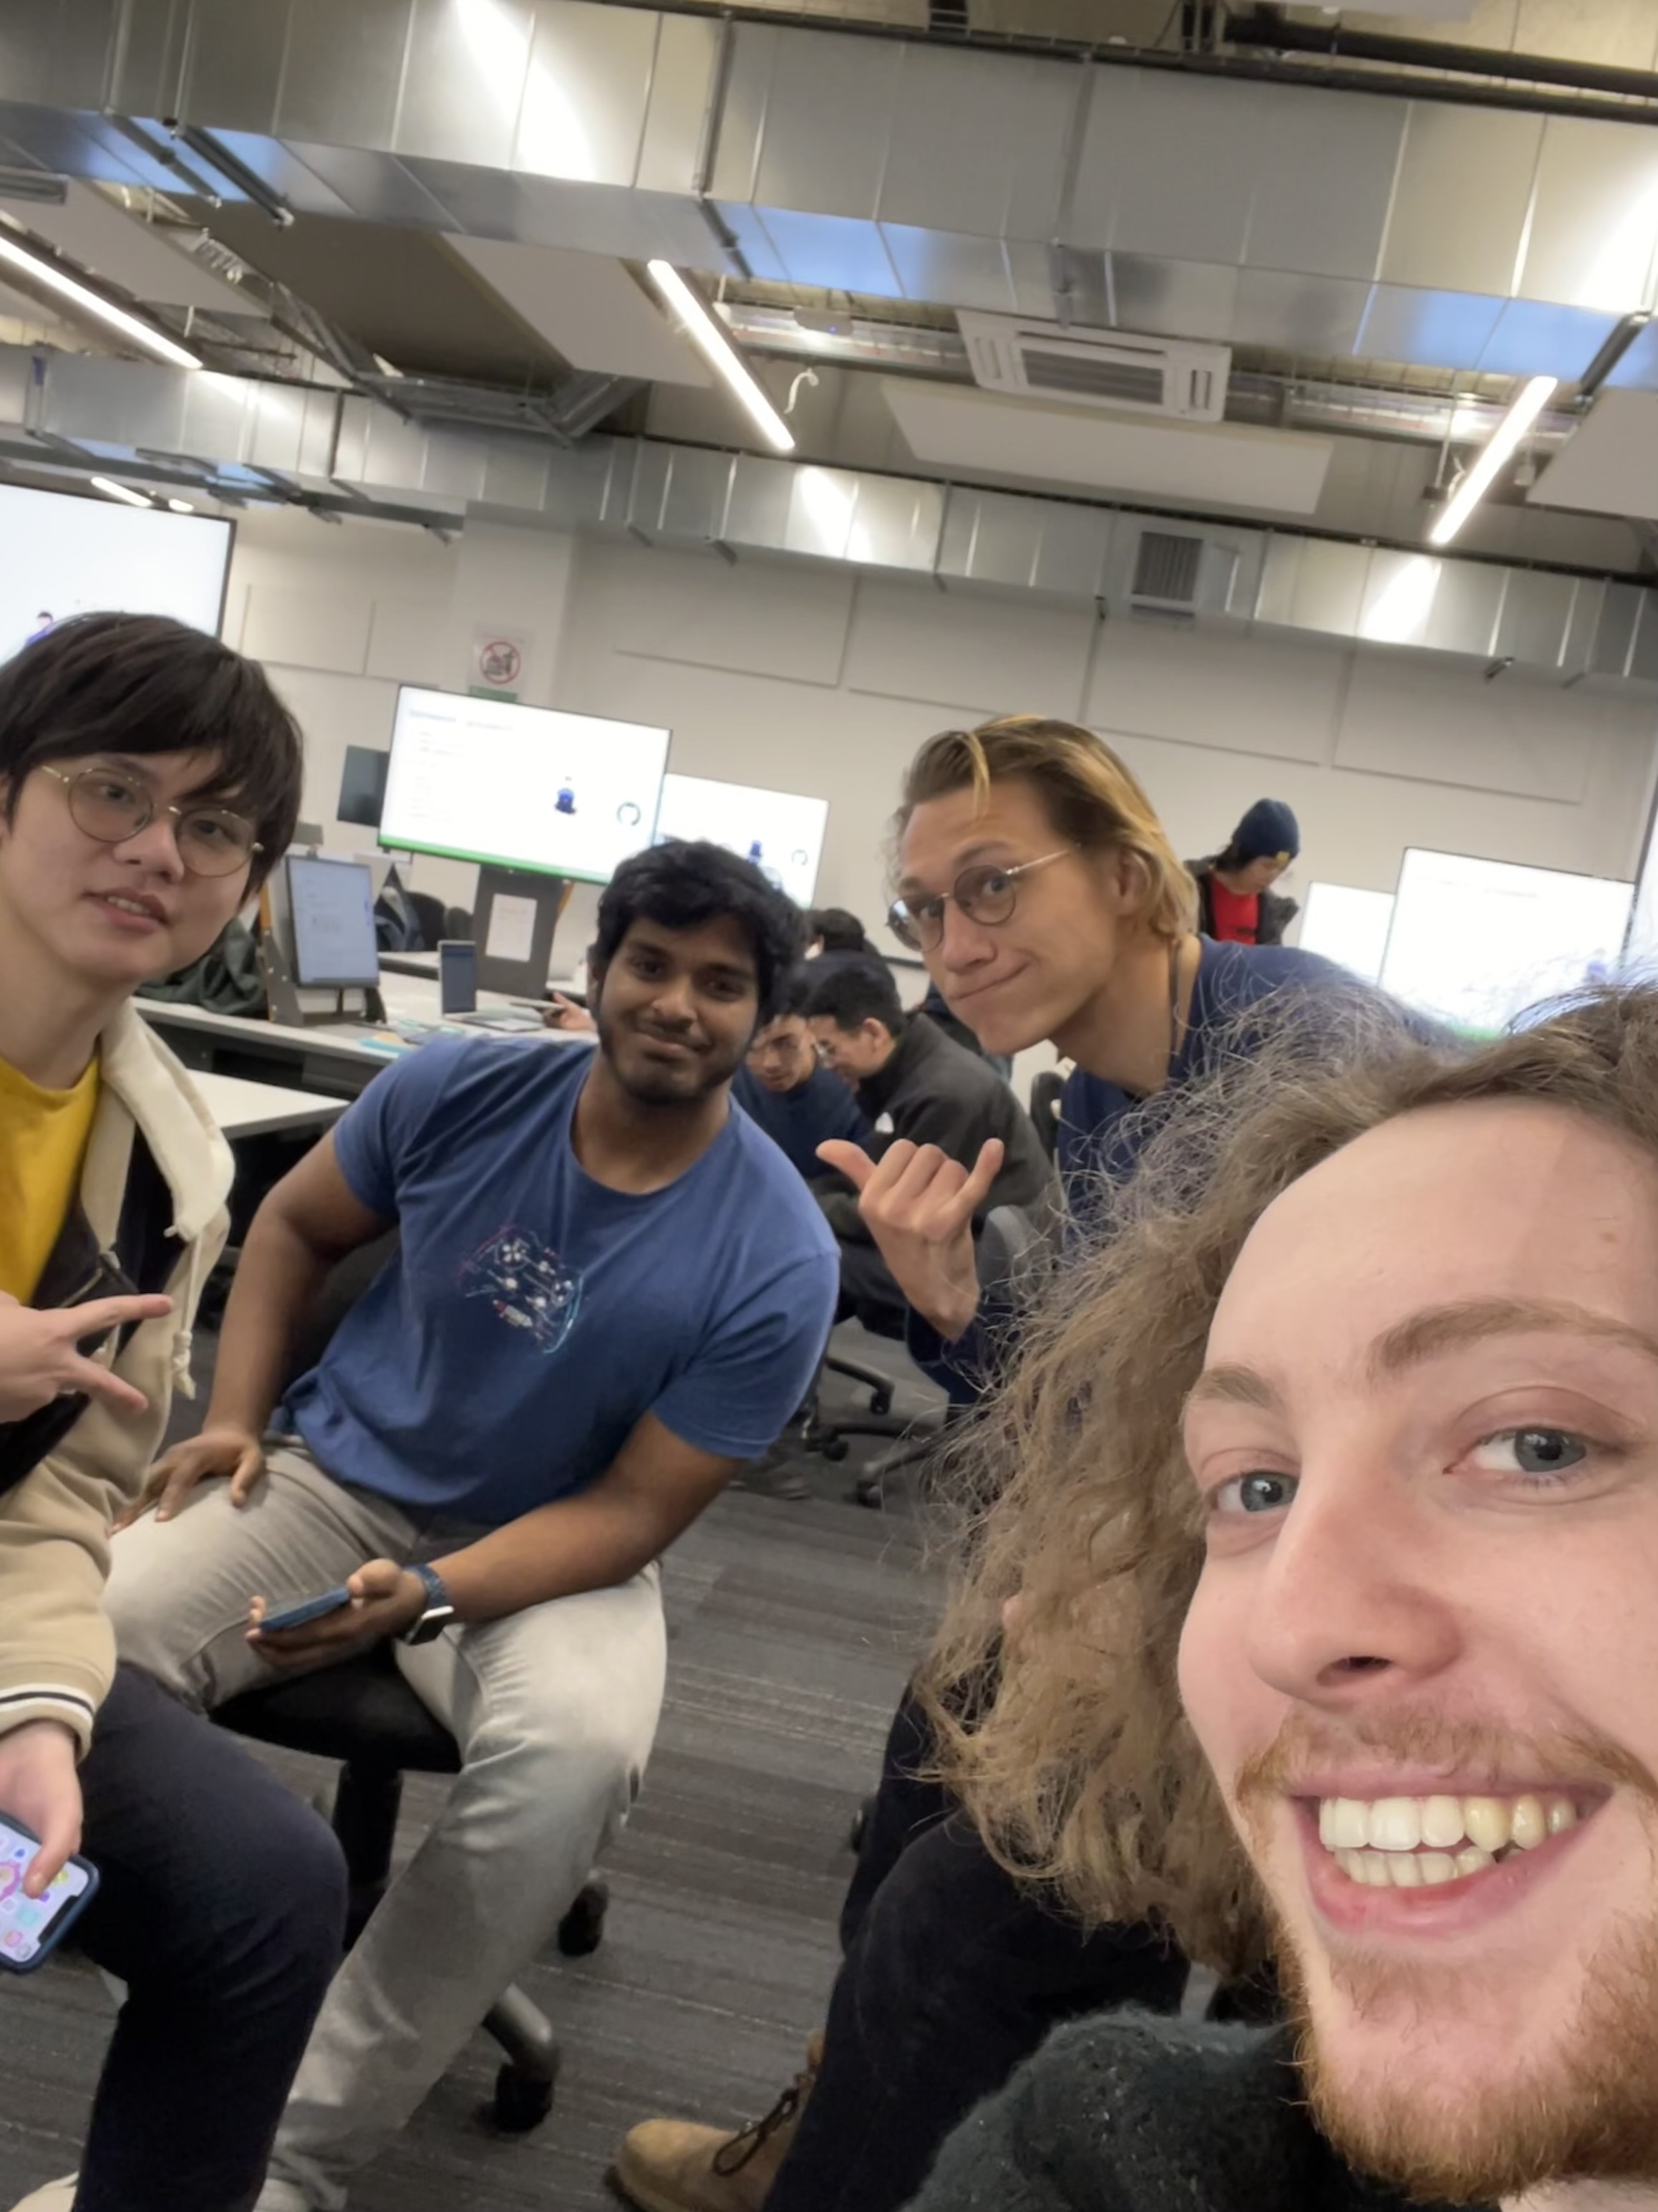
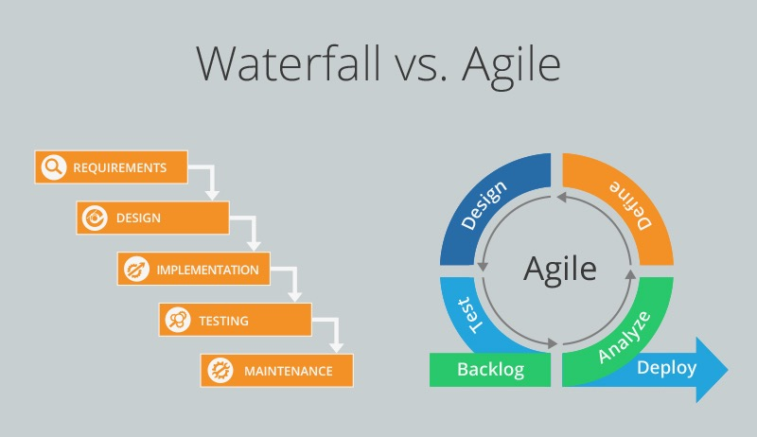
Our Team and Our Process

Slide 3

Challanges
Realistic game mechanics
Exciting and challenging spells
Intuitive UI

Slide 4
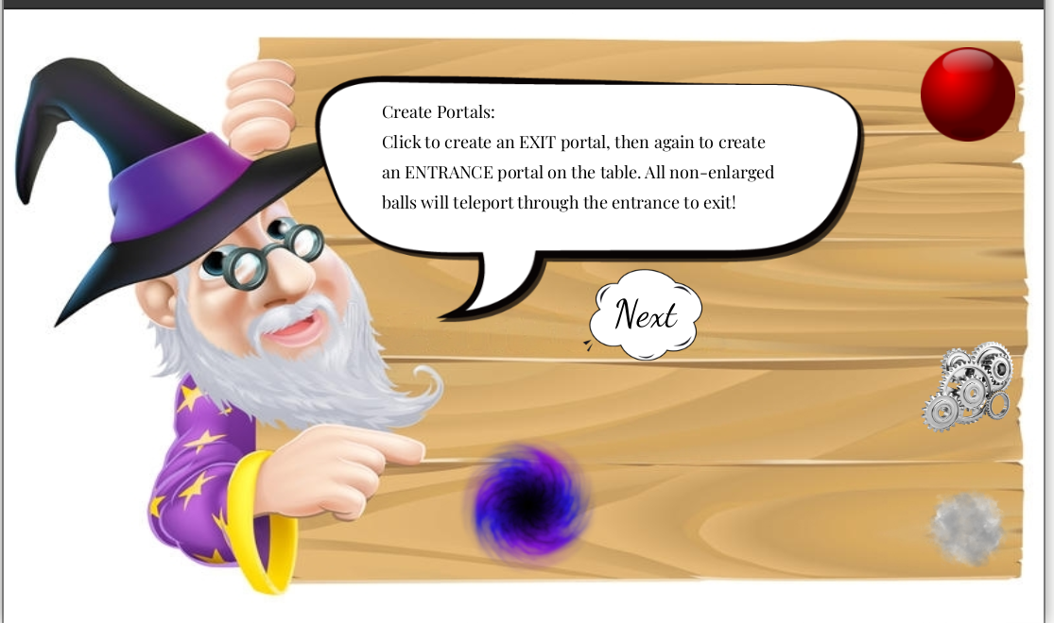
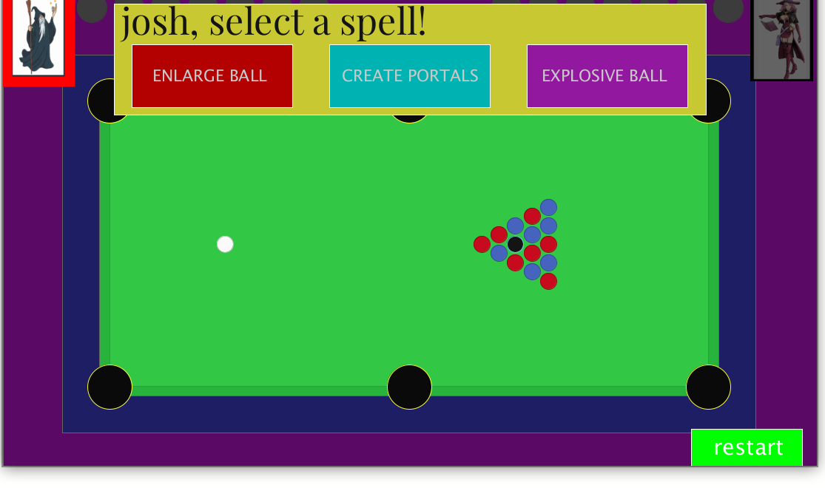
Spells
Introduced in the tutorial
Select before each turn
Changing selection

Slide 5

Future Work
More Spells
Better UI
Online Feature

