Slide 1

Wizard pool

Slide 2
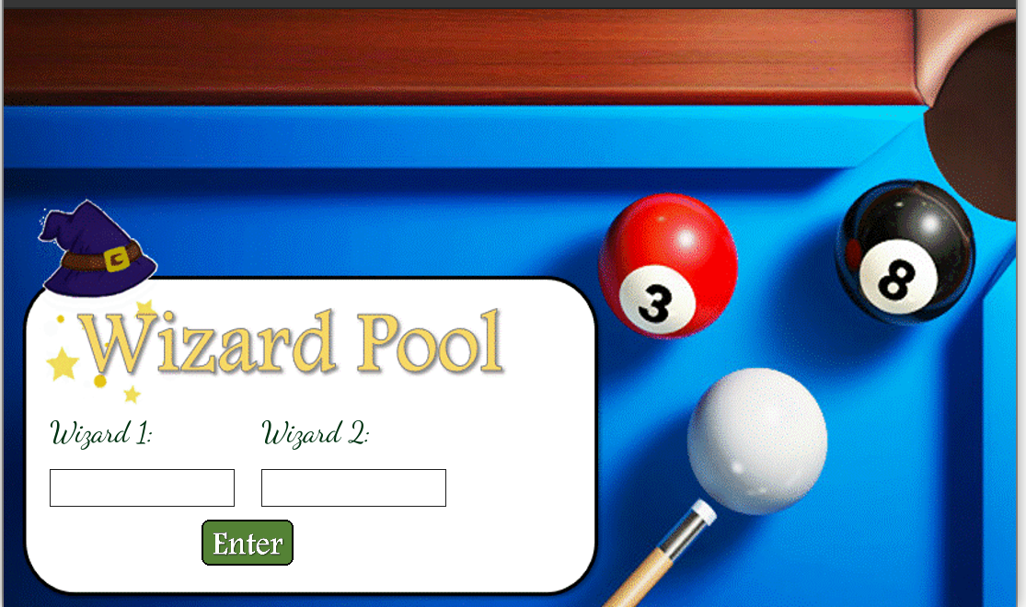

Slide 3
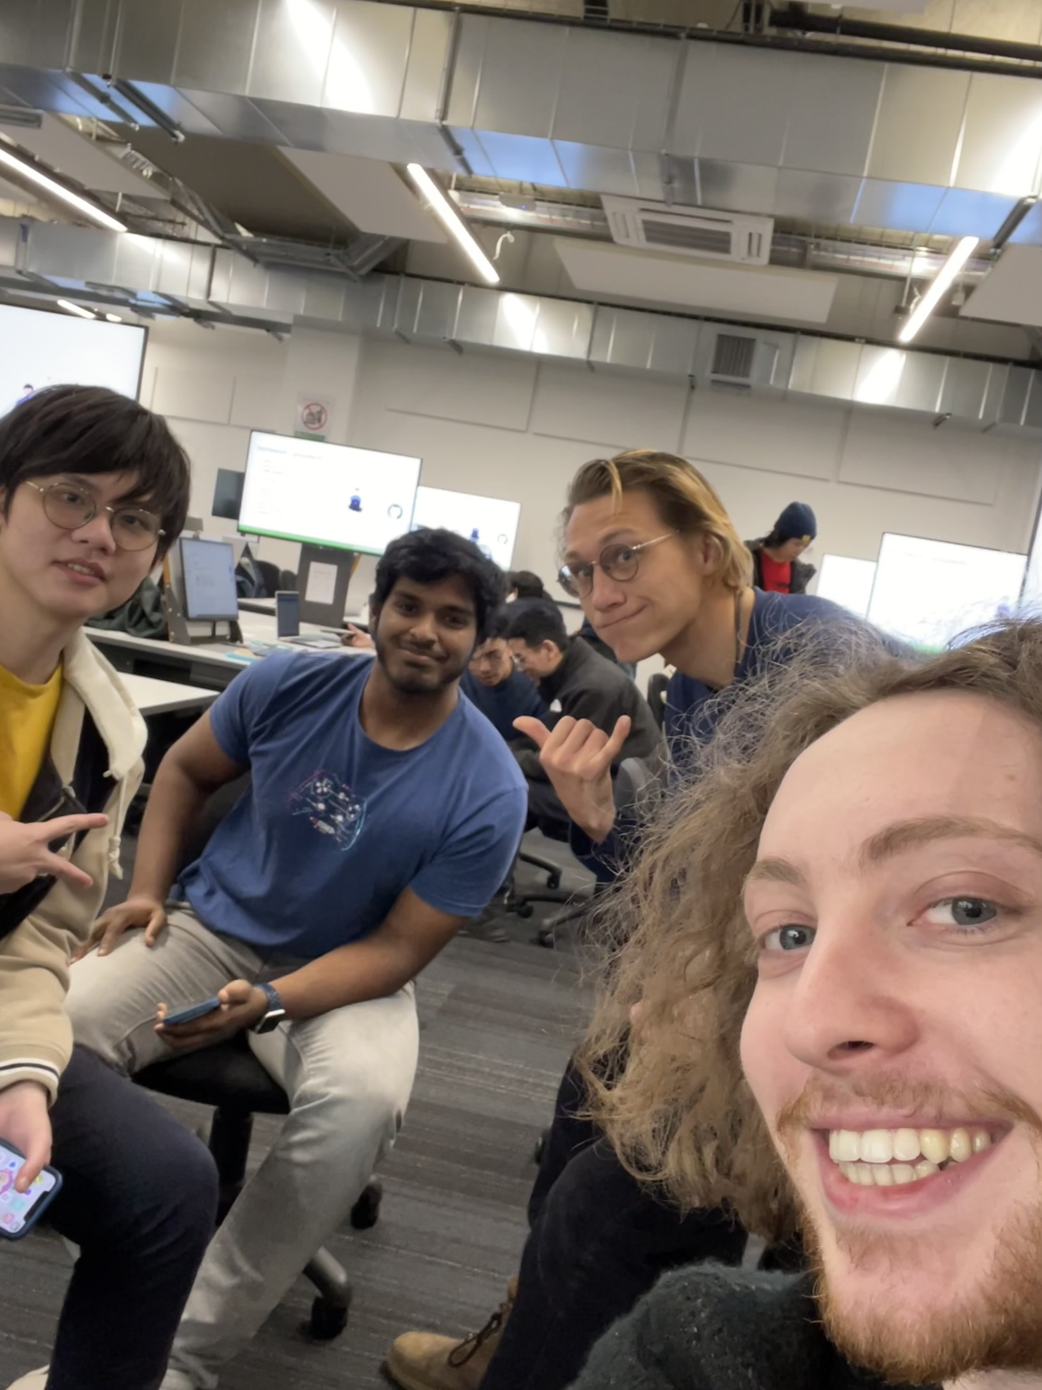
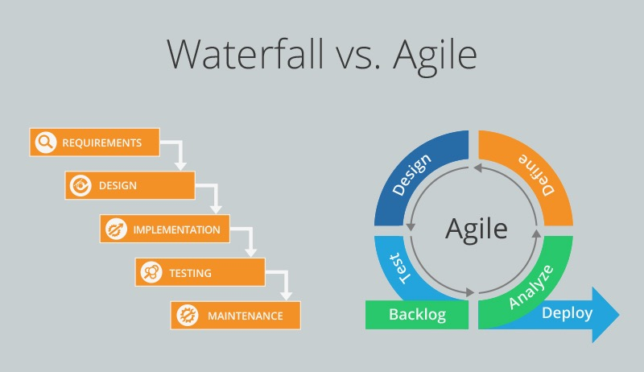
Our Team and Our Process

Slide 4

Challanges
Realistic game mechanics
Exciting and challenging spells
Intuitive UI

Slide 5
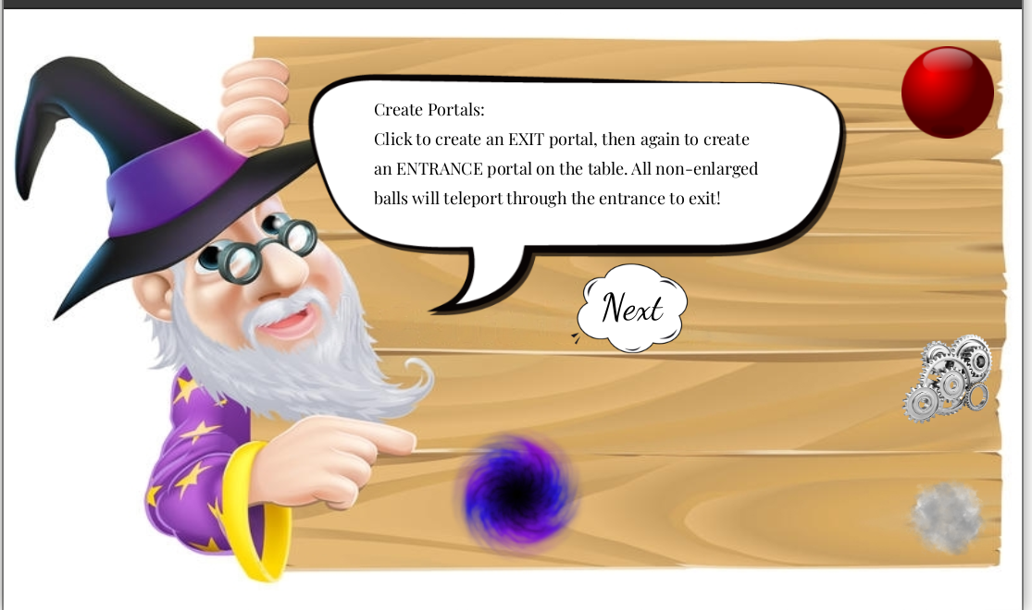
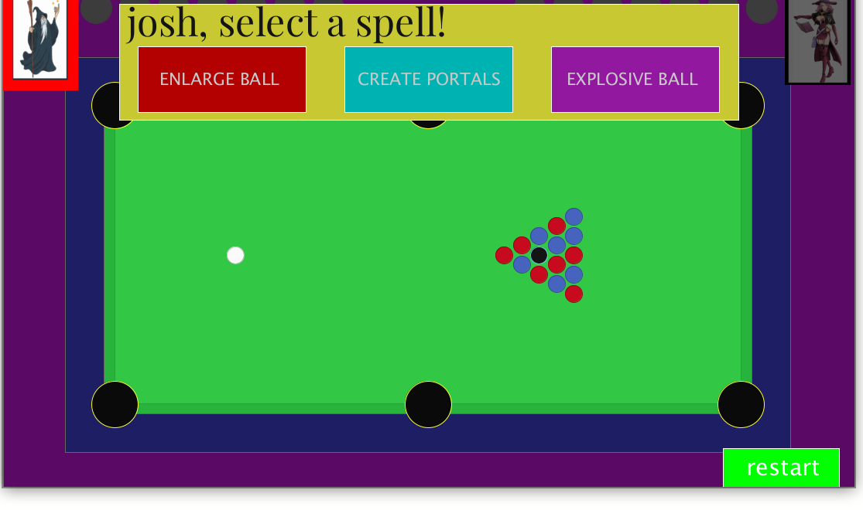
Spells
Introduced in the tutorial
Select before each turn
Changing selection

Slide 6

Future Work
More Spells
Better UI
Online Feature

