Slide 1


Passive Dark Web Crawler for CTI Extraction and Visualization
Supervised by Prof. Dr. Osama Amjad
Wael Fahmy 1265745
Amirhossein Zeinali Dehaghani 1225496
COMP-5473-AA – Computer Security

Slide 2

Introduction
Dark web contains valuable cyber threat intelligence (CTI) such as leaked credentials, malware, and phishing kits.
Accessing and analyzing this data is challenging due to volatility, anonymity, and unstructured content.
Manual browsing is risky and time-consuming, requiring safer automated solutions.
Our passive Tor-based crawler extracts CTI from .onion sites with live keyword matching, encrypted export, NLP analytics, and a user-friendly GUI.
Project scope spans cybersecurity, NLP for security, and safe dark web reconnaissance.

Slide 3
Motivation And Related Work
Dark web is a critical source of early CTI, including leaked data, malicious tools, and emerging attack strategies.
Many organizations lack visibility into hidden channels, reducing preparedness for zero-day threats and active campaigns.
Existing commercial tools (e.g., Recorded Future, DarkOwl) are costly and lack transparency, while academic tools lack modularity and real-time interfaces.
Our solution offers open-source, ethical, and cost-effective passive crawling with anonymized access, secure storage, and real-time NLP analytics.

Slide 4
Literature Review
Portnoff et al. (2017) extracted CTI metadata from dark web marketplaces.
Biryukov et al. (2014) studied Tor anonymity vulnerabilities, motivating safe crawling practices.
Ahmed et al. (2020) integrated NLP into dark web crawling for semantic threat term analysis.
Singh & Atrey (2021) applied keyword matching and NLP to classify CTI from forum text.
Our 2025 work combines Tor-based crawling, regex matching, NLP, encrypted export, and a GUI for comprehensive dark web CTI analysis.

Slide 5
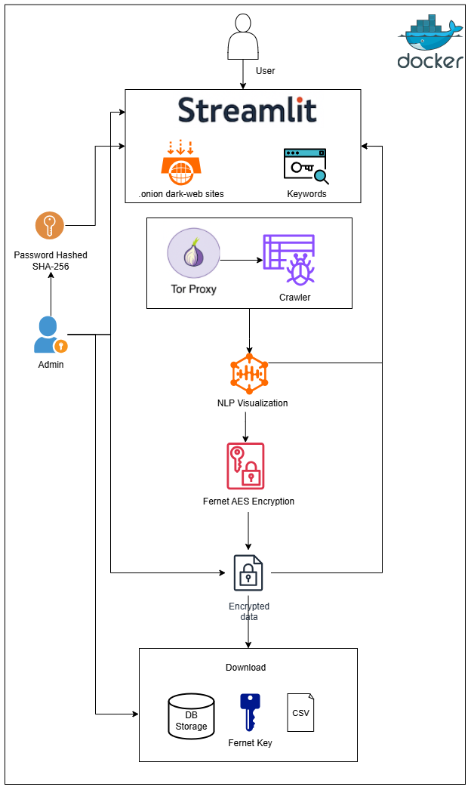

System Architecture
User Interface layer using streamlit
Authentication and Access control using hashing
Crawler Engine with Tor browser
Processing and NLP Analysis
Encryption Module with Fernet AES
Data Storage and Export CSV
Docker Deployment

Slide 6
Implementation Steps
Tor Routing and Onion Access
Web Scrapping and Parsing
Keyword Matching and Context Extraction
Database Encryption and Export
Admin Authentication and Logout
NLP Processing and CTI Taxonomy
Dockerize the code for easier deployment

Slide 7
Security & Ethical Considerations
Threat Model and Authentication
Data Confidentiality
Privacy by Design
Network Anonymity
Legal Scope and Research Use Only

Slide 8
Demo Access and Code
GitHub Repository
https://github.com/wael-fahmy/dark-web-crawler-streamlit
Includes: Readme for Installation and Deployment steps

Slide 9

Validation and Results
SOC analysts looking to extract dark web IOCs
Keyword match accuracy averaged 96%
Researchers conducting NLP-based CTI text mining
crawl time of approximately 4.2 seconds per static page over Tor
9

Slide 10
Critical Analysis & Limitations
Static Content Only
Limited Scalability
False Positives

Slide 11
Future Work
Named Entity Recognition (NER)
Scheduled Crawling and Deltas
Integration with Dashboards (Elastic Search)

Slide 12
Conclusion
Passive dark web crawler optimized for cyber threat intelligence collection
Integrates secure storage, real-time visualization, NLP analysis, and admin controls.
Designed for analysts and researchers with ethical safeguards in place.
Dockerized for safe, reproducible, and easy deployment.

