Slide 1

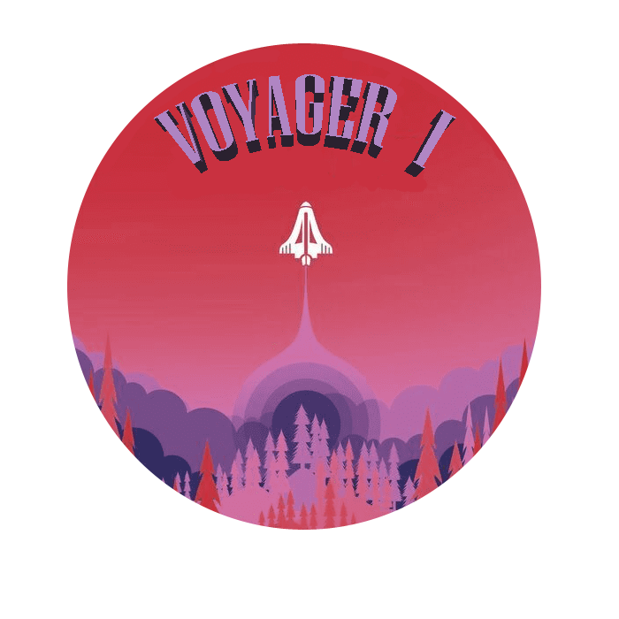
SOFTWARE ENGINEERING
Project assignment: Final Delivery
Group 4
Members:
Bortone Erasmo Alessio
Finamore Michele
Gambardella Christian
Karman Wael
Rago Emilio
Riva Francesco
Senatore Vittorio

Slide 2
SCRUM Roles
Product Owner
Michele Finamore
SCRUM Master
Emilio Rago
Development Team
Alessio Bortone
Christian Gambardella
Wael Karman
Francesco Riva
Vittorio Senatore

Slide 3
User Stories
As a player, I would to pause the game (13)
As a player, at the end of the game I would save my score (2)
As a user, I would to change game commands (5)
As a user, I would to see my 10 best scores so that I can check my improvements (8)
As a user, I would start a multiplayer game so that I can play with an other person (34)
As a product owner, I want to implement a demo function in the game, to learn the commands (21)
Story points : 83/83

Slide 4
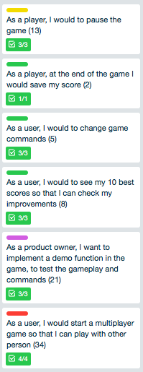
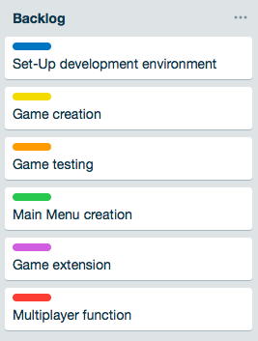
Product Backlog

Slide 5
1° vs 2° vs 3° Sprint
1°
2°
3°

Slide 6
Final Burndown Chart
Total Story Points: 210

Slide 7
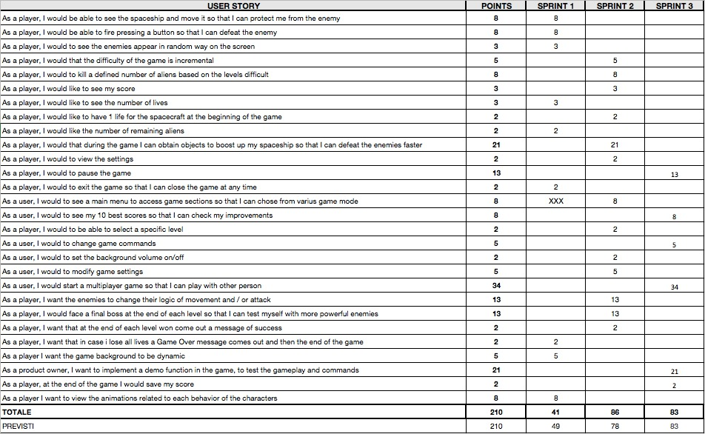
All User Stories

Slide 8
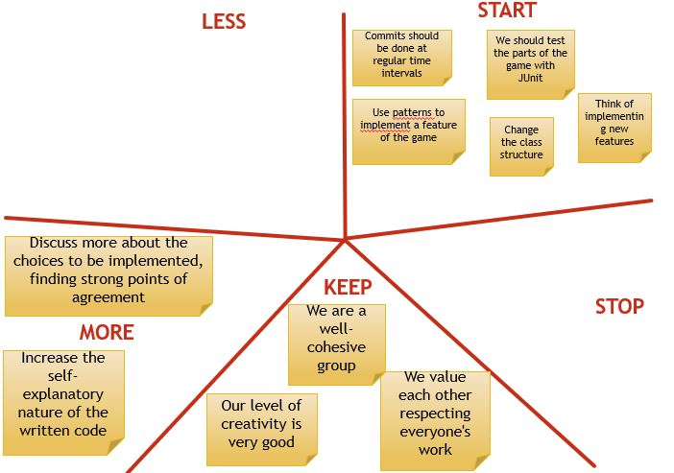
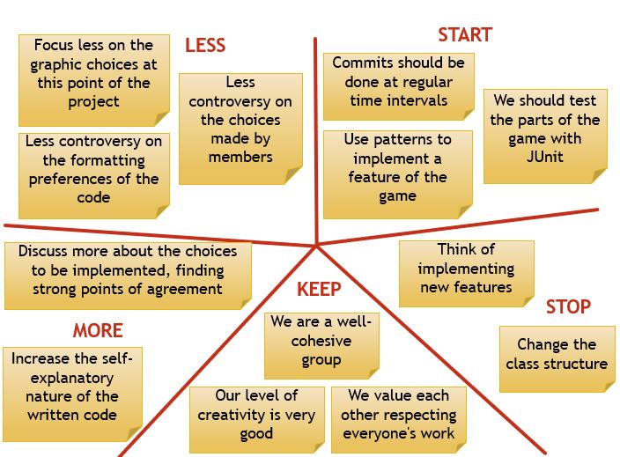
1° Sprint Retrospective
2° Sprint Retrospective

Slide 9
Problems solved with Scrum
Cognitive relationship between the members of the group
Daily Scrum, Sprint Retrospective
Collection of different ideas for the implementation of game features
Sprint Planning, Task Board, Sprint Retrospective
Meetings with pre-arranged appointments to discuss progress of work
Daily Scrum with videoconference service
Divisions of the various tasks for the realization of the project objectives
Implementing Scrum roles, Task Board
Structuring of the code deriving from the various releases implemented during the design
GitHub, Visual Studio, Sprint Demo, Sprint Review
Establish according to which conditions the definition of "Done" is valid in order to complete the realization of a functionality
JUnit Test

Slide 10
Problems solved with Design Patterns
Need to manage the implementation of objects with similar behavior (Alien classes)
Implementing Abstact Factory and Factory Method
Avoid the instantiation of multiple instances of the same game object by the user, to avoid creating inconsistencies in the parameters passed through the levels of the game
Implementing Singleton
Manage with one controller multiple types of events resulting from the pressure of the controls for game controls
Implementing Adapter
Being able to operate iteratively on the various data structures used within the code
Implementing Iterator

Slide 11

SETTINGS
SAVES
CORE
M
E
N
U
BOARD
E
N
D
L
E
V
E
L
1
L
E
V
E
L
2
L
E
V
E
L
3
SCOREBOARD
MUSIC
OPTIONS
PAUSE
MULTI
PLAYER

Slide 12
Architecture Explanation
Structured as a logical block architecture
Hybrid of different architectural styles
Multi-tier style architecture
Core
Pipe and filter style architecture
Board
Use of external services
Music, Multiplayer
A data saving module is displayed by continuously updating a file on the device
Notes:
For this software it was decided to show the architecture according to the block system. In particular, it was decided to use a hybrid of different architectural styles for the various subsystems that compose it, while focusing the design on multi-tier model or multi-layer architecture in which the various software features are divided into several layers or different software levels in communication with each other. They are :
-Module Menu: the main game menu of the game
-Sub-system Board: main game interface divided into levels developed according to the Pipe-and-filter style where the functional transformations process their input and generate output
-Module end : the end game ponel
The other modules are:
-Settings: allows you to set the game settings
-Options: allows you to set levels and spacecraft
-Pause: pause panel
-Scoreboard: panel in which the user saves the results that will be written to a file (saves module)
In particular, there are services available to the user, such as the possibility of playing in multiplayer mode and the possibility of listening or not audio present in the game

Slide 13


Why VOYAGER I ?
Voyager 1 left Cape Canaveral in 1977 to visit the orbits of Saturn and Jupiter and their moons ended up in interstellar space. After Saturn travels into the interstellar space at the borders of the Solar System, today it is still active and has reached the Heliosphere.
The game is inspired by the story presented and has the goal of providing a second chance to the Voyager 1 probe allowing it to return to base.
During the journey that will bring it back home traveling in the solar system it will have to face the adversities of space, having to deal with some types of aliens and monsters that populate the unexplored territory.

Slide 14
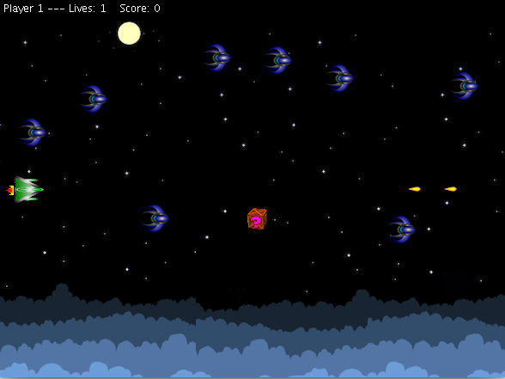
Feature & Overview
The game is inspired by the 2D retro game, from which it takes the form factor for the visualization, the intuitive graphics and the game modes in continuous.
The starting point on which it was developed is that of the game "Space Impact", a symbolic game of mobile gaming of the 2000s.
The classic features have been expanded with additional features, and the game modes are increased to allow the user an even more engaging gaming experience, while leaving the charm of games of that kind.

Slide 15

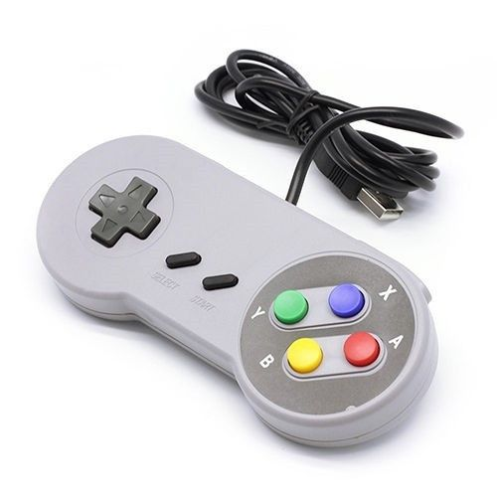
Game Modes
The game includes an arcade mode, which puts the player in front of different scenarios, with incremental difficulties, in which he must try to survive in order to move to the next level and increase his score
In addition to the classic single player mode, the game offers multiplayer mode so you can share the game experience with a friend
The game integrates perfectly with the retro 2D style so you would want to play with the commands of the past ... Why do not you try ?!

