Slide 1




YouTube
Data Analysis

Slide 2
The Team
Name | Role | Links
Kirollos Sameh Boules | Data Cleaning, Sentiment Analysis, NLP | LinkedIn GitHub
Fares Hesham | API, Power BI | LinkedIn GitHub
Wael Ayman | ML Models, Deployment | LinkedIn GitHub

Slide 3

Background
Millions of comments are posted daily on YouTube. Manually analyzing users' opinions is impossible. Sentiment Analysis helps companies understand customer feedback automatically using NLP and Machine Learning.
Text on Background Of
Sub-headline goes here

Slide 4
Problem Statement
Current Problem
Huge amount of YouTube comments.
Difficult to classify opinions manually.
Proposed Solution
Build an automated Sentiment Analysis model.

Slide 5
Objectives
Business Objective
Understand audience opinion.
Technical Objective
Develop an NLP model capable of predicting Positive, Negative and Neutral comments.

Slide 6
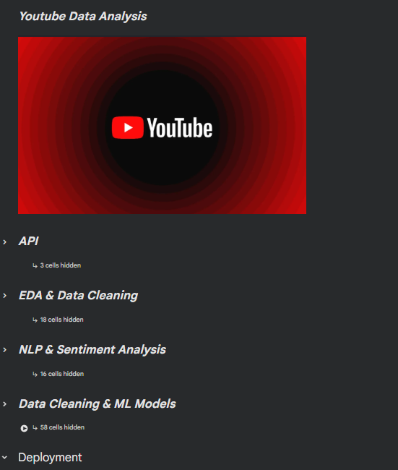
Workflow
YouTube API
Raw Data
EDA
Cleaning
NLP
Sentiment Labeling
Machine Learning
Evaluation
Deployment

Slide 7
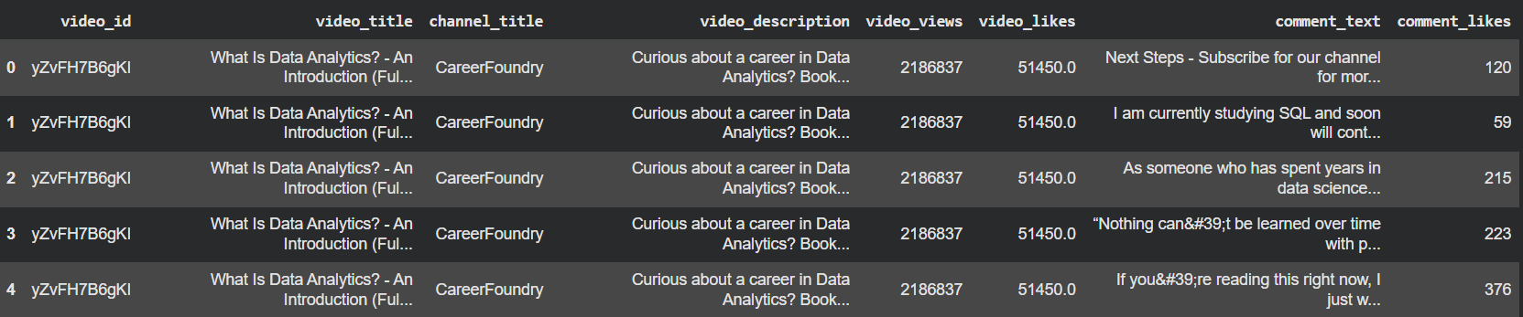
Dataset
Features
Video Title
Channel Name
Views
Likes
Description
Comment
Comment Likes
Source : YouTube Data API

Slide 8
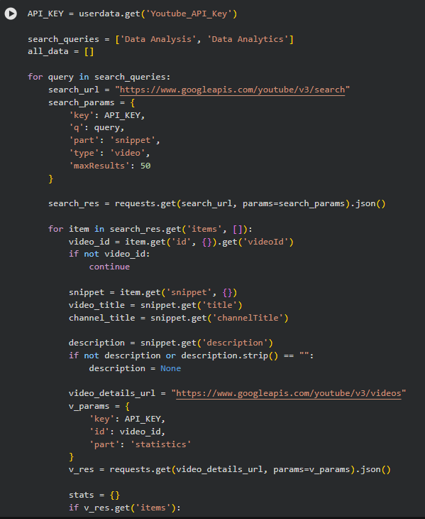
Data Collection
Tools we used
YouTube Data API
Python
Requests
JSON

Slide 9
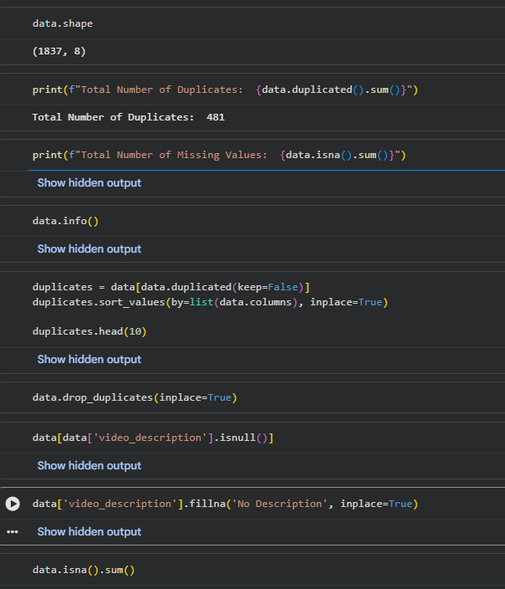
Data Cleaning
What we did
✔ Remove duplicates
✔ Handle missing values
✔ Handle data types
✔ Remove special characters
✔ Lowercase text
✔ Remove URLs
✔ Remove punctuation

Slide 10
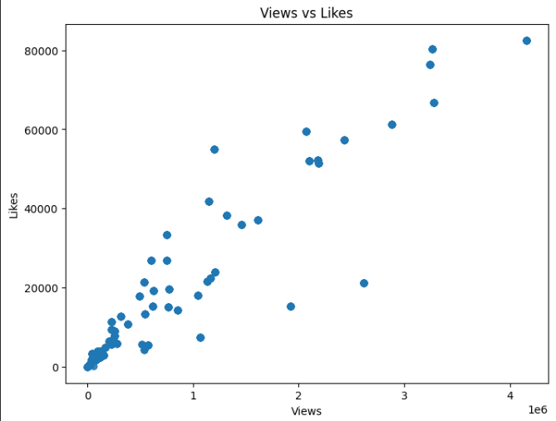
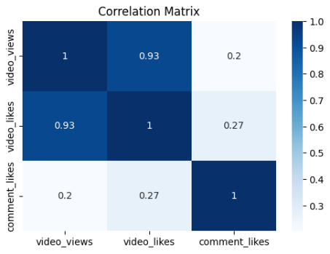
Exploratory Data Analysis
Correlation Matrix
Identifying data patterns by detecting a linear relationships between video views,video likes
Scatter Plot
Displaying and analyzing the relationship between video views and video likes

Slide 11
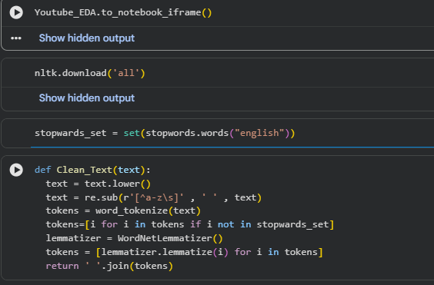
NLP Preprocessing
What we did
Tokenization
Stopwords Removal
Lemmatization
Regex Cleaning
Text Normalization

Slide 12
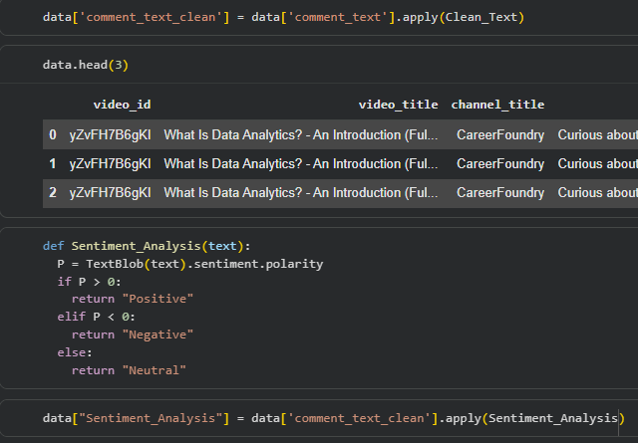
Sentiment Analysis
TextBlob was used to calculate the polarity score.
Positive
Neutral
Negative
Polarity > 0 → Positive
Polarity < 0 → Negative
Else → Neutral

Slide 13
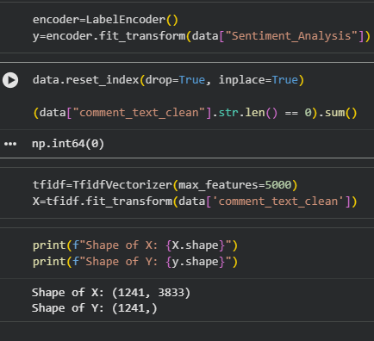
Feature Engineering
TF-IDF Vectorization
TF-IDF Vectorization was used to transform text comments into numerical features by measuring the importance of each word in the dataset. These features were then used to train the Machine Learning models.

Slide 14
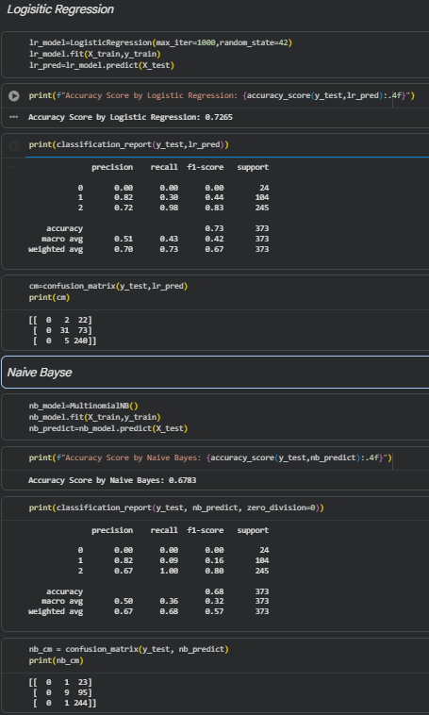
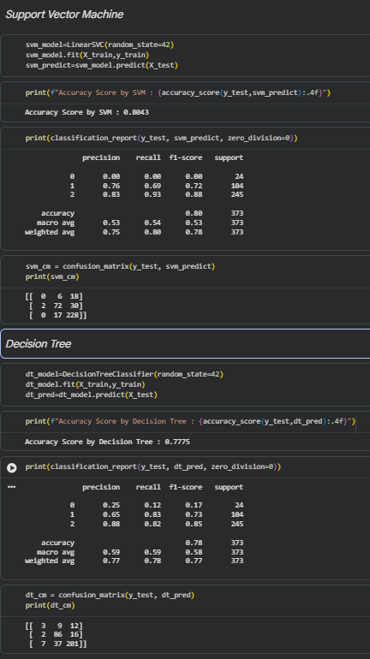
Machine Learning Models
Logistic Regression
Naive Bayes
SVM
Decision Tree
Random Forest

Slide 15
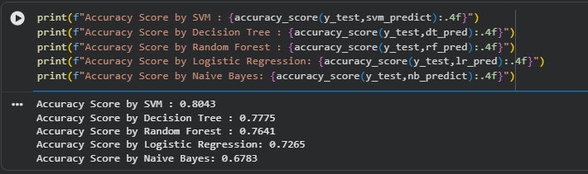
Model Comparison
Five Machine Learning Models were trained and evaluated using the test dataset. Their performance was compared based on the Accuracy metric. Among all Models, Linear SVM achieved the highest accuracy 80.43%, demonstrating the best overall performance for this sentiment analysis task. It was followed by Decision Tree 77.75%, Random Forest 76.41%, Logistic Regression 72.65%, and Naive Bayes 67.83%. Therefore, the Linear SVM model was selected as the Final Model due to its superior classification performance

Slide 16
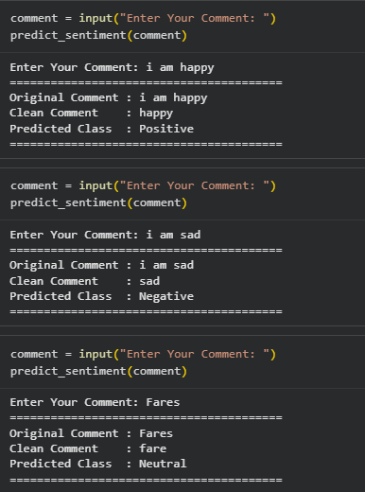
Model Test
"After training and evaluating our Machine Learning model, we performed a final test using new comments that the model had never seen before. The purpose was to verify how well the model generalizes to unseen data. We entered different comments manually, and the system first applied the same preprocessing steps used during training, such as text cleaning and normalization. Then, the processed text was passed to the trained model to predict the sentiment."

Slide 17
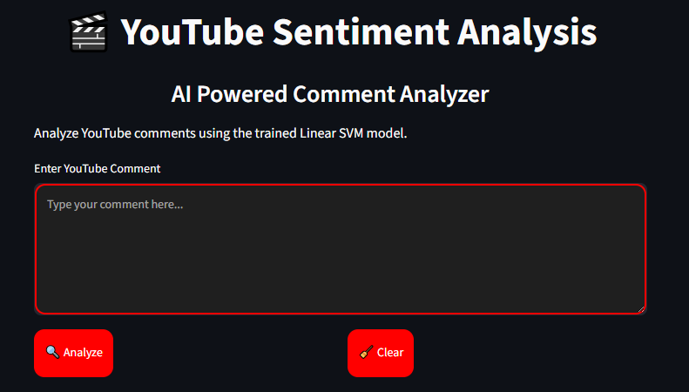
Deployment
System Overview:
This user interface serves as an AI-Powered Comment Analyzer designed to perform sentiment analysis on YouTube comments. By leveraging a trained Linear SVM (Support Vector Machine) machine learning model, the application classifies viewer input, providing real-time insights into user sentiment with an intuitive and interactive layout. Developed the application using Streamlit.Loaded the trained Linear SVM model.Applied Text Preprocessing and TF-IDF.Predicted the sentiment of YouTube comments.Displayed the result in a simple and interactive interface

Slide 18
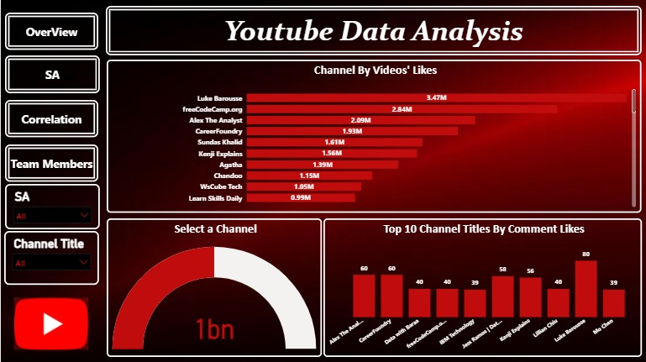
Overview
Ethical Considerations
Scholar Research

Slide 19
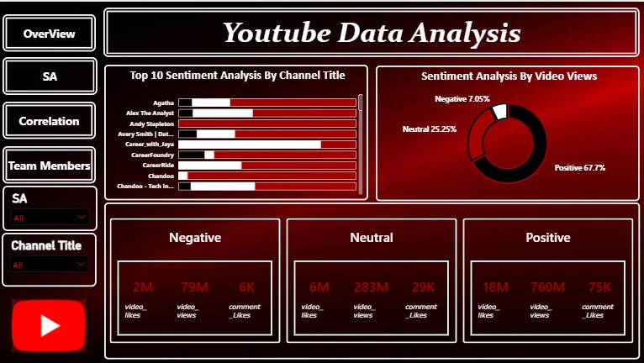
SA
Ethical Considerations
Scholar Research

Slide 20
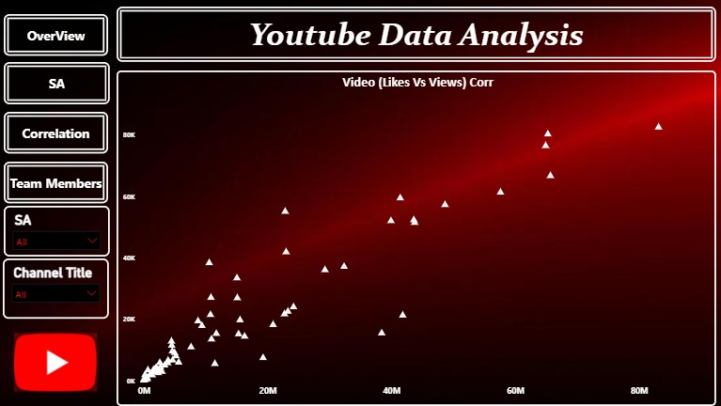
Correlation Analysis
Ethical Considerations
Scholar Research

Slide 21
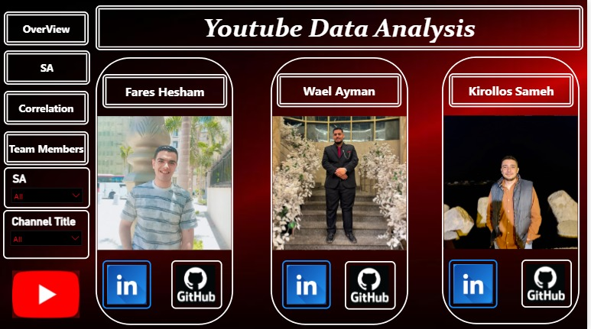
Team Members
Ethical Considerations
Scholar Research

Slide 22
What we Faced in
Challenge & Work & Tools
Future Work
Tools & Technologies
Challenges
NumPy
Pandas
NLTK
TextBlob
Scikit-learn
Streamlit
Power BI
Plotly
Google Colab
YouTube API
API limits
Noisy comments
Emojis
Mixed languages
Slang
Deep Learning
BERT
Arabic Sentiment Analysis
Real-time Dashboard

