Slide 1

Capital Edge Data Pipeline: Automated Stock Data Processing Waetsi Patty Anyanwu

Slide 2
Problem Statement
Raw financial data is unstructured
Manual processing is inefficient
Need automation and scalability

Slide 3
Objectives
Extract stock data
1
Transform and clean data
2
Automate workflow using Airflow
3
Prepare data for analytics/storage
4

Slide 4
Architecture Diagram
Raw JSON → Extract → Transform → Processed CSV → (Azure Storage) ↑ Airflow DAG

Slide 5
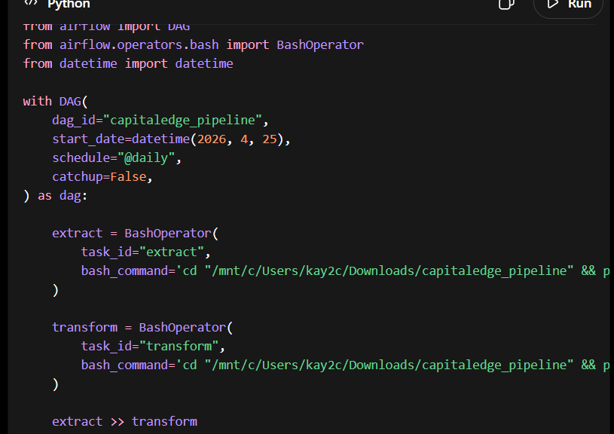
Airflow DAG (Code snippet)

Slide 6
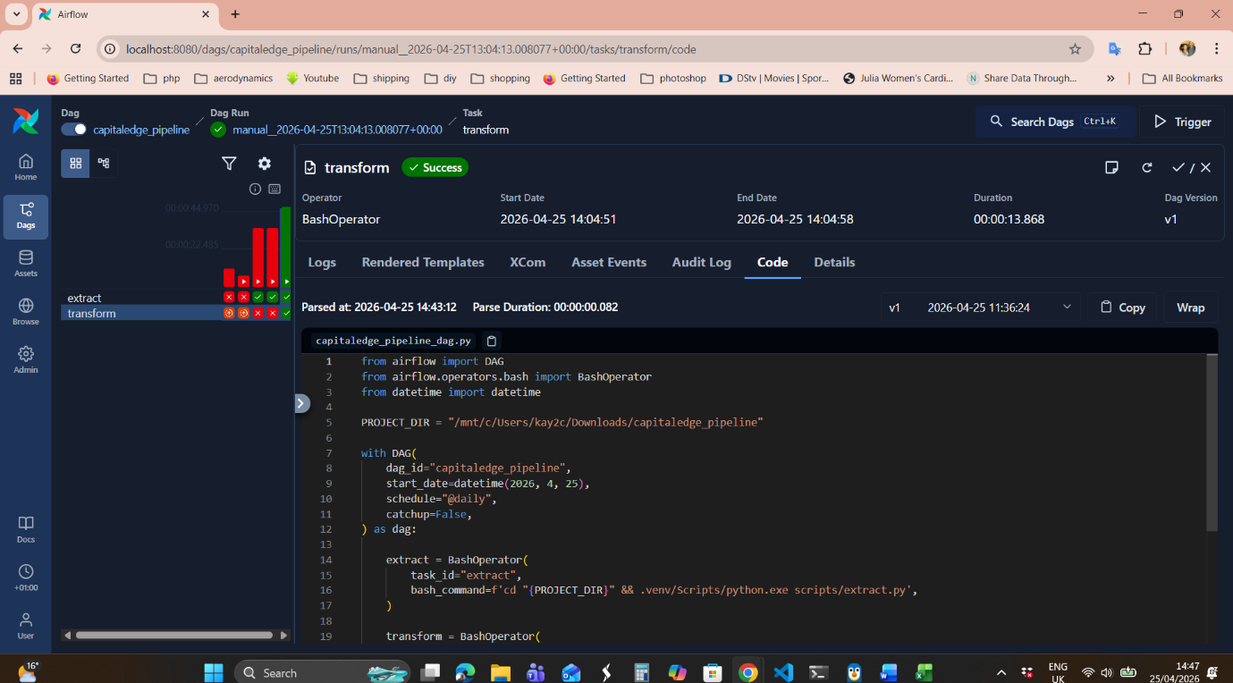

Slide 7
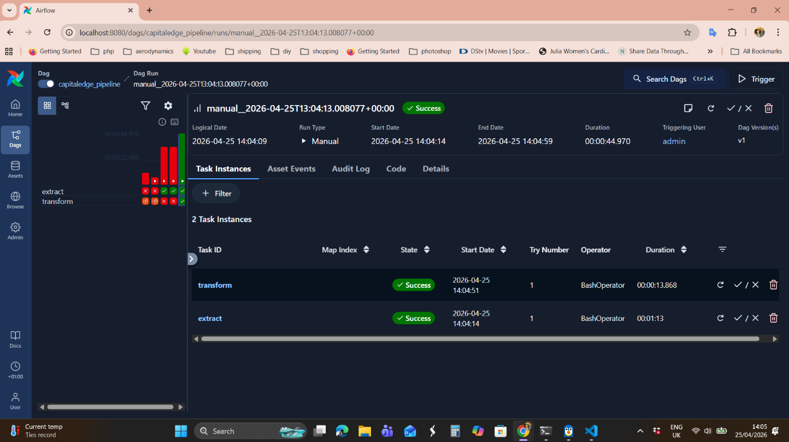
Airflow Execution

Slide 8
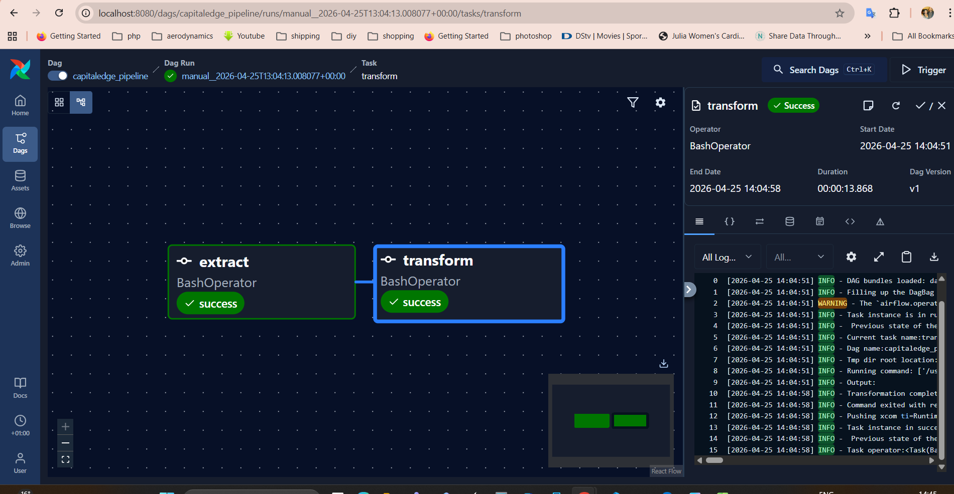
Graphical view Output

Slide 9
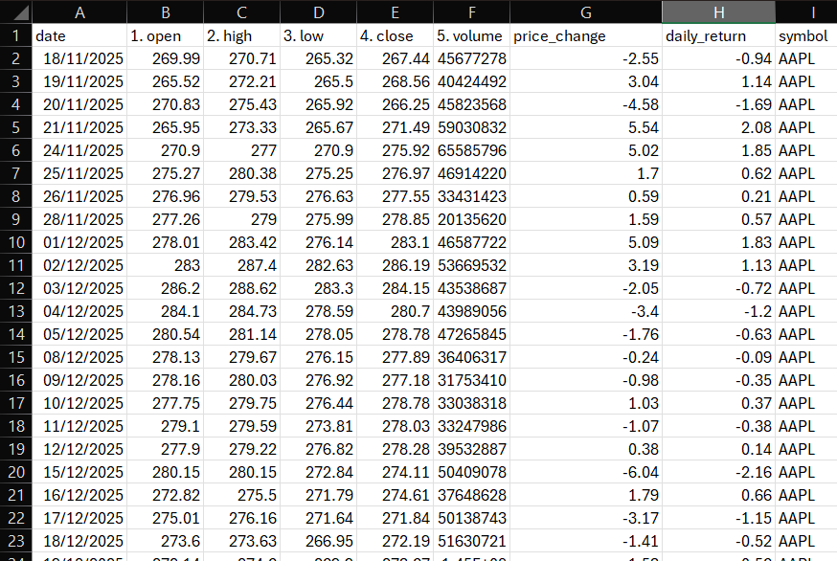
Processed CSV

Slide 10
Challenges & Solutions
Environment setup (WSL, Airflow)
Dependency issues
File path errors
Debugging DAG errors

Slide 11
Conclusion
Automated pipeline built
Scalable solution
Real-world application

