Slide 1
Checkpoint DATABASE

Slide 2
MYSQL

Slide 3
What is MYSQL?
a multithreaded, multi-user SQL database management system.
A Database Management System which is available for both Linux and Windows.
Popular Open Source Database.
a relational database management system (RDBMS) that has more than 6 million installations.

Slide 4
Advantages of Using MySQL

Slide 5
Data Security
On-Demand Scalability
High Performance
Round-The-Clock Uptime
Comprehensive Transactional Support
Complete Workflow Control
Reduced Total Cost Of Ownership

Slide 6
POSTGRESQL?

Slide 7
WHAT IS PostgreSQL
PostgreSQL is a powerful, open source object-relational database system with over 30 years of active development that has earned it a strong reputation for reliability, feature robustness, and performance.
is available for Linux, UNIX (AIX, BSD, HP-UX, SGI IRIX, Mac OS X, Solaris, Tru64) et Windows.

Slide 8
Advantages of PostgreSQL

Slide 9
PostgreSQL can run dynamic websites and web apps as a LAMP stack option
PostgreSQL's write-ahead logging makes it a highly fault-tolerant database
PostgreSQL source code is freely available under an open source license. This allows you the freedom to use, modify, and implement it as per your business needs.
PostgreSQL supports geographic objects so you can use it for location-based services and geographic information systems
PostgreSQL supports geographic objects so it can be used as a geospatial data store for location-based services and geographic information systems
To learn Postgres, you don't need much training as its easy to use
Low maintenance and administration for both embedded and enterprise use of PostgreSQL

Slide 10
SQL_SERVER

Slide 11
What is SQL_SERVER ?
SQL Server is a relational database management system
Databases contain objects and data
Each database has multiple tables
Tables are joined together to extract meaningful information

Slide 12
Advantages of sql_server

Slide 13
Increases data security
Ease of configuration
Optimized data storage
Data recovery support

Slide 15
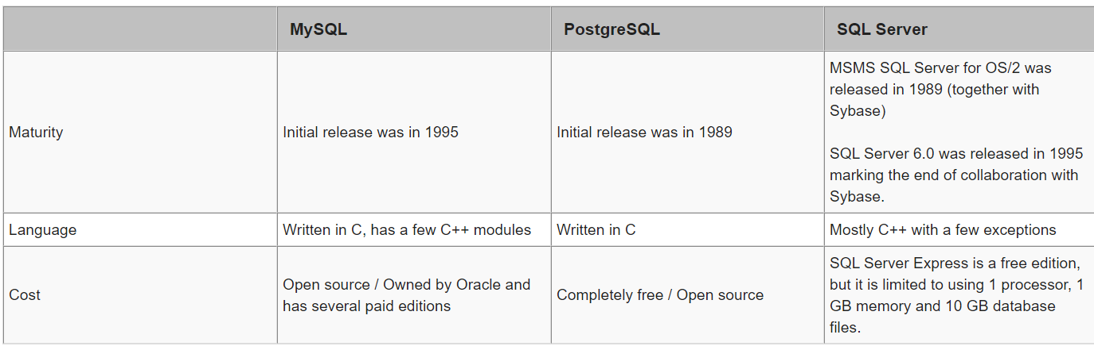

Slide 16
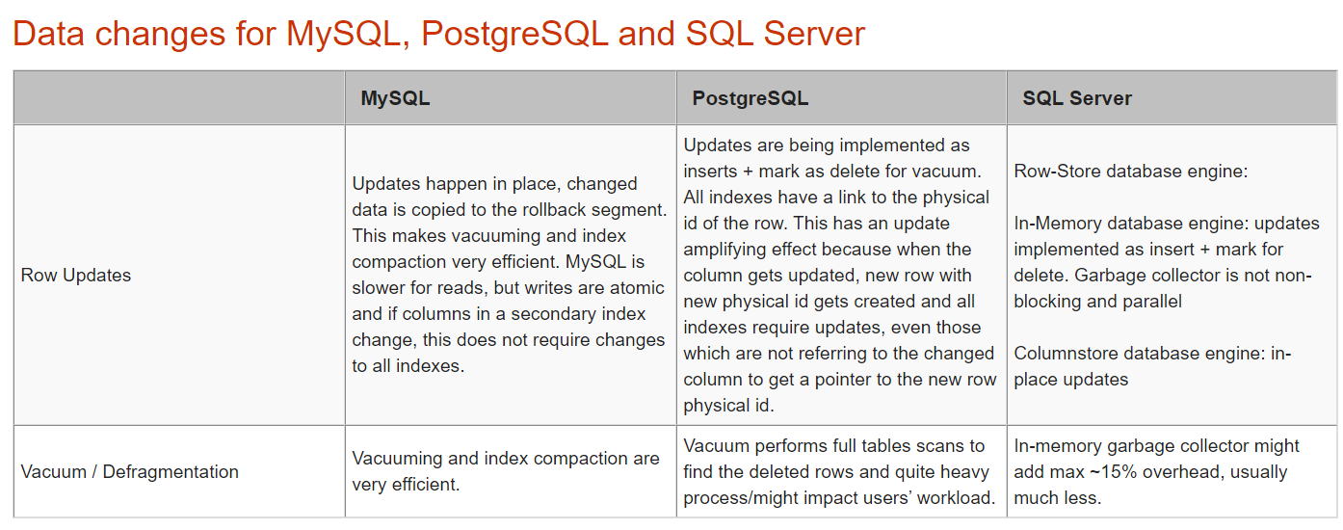

Slide 17
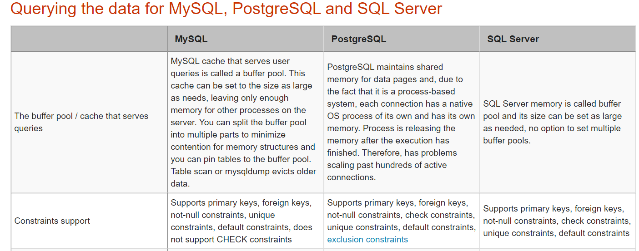

Slide 18
