Slide 1

NoSQL vs SQL: A Battle of Data Management Systems

Slide 2
NoSQL and SQL
NoSQL vs. SQL Databases:
NoSQL and SQL are distinct database management systems with differing data structure, scalability, and query language approaches.
NoSQL databases excel in flexibility and managing unstructured data, while SQL databases are structured and handle structured data efficiently.
Both database types possess unique strengths and limitations, requiring selection based on project or organizational requirements.
NoSQL Database Usage:
NoSQL databases suit web applications, offering rapid and adaptable data storage and retrieval.
They thrive in big data contexts, managing vast data volumes that could overwhelm traditional SQL databases.
SQL Database Usage:
SQL databases find utility in industries like finance and healthcare, prioritizing data accuracy and consistency.
Prevalent when dealing with intricate queries due to the robust and standardized SQL query language.

Slide 3
Exploring MongoDB
Advantages of MongoDB:
Popular NoSQL database for modern web applications.
Designed for scalability and high availability.
Flexible data model supports various data formats.
Suitable for complex data structures and changing data requirements.
Challenges and Limitations:
Lack of transaction support impacts data consistency.
Flexible data model can lead to performance issues.
Requires careful management for optimal performance.

Slide 4


Slide 5
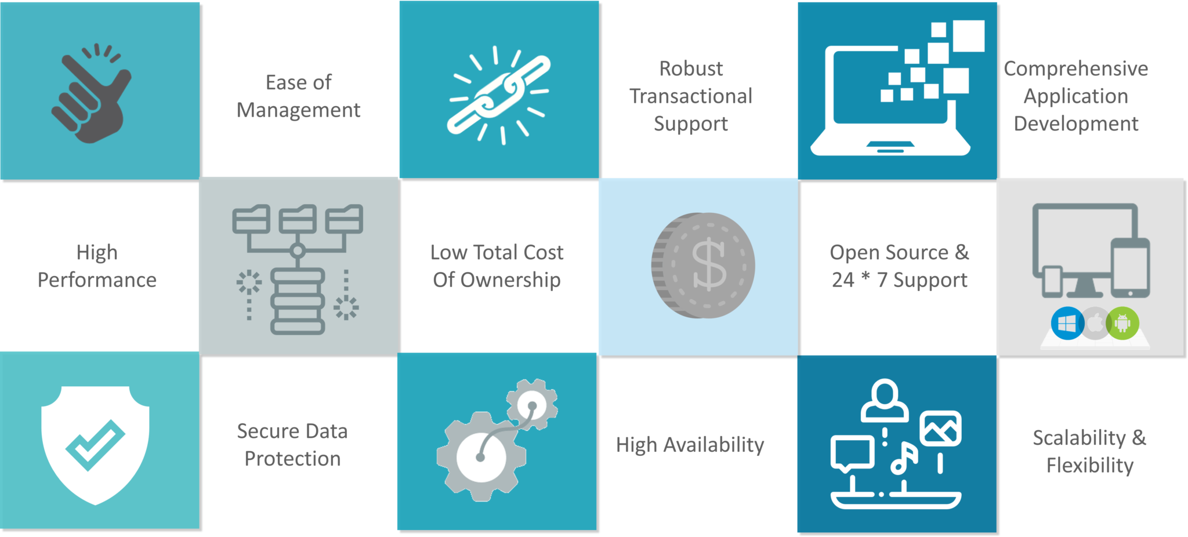

Slide 6
Comparing MongoDB and SQL
MongoDB vs. SQL:
MongoDB is a NoSQL database employing a document-oriented data model.
Data is stored in dynamic schema JSON-like documents.
SQL, however, employs a table-based data model with fixed schemas.
Data Model:
MongoDB accommodates varying fields within documents.
SQL stores data in rows and columns with consistent schemas.
Query Languages:
MongoDB uses MongoDB Query Language (MQL).
MQL offers flexibility, enabling complex queries, aggregation, and indexing.
SQL relies on Structured Query Language.
SQL is more standardized and widely familiar, despite being less flexible than MQL.

Slide 7
Conclusion
Database Choice Consideration:
NoSQL and SQL databases offer distinct strengths and weaknesses tailored to different scenarios.
NoSQL databases excel in flexibility and scalability for unstructured data.
SQL databases prioritize reliability and consistency for applications needing strict data integrity.
Application Relevance:
Choosing a database hinges on application specifics.
NoSQL, such as MongoDB, suits unstructured data like social media or sensor readings.
SQL databases like MySQL or PostgreSQL are apt for stringent data consistency, as in finance or healthcare.
In the end, the decision relies on aligning the database type with the unique demands of your project or organization.

