Slide 1
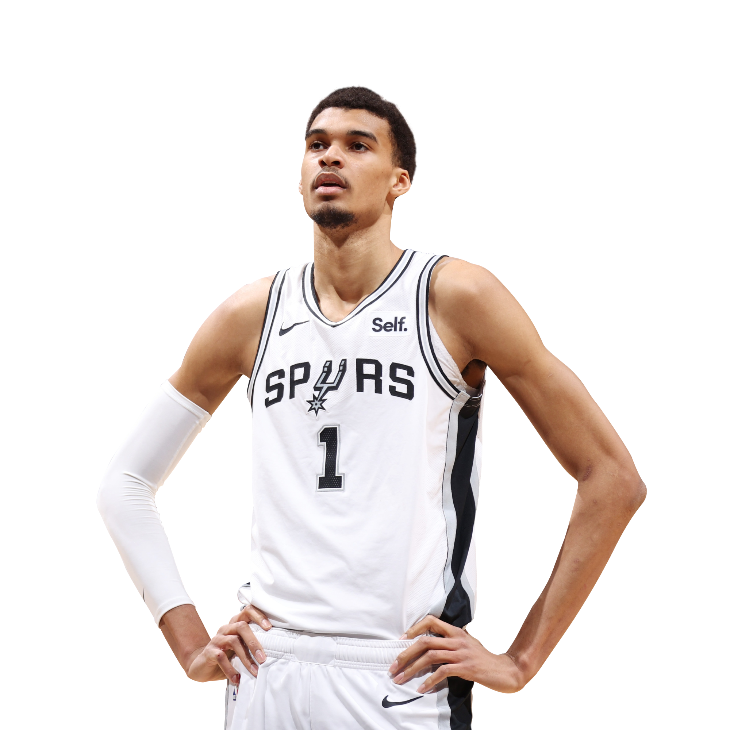
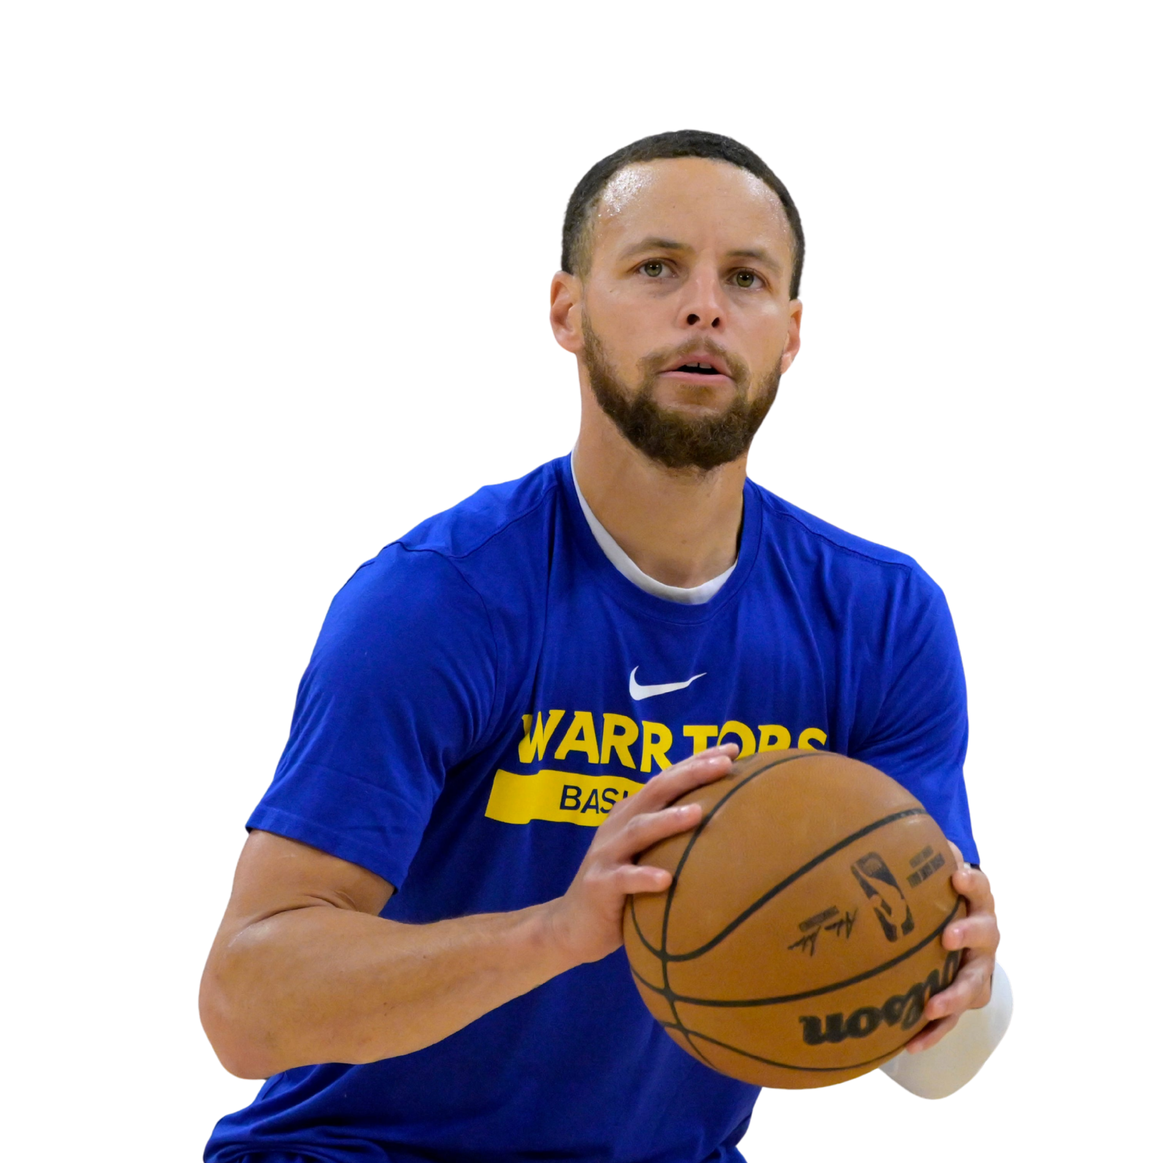
NBA
Predicting NBA Player
Positions Using Statistical Profiles
analytics
Using per-75 possession statistical profiles, KNN, SVM, K-means, and hierarchical clustering
MATH 4323 Final Project
Waleed Farrakh
Sultan Sadiq
Lillee Garza
1
Notes:
Open by introducing the project: this is a basketball analytics project using NBA player-season data. The main goal is to see whether player statistics can predict whether a player is a guard or non-guard, and then to compare that with unsupervised clustering. Mention that the talk covers the question, data, models, results, and conclusions.

Slide 2
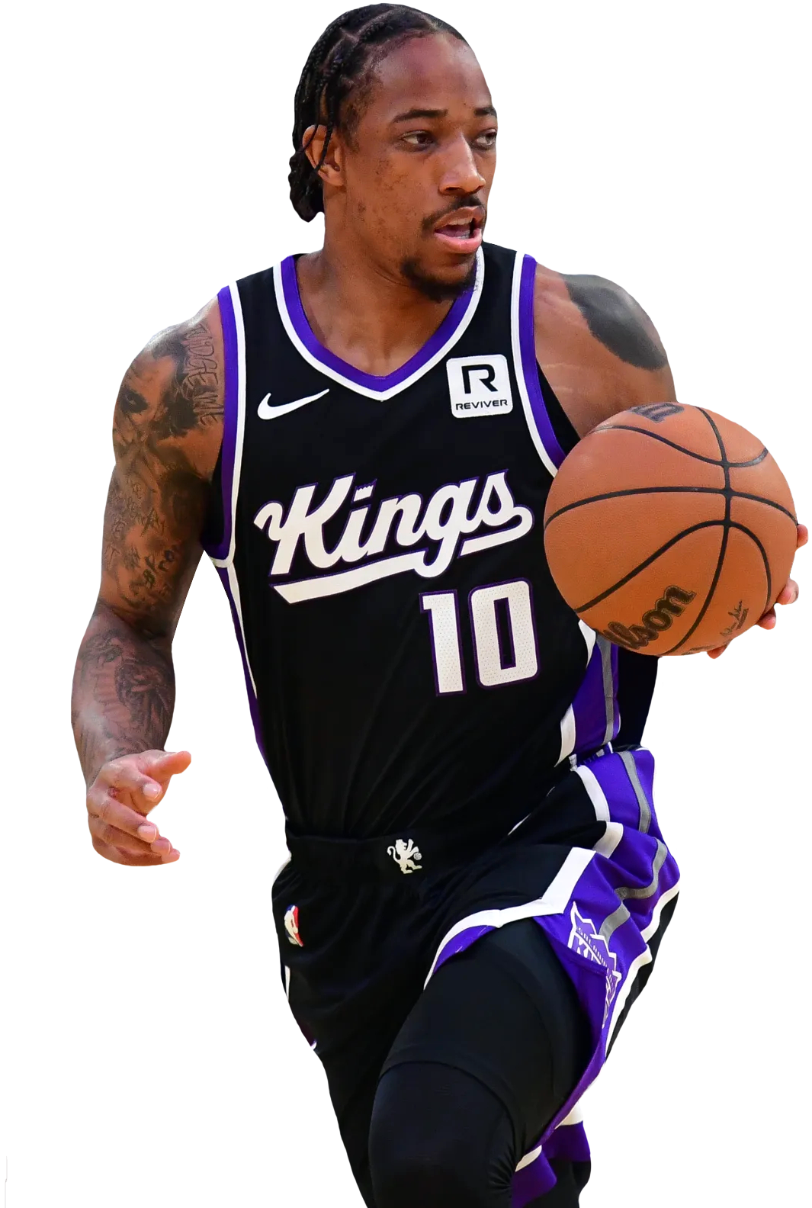
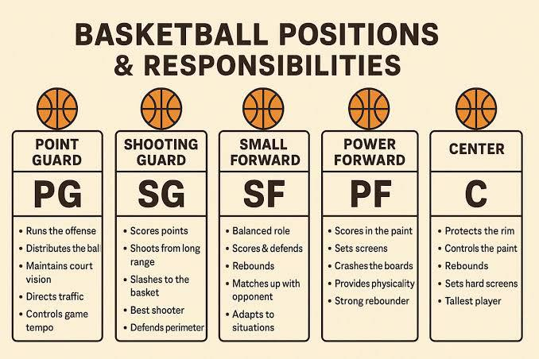
Project question & storyline
What we tried to learn from player statistics
RESEARCH QUESTION
Can NBA player statistical profiles accurately predict whether a player is a guard or non-guard?
Secondary Question:
Do players naturally group into clusters based on their statistical profiles?
2
Notes:
Explain the central research question. Stress that the response variable is GuardClass, a binary label: guard versus non-guard. The unsupervised clustering does not define a second response variable; it complements the question by asking whether similar statistical profiles naturally form groups consistent with those labels.

Slide 3
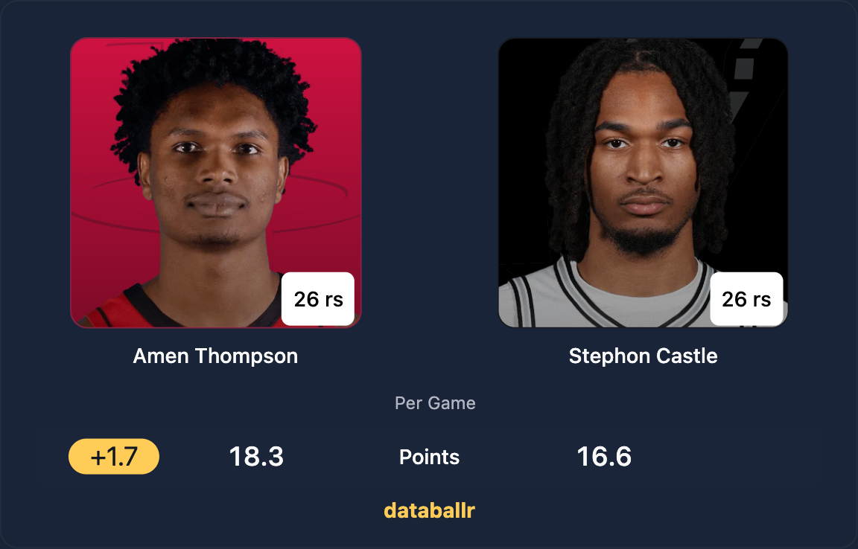
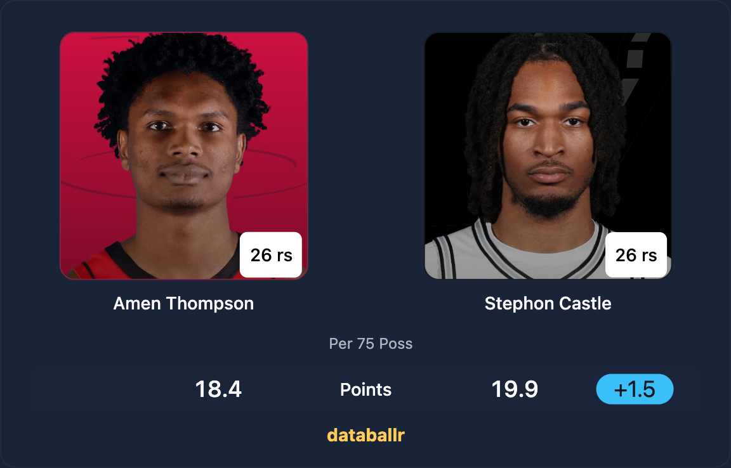
Rationale for PER 75
Standardizing player performance across contexts
Per-game stats are influenced by pace and playing time
Fast teams and high-minute players appear inflated
Per-75 possessions standardizes production
Allows fair comparison across players, roles, and eras, which is critical for building reliable machine learning models.
PER GAME
PER 75
Minutes per game
Castle: 30.0 MPG
Amen: 37.4 MPG (1st in NBA)
2
Notes:
Explain the central research question. Stress that the response variable is GuardClass, a binary label: guard versus non-guard. The unsupervised clustering does not define a second response variable; it complements the question by asking whether similar statistical profiles naturally form groups consistent with those labels.

Slide 4

Data Source
Where the dataset comes from and how it was constructed
Source: Stathead Basketball
Why these filters?
Ensuring data quality and fair comparison
  Start from 1981–82: first 3-point era season with complete data (no missing values)
  Regular season only: avoids playoff variability and keeps comparisons consistent
  Minimum 42 games played:
    Ensures reliable sample size (> half of 82-game season)
    Avoids small-sample bias
    Still includes shortened seasons (e.g., COVID years)
Data Filters Applied:
  Seasons: 1981–82 through 2025–26
  Regular Season only
  Minimum Games Played ≥ 42
  Ranked by Points per 75 Possessions
  Top 600 single-season performances
2
Notes:
Explain the central research question. Stress that the response variable is GuardClass, a binary label: guard versus non-guard. The unsupervised clustering does not define a second response variable; it complements the question by asking whether similar statistical profiles naturally form groups consistent with those labels.

Slide 5
Data overview
NBA player seasons ranked by scoring profile
600
33
28
2
player-season observations
original variables
numeric predictors used
classes: Guard / NonGuard
DATA FIELDS
CLASS BALANCE
Categorical: Player, Season, Team, Position
Numerical: Age, G, GS, MP, AS
All box score stats are per 75 possessions
Includes shooting, rebounding, and playmaking metrics
Key variables: PTS/75, PTS/G, efficiency (FG%, TS%, eFG%)
Per-75 allows fair comparison across players and eras
3
Notes:
Walk through the dataset. Each row is one NBA player-season. The class balance is not perfectly equal but is reasonable: 373 guards and 227 non-guards. Mention that positions like G-F or F-G were treated as guards because they include a guard role.

Slide 6
Preprocessing decisions
Preparing data for distance-based and kernel methods
Step
Why it matters
Removed Player, Team, Season
Identifiers do not contribute to prediction
Created GuardClass
Defines classification target
Replaced 3P% NA → 0
Players with no 3PA have undefined 3P%; 0 keeps all 600 observations
Centered and scaled predictors
Needed because KNN, SVM, and clustering rely on distances
Retained numeric features
Preserves full statistical profile and basketball interpretability
These steps ensure fair distance calculations and improve model reliability.
4
Notes:
Explain that preprocessing was important for fair model comparison. Distance-based methods can be distorted when predictors have different scales. The missing values in 3P% were not treated as data errors; they occurred because some players did not attempt threes, so replacing with 0 was a reasonable basketball interpretation.

Slide 7
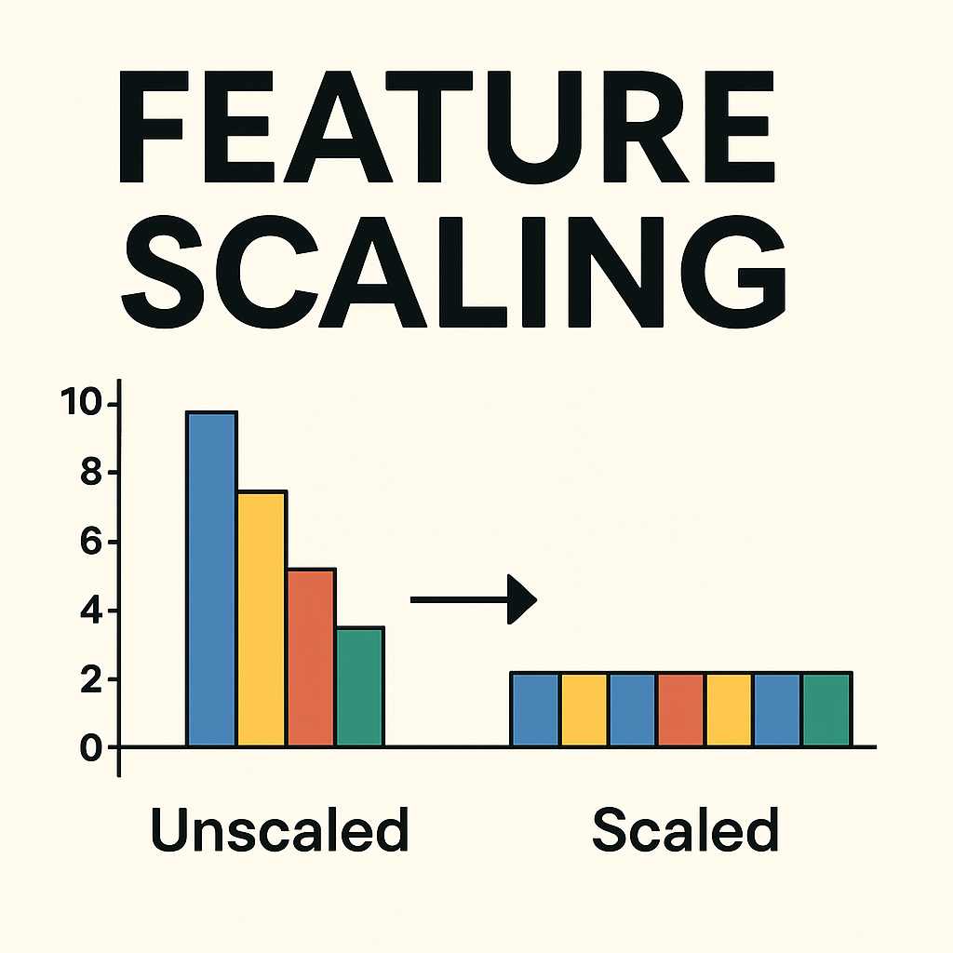
Why Scaling Matters
Ensuring fair contribution of all variables
Models like KNN, SVM, and clustering rely on distance calculations
Without scaling:
Variables with large values dominate
With scaling:
All features contribute equally
Supervised models use labels, clustering does not
This step is critical or results become meaningless
3
Notes:
Walk through the dataset. Each row is one NBA player-season. The class balance is not perfectly equal but is reasonable: 373 guards and 227 non-guards. Mention that positions like G-F or F-G were treated as guards because they include a guard role.

Slide 8
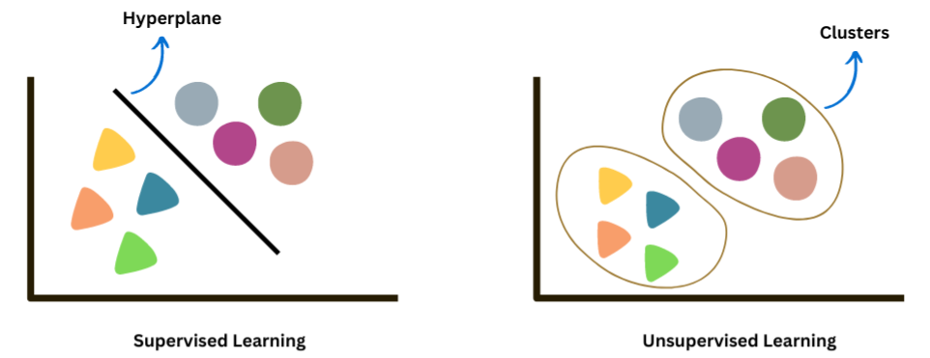
Modeling plan
Two supervised models + two clustering models
Supervised classification
Unsupervised clustering
K-Nearest Neighbors (KNN)
Support Vector Machine (SVM)
K-Means Clustering
Hierarchical Clustering
5
Notes:
This slide gives the road map of the analysis. KNN and SVM answer the direct prediction question. K-means and hierarchical clustering check whether the data naturally forms groups similar to position labels. Point out that both approaches use the same cleaned, scaled numeric data.

Slide 9
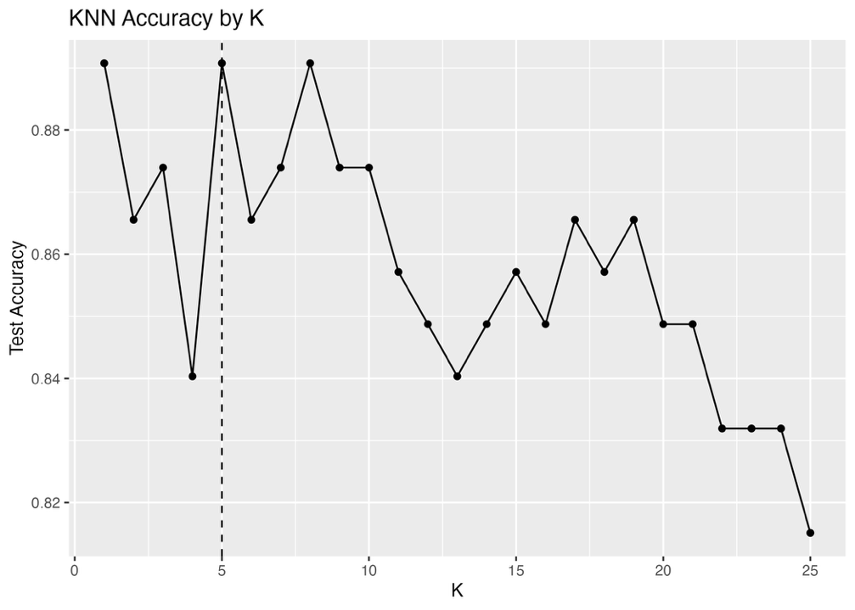
KNN results
Choosing K from test accuracy
KNN summary
K tested: 1 to 25
Chosen K: 5
Test accuracy: 89.08%
Balanced accuracy: 87.30%
K = 5 was selected because it tied for best accuracy while avoiding the instability of K = 1.
6
Notes:
Explain KNN in simple terms. The model compares each test observation to nearby training observations. Accuracy was evaluated for K values 1 through 25. Although K equals 1 also performed well, K equals 5 was selected because it gives the same top accuracy while being more stable.

Slide 10
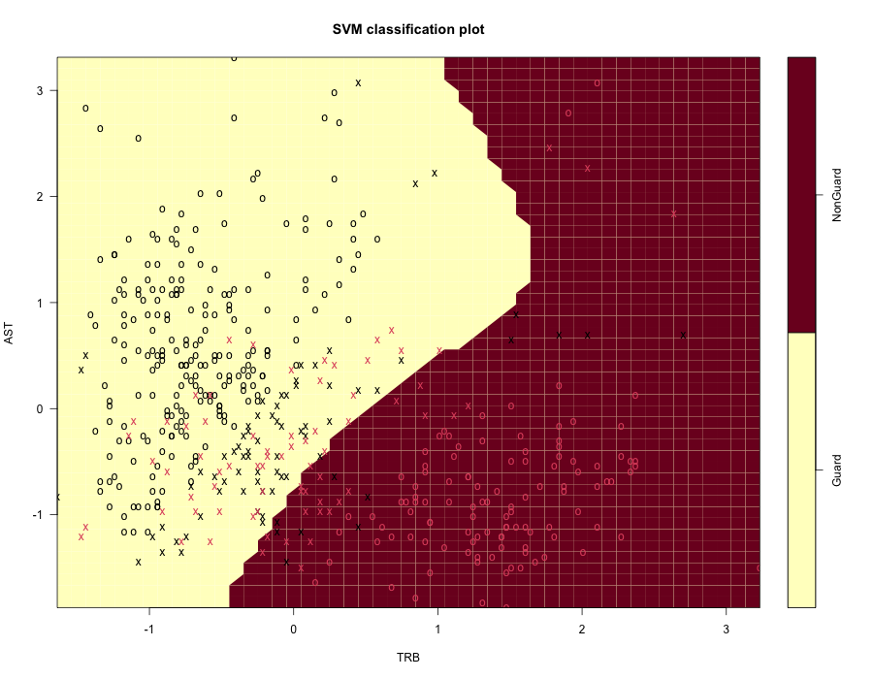
SVM results
Best supervised model using an RBF kernel
SVM decision boundary
Tuned using cross-validation
Best parameters:
  Cost = 10
  Gamma = 0.1
Test accuracy: 89.92%
The SVM slightly outperformed KNN
7
Notes:
Describe the SVM as the model that tries to draw a boundary between guards and non-guards. The RBF kernel allowed a curved, non-linear boundary. The best tuning values were cost 10 and gamma 0.1, and the test accuracy was 89.92 percent, slightly higher than KNN.

Slide 11
Supervised model comparison
Both models predict position well; SVM is slightly better
CONFUSION MATRICES
KNN
Actual G
Actual NG
Pred G
70
9
Pred NG
4
36
SVM
Actual G
Actual NG
Pred G
70
8
Pred NG
4
37
Takeaway: SVM reduced one additional non-guard error compared with KNN, giving it the best test accuracy.
8
Notes:
This is the main supervised result slide. Both models classify well, but SVM is the winner by a small margin. Mention that the models are not perfect, but around 90 percent test accuracy is respectable and answers the main research question strongly.

Slide 12
Clustering setup
Testing whether natural groups match basketball roles
K-means
Hierarchical
Tested K = 2 to 10
Best K = 2
Silhouette Score = 0.174
  Indicates weak cluster separation
Goal: compact groups of similar players
Tested complete, average, and Ward linkage
Selected average linkage
Best K = 2
Silhouette Score = 0.208
  Slightly better than K-Means
Goal: visualize cluster hierarchy
Silhouette values closer to 1 indicate cleaner separation; values near 0 suggest overlap.
9
Notes:
Transition from supervised learning to clustering. Clustering does not use the labels to form groups. Instead, it looks for similarity among numeric player profiles. The main evaluation metric is silhouette, and after clustering the groups were compared to GuardClass as external labels.

Slide 13
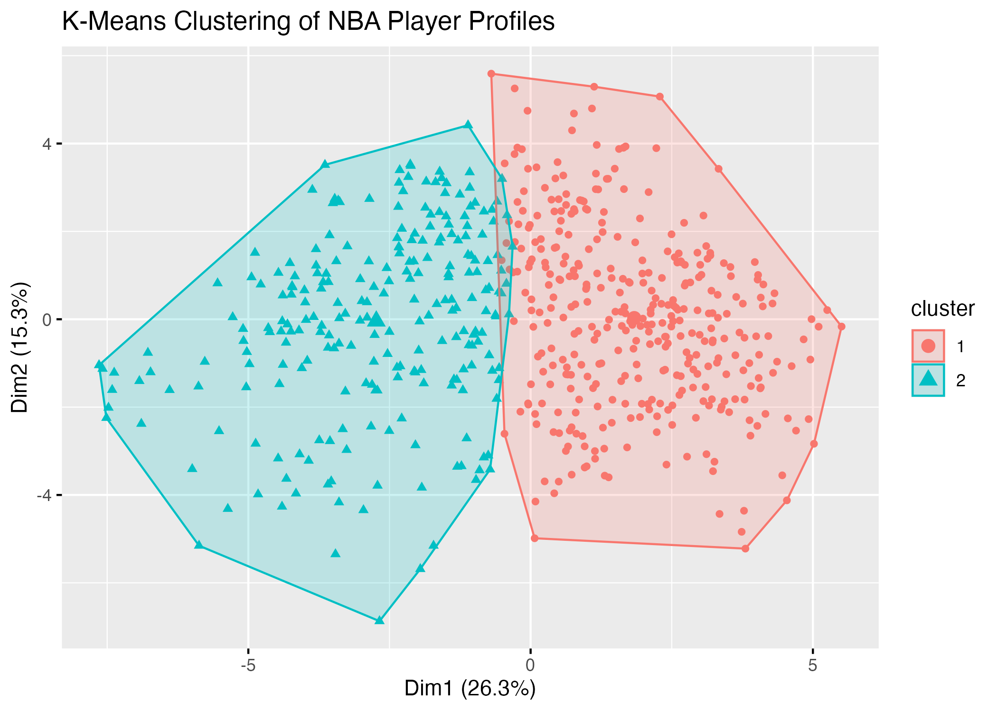
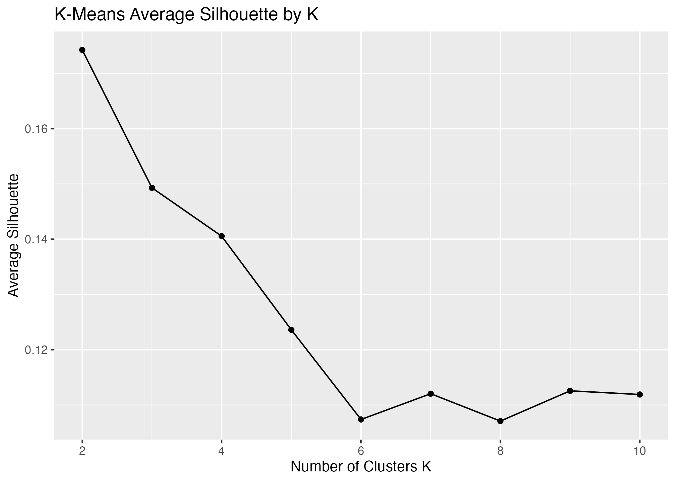
K-means clustering results
K = 2 had the best silhouette score
MATRIX
K-means
Guard
NonGuard
Interpretation
Cluster 1
295
64
Cluster 1 is guard-heavy.
Cluster 2 has more non-guards.
Separation exists, but overlap is still meaningful.
Cluster 2
78
163
10
Notes:
Explain that K-means found two clusters. The clusters roughly correspond to positional role, but not perfectly. Cluster 1 contains many guards, while cluster 2 contains more non-guards. The silhouette score is low, which means the clustering separation is weak compared with the supervised classification performance.

Slide 14
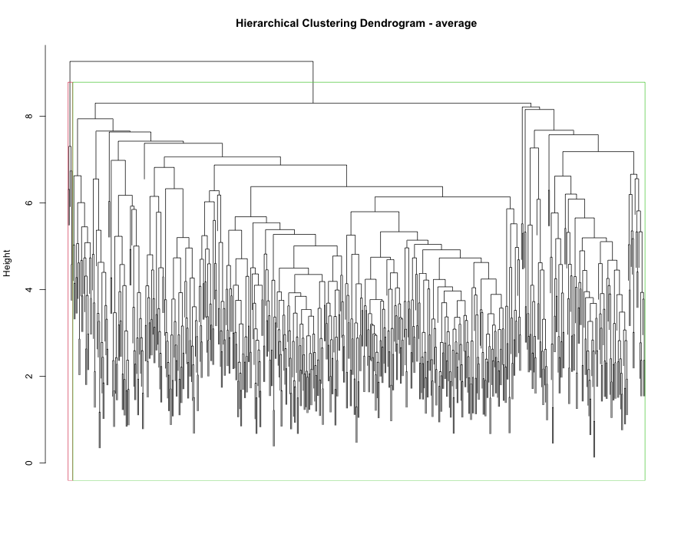
Hierarchical clustering results
Average linkage performed best
Hierarchical dendrogram
Best configuration
Linkage: average
K = 2
Silhouette: 0.208
Slightly higher than K-means
Hierarchical
Guard
NonGuard
Cluster 1
368
227
Cluster 2
5
0
11
Notes:
Explain that average linkage had the best silhouette score among hierarchical settings. However, the cluster distribution is not ideal: one large mixed cluster and one tiny guard-only cluster. This supports the conclusion that the data has weak natural separation even though supervised prediction works well.

Slide 15
Clustering comparison
Natural groups are weaker than supervised labels
Interpretation
Hierarchical clustering performed slightly better than K-Means based on silhouette score.
However, both methods produced relatively low scores, indicating weak cluster separation.
This suggests that player positions are not clearly distinguishable based on statistical profiles alone.
Significant overlap exists between guards and non-guards, reflecting shared skill sets.
Overall, the data shows weak natural grouping, making clustering a challenging task.
12
Notes:
Use this slide to summarize the unsupervised side. The key point is that clustering does not separate players as cleanly as supervised classification. This is important: the model can predict positions, but the positions are not naturally separated into clean clusters.

Slide 16
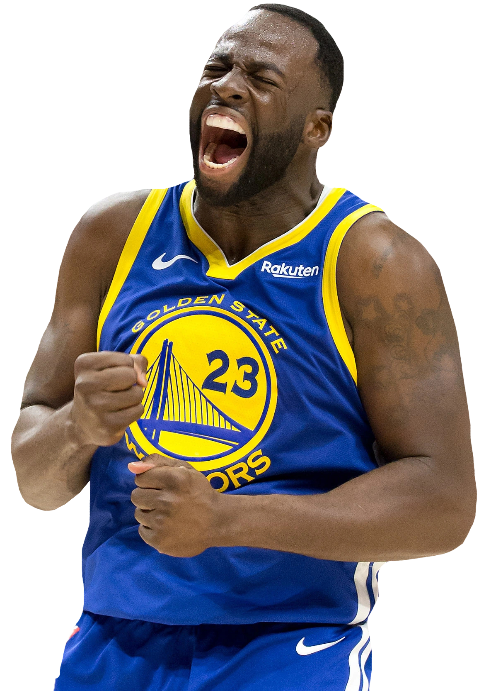
Positional Flexibility in Modern Basketball
Why player roles are no longer clearly separated
Modern basketball has shifted toward greater positional flexibility.
Traditionally:
Guards handled ball movement and perimeter shooting
Forwards/Centers focused on rebounding and interior play
Today:
Players often perform multiple roles (e.g., point-forwards, stretch bigs)
Skill sets overlap across positions
As a result:
Statistical profiles between guards and non-guards are less distinct
Clear boundaries between positions are harder to define
This helps explain why clustering methods showed weak separation and overlapping groups in our results.
2
Notes:
Explain the central research question. Stress that the response variable is GuardClass, a binary label: guard versus non-guard. The unsupervised clustering does not define a second response variable; it complements the question by asking whether similar statistical profiles naturally form groups consistent with those labels.

Slide 17
Final model on the full dataset
SVM was selected as the best supervised model
382
209 / 173
100%
support vectors
Guard / NonGuard support vectors
full-data accuracy
Important caution
The 100% full-data accuracy is not the true predictive estimate because the model is evaluated on the same data it was trained on. The realistic performance estimate is the test accuracy: 89.92%.
13
Notes:
This slide explains the final full-data model required by the project instructions. The SVM summary reports 382 support vectors. Emphasize the caution: the 100 percent full-data result is not the main performance claim. The key generalization estimate is the test accuracy of about 90 percent.

Slide 18
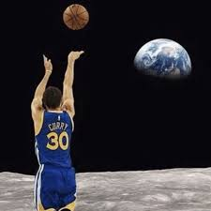
Limitations and difficulties
What made the analysis challenging
Hybrid positions such as G-F and F-G blur class boundaries.
Correlated efficiency variables such as TS% and eFG% may add redundancy.
Clustering had low silhouette scores, meaning natural separation was weak.
The data captures statistical profile, but not context such as team role or defensive assignments.
Key Insight
Position labels are predictable, but player roles are more continuous than discrete.
14
Notes:
Discuss limitations honestly. The strongest limitation is that modern basketball positions overlap. A player can have guard skills and forward size, or forward position with guard-like playmaking. That helps explain why supervised classification works but clustering is weak.

Slide 19
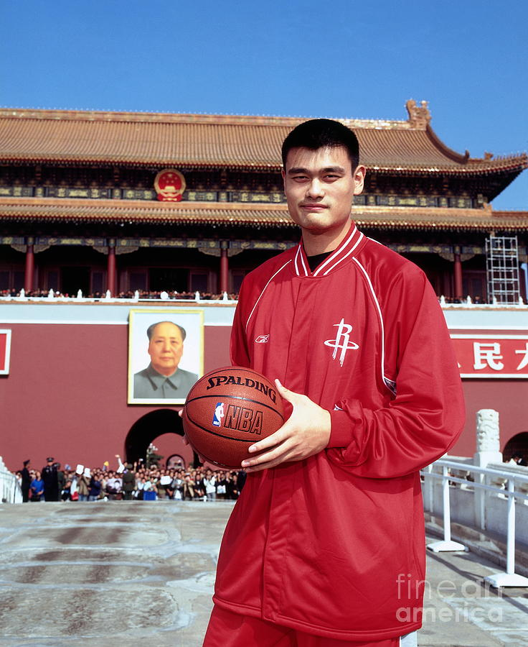
Possible improvements
How the analysis could be extended
Several improvements could strengthen both predictive performance and interpretability:
Feature Engineering
  Apply feature selection or PCA to reduce redundancy (e.g., TS% vs eFG%)
  Improve model interpretability and reduce noise
Add More Context
  Include role-based variables (usage rate, lineup role)
  Add defensive metrics and team system information
  Capture factors not reflected in box score stats
More Advanced Models
  Use Random Forests or Neural Networks
  Capture non-linear interactions between features
Improved Clustering Methods
  Apply DBSCAN or model-based clustering
  Better handle overlapping and uneven player groups
15
Notes:
Explain that the current project satisfies the course methods, but there are ways to improve it. More features could add context, while feature selection could make the model less redundant. Alternative clustering methods may handle the overlap in modern player roles better.

Slide 20
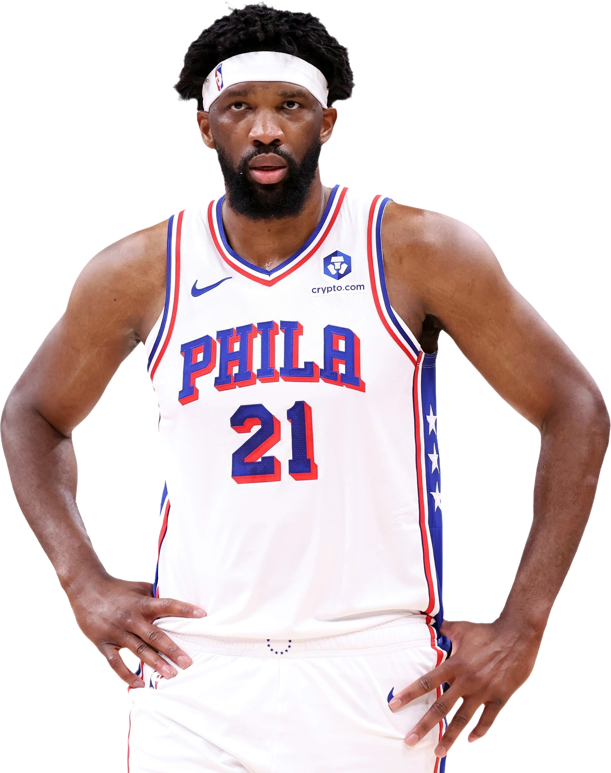
Conclusion
Main answer:
NBA statistical profiles can predict guard vs non-guard position with about 90% test accuracy.
But clustering shows that player roles overlap, reflecting the positional flexibility of modern basketball.
Questions?
16
Notes:
Close by directly answering the research question. The supervised models, especially SVM, show that position can be predicted well from statistics. The clustering results add nuance: even though labels can be predicted, natural role groups are not perfectly separated because modern basketball positions overlap. Then invite questions.

Slide 21
References
https://www.facebook.com/groups/205905269249138/posts/762309966941996/
https://uniqrenders.com/athletes/basketball/demar-derozan-sacramento-kings-nba-usa-american-basketball-players-7359
https://medium.com/learning-data/why-feature-scaling-is-essential-in-machine-learning-dfd6e7e51671
https://kritikalsolutions.com/wp-content/uploads/2024/02/image-4.png
https://www.sports-reference.com/stathead/basketball/player-season-finder.cgi?request=1&order_by=pts_per_poss_75&year_min=1982&year_max=2026&display_type=per_poss_75&ccomp%5B1%5D=gt&cval%5B1%5D=42&cstat%5B1%5D=games\
14
Notes:
Discuss limitations honestly. The strongest limitation is that modern basketball positions overlap. A player can have guard skills and forward size, or forward position with guard-like playmaking. That helps explain why supervised classification works but clustering is weak.

